Slide 1
Credit for Military Service - Norco College Success Story and Lessons for all Colleges Through a Student Equity Lens
Silvester Henderson, At-Large Representative Dr. Bryan Reece, Norco College, President Peggy Campo, Norco College, Academic Senate President Dr. Kevin Fleming, Norco College, Dean of CTE
,
[Date]

Slide 2
Presentation Highlights
Overview of Assembly Bill 1786
Overview of Senate Bill 1071
Norco College –Success Stories - Overview
How are students granted curricular college credit using prior military experiences – “Joint Service Transcript”
Norco College Resource Veterans Center - the promotion of “Student Equity”
Questions and Comments?

Slide 3
AB-1786 Community Colleges: Academic Credit for Prior Military Experience
What is a California Assembly or Senate Bill ? An idea or concept introduce by the California Legislature for the purpose of “Legislative” consideration to become a Law! The process begins when a Assembly Member or Senator decides to author a bill. http://www.leginfo.ca.gov/bil2lawx.html
What is Assembly Bill 1786 – SECTION 1 Section 66025.7 of the Education Code is amended to read:
(a) By March 31, 2019, the Chancellor of the California Community Colleges shall establish an initiative to expand the use of course credit at the California Community Colleges for students with prior learning. The initiative shall identify best practices for the use of course credit for students with prior learning, locate and collect available resources, and provide professional development in connection with the identified best practices. The initiative shall identify the best practices for purposes of establishing potential pilot programs and shall provide recommendations for internal system wide policy changes to expand the use of course credit at the California Community Colleges for students with prior learning.
Honorable Assemblywoman Shirley Cervantes - Author

Slide 4
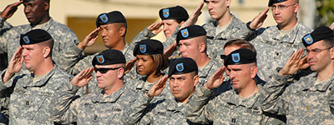
SENATE BILL - SB 1071 - (William Roth, Author) Public postsecondary education: Chancellor of the California Community Colleges: policy to award course credit for prior military education, training, and service
Senate Bill 1071 Section 66025.71 to the Education Code, relating to public postsecondary education.
This bill would require, by September 1, 2019, the office of the chancellor, in collaboration with the Academic Senate for the California Community Colleges, to develop a consistent policy to award military personnel and veterans who have an official Joint Services Transcript course credit for California Intersegmental General Education Transfer Curriculum, California State University General Education Breadth, or local community college general education requirements, as specified. The bill would also require the office of the chancellor and the academic senate to review and adjust this uniform policy to align it with policies of other public postsecondary educational institutions.
https://leginfo.legislature.ca.gov/faces/billTextClient.xhtml?bill_id=201720180SB1071
Joint Service Transcript: The Joint Services Transcript (JST) provides a description of military schooling and work history in civilian language. It serves as a counseling tool for academic and career counselors in advising service members and veterans.
https://www.military.com/education/timesaving-programs/the-joint-services- transcript.html
This bill would

Slide 5
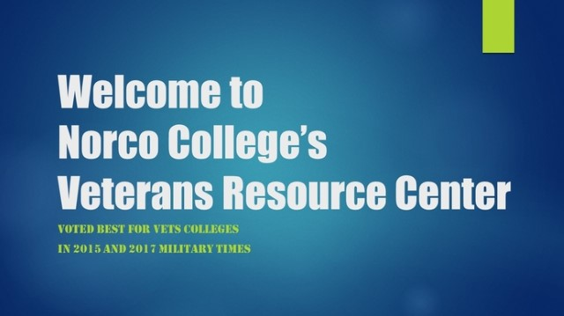
Norco College –Success Stories – Overview
Norco College’s Veteran Resource Center (951) 372-7142 Peggy Campo, Norco College, Academic Senate President Dr. Bryan Reese,Norco College, President Dr. Kevin Fleming, Norco Colelge, Dean CTE

Slide 6
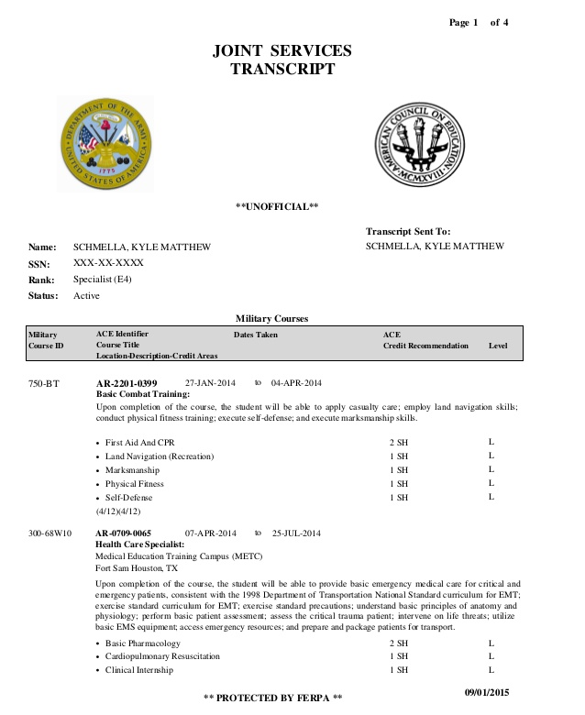
How are students granted curricular college credit using prior military experiences – “Joint Service Transcript”
Joint Service Credit
The Joint Services Transcript (JST) provides a description of military schooling and work history in civilian language. It serves as a counseling tool for academic and career counselors in advising service members and veterans. It serves as an aid in preparing resumes and explaining Army, Coast Guard, Marine Corps, National Guard and Navy work experience to civilian employers. It also saves time and money by awarding academic credits, which means less tuition to pay and less time spent in the classroom.
The JST is accepted by more than 2,300 colleges and universities.

Slide 7
Norco College Resource Veterans Center - the promotion of “Student Equity”
Promotes Student Equity
“Equity means everyone receives fair treatment”
A: Value the learning and working experiences of all veterans.
B: Offers “Tuition Support” (California Assembly Bill 13)
C: Offers intentional advisement and resource assistance for challenges such as College Fees, Books, Housing Needs, Educational Counseling and Student Support Services. D: Allocates a dedicated “Space” for this specialized student population.

Slide 8
Questions & Comments
Please feel free to contact each of us for more information.
Silvester Henderson Shenderson@losmedanos.edu
Dr. Bryan Reece Bryan.Reece@norcocollege.edu
Peggy Campo Peggy.Campo@norcocollege.edu
Dr. Kevin Flemings
Kevin.Fleming@norcocollege.edu

