Slide 1
Curriculum Basics

Slide 2
Your Presenters
Randy Beach, ASCCC Curriculum Committee, Southwestern College
Rose Giordano, ASCCC Curriculum Committee, Folsom Lake College
David Williams, California Community Colleges Curriculum Committee, Vice President Academic Affairs Solano College

Slide 3
We’re Glad You’re Here!
Who are YOU?
What is your experience level with navigating the delicate dance of curriculum?
What’s your greatest worry in your curriculum role?
Notes:
Randy

Slide 4
Today’s Agenda
Ed Code, Title 5, and your Local Culture
Communication Strategies
Managing Conflicts
Scenarios (Here come the polls!)
Wrap-Up and Q & A
Notes:
Randy

Slide 5
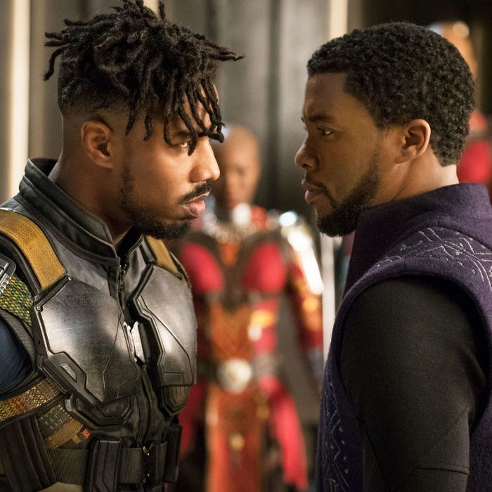
Getting To Know the Players
CA Education Code
Statute
Determined by legislation
CCC Chancellor’s Office
Chancellor’s Office Guidelines
Further clarify implementation of Title 5
Program and Course Approval Handbook (PCAH)
Establishes specific guidelines for implementing Title 5
Developed by Chancellor’s Office with ASCCC and 5C
Title 5 Code of Regulations
Interprets Ed Code into regulations
Determined by Board of Governors
Notes:
Randy

Slide 6
Getting To Know the Players
Academic Senate for California Community Colleges
Established in Education Code as the voice of faculty in “academic and professional matters”
Authors papers and other resources
Webinars and in-person professional development
Resolutions on curriculum and student support issues (legislation, initiatives, innovations)
Notes:
Randy

Slide 7
Authority of the Academic Senate
Ed Code 70901(b)(1)(E)
Minimum standards governing procedures established by governing boards of community college districts to ensure faculty, staff, and students the right to participate effectively in district and college governance, and the opportunity to express their opinions at the campus level and to ensure that these opinions are given every reasonable consideration, and the right of academic senates to assume primary responsibility for making recommendations in the areas of curriculum and academic standards.
Ed Code 70902(b)(7)
Establish procedures that are consistent with minimum standards established by the board of governors to ensure faculty, staff, and students the opportunity to express their opinions at the campus level, to ensure that these opinions are given every reasonable consideration, to ensure the right to participate effectively in district and college governance, and to ensure the right of academic senates to assume primary responsibility for making recommendations in the areas of curriculum and academic standards.
Notes:
Randy

Slide 8
Title 5 § 53200 - Definitions
(b) Academic Senate means an organization whose primary function is to make recommendations with respect to academic and professional matters.
(c) Academic and Professional matters means the following policy development and implementation matters:
Notes:
Randy

Slide 9
Title 5 § 53200 – The “10 + 1”
Curriculum, including establishing prerequisites
Degree and certificate requirements
Grading policy
Educational program development
Standards or policies regarding student preparation and success
College governance structures, as related to faculty roles
Faculty roles and involvement in accreditation processes
Policies for professional development activities
Processes for program review
Processes for institutional planning and budget development
Other academic and professional matters as mutually agreed upon.
Notes:
Randy

Slide 10
“Curriculum Allies: Assemble”
Academic Senate
Articulation Officers
Counselors
Institutional Researchers
Financial Aid Staff
Admission and Records Staff
Catalog and Schedule Coordinators
MIS Peeps
Local Board
DEANS
Program Review Committee
Outcomes and Assessment/SLO Committee
Others?
Notes:
Randy

Slide 11
Local Culture Process Vs. Reality
10+1 can vary from district to district
Local curriculum handbooks further refine standards and processes
Technology can often make processes more esoteric at a college or district
Local chairs, committees can, over time, emphasize some standards over others based on the experiences and “pet peeves” of committee members
Lots of myths and misconceptions about what title 5 says and does not say
Title 5 is “permissive”...doesn’t say we can...doesn’t say we can’t
Each college (and sometimes the district) Academic Senate may have different parameters than other colleges regarding what comes to the senate and what does not
“Good fences make good neighbors”
Notes:
Randy

Slide 12
Scenario #1
The Unicorn Studies department is the primary department offering courses in unicorn history and unicorn literature. They initiated, got curriculum approval, and are institutionally designated to offer the course curricula. The faculty in the history
department and the English department are unhappy with Unicorn Studies department “owning” these courses and not offering them in the last few years. The history and English faculty would like to offer the courses, but Unicorn Studies faculty do not want to give them up.
In the Poll Section in Pathable respond to the question: What first step would you take to address this situation?
Notes:
Randy - How would you strategize, initiate, and lead a conversation between these departments? Who need to be involved in this conversation? What T5 Sections are relevant? Local culture-specific

Slide 13
Communication Strategies - Who are We?
A complex system and institutions!
STUDENTS!
Colleagues
Deans/ Supervisors
Vice President(s)
Superintendent/President/Chief Executive Officer (CEO)
Chancellor
Board of Trustees
UNIONS
Other stakeholders?
Notes:
Rose

Slide 14
Communication Strategies Get Yourself Out There!
Communication between discipline faculty and the curriculum committee is essential for smooth processes
Regularly attend leadership meetings; maintain regular contact with local committee/department chairs
Relay direction from local board policies, administrative procedures, and faculty contract
Build and maintain working relationships with faculty, classified staff, and administration
Mutual understanding of roles/responsibilities and genuine respect for your colleagues
Inclusivity, transparency, diplomacy in decision making
Demonstrate integrity, creativity, and wisdom
Notes:
Rose
Socialization practices and problem solving
Identify any potential barriers to collaboration
Challenges surrounding institutional transformation

Slide 15
Scenario #2
The CA legislature approves the requirement that all community colleges use the same numbering system (AB 1111). This will impact many elements of your local curriculum and processes.
In the Poll Section in Pathable respond to the question: What would an effective communication strategy look like at your campus? What resistance should you anticipate?
Notes:
Rose
How do you communicate the importance and implications of this change to all necessary folks? Who needs to be involved? Where do you begin communicating. AB 1111

Slide 16
Managing Conflict
Accept conflict. Remember that conflict is natural and happens in every ongoing relationship. Conflict is a sign of a need for change and an opportunity for growth, new understanding, and improved communication. Conflict can not be resolved unless it is addressed with the appropriate individual(s).
Move past positions. A position is the desired outcome of a conflict. A position is something like “We need to approve this change” or “This prerequisite will ensure that students are prepared.” Positions are not negotiable and result in impasse.
Share your interests. To solve conflict, all parties must talk about their interests or the WHYs behind their positions. They must share their true interests and work together to find a solution that satisfies those interests. An interest might be, “We want our courses to include the most up-to-date technology so our students are prepared for the workforce.”
Notes:
David - As a rule, collaboration is the way to deal with important issues, although forcing can sometimes be appropriate if time is an issue. For moderately important issues, compromising can lead to quick solutions but it doesn’t satisfy either side, nor does it foster innovation, so collaboration is probably better. Accommodating is the best approach for unimportant issues as it leads to quick resolution without straining the relationship.

Slide 17
Managing Conflict
According to the Thomas-Kilmann Conflict Instrument, there are five key styles for managing conflict:
Forcing — using your formal authority or power to satisfy your concerns without regard to the other party’s concerns
Accommodating — allowing the other party to satisfy their concerns while neglecting your own
Avoiding — not paying attention to the conflict and not taking any action to resolve it
Compromising — attempting to resolve the conflict by identifying a solution that is partially satisfactory to both parties but completely satisfactory to neither
Collaborating — co-operating with the other party to understand their concerns in an effort to find a mutually satisfying solution
Notes:
David - As a rule, collaboration is the way to deal with important issues, although forcing can sometimes be appropriate if time is an issue. For moderately important issues, compromising can lead to quick solutions but it doesn’t satisfy either side, nor does it foster innovation, so collaboration is probably better. Accommodating is the best approach for unimportant issues as it leads to quick resolution without straining the relationship.

Slide 18
Scenario #3
The English Department has a transfer course with more units than the equivalent C-ID descriptor. The Articulation Officer is concerned that the additional number of units for the course is unnecessary and does, in fact, add more time and cost for students than if they took the course at the local university. The course has come to the Curriculum Committee for its five-year review and factions are lining up to speak at the meeting about the units.
In the Poll Section in Pathable respond to the question: Given your role in the committee, how would you approach this conflict?
2021 ASCCC Curriculum Institute 18
Notes:
David
What strategies would you use to navigate the conversation in the meeting? Before the meeting?

Slide 19
info@asccc.org
Thank you!

