Slide 1
Curriculum Basics for Allies
2017 Curriculum Institute
Marie Boyd, Chaffey College
Michelle Sampat, Mt. San Antonio College

Slide 2
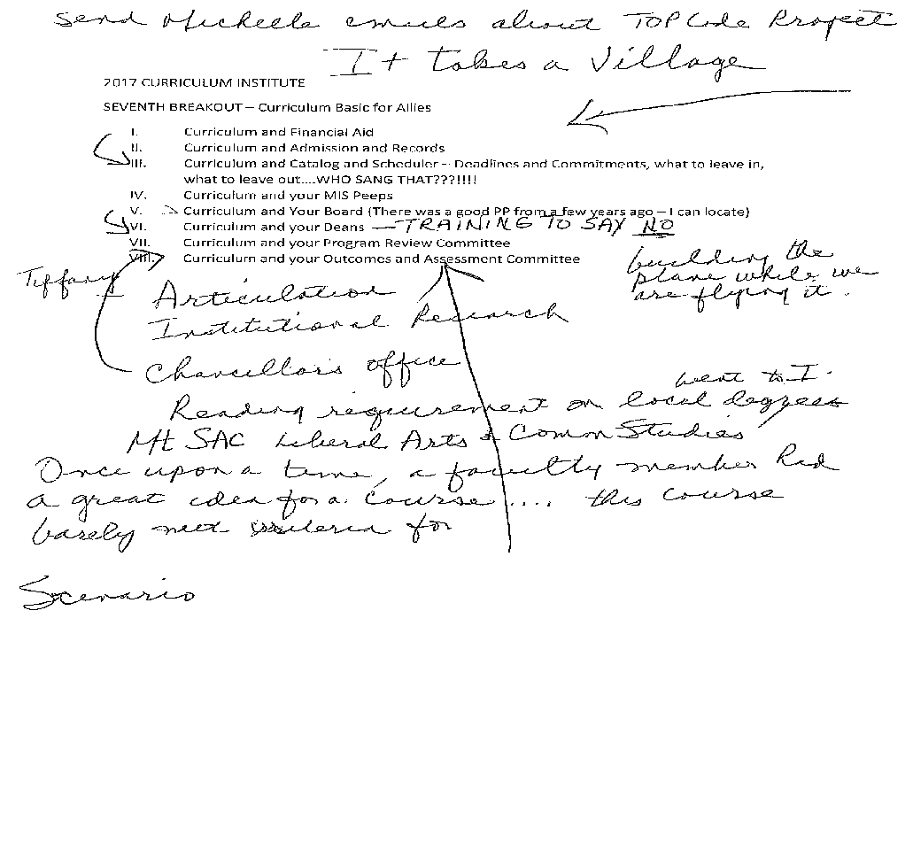

Slide 3
Outcomes for This Session
Gain a wider realization of the campus ripple effect
of the local curriculum process and decision making.
Develop a (renewed) appreciation for “the village campus” in terms of curriculum work.
“Always pass on what you have learned”
-Yoda

Slide 4
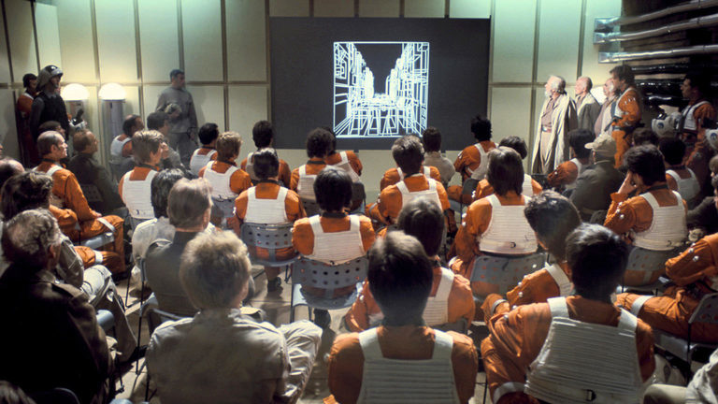
How Can Curriculum Allies Help?
“10 Things An Ally Can Do”
Listen
Get Educated
Get Involved
Show Up
Speak Up
Intervene
Welcome Discomfort
Learn From Your Mistakes
Stay Engaged
DONATE! (Food always works with Curriculum Committees!)
The Alliance to Restore the Republic
(also known as the Rebel Alliance or
the Rebellion) is an interstellar pro-
democratic republic revolutionary
faction in the fictional universe of
Star Wars.
Notes:
Focus on “communication links and processes necessary to ensure a smooth and balanced curriculum process”
https://www.ywcahbg.org/sites/default/files/manager/10%20Things%20Allies%20Can%20Do.pdf

Slide 5
Who Are “Curriculum Allies” on Your Campus?
Articulation Officers
Counselors
Institutional Researchers
Financial Aid Staff
Admission and Records Staff
Catalog and Schedule Coordinators
MIS Peeps
Local Board
DEANS
Program Review Committee
Outcomes and Assessment/SLO Committee
Others?

Slide 6
Articulation Officer
What is your Articulation Officer’s role in your curriculum approval process?
Suggest new courses
Promotes the integrity of the curriculum review process during the Technical Review process
Contributes suggestions regarding appropriate rigor
Negotiate with university AOs on behalf of departmental faculty
Identify similar courses at other colleges (OSCAR) and provide models
Work one-on-one with faculty
Encourage interdepartmental collaboration
Assist in development of curriculum management systems
Networks with Counselors
Comparable Courses?
Attention to Articulation deadlines
C-ID submissions
Serves as a liaison to California Intersegmental Articulation Council
Assists in local and regional articulation meetings
Serves as a mentor AO for others
Intersegmental issues
Others?
“You will find many of the truths we cling to depend greatly on our own point of view”
-Obi Wan Kenobi
Notes:
California Articulation Policies and procedures Handbook 2013 https://ciac.csusb.edu/documents/CIAC_Handbook_Spring_2013.pdf

Slide 7
Counselors
Academic Counseling is only one component of a counselor’s role at a California Community College and includes the following:
Assessment using multiple measures and diagnosis of students’ academic abilities, disabilities, strengths and weaknesses
Help in clarifying academic goals and selecting a program of study
Educational planning for transfer, associate degree, and certificate programs
Assisting with clarifying choices and actions, as well as decision-making, planning, and transitioning
Making referrals to other support services when a need is indicated
Intervening when students’ academic performance is at risk
Providing follow-up (e.g., academic mentoring, early alert processes, and probation counseling)
How many have Counselors in their Curriculum Committee?
What role do they play if they are on your Curriculum Committee?
“Together we can rule the galaxy”
-Darth Vader
Notes:
http://www.asccc.org/sites/default/files/publications/Standards-of-Practice_0.pdf The following Counseling functions are derived from T5:
Academic Counseling
Career Counseling
Personal counseling
Crisis Intervention
Conducting Outreach to Students’
Participating in Shared Governance
Researching and reviewing counseling programs and services
Training and professional development for counseling staff, interns, and others in the college
community.

Slide 8
Institutional Researchers
Statistical validations on pre-reqs
Labor Market Information
Enrollment statistics
“Never tell me the odds”
-Han Solo

Slide 9
Financial Aid Staff
Participation Agreements and Federal Financial Aid
http://iepi.cccco.edu/Portals/0/uploads/IEPI%20Workshops/The%20Role%20of%20Curriculum%20in%20Institutional%20Financial%20Aid%20Eligibility_Workbook_1.pdf
“Han my boy, why haven’t you paid me?”
-Jabba the Hutt
Notes:
Does anyone have reps from Financial Aid on their Curriculum Committee or a part of their Curriculum Approval process?

Slide 10
Admissions and Records Staff
Transcript issues
Course equivalency issues
Other issues?
“Stay on Target”
- Gold Five

Slide 11
Catalog and Schedule Coordinator – T5 concerns
Timelines and Deadlines for curriculum approvals
Pay attention to:
Lecture/lab hours
To be announced (TBA) hours
Distance education and other formats
C-ID equivalency
Honors distinction
Special fees
Others?
“Don't blame me. I'm an interpreter.
I'm not supposed to know a power socket from a computer terminal.”
- C3PO

Slide 12
Catalog and Schedule Coordinator – Accreditation Concerns
ACCJC Requirements:
Standard 1.C (2014)
The institution assures the clarity, accuracy, and integrity of information provided to students and prospective students, personnel, and all persons or organizations related to its mission statement, learning outcomes, educational programs, and student support services…
The institution provides a print or online catalog for students and prospective students with precise, accurate, and current information on all facts, requirements, policies, and procedures listed in the “Catalog Requirements.”

Slide 13
MIS Peeps
MIS versus Chancellor’s Inventory vs local enrollment management system
CB Coding/CIP Codes/ SOC Codes/ SAM Codes
Decisions about local curriculum development and approval.
“The force will be with you, always.”
-Obi Wan Kenobi
Notes:
Why Are Codes Important?
Courses and programs are tracked across the state as well as locally for data and evidence of student success and other important outcomes
Being sure that courses are correctly coded will provide reliable data on student progress and achievement.
Some funding mechanisms in the state are also tied to how courses are coded.
All curriculum committee members should be knowledgeable about the different codes and how coding a course in a particular way may influence the perceived success of students and the college.
Curriculum committees should be aware of some of the technical aspects of managing curriculum at the local level and that includes understanding how courses may be coded.
Specifically, there are Taxonomy of Programs (TOP) codes to identify the discipline area for a course or program, and the Chancellor’s Office provides a crosswalk for California TOP codes to the federal Course Identification Program (CIP) codes.
Courses are also coded with data elements used to identify course basic (CB) information, such as whether or not a course is transferable or basic skills and if the course has a prerequisite.
TOP and CB codes may be revised from time to tim

Slide 14
Local Board
What they should do and what they should not do
Support Faculty and Administration in terms of curriculum approval, discontinuance, etc.
“Only imperial stormtroopers are so precise.”
-Obi-Wan Kenobi

Slide 15
DEANS
Deans need to play an active role in the dialogue with their faculty about surrounding new curriculum.
Of course Faculty have purview over Curriculum, but dialogue needs to occur with the Dean early and often during the curriculum approval process.
“All mentors have a way of seeing more of our faults than we would like. It’s the only way we grow.”
-Padme Amadala

Slide 16
Program Review Committee
Program Review
Program Viability
Program Vitality
Program Initiation
Program Suspension
Program Discontinuance
“This is madness!” We’re doomed!!
-C3PO

Slide 17
Outcomes and Assessment/SLO Committee
This committee often assists faculty in conducting meaningful dialogue about SLO assessment data, and then “closing the loop.”
How can “closing the loop” have anything to do with curriculum????
“I don’t know who you are or where you came from,
but from now on, you’ll do as I say.”
-Princess Leia
Notes:
Share handout

Slide 18
Thank You
Marie Boyd marie.boyd@chaffey.edu
Michelle Sampat MSampat@MtSAC.edu

