Slide 1
Improving Student Success: Acceleration in ESL and Reading Apprenticeship ASCCC Curriculum Institute July 9th, 2016
Mark Manasse, San Diego Mesa College

Slide 2
Agenda
Reading Apprenticeship Overview
Culturally Responsive Pedagogy
Mentor Texts
Reading Apprenticeship/Metacognition
Questions
Notes:
Nancy

Slide 3
Reading Apprenticeship
Framework: Incorporating the whole learner
Social
Personal
Cognitive
Knowledge Building
Metacognition: Thinking about thinking
Community of Practice
Campus–Cross Discipline: Nursing/STEM/ESL/English
First Year Experience (FYE)
Connection to Tutor/Teacher Training
Statewide
National
Notes:
TIffany

Slide 4
ESL and RA
Molina, S., & Manasse, M. (2015). Mentor texts squared: Helping students explore voice through readings that promote critical consciousness. CATESOL Journal 27(2), 281-301.

Slide 5
Background
Moved to the Czech Republic
Museum, Stamps, Accent
Hard to Gain Access to Culture of Power…Linguistically

Slide 6
Culturally Responsive Pedagogy
My time in CR = the life of ESL students
Lipman (1995), Delpit (2008), Ladson-Billings (2008)
Discourse of power
Create community
Demand critical thinking
Connect material to real life
Being informs doing (students, curriculum, instruction)

Slide 7
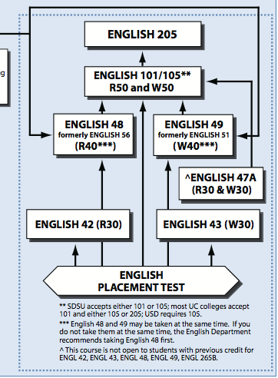
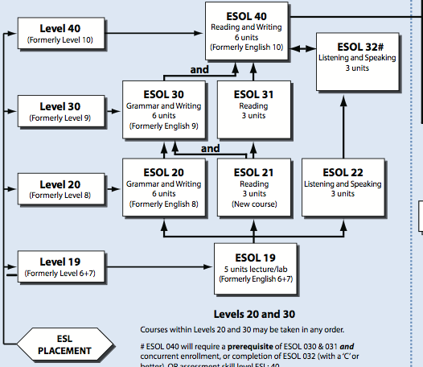
Research Context ESOL -> English Trajectory
3 levels below English 101
Class Meetings:
3 hrs./wk for 16 weeks

Slide 8
Research Context The Students
Total # of students: 32
Time Spent in US
0-21 Years
Mean 5.27
Age Range(4 no response)
19-53 years old
Mean 27.9
Years Studying Formal English
0-13 Years
Mean 4.125
Gender
48%
52%
Languages spoken > 1
7 - Vietnamese
5 - Farsi
4 - Spanish
2 - Russian

Slide 9
Research Question
In what ways can we support struggling ESOL readers in a community college pre-intermediate classroom for future community college coursework?

Slide 10
Project Focus
Finding Voice in Response to Institutional Challenges Confronting Basic Skills/ESOL Instructors and Students
Finding Voice in Response to Classroom Challenges Confronting Basic Skills/ESOL Instructors and Students
Improving Student Meaning Negotiation via Communication
Reading Material as Writing & Social Mentorship (Mentor Text²)

Slide 11
Mentor Text²: Readings Become Mentor via Access, Equity, Voice Creation, Metacognition
Teaching Studio (USD)/Teaching Institute (Miramar)
Teachers Teaching Teachers
Lit Circle
Leveled Texts
Social Justice
California Community College Success Network (3CSN)
Reading Apprenticeship
Habits of Mind
San Diego Area Writing Project (SDAWP)
Mentor Texting
Mentor Text²

Slide 12
Differentiating Instruction in Reading
Pretest: leveled reading texts from www.readtheory.org and www.readworks.org to assess student current reading level.
Based on these online assessments and instructor’s informal assessments, created eight groups of students with three levels of reading ability.
Levels | Group 1 | Group 2 | Group 3 | Group 4
High | 4 | 4
Mid | 4 | 4 | 4 | 4
Low | 4 | 4

Slide 13
Interventions (Level 1) Metacognitive Reading Strategies
Socializing students into the culture of reading in the classroom
I) Reading Apprenticeship Model (Lesmeister, 2010)
a) Lens changing: Thinking about a piece of writing from multiple perspectives
b) Talking to the Text: How to annotate a piece of writing
c) Thinking Aloud: How to socially construct meaning. Read and question a piece of writing with a group
II) Vocabulary Development (Aebersold & Field, 1997)
a) Awareness-raising of receptive vs. productive vocabulary levels

Slide 14
Intervention (Level 2) Reading Circles
Reading Circle Tasks
Roles: Summarizer, Quote Finder, Questioner, Illustrator
Jigsaw: Home Group & Expert Group
Home Group – Homogeneous Level, Heterogeneous Tasks
Expert Group – Heterogeneous Level, Homogeneous Tasks
Discussion and Poster Presentation

Slide 15
Intervention (Level 3) Mentor Text² Leveled and Socially Relevant Readings
Used three Mike Rose blog entries and created leveled texts using Flesch-Kincaid grade level.
Professor X, Teaching Remedial Writing, More Than a Paycheck
Mike Rose Blogs (http://mikerosebooks.blogspot.com)
Rose advocates for the marginalized, or what he terms “underprepared” students - he also writes about challenges that these marginalized students often experience in the public school and college systems, issues on teaching and learning and social justice issues.

Slide 16
Let’s Practice: In Groups of 4…
You will be given an original Mike Rose blog post (unleveled).
QUICKLY Choose one of these reading lenses:
Summarizer: In a few sentences, write down the main idea.
Quote Finder/Analyzer: What is the “Golden Line.” Underline an important sentence. Write about why it is important to you.
Question Creator: You can create comprehension questions, questions about how others feel about the reading, questions or the author, etc.
Illustrator: Draw what you feel the reading means to you. Can be pictures and words.
You will have about 3 to 5 minutes to silently skim PART of the reading, and complete your task via your lens. You may not finish. Just get a taste of reading with a lens.

Slide 17
Let’s Practice: In Groups of 4…
3 to 5 Minutes: Discuss the reading via your reading lens with your group. Make sure at least a few people get to talk (about 1 min/person). You might not finish.
In class, this would be happening amongst students with:
The same leveled reading
Homogenous skill level
Heterogeneous task

Slide 18
Next Steps
All Summarizers, Quote Finders, Questioners, and Illustrators would meet
In class, students would now be meeting with:
Different leveled-versions of the reading
Heterogeneous reading levels
Homogenous tasks
Work on poster paper
Prepare to present

Slide 19
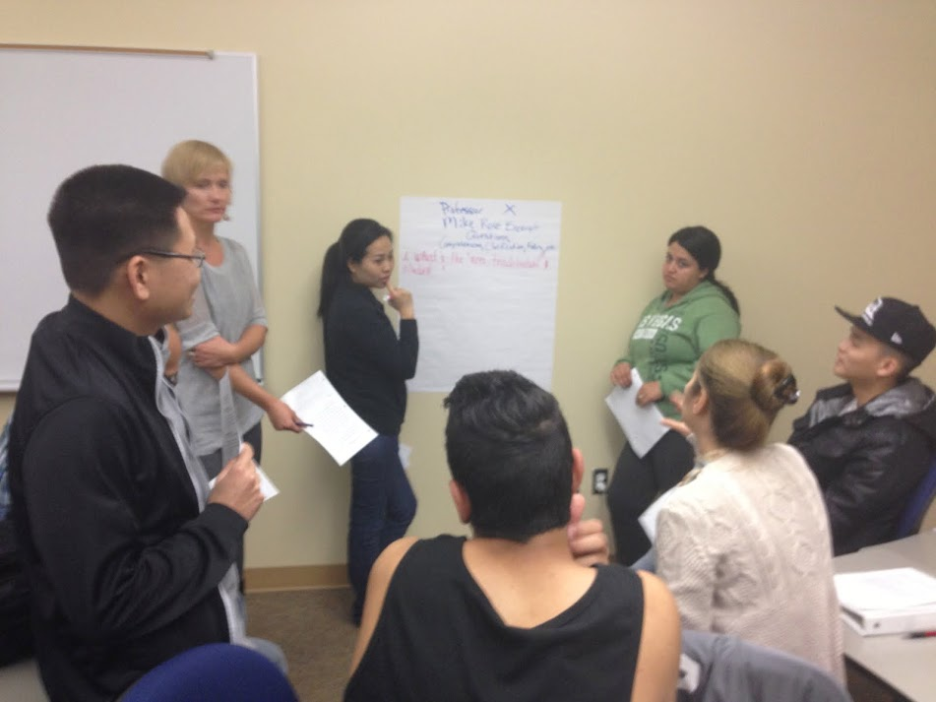
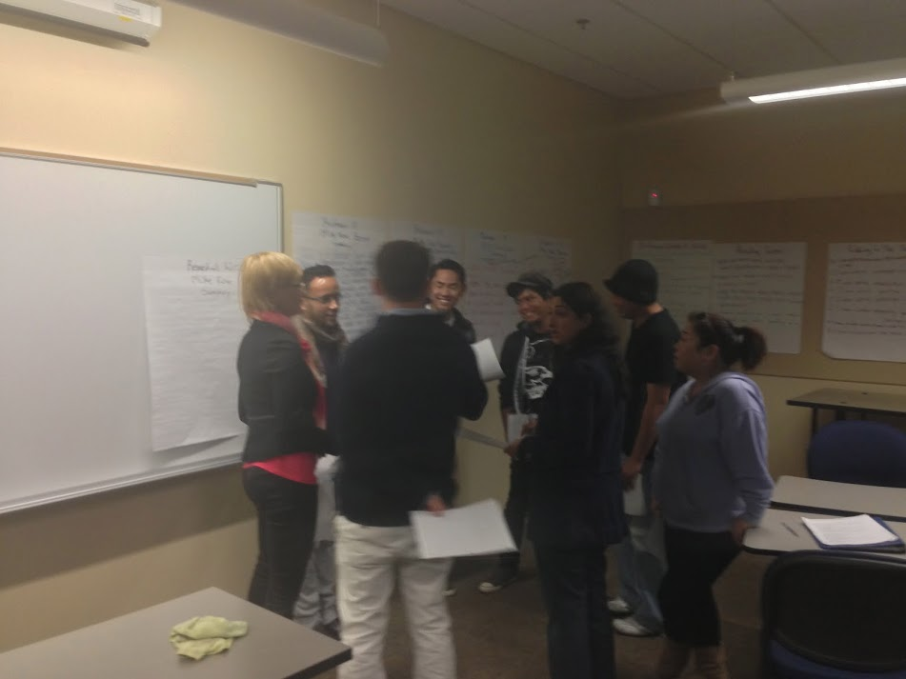
Groups Discuss Reading: Homogenous Task, Heterogeneous Level

Slide 20
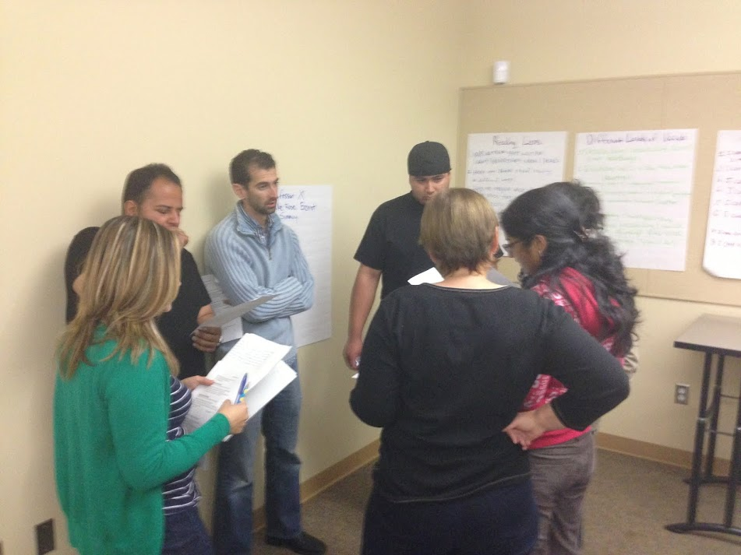
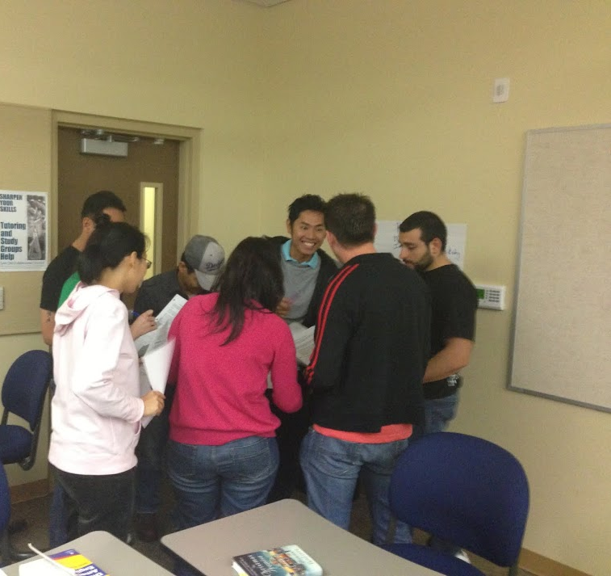
Groups Discuss Reading: Homogenous Task, Heterogeneous Level

Slide 21
Reading Circle Culminating Project: Homogenous Task, Heterogeneous Level

Slide 22
Analysis of Student Engagement in Reading Circles: Homogeneous Level, Heterogeneous Task

Slide 23
Analysis of Student Engagement in Reading Circles: Heterogeneous Level, Homogenous Task

Slide 24
Analysis of Student Engagement in Reading Circles: Heterogeneous Level, Homogenous Task

Slide 25
Self-Perceptions of Reading Comprehension Pre- and Post-interventions

Slide 26
Writing for a Purpose and Audience: Finding Student Voice
As part of the post-reading, students were given access to Mike Rose’s blog with the original reading and responded to one of the blogs online.
28%
36%

Slide 27
Analysis of Student Response to Blogs: Finding Student Voice
…you're talking about me. I am a nontraditional student original from Japan….When I told my parents about me going to college at my age(I just turned 40!) they have bunch of negative comment about it. They thought It's way too late to go college at my age, and they can't believed there are any college are accepted me. After I told them about there is remedial classes that I can take. My father said, ‘Really? Whose teaching those classes? Are they real professors??’ Yes, they are real professors, who have so much passion for teaching. Matter fact, they are best. Because they have way more patience! [sic]

Slide 28
Analysis of Student Response to Blogs: Finding Student Voice
Mr. Rose I feel very pledge writing a response to you because I know you support us “the nontraditional students” I’m very thankful with you for thinking that students from other countries have the ability to attend college, learn English and have a career so we can all have the opportunity to live better and I know is not about money but live with knowledge so we can teach are descendents what we know, also I want to say that people like you are doors open for us, your blog is so motivational for me and it make me express all my ideas and try to learn something new everyday [sic]

Slide 29
Conclusions
All students, including ESL students, can use reading support
RA techniques increase communication in the classroom
RA can work across the curriculum/across levels
RA training is for students, tutors, and faculty

