Slide 1
Welcome to ASCCC Curriculum Institute 2020
#ResponsiveCurriculumCollectiveImpact
#Ilovecurriculum
#ASCCC

Slide 2
Welcome Dolores Davison, ASCCC President

Slide 3
Welcome
Responsive Curriculum & Collective Impact
Cheryl Aschenbach
ASCCC Secretary
2019-2020 Curriculum Chair

Slide 4
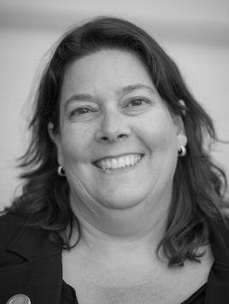
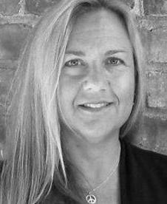
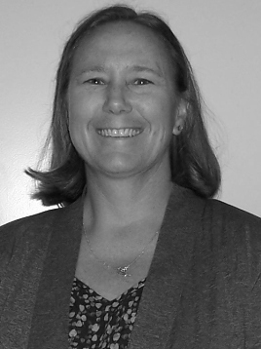
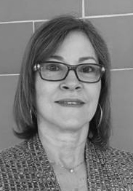
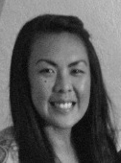
ASCCC Executive Committee 2020-21
Officers
Dolores Davison
President
Virginia May
Vice President
Cheryl Aschenbach
Secretary
Mayra Cruz
Treasurer
Krystinne Mica
Executive Director

Slide 5
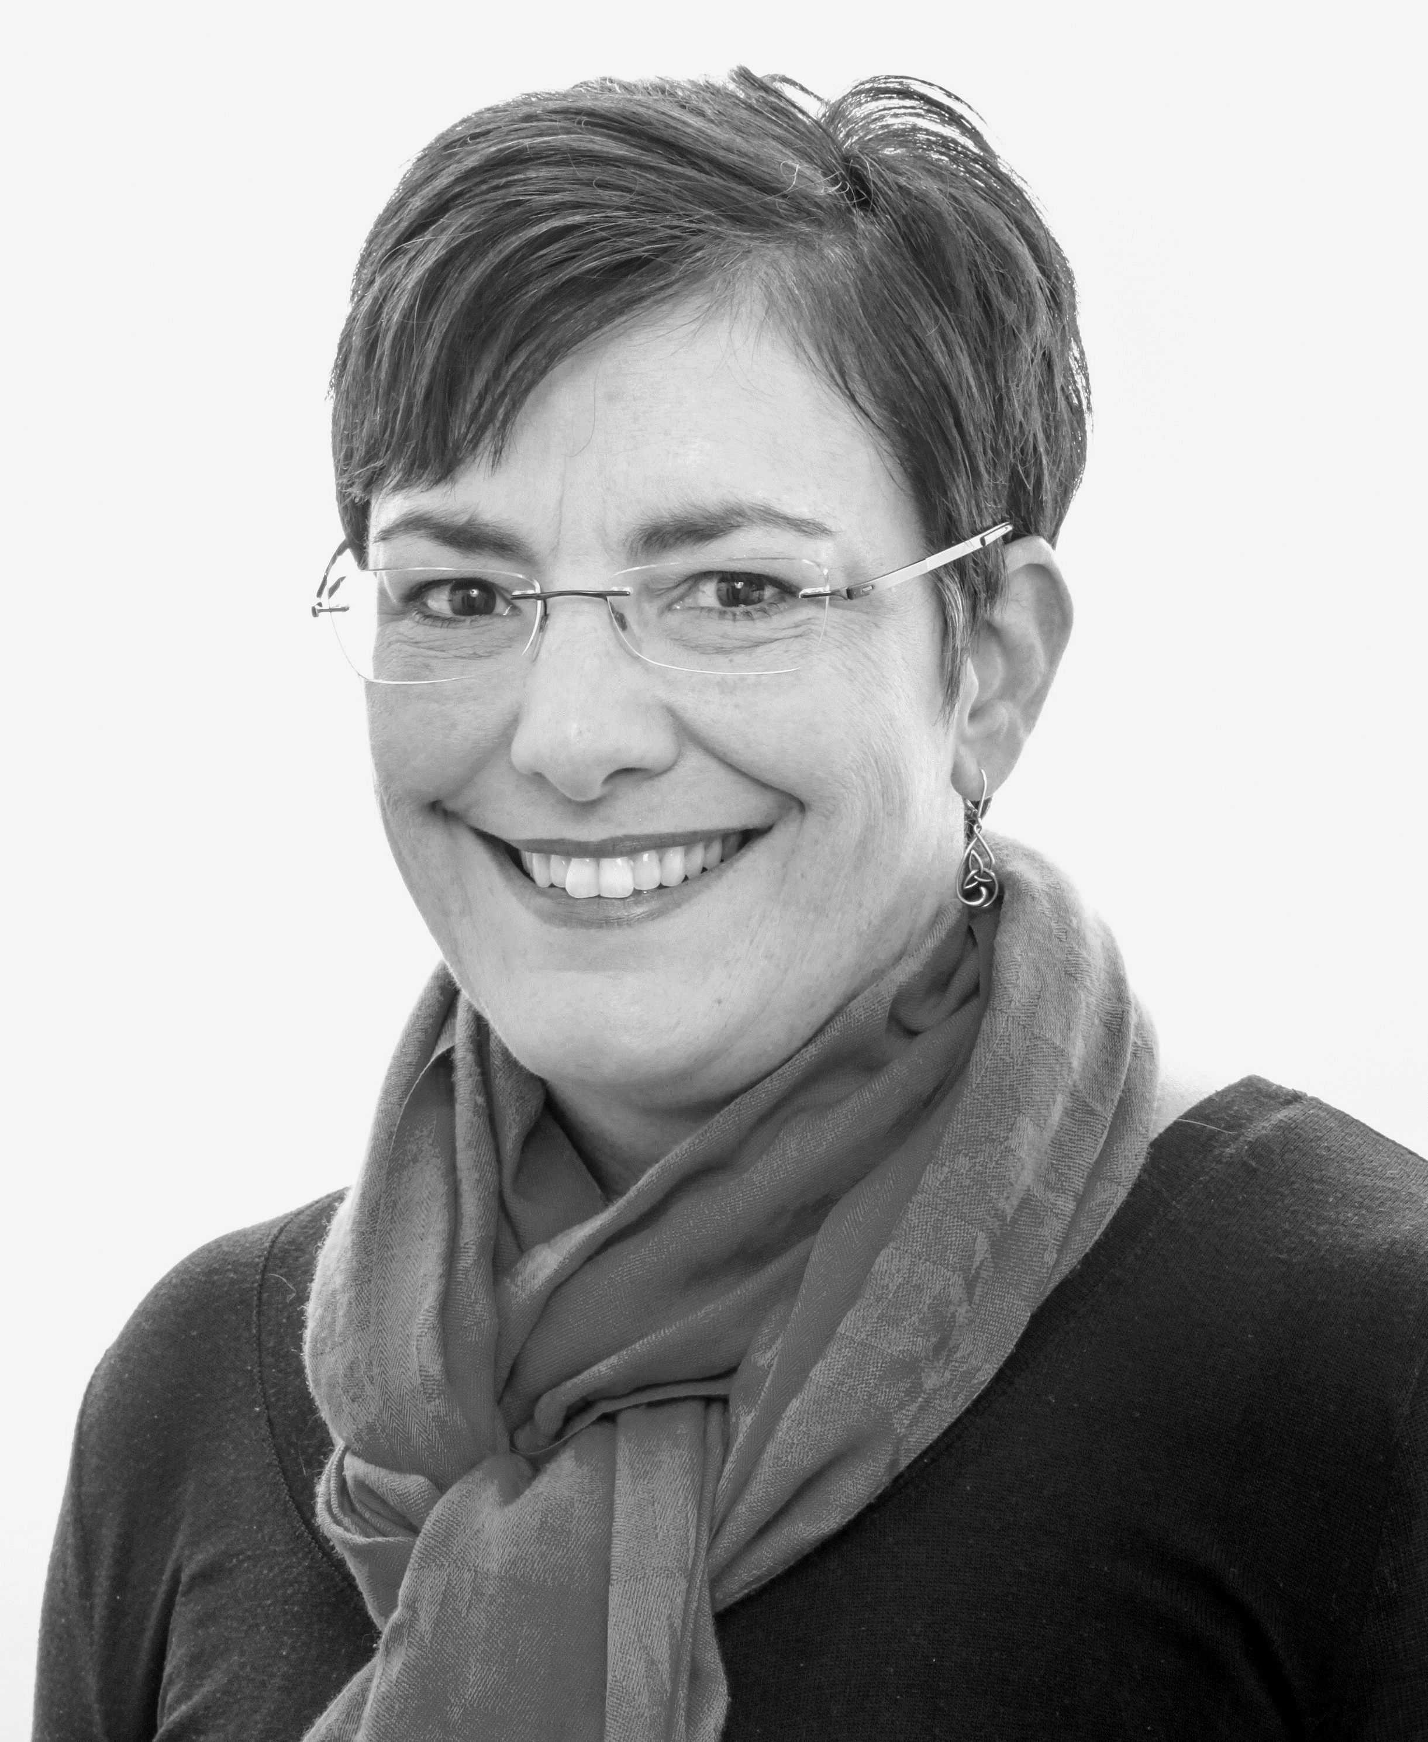
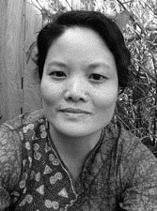
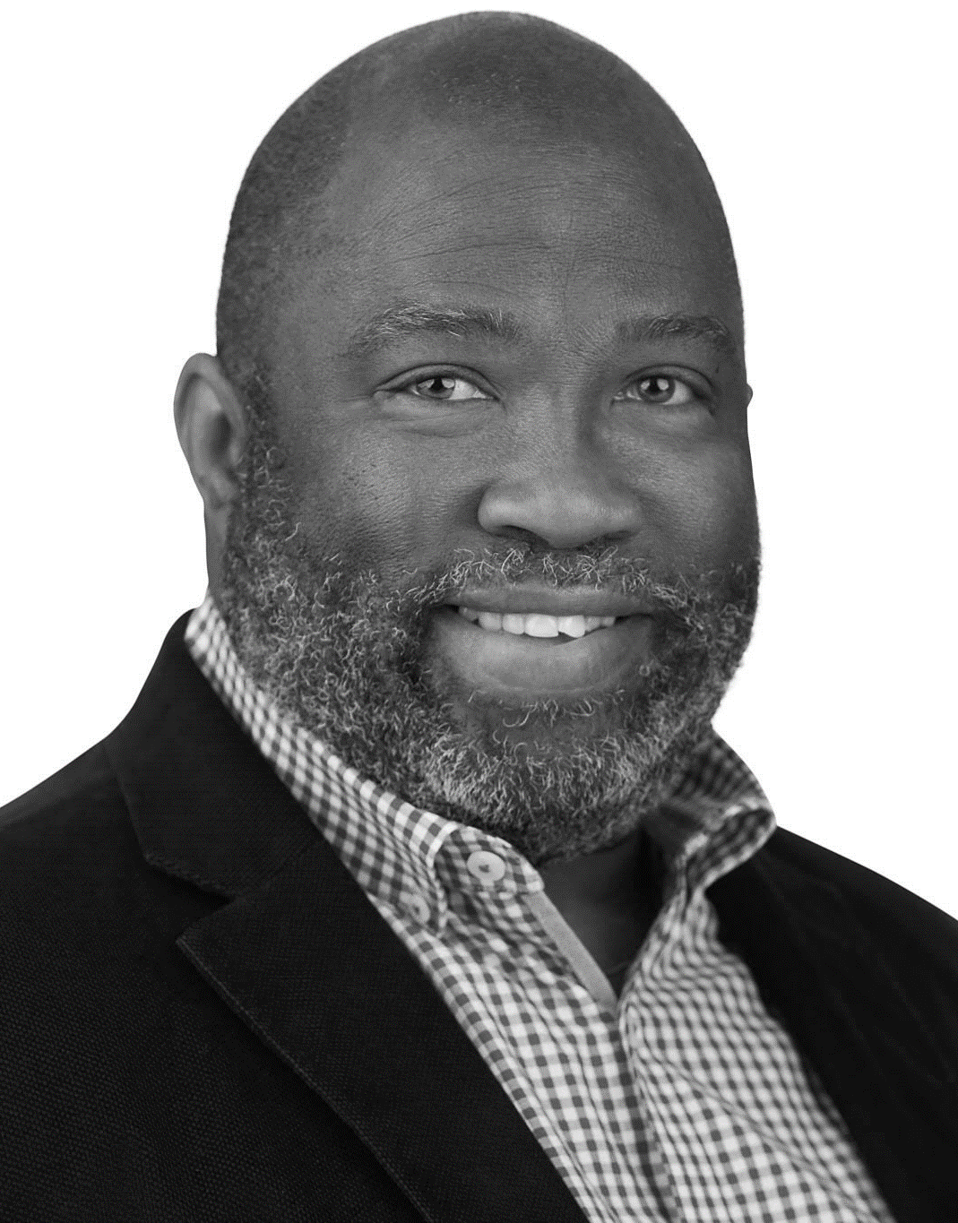
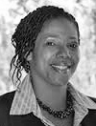
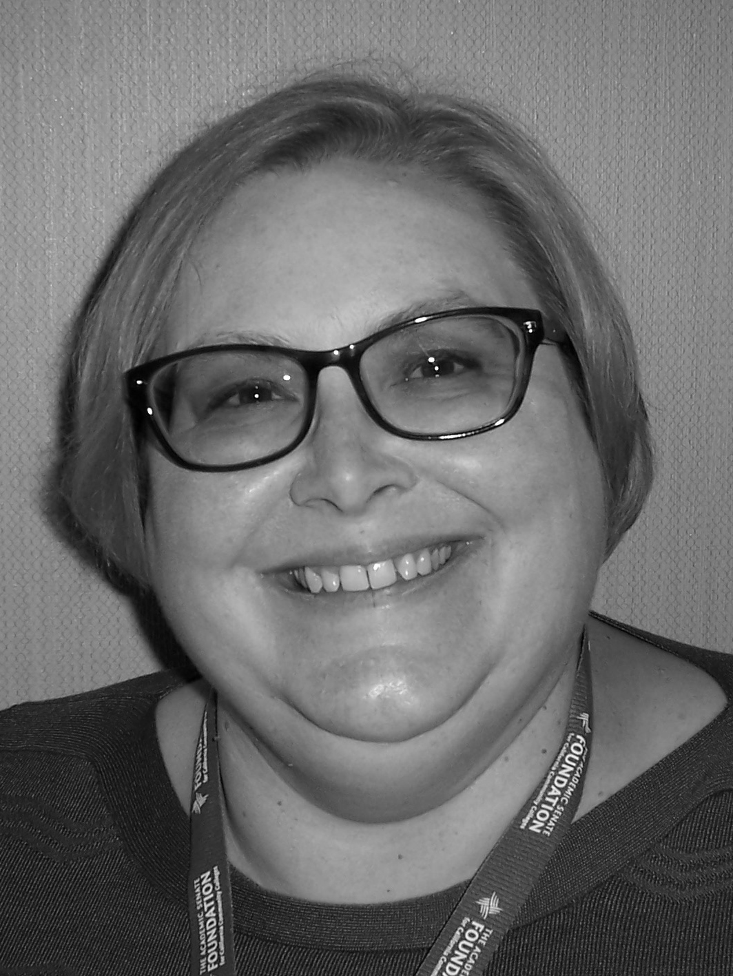
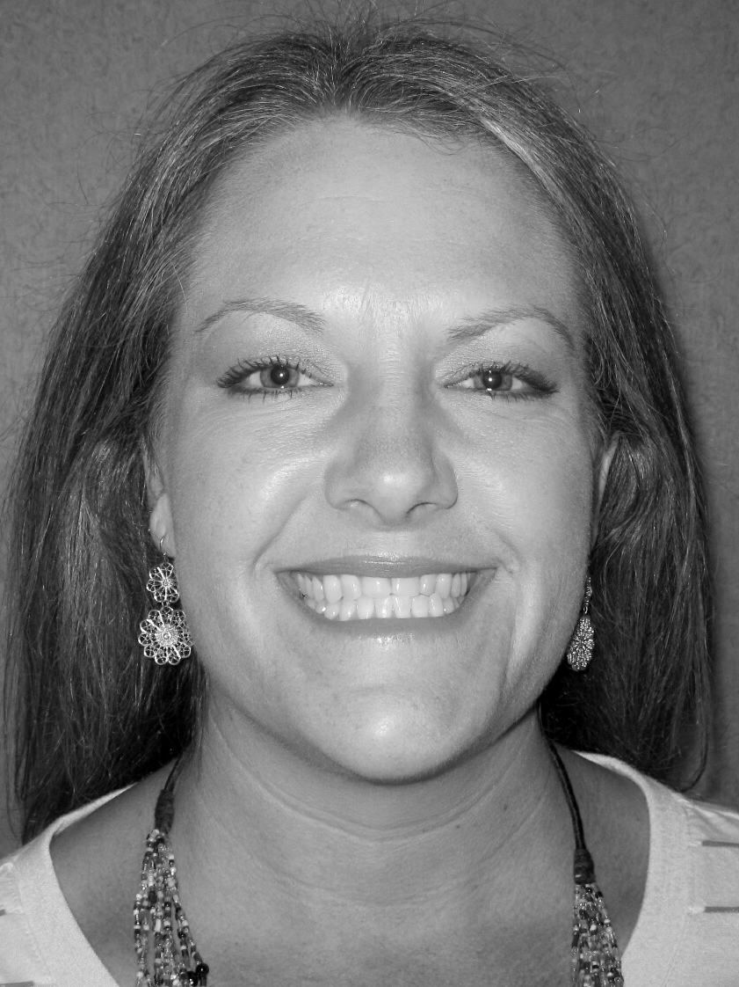
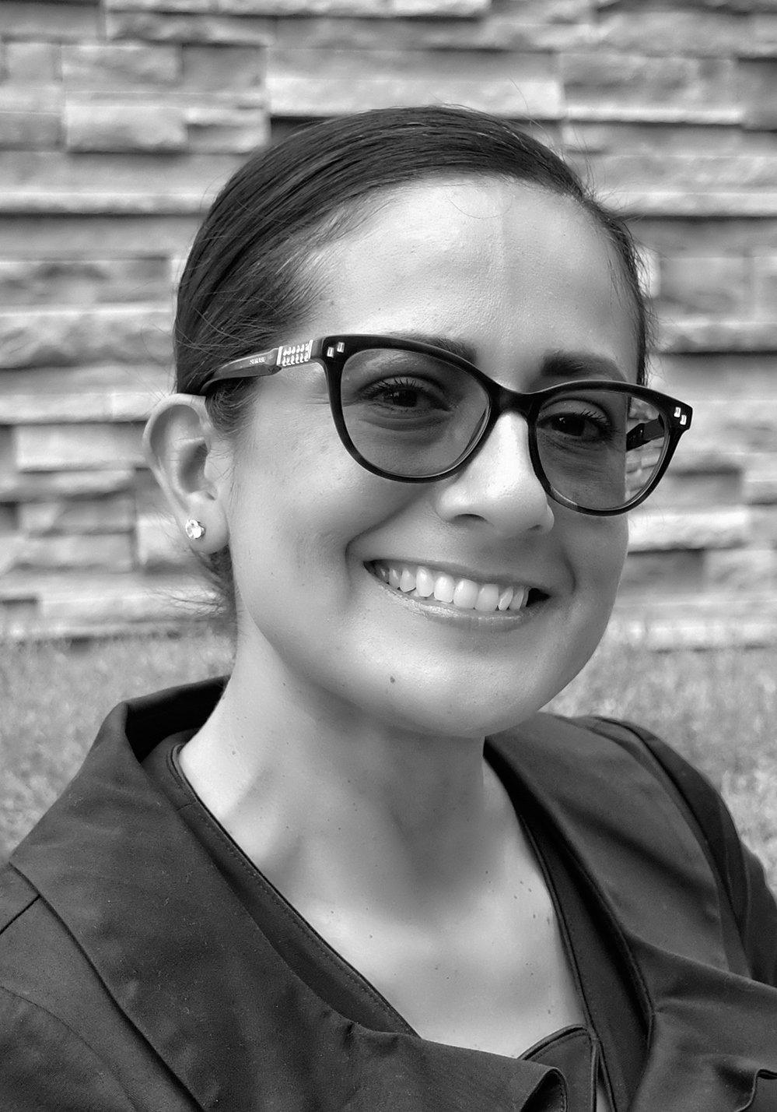
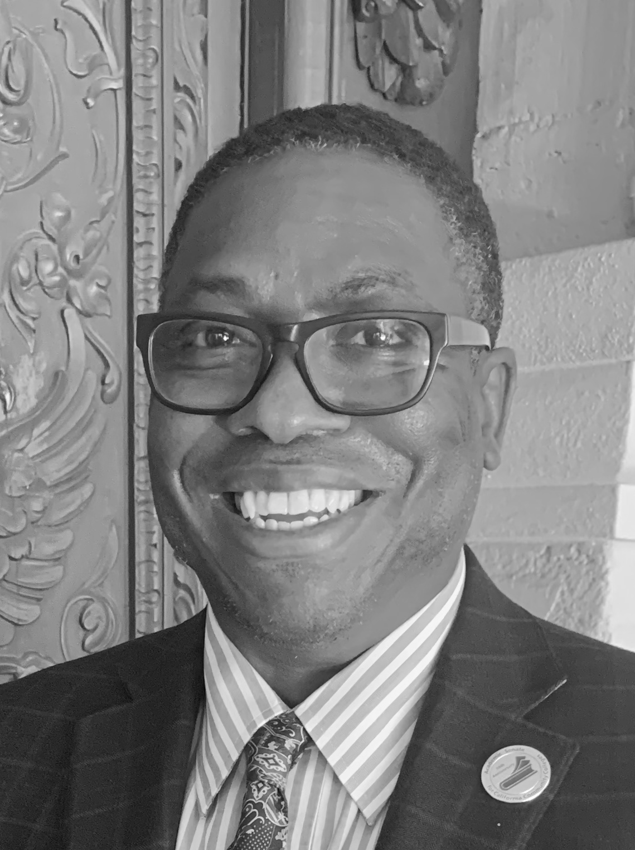
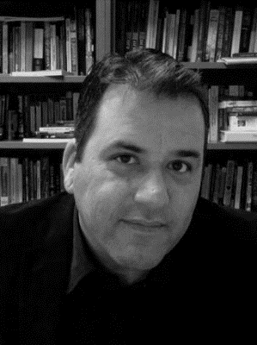
ASCCC Executive Committee 2020-21
Representatives
Julie Oliver
Area A Representative
Karen Chow
Area B Representative
Robert L. Stewart Jr. Area C Representative
LaTonya Parker
Area D Representative
Stephanie Curry
North Representative
Carrie Roberson North Representative
Silvester Henderson
At-Large Representative
Michelle Bean
At-Large Representative
Sam Foster
South Representative
Manuel Velez
South Representative

Slide 6
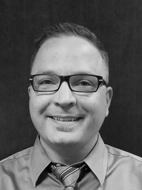
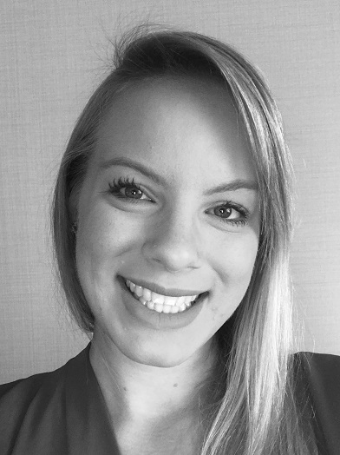
ASCCC Staff
Krystinne Mica
Executive Director
Tonya Davis
Director of Administration
Alice Hammar Director of Finance
Miguel Rother
Director of Grants & Initiatives
April Lonero Executive Assistant
Jennifer Valencia
Program Manager

Slide 7
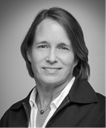
ASCCC Staff
Kyoko Hatano Administrative Assistant
Veronica Rey Administrative Assistant
Selena Silva Program Specialist
Meuy Rosales
Accounting Clerk II
Edie Martinelli Events Manager
Megan Trader Program Coordinator
Katie Nash
Visual Designer

Slide 8
ASCCC Curriculum Committee 2019-2020
Jimmie Bowen
Antelope Valley College
Silvester Henderson
ASCCC At-Large Representative
Nili Kirschner
Woodland College
Shilo Nelson
Los Angeles Pierce College
Donna Necke
Mt. San Antonio College
Elizabeth Ramirez
Rio Hondo College
Lisa Saperston
Los Angeles City College
Erik Shearer
Napa Valley College
Jennifer Taylor-Mendoza
Skyline College
CIO Representative

Slide 9
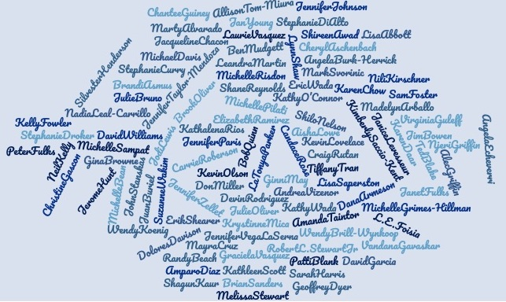
ASCCC Curriculum Institute 2020 Presenters
Over 100 presenters
from Lisa Abbott (A)
to
Jennifer Zellett (Z)
from over 40 colleges
ACCJC
ASCCC
CCCCO
CCC Foundation
CCC Success Center

Slide 10
Sponsors

Slide 11
Engage during sessions

Slide 13
Engage between sessions

Slide 14
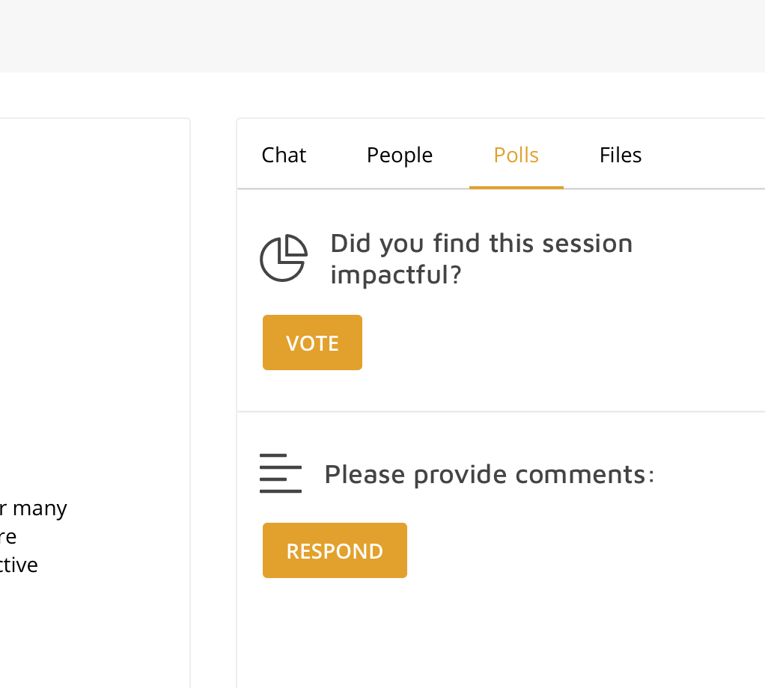
Please Provide Feedback!
After the event
After each session

Slide 15
Responsive Curriculum & Collective Impact

Slide 16
ASCCC Summer 2020 Rostrum
The Academic Senate for California Community Colleges Executive Committee, and our Equity and Diversity Action Committee (EDAC) and Faculty Development Leadership Committee (FDLC), engaged Black faculty from around the state to provide their voices on topics ranging from personal experiences to necessary changes in disciplines, institutional constructs, and hiring practices.
These articles are a powerful call to action to all faculty within our system. We hope that you find strength, hope, and unity as we come together collectively to listen to the stories and voices. We hope that you use the articles in this Rostrum as resources to continue to engage in the work of addressing and educating ourselves, our students, and our institutions. Lastly, we must not be afraid to use our own power, privilege, and position to change those systems that we have the power to change.

Slide 17
Chancellor’s Office Update Dr. Aisha Lowe Vice Chancellor of Educational Services and Support

Slide 18
CCCCO Updates
Vision for Success and the State of our System
New and Revised Regulations
Credit for Prior Learning (CPL)
CVC-OEI and the Exchange
Competency-based Education (CBE)
Curriculum Inventory RFP
Equity Call to Action
5C 2020-21 Priorities

Slide 19
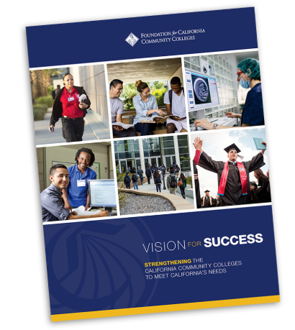
Vision for Success and Core Commitments
Vision for Success
Increase credential obtainment by 20%
Increase transfer by 35% to UC and CSU
Decrease unit obtainment for a degree
Increase employment for CTE students
Reduce and erase equity gaps
Reduce regional gaps
Core Commitments
Focus on students’ goals
Design and decide with the student in mind
Pair high expectations and high support
Evidence-based decisions
Own student performance
Enable innovation and action
Cross-system partnership

Slide 20
State of the System 2020
Vision for Success Goals
Increase credential obtainment by 20%
Increase transfer by 35% to UC and CSU
Decrease unit obtainment for a degree
Increase employment for CTE students
Reduce and erase equity gaps
Reduce regional gaps
Goal Attainment
Goal attained in 2018-19
Students who are ready to transfer increased by more than 35%
Progress continues to lag
Slight increases
Gaps are closing slowly as all groups increase attainment
Regional achievement gaps are slowly closing

Slide 21
New and Revised Regulations
AB 705 ESL: Created section § 55522.5 which details ESL Placement and Assessment procedures for students.
CPL: Expands section § 55050 to require community colleges to develop procedures for students to be able to attain credit for prior learning through the evaluation of Joint Services Transcripts, evaluation of student-created portfolios, evaluation of industry-recognized credential documentation, and standardized exams.
Forthcoming:
Correspondence Education: Adds correspondence education to title 5, sections §58003.1 and §58009 as an approved delivery method for apportionment.
IB/CLEP: To support enacted legislation (codified into Education Code statute 66025.7), created section §55052.5 which requires the Chancellor, in collaboration with the Academic Senate for the California Community Colleges, to develop policy guidelines on the minimum passing scores for the International Baccalaureate and/or College Level Examination Program examinations distributed to community college districts on an annual basis.
CBE regulations for direct-assessment CBE degree programs have been drafted with 5C.

Slide 22
Credit for Prior Learning (CPL)
Credit for prior learning is college credit awarded for validated college-level skills and knowledge gained outside of a college classroom.
Students’ knowledge and skills might be gained through experiences such as:
Military training
Industry training
State/federal government training
Volunteer and civic activities
Apprenticeships, internships, work-based learning, or other industry-based experiential learning
CPL is not awarded for knowledge and skills already assessed and awarded credit through formal education at regionally accredited in-state and out-of-state institutions.

Slide 23
Credit for Prior Learning (CPL)
The CPL policy is designed to increase degree and certificate completion, close equity gaps, and meet California’s projected workforce demands. Research indicates that students who earn CPL:
are roughly twice as likely to complete a degree than those who do not;
accumulate more credits through coursework at the institution than their counterparts, which translates to increased enrollment for colleges;
save an average of 6-10 months in time to degree compared to their non-CPL counterparts.
This policy reform encourages districts and colleges to provide students more consistent and equitable access to prior learning assessments, to promote quality, integrity and equity in the award of credit, and make programs more accessible to millions of students without certificates or degrees.

Slide 24
Credit for Prior Learning (CPL) Session
Thursday, July 9, 9:00-10:15
Credit for Prior Learning: What's New and What Can You Do Next?
Guiney, Chantee cguiney@CCCCO.edu; Jodi Lewis <jlewis@foundationccc.org>
Credit for Prior Learning (CPL) is an equity driven initiative that focuses on research and local policies/procedures that support students and colleges in increasing completion and reducing achievement gaps by acknowledging that learning happens in environments outside the traditional classroom. Driven by regulation and legislation, ASCCC, in collaboration with the Success Center at the Foundation for California Community Colleges, the Chancellor's Office, and faculty throughout the system, developed effective practices around CPL that consider the Vision for Success, Guided Pathways, and the student experience. What are the next steps needed to implement CPL at the local college/district? This breakout session focuses on what’s new and what you need to know to take local action to support students in their educational endeavors using credit for prior learning.

Slide 25
CVC-OEI
Began in 2013-14
Statutory obligation: Expand the availability of courses through technology
Online ecosystem
Quality courses
Calbright is not CVC-OEI
The Course Exchange is an initiative for system-wide online education.
California Virtual Campus – Online Education Initiative
(CVC-OEI)
Technology resources that maximize economies of scale
System wide resource for online students
System wide resources for developing high-quality online courses
Notes:
Began in 2013-14
Some of you may have received a grant to develop programs or program supports for this effort.
“Expand the availability of courses through technology” is what is stated in the budget act. The way CVC has done this is – maximizing technology resources, support for online students and resources for quality courses
For those who didn’t already know (very few in this group I expect), Calbright has never been CVC-OEI.
The Course Exchange is what will connect our colleges online and provide a seamless experience for students.

Slide 26
CVC-OEI’s Course Exchange
Mechanism by which students can seamlessly cross enroll in online courses between colleges
Students will conveniently find online classes available to them
Colleges will have the back end data-sharing and coordination
Evolution of the CVC-OEI Course Exchange:
cvc.edu – catalog of online courses
OEI - cross-enrollment and Course Exchange
CVC-OEI revamped cvc.edu
CVC-OEI merging and upgrading cvc.edu and Course Exchange
CBE
Common ERP
Program Planning
Other statewide initiatives
Notes:
For those of you who don’t know, the Course Exchange will be how students seamlessly cross-enroll in online courses between colleges.
“Cross enrollment in online education” is simply the coordination of student who are enrolled in one college to take courses online at another college. It was codified in 2018 (Education Code Section 66770) with the help of CVC-OEI.
Students will find the classes they need and at the same time colleges will have behind the scenes data-sharing and coordination.
How did it evolve:
[Dot 1:] cvc.edu – The California Virtual Campus website was a static catalog.
Some of you may remember having to share your courses in files that were uploaded to the database behind the website.
While students could find a course, they would then have to visit the college’s site to see if it was available that term. Then they would have to determine if the course was open.
In short, it was not very helpful and an onerous process for the student.
[Dot 2:] OEI – cross-enrollment and Course Exchange
Along comes the Online Education Initiative in 2013-14.
They discover that online education needed help.
Courses quality varied wildly.
Faculty accustomed to face-to-face teaching were not prepared in online methods of instruction
The system lacked innovative tools that would make online education easy and dynamic.
Essentially, CVC-OEI already knew back then what the rest of the system discovered within the past few months.
[Dot 3:] CVC revamped cvc.edu
In 2018, CVC-OEI brought the old static cvc.edu site up to speed by making it an online course finder.
As the “Finish Faster” site, students were able to find courses that were full at their college, the class they needed to complete their program, or even that last GE requirement that they needed.
(Dot 4:] CVC-OEI merging and upgrading both sites into one for a more SEAMLESS STUDENT EXPERIENCE.
Through the new Course Exchange we can view the online offerings at all of our colleges in one place making it more of a single system.
We are preparing cvc.edu and the Course Exchange to be flexible enough to respond to the initiatives to come (like CBE, program planning, and other statewide initiatives; common ERP is one of those lofty dreams but you never know)
[You can acknowledge the past challenges of the Exchange and talk about how now that we all know what it takes to have quality DE online, we can own up to what needs to be done]
Challenges –
Each campus has different tools and technology that don’t work well with each other or the system as a whole
Colleges never had enough resource people to implement the Exchange
Colleges didn’t know or understand the level of coordination involved at the campus level
For most colleges online education was not a priority
Distance Education is a main dish

Slide 27
Competency-based Education (CBE)
For-credit CBE programs are a needed addition to our instructional portfolio
CBE will help us meet our goals (Vision for Success)
CBE is an economic mobility lever
Career preparation is essential to the future of our state and our system
CBE can flex with changing technologies, employer demands, and unexpected societal shifts

Slide 28
CCC CBE Definition
Direct assessment competency-based education is an intentional outcomes-based equity-minded approach to earning a college degree with the expectations of learning held constant, but time is variable through a flexible, self-paced, high-touch and innovative learning practice. The goal of competency-based education is to empower students in their learning journey by providing a personalized, flexible, adaptive, and culturally responsive curriculum with which students can engage; it allows students to demonstrate mastery of learning and the achievement of competencies at their own pace aided by customized instructional and student service support.
Notes:
Slide content January 2020 5C CBE presentation

Slide 29
The Equity Imperative
We have made progress toward our goals, but gaps remain
Noncredit serves a high number of students that are disproportionately impacted (DI)
CBE for-credit opportunities will enhance student outcomes
Giving students access to significant wage gains with a degree
Notes:
Equity imperative: Noncredit serves a lot of DI students; CBE transitions to for-credit opportunities will enhance student outcomes

Slide 30
Draft CBE Regulations approved by 5C this June
Date | Discussion
January 2020 | Competency-based education overview and definition
February 2020 | CBE Program Design Overview of CBE Program Introduction to Backwards Design
April 2020 | • Program Quality Standards and Approval • Academic Standards and Course Approval • Related Course Elements - Credit Hour - Academic Symbols and Grade Point Average - Types of Courses Appropriate for Associate’s Degrees
May 2020 | Consider a full CBE program model Policy and Guidance Focus Areas Faculty Role Academic Calendar Withdrawal Repetition
June | Implementation Governance and approval processes Regional accrediting processes Evaluation
Notes:
CCCCO CBE Report to BOG (2020)
ACCJC Policy on CBE (January, 2020)

Slide 31
CBE Session 1
Wednesday, July 8, 1:00-2:45
Competency Based Education: What Is It and How Is It Different Than What We Already Do?
Cheryl Aschenbach, Karen Daar, and Aisha Lowe
The California Community Colleges Curriculum Committee (5C) worked this spring to prepare the regulatory language necessary to allow implementation of direct assessment competency based education (CBE) at colleges. Join presenters from the Chancellor's Office and 5C to learn more about CBE, how it is different than what we already do, and for an overview of the title 5 regulations being proposed to the Board of Governors.
Notes:
Slide content January 2020 5C CBE presentation

Slide 32
CBE Session 2
Wednesday, July 8, 2:45-4:00
Competency Based Education: Follow-up and Facilitated Dialog
Cheryl Aschenbach, Karen Daar, Aisha Lowe, Amparo Diaz and Nadia Leal-Carrillo
Continue a conversation about implementation of direct assessment competency based education in the California community colleges by joining presenters for this follow-up conversation. Learn more and engage in dialog about plans to roll out a CBE pilot or collaborative, how colleges can be involved, equity intent and expected impacts, and more.
Notes:
Slide content January 2020 5C CBE presentation

Slide 33
COCI RFP Project Process
Step I Business Requirement Development
Team: 5C, ASCCC, CCCCO Curriculum Teams, CCCTech Center, CCCCO Leadership Team, College Curriculum Stakeholders
Step 2 Market Scan – Curriculum Management Vendors
Step 3 RFP Development
Step 4 Draft Review & Comment by RFP Review Team
Step 5 RFP Release to public

Slide 34
COCI RFP Project Process
Step 6 College Curriculum Stakeholder Listening Sessions
Focus: To understand concerns & needs of college-based curriculum stakeholders and ensure that business requirements were accurately reflected in the RFP (10 sessions; 264 participants)
Step 7 RFP Submission
Step 8 PHASE I
RFP Review – RFP Review Team
5C
ASCCC
College Curriculum Specialists
TTAC
CISOA
Accessibility SME
Security SEM
CCCCO Curriculum Team
CCCCO Executive Leadership Team

Slide 35
COCI RFP Project Process
Step 9 PHASE II
Invited Vendor Demos with RFP Review team
Step 10 PHASE III
Invited Vendor Demos with CCCCO Executive Leadership Team
Step 11 PHASE IV
Product Demos with College Curriculum Stakeholders
FOCUS: Provide vendor product demos & solicit comments from college curriculum stakeholders on product functionality.
RESULTS:
5 Live Vendor Sessions – 110 attendees (average) each session
10 Recorded Vendor Sessions – 15 attendees (average) each session
180 Surveys submitted
692 Submitted Comments Reviewed

Slide 36
COCI RFP Project Process
Step 12 Analysis and review of all data by Executive Leadership Team Current Step
Step 13 Final review of RFP evaluation with RFP Review team
Step 14 Vendor selection by Executive Leadership Team

Slide 37
Call to Action for Equity
System-wide review of police and first responder training and curriculum.
Campus leaders host open dialogue and address campus climate.
Campuses audit classroom climate and create an action plan to create inclusive classrooms and anti-racism curriculum.
District Boards review and update your Equity plans with urgency.
Shorten the time for the full implementation of the DEI Integration Plan
Engage in the Vision Resource Center “Community Colleges for Change.” System-wide review of police and first responder training and curriculum.

Slide 38
5C 2020-21 Priorities
Champion curricular diversity of representation and culturally sensitive, relevant and responsive content
Develop guidance and provide support for instructional continuity and system resiliency
Develop a comprehensive approach to ongoing faculty professional development that strengthens student outcomes and reinforces continuity of education
Support the evolution, innovation, and adoption of system-wide teaching and learning practices

Slide 39
Curriculum Institute Sessions
Wednesday, July 8, 10:45-12:00: Financial Aid and Curriculum
Wednesday, July 8, 2:45-4:00: Noncredit Basics
Wednesday, July 8, 2:45-4:00: Submission of ADTs and Double Counting
Wednesday, July 8, 1:00-2:45: Competency Based Education: What Is It and How Is It Different Than What We Already Do?
Wednesday, July 8, 2:45-4:00: Competency Based Education: Follow-up and Facilitated Dialog

Slide 40
Curriculum Institute Sessions
Thursday, July 9, 9:00-10:15: Credit for Prior Learning: What's New and What Can You Do Next?
Thursday, July 9, 1:00-2:15: Program Submission Requirements
Friday, July 10, 9:00am-10:15am: General Session III: Certification Training and Training Local Committees

Slide 41
We are Here to Support You
Noncredit – Chantee Guiney (cguiney@cccco.edu); Neil Kelly (nkelly@cccco.edu)
ADT – Kevin Olson (kolson@cccco.edu); Njeri Griffin (ngriffin@cccco.edu)
Financial Aid – Gina Browne (gbrowne@cccco.edu)
Apportionment - Wrenna Finche (wfinche@cccco.edu)
Articulation – Bob Quinn (bquinn@cccco.edu); Devin Rodriguez (drodriguez@cccco.edu)
Competency Based Education – Chantee Guiney (cguiney@cccco.edu)
Credit for Prior Learning – Chantee Guiney (cguiney@cccco.edu)

Slide 42
Curriculum Team by Region
Name and Email | Region
Patti Blank pblank@cccco.edu | Macro Region A (Northern Inland, Northern Coastal, Lake Tahoe)
David Garcia dgarcia@cccco.edu | Macro Region A (Greater Sacramento) Macro Region E (San Diego/Imperial)
Chantee Guiney cguiney@cccco.edu | Macro Region B (North Bay, Mid-Peninsula, Silicon Valley, Santa Cruz/Monterey)
Zitlali Torres ztorres@cccco.edu | Region B (East Bay)
Kevin Lovelace klovelace@cccco.edu | Region C (Central Valley)
Kevin Olson kolson@cccco.edu | Region D (South Central Coast) Region F (Inland Empire/Desert)
Njeri Griffin ngriffin@cccco.edu | Region G (Los Angeles/Orange County)

Slide 43
Thank you!
Aisha N. Lowe, Ph.D.
Vice Chancellor
Educational Services and Support
(916) 322-4285
alowe@cccco.edu
California Community Colleges Chancellor’s Office
1102 Q Street, Sacramento, California 95811
www.cccco.edu

