Slide 1
Curriculum Overview
Raul Arambula
Jackie Escajeda
Njeri Griffin
Academic Affairs Division
Chancellor’s Office

Slide 2
Academic Affairs
COCI
Puente
CWE
MQs
Basic Skills
CDCP
Library Resources
BDP
ADTs
Inmate Education
Distance Ed
OEI
PCAH
UMOJA
Dual Enrollment
MESA
Inmate
Ed.
Curriculum
CID

Slide 3
Overview
Overview
Curriculum Process
Credit Courses
Certificates of Achievement
Associate Degrees
Generating Reports
ADT’s

Slide 4
Curriculum Process
Local Curriculum Process
Chancellor’s Office Curriculum Inventory
College
College Catalog
College Software
College Participation Agreement

Slide 5
CO Process for Programs
Approval Letter & New Control Number
New
Substantial Change
College
Nonsubstantial
Change

Slide 6
Sub vs. Nonsub Changes
Substantial
Action to create a new Program Record based upon an active program record
New Program Control Number
Goals/Objectives
TOP Code--different discipline
New program award using active proposal
Nonsubstantial
Changes Active Program Record
Same Program Control Number
Program title
TOP Code--same discipline
Unit changes
Addition/removal of courses

Slide 7
Reconcile
CO Curriculum Inventory
College
College Catalog
College Software
Program Participation Agreement

Slide 8
Courses

Slide 9
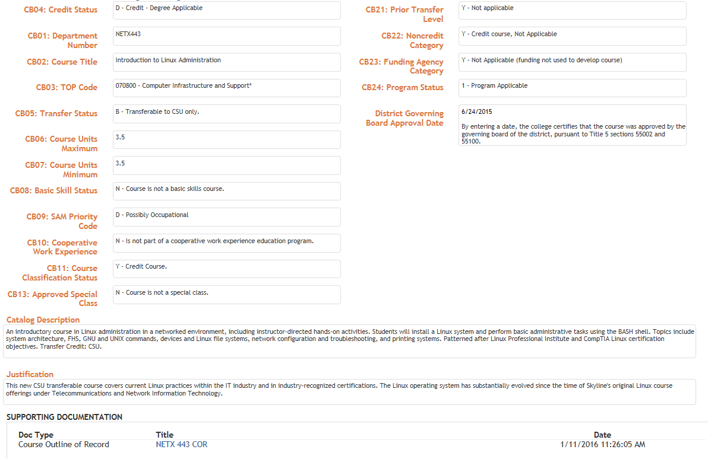

Slide 10
Course Review
Review CB fields
Credit Status – CB04
Course Title – CB02
TOP Code – CB03
Sam Code – CB09
Unit fields – CB06 & CB07
Ensure the completeness of the COR
Verify hours and units

Slide 11
Common Revision Requests: Courses
Incomplete proposal record
Units to Hours calculations
Cooperative Work Experience
CB03 (TOP Code) - CB09 (Sam Priority Code) Relationship
Repeatable/Repeatability

Slide 12
Credit Hour: Standard Formula
Units of Credit =
[Total Contact Hours + Outside-of-class Hours] Hours-per-unit Divisor*
*Value used by the college to define the number of hours to award each unit of credit (minimum of 48 or maximum of 54)

Slide 13
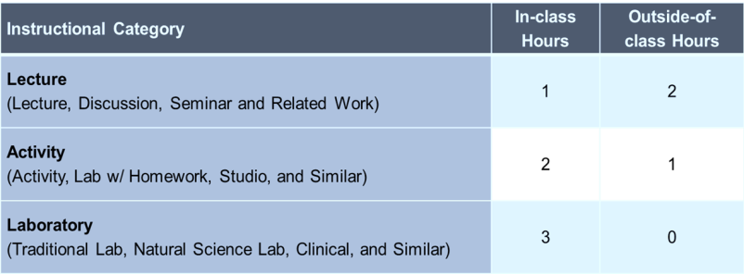
Credit Hour Standard Practices: In-class to Outside-of-Class Ratios

Slide 14
Hours and Units
36 Lecture
72 Lab
72 Outside-of-class hours (36x2)
=180 total student learning hours
180 / 54 = 3.33; therefore, 3 units of credit
Notes:
Strengths, Weaknesses, Opportunities and Threats:
Continuous Process Improvement

Slide 15
Cooperative Work Experience
Units are awarded based on student on-the-job-training hours (75 paid hours or 60 unpaid hours = one semester unit).
Units are awarded for on-the-job training hours and not for lecture.
Notes:
For cooperative work experience, units are awarded based on student on-the-job training hours, for example 75 paid hours or 60 unpaid hours equals 1 semester unit.
Units are awarded for on-the-job training hours and not for lecture.

Slide 16
CB03 - CB09 Relationship
CB03: TOP Code
Vocational TOP Code denoted in the inventory with an asterisk (*)
Non-vocational (CTE)
CB09: SAM Priority Code
A: Apprenticeship
B: Advanced Occupational
C: Clearly Occupational
D: Possibly Occupational
E: Non-Occupational
Notes:
The relationship between top code and Sam priority code:
If you select a CTE top code, then the Sam priority code should be A - D.
If it's not a CTE top code, the only option is E.

Slide 17
Repeatable Courses
Courses for which repetition is necessary to meet the major requirements of CSU or UC for completion of a bachelor’s degree
Intercollegiate Athletics
Intercollegiate academic or vocational competition
Cooperative Work Experience

Slide 18
Common Revision Requests:
Courses
General course whose title excludes others, e.g.,
Volleyball for Business Majors
Car Repair for People Over Age 30
Inappropriate pre-requisites, e.g.,
Must be a licensed LVN or RN in order to take a basic CPR refresher course
Must be employed by River City Department of Public Works in order to take Basic Accounting 101

Slide 19
Nonsubstantial Change
An action to change an active course record that will not initiate a new control number.
(Example: Course Title or Transfer Status)
Substantial Change
An action to create a new course record based upon an active course record. This action will initiate a new control number.
(Example: TOP Code, Number of Units or SAM Priority Code)

Slide 20
Notes:
Define a Certificate of Achievement and the benefits
Most often CTE
Job attainment
Add statistics

Slide 21
CO Review
Proposal fields filled in
Course Outline of Records (CORs) attached
CORs in Narrative, Course Report & Supporting Documentation match
Narrative is complete and accurate
Total units on proposal match total units on Narrative

Slide 22
CO Review for CTE
Supporting Documentation:
Labor Market Information (LMI) & Analysis
Regional Consortia Approval Meeting Minutes
Advisory Committee Recommendation
Program Review Date:
Must be within 2 years, Education Code 78016

Slide 23
Common Revision Requests
Program Award (SP02)
Program Goal
Units don’t match Narrative
Missing Supporting Documentation
CORs not listed
CORs duplicated

Slide 24
Program Award (SP02)
B – Certificate of Achievement: 12 to fewer than 18 semester units (quarter equivalent) units
For these low unit certificates that don’t obtain CO approval:
Cannot appear on student transcript
Cannot call them Certificate of Achievement
Need to follow same requirements of the ones submitted to CO and obtain documents on file
C – Certificate of Achievement: 18 or greater semester (quarter equivalent) units

Slide 25
Program Goal
Program Goal must match “Item 1. Program Goals and Objectives” in the Narrative
Options for a Certificate are:
Career Technical Education (CTE)
Other (Local)
Both Certificates cannot have a program goal of transfer

Slide 26
More about Program Goal
Certificates of Achievement - Transfer:
CSU-General Education-Breadth
Intersegmental General Education Transfer Curriculum (IGETC)
title 5, section 55070 (a):
…the term “general education” includes coursework taken to satisfy transfer patterns established by the UC, the CSU or accredited public postsecondary institutions in adjacent states which award the baccalaureate degree.

Slide 27
Associate Degrees

Slide 28
CO Review
Proposal fields filled in
CORs attached
CORs in Narrative, Course Report & Supporting Documentation match
Narrative is complete and accurate
Total units on proposal match total units on Narrative

Slide 29
CO Review For CTE
Supporting Documentation:
Labor Market Information (LMI) & Analysis
Regional Consortia Approval Meeting Minutes
Advisory Committee Recommendation
Program Review Date:
Must be within 2 years, Education Code 78016

Slide 30
CTE & Transfer or Transfer
1
ASSIST Articulation Agreement
2
Majority 51% of required courses articulate

Slide 31
Common Revision Requests
Units don’t match Narrative
General Education Patterns
Missing Supporting Documentation
CORs not listed
CORs duplicated

Slide 32
General Education Patterns Local Degrees
If Associate Degree Program Goal is CTE or Other, use local General Education pattern
Okay to include other General Education patterns
 | Local
Total Required Major: | 21 units
College GE Requirements: | 18 units
Electives (if needed): | 21 units
Total Degree Units: | 60 units

Slide 33
General Education Patterns Transfer Degrees
If Associate Degree Program Goal is Transfer or CTE and Transfer, the college must use an IGETC and/or CSU-GE Breadth General Education pattern
 | IGETC | CSU-GE
Major Total: | 18 units | 18 units
Double Count (IGETC/ CSU-GE): | 3 units | 6 units
IGETC/ CSU-GE Breadth: | 37 units | 39 units
Electives (as needed): | 8 units | 9 units
Total Degree Units: | 60 units | 60 units

Slide 34
Narrative for COAs & Degrees
Program Goals & Objectives
Catalog Description
Program Requirements
Master Planning
Enrollment and Completer Projections
Place of Program in Curriculum/Similar Programs
Similar Programs within the region

Slide 35
LMI for COAs & Degrees
Required for CTE programs
Within two years & region college serves
Employer survey okay in lieu of LMI

Slide 36
Generating Reports

Slide 37
CI Tools: College View
Courses
Programs
Ad Hoc Report—Select multiple fields—Save Report

Slide 39
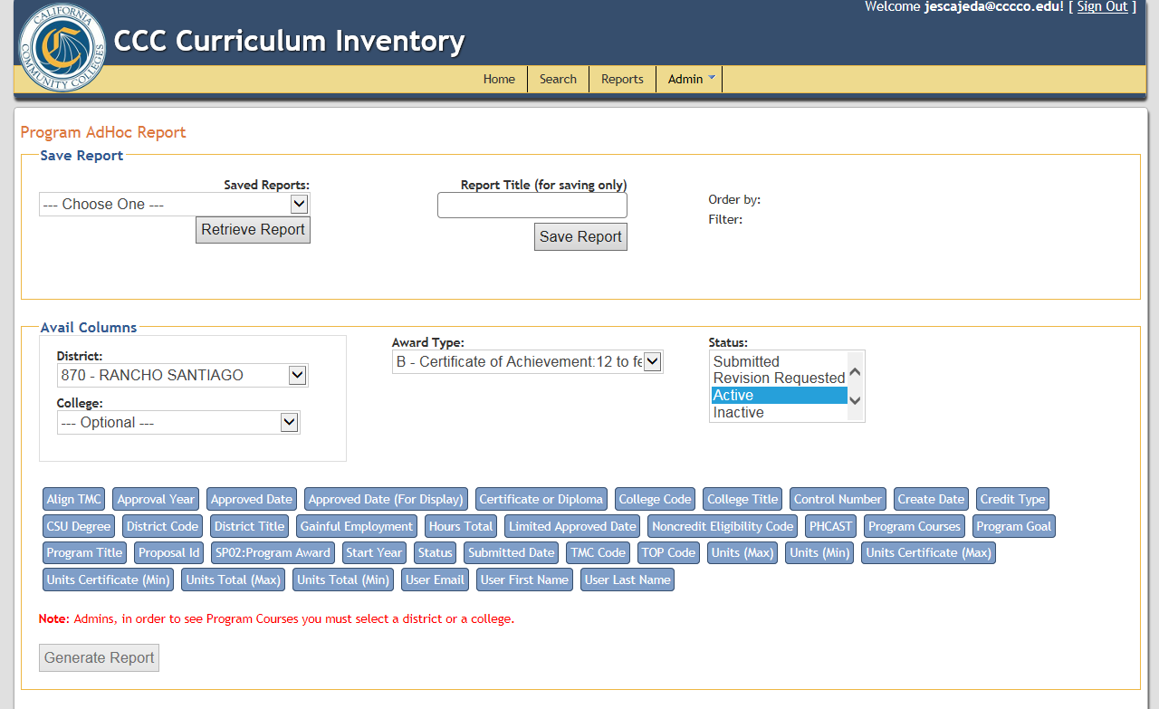
Award Type:
A -- A. A.
S -- A. S.
Y -- A. A. T.
X -- A. S. T.
B – COA: 12 to fewer than 18
C – COA: 18 or greater

Slide 40
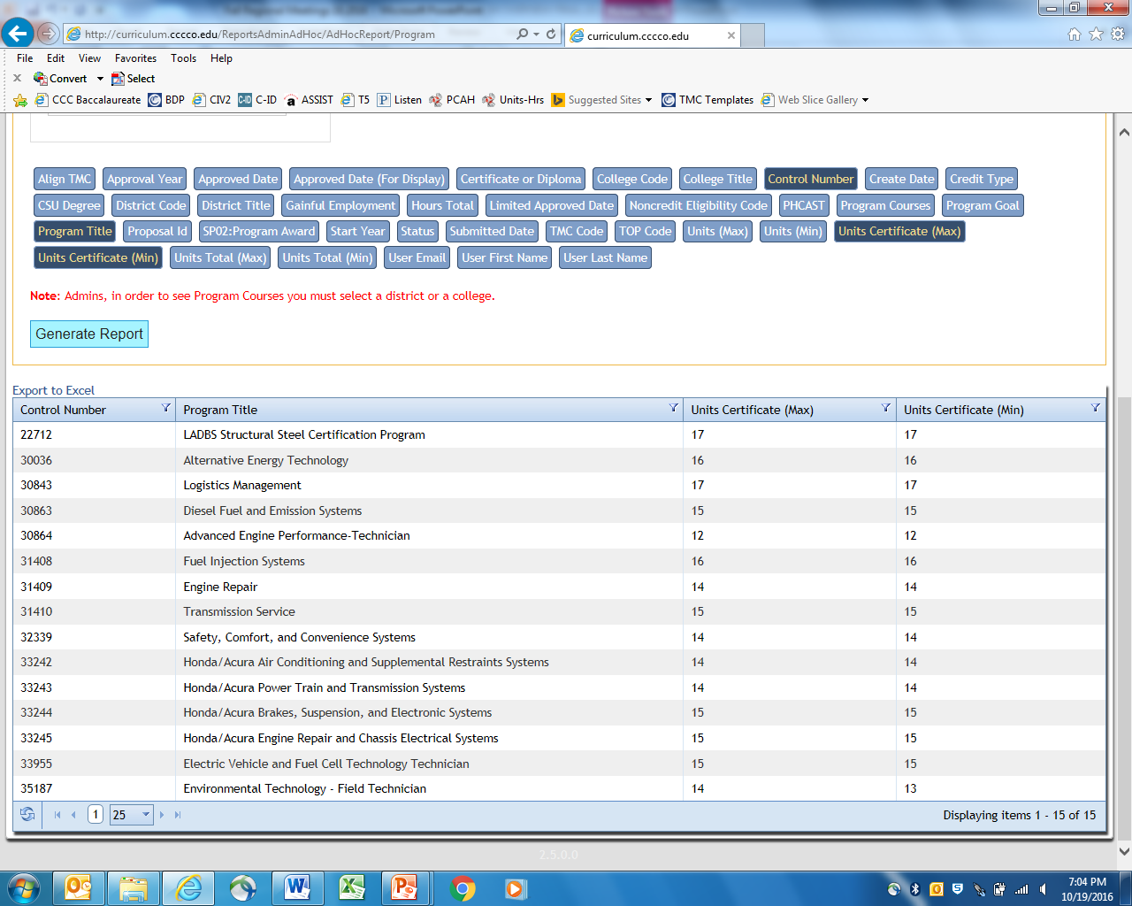

Slide 41
C-ID
Update

Slide 43
ADTs
2079 Associate Degrees for Transfer (9/28/16)
New TMCs with a deadline of 8/01/16
Agriculture Plant Science
Biology
Chemistry
Film, Television & Electronic Media
Nutrition & Dietetics
Notes:
Strengths, Weaknesses, Opportunities and Threats:
Continuous Process Improvement

Slide 44
ADTs
New TMCs:
Child & Adolescent Development
Global Studies
Public Health Sciences
Social Justice Studies
Notes:
Strengths, Weaknesses, Opportunities and Threats:
Continuous Process Improvement

Slide 45
ADT Review
Verify the completion of all the proposal fields
Ensure all the required CORs are attached
Match CORs to the courses listed in the Narrative and Course Report Section
Review Narrative for completion and accuracy
Verify total Unit count on the TMC
Verify Double Count calculation

Slide 46
ADT Common Revision Requests
GE Area (both CSU and IGETC) – incorrect or incomplete breadth requirement next to the course
Double count discrepancies
ASSIST Supporting Documents – incorrect report or not attached at all
Courses “expired” or not submitted to C-ID

Slide 47
ADT Common Revision Requests
Missing information in the Narrative or Education Code Section 66746(a) is misquoted or altered
Degree should follow the convention “Associate in (Arts/Science) in (Discipline) for Transfer Degree”
Associate in Arts in English
Program requirements (when included) does not match template
Name the baccalaureate program, specifies preparation for transfer to a CSU

Slide 48
Correct ASSIST Documentation
Notes:
A current ASSIST report (as identified on the TMC Template) is required for courses entered on the TMC Template where no C-ID Descriptor is indicated.
The required ASSIST report (AAM, BCT or GECC) is indicated on the TMC template in the C-ID Descriptor column.
No substitute documentation is accepted for ASSIST reports.
No other ASSIST report is accepted.

Slide 49
ADT Double Count
3
0
3
3
6
3
0
0
3
3
0
0
9
6

Slide 50
THANK YOU!!

Slide 51
Contact
Jackie Escajeda – jescajeda@cccco.edu
Raul Arambula – rarambula@cccco.edu
Njeri Griffin – ngriffin@cccco.edu

