Slide 1
Avoiding the Curriculum Pressure Cooker with the New Recipe for Funding
Stephanie Curry, ASCCC Curriculum Committee, Reedley College
Ginni May, ASCCC Treasurer, Curriculum Chair
Carrie Roberson, ASCCC North Representative
Spring Plenary Session, Westin San Francisco Airport
April 12, 2019, 3:45-5:00

Slide 2
Description
With colleges receiving 10% of their funding based on student success metrics consisting of course, certificate, or degree completion, faculty may be experiencing pressure to create additional courses, certificates, and degrees in an effort to increase student completion numbers. Join us as we examine the Student Centered Funding Formula with a Guided Pathways temperature check and discuss how to best serve our students in a smorgasbord of options.

Slide 3
Overview
Student Centered Funding Formula
Performance Metrics
A Tale of Three Students
Processes and Procedures
Guided Pathways in the Mix

Slide 4
Student Centered Funding Formula
Passed through Budget Bill in 2018,
Signed by the Governor on September 27, 2018
Senate Bill 840

Slide 5
Student Centered Funding Formula
Three Components
Base Allocation – promote broad access
Supplemental Allocation – address barriers to access and success for low-income students
Student Success (Performance) Allocation – encourage progress on outcomes linked to goals in the Vision for Success
Allocation
Year | 2018-19 | 2019-20 | 2020-21
Base | 70% | 65% | 60%
Supplemental | 20% | 20% | 20%
Student Success/Performance | 10% | 15% | 20%
Notes:
Allocations are changing to allow colleges to adjust

Slide 6
Student Centered Funding Formula
Equity Component
Pell Grant Recipients - outcomes
CA Promise Grant Recipients (previously BOG)
Students Success Allocation
AA’s
Credit Certificates
Supplemental Allocation
Headcount - Pell Grant Recipients -
Headcount - AB 540
Base Allocation
Credit Full-time Equivalent Students (FTES)
Base Allocation
Special Admit (FTES)
Inmates in Correctional Facilities (FTES)
Headcount - CA Promise Grant Recipients (previously BOG)
CCC Bachelor
Completion of Transfer level Math and English
Transfer to Four-year University
Completion of 9 CTE units
Regional Living Wage
ADTs

Slide 7
Student Success (Performance) Metrics
Student Success or Performance Metric – 8 Outcomes
associate degrees for transfer (ADT) granted,
associate degrees granted (excluding ADTs),
baccalaureate degrees granted,
credit certificates (16 units or more) granted,
completion of transfer-level math and English courses within the first academic year of enrollment,
successful transfer to a four-year university,
completion of nine or more CTE units, and
attainment of a regional living wage

Slide 8
Performance Metrics
Performance Funding
2018-19:
$440 per point
$111 additional per point for Pell and Promise Grant students
2019-20:
$660 per point
$167 additional per point for Pell and Promise Grant students
2020-21:
$880 per point
$222 additional per point for Pell and Promise Grant students
Notes:
Rates will be adjusted for Cost of Living and other base adjustments

Slide 9
Performance Metrics
The Point System
 | Outcome | Points
1 | ADT | 4 (per degree)
2 | Local Associate Degree | 3 (per degree)
3 | Baccalaureate Degree | 3 (per degree)
4 | Credit Certificate (16 or more semester units, 24 or more quarter units) | 2 (per certificate)
5 | Completion of transfer-level math and English during student’s first academic year | 2 (per student)
6 | Successful transfer to a 4-year institution | 1.5 (per student)
7 | Completion of 9 or more CTE units | 1 (per student)
8 | Attainment of a Regional Living Wage | 1 (per student)

Slide 10
10
Source: Workshop Materials:Slide Decks Connecting the Dots Part 1
https://iepi.cccco.edu/2019dataworkshops

Slide 11
ASCCC Recommendations on SCFF
If the state of California must keep the performance metric…
Letter to legislature on “Revisiting the Student Centered Funding Formula to Incentive Student Focused Outcomes”
Level the point system for associate degree awards so that all educational goals and achievements of comparable unit values are counted equally.
Award colleges only once per year per student for the highest award achieved as a means of prioritizing per-student success, as opposed to incentivizing maximizing awards more generally.
Keep the performance metric portion set at 10% of the total allocation to ensure funding stability and to support college exploration of how best to serve students.

Slide 12
A Tale of Three Students
Student Profile 1:
Full time, started in fall semester, Pell and Promise Grant
Passed English AP Exam with a 4 so took English critical thinking course first semester
Passed Calculus I first semester and decided to get an ADT in math
Earned math ADT at end of 2nd year
Also picked up local AS in math and Certificate for completing CSU GE Breadth pattern
Successfully transferred to CSU
Points for College | First Year = | Second Year =

Slide 13
A Tale of Three Students
Student Profile 2:
Started in spring, taking 13 units, transferred after one semester from out-of-state university, does not qualify for Pell/Promise
Took transfer-level English and mathematics both with corequisite support courses for a total of 10 units, plus a CTE 3-unit accounting course—did not pass the English course (4 units)
Decided to major in accounting and passed the business course that counts for CSU GE English composition
By end of 2nd year, completed 12 CTE units
Points for College | First Year = | Second Year =

Slide 14
A Tale of Three Students
Student Profile 3:
Part time student with 3 young children, started in fall – takes 5-8 units per semester, Pell and Promise
Took English composition with support (5 units) fall semester and another GE course
Took statistics with support (6 units) spring semester and opted not to take an additional course
Passed all courses that first year, and took an additional 12 GE units the second year.
Is it possible that this student has earned a CSU GE or IGETC Certificate of Achievement yet?
Points for College | First Year = | Second Year =

Slide 15
Processes and Procedures
Clear, Established and Articulated processes and procedures for Curriculum help avoid the pressure to make changes based purely on economic drivers.
Curriculum processes should address the “Why” for creating new programs, degrees and certificates that meet the educational needs of the students and public.
Processes should include cross-functional dialog in a effort to eliminate unintended consequences may negatively impact students.

Slide 16
Guided Pathways in the Mix
PRESSURE IS ON!
GUIDED PATHWAYS IS ALL ABOUT CURRICULUM…
Notes:
Guided Pathways frameworks is ALL ABOUT CURRICULUM!
Clarify: Meta-Majors and Program Mapping
ENTER:

Slide 17
Guided Pathways is ALL about Curriculum!
CLARIFY THE PATH:
Simplify choices to show students a clear pathway to completion, further education, and/or employment
Establish transfer pathways to optimize applicability of community college credits to university majors
ENTER THE PATH:
Bridging K-12 to higher education
Redesign the pathways through the college experience
Integrate and contextualize instruction to build foundational skills.
STAY ON THE PATH:
Support students with ongoing advising mechanisms to support *informed choices, strengthen clarity about opportunities, develop an academic plan with a predictable schedule, monitor progress, and intervene if they go off track
Embed academic and nonacademic support services throughout programs to promote student learning, persistence, and retention
a
ENSURE LEARNING:
Establish program-level learning outcomes aligned with the requirements for success in employment and/or further education
Apply the results of learning outcomes assessments to improve the effectiveness of instruction across programs
Ensure incorporation of effective teaching practice throughout the pathways

Slide 18
CURRICULAR PATHWAYS
REQUIREMENTS:
GENERAL EDUCATION
MAJOR PREPARATION
ELECTIVES
GRADUATION/TRANSFER

Slide 19
What do faculty need to consider?
How much time are students taking to complete a certificate/ degree?
How many units is it taking students to earn a certificate/ degree – and why?
How many students are in an area/discipline? How many have declared a program/major?
Are they signing up for the “right” classes?
What might prevent students from getting or taking classes when they need them?
Are there processes in place to assess program viability, course rationale or determine discontinuance?
WHAT ELSE?
Notes:
These are key questions faculty have not typically gotten answers or reports on.
Power of data

Slide 20
THINK LIKE A STUDENT
Are there courses in a program/ the catalog that are never offered?
Are there programs in the catalog that no longer exist -OR- have never existed?
Are there certificate and/or degree options that have never been awarded?
Are courses offered strategically with the student in mind?
Notes:
Meta-Majors, program mapping…
Why “clean-up” curriculum in advance of serving our students?
Who is responsible for the “work”, culture shift, change management, marketing, etc!

Slide 21
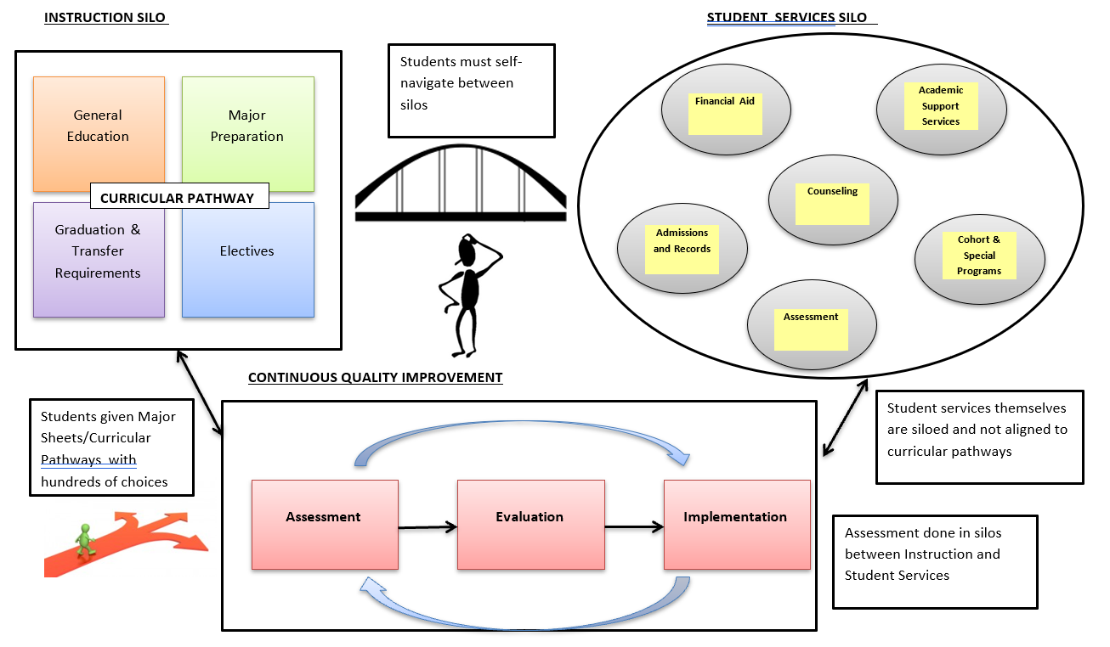

Slide 22
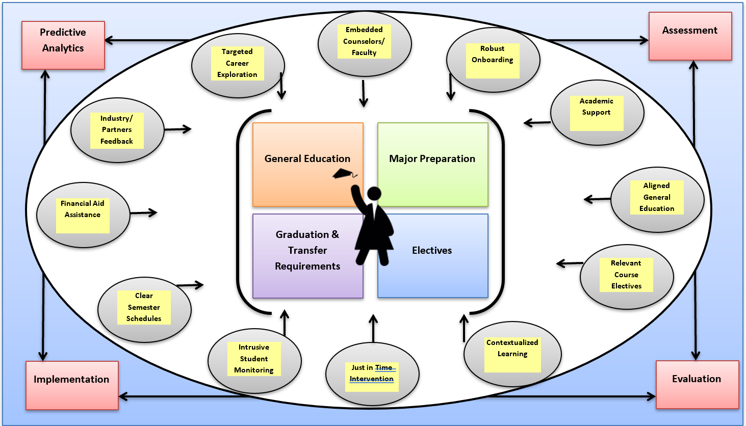
Notes:
The STUDENT experience as it relates to GP

Slide 23
Resources
CCCCO Student Centered Funding Formula: http://extranet.cccco.edu/Divisions/FinanceFacilities/StudentCenteredFundingFormula.aspx
Student Success Metrics Dash Board, Second Build 1-18-2019: https://digitalfutures.cccco.edu/Portals/0/Documents/data-element-dictionary.pdf
CCCCO Data Element Dictionary: http://extranet.cccco.edu/Divisions/TechResearchInfoSys/MIS/DED.aspx
CCCCO MIS Data Mart: https://datamart.cccco.edu/DataMart.aspx
Academic Senate for California Community Colleges: https://asccc.org
ASCCC GP Canvas: https://tinyurl.com/CCC-GP2018
ASCCC Guided Pathways RESOURCES: https://www.asccc.org/guided-pathways

Slide 24
Acronyms
ASCCC – Academic Senate for California Community Colleges
CCCCO or CO – California Community Colleges Chancellor’s Office or Chancellor’s Office
CSU GE – California State University General Education
IGETC – Intersegmental General Education Transfer Curriculum
SCFF – Student Centered Funding Formula
ADT – Associate Degree for Transfer
CTE – Career and Technical Education
LMI – Labor Market Information
PCAH – Program and Course Approval Handbook
AAM – Articulation Agreement for Major
SOC – Standard Occupational Classification
TOP – Taxonomy of Program
EDD – Employment Development Department
CDCP – Career Development and College Preparation
COR – Course Outline of Record
COCO – Chancellor’s Office Curriculum Inventory
CWE – Cooperative Work Experience

