Slide 1
Curriculum Processes for CTE
Marie Boyd, ASCCC CTEL Committee, Chaffey College
Julie Pehkonen, Chair, Inland Empire/Desert Regional Consortium
Craig Rutan, ASCCC Executive Committee, Santiago Canyon College
Career and Noncredit Education Institute
May 3-5 , 2018

Slide 2
Outcomes For This Session
Review Best Practices for Local CTE Curriculum Approval
Review Regional Consortium Endorsement of Local CTE Curriculum
Review Chancellor’s Office Review/Chaptering of CTE Curriculum

Slide 3
Best Practices for Local CTE Curriculum Approval
CTE Curriculum should be submitted to the same review processes, locally, as all other curriculum, credit and noncredit!
CTE Curriculum, besides being driven by industry demands, should also have input from the local Advisory Board.
§ 55601. Appointment of Vocational Education Advisory Committee.
Examples of guide books for working with Advisory Committees:
CTE Advisory Committee Handbook - San Diego Community College District
Santa Rose College CTE Advisory Committee Handbook

Slide 4
Best Practices for Local CTE Curriculum Approval
Program Initiation Anyone?
Separate in scope from a local Curriculum Committee review
Examines the “Total Cost of Ownership”
Facilities
Faculty
Sustainability
Funding Sources
ASCCC White Paper: Effective Practices for Educational Program Development

Slide 5
Local Curriculum Committee Approval- Courses
Best Practices:
Annual training of Curriculum Committee
Regularly scheduled Curriculum Committee meetings
Technical Review of proposed curriculum by the Technical Review Committee
Reading(s) by the Curriculum Committee
Timely communication between the Curriculum Office and the originator to make requested changes
Looking at the Title 5 requirements of the Course Outline of Record
Title
Units/hours
Description
Content
Course Objectives
Methods of Instruction
Methods of Evaluation
Sample Textbooks
Sample Assignment(s)
CTE courses are reviewed every two years

Slide 6
Local Curriculum Committee Approval- Awards
Best Practices
Check that all program/certificate courses are regularly reviewed and none have been deactivated
A thorough program/certificate description – clearly aligned with the Guided Pathway for the particular area of discipline
Knowledge skills and abilities students will acquire upon successful achievement
If CTE, a list of job titles for which the award will prepare students
Make sure the program/certificate still aligns with market demand

Slide 7
Local Board Approval
Best Practices:
Monthly Review and Approvals
Board training for appropriate roles in curriculum review and approvals

Slide 8
Regional Consortium Review
New and substantially revised programs require the recommendation of the Regional Consortia

Slide 9
Who Makes the Recommendation?
Curriculum Specialist or Curriculum Chairs can submit proposals to regional consortium on NIFTY new online submission tool
Typically a subcommittee of the consortium’s CTE Deans review these proposals and recommends
Notes:
Julie – any further points you want to add here about what happens during the review process?

Slide 10
What are consortia looking for?
Primarily … to ascertain the need for the proposed program in regard to other community colleges in the area, as specified by Title 5, section 55130 (b)(8)(E).
Secondarily … assures program originators that the design of their program curriculum is along the lines of current good practice as judged by their professional peers.

Slide 11
The process?
Cannot submit or view proposals without creating an account

Slide 12
Notes:
One of the things I enjoy about this new online submission tool is the ability to see other program submissions from other consortia around the state.

Slide 13
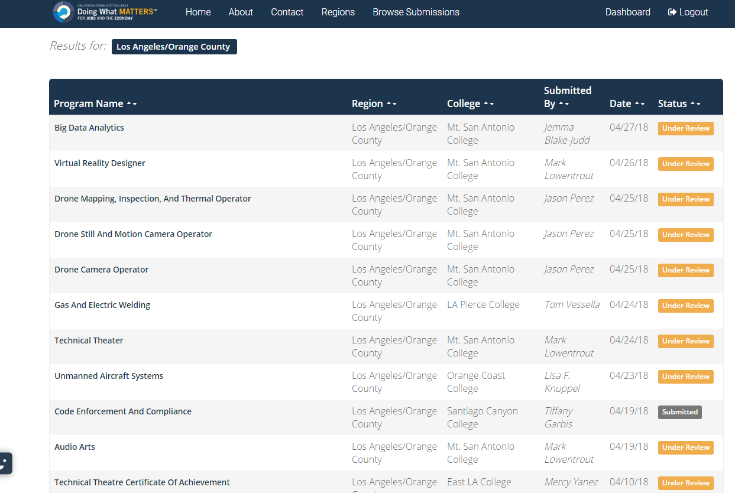
Notes:
I am in the Inland Empire area, but here are program submissions from LA County!

Slide 14
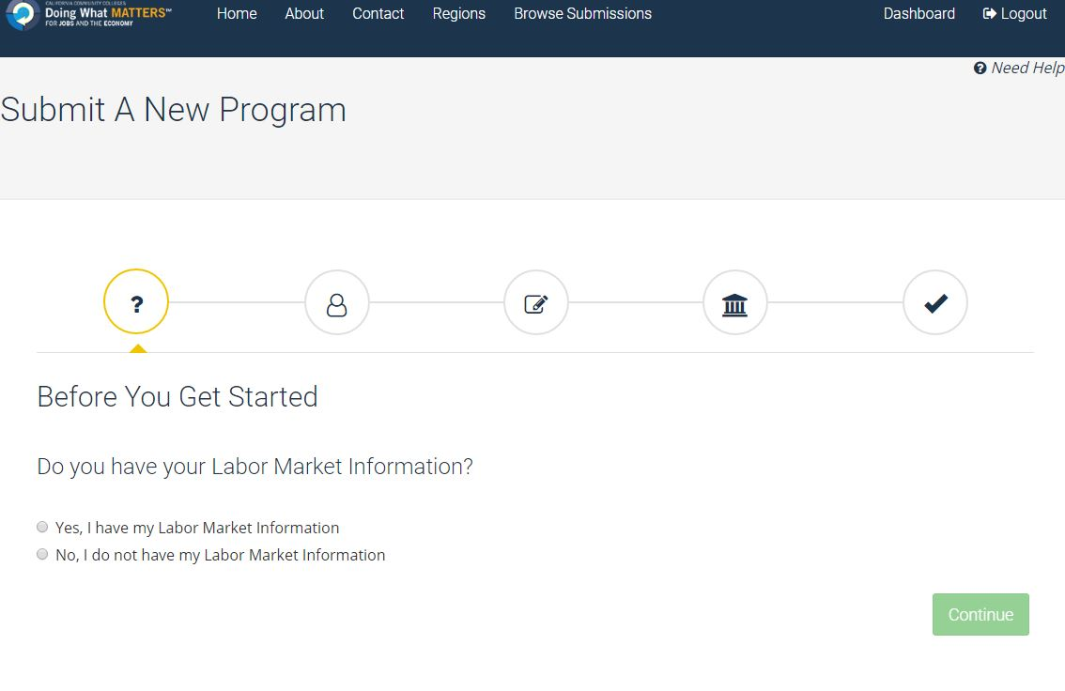

Slide 15
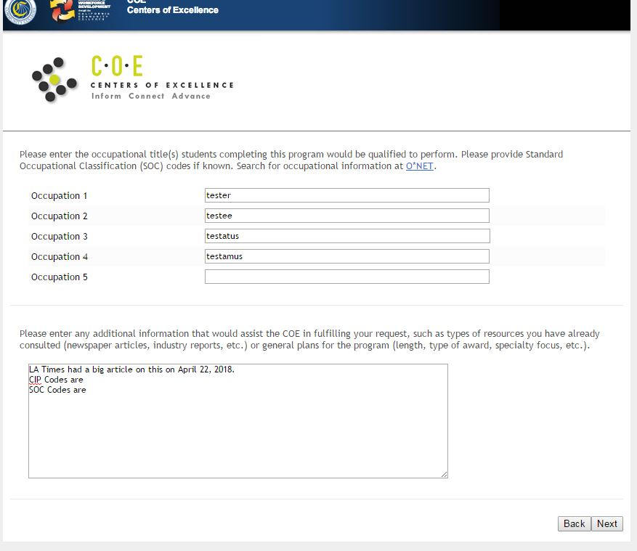
Step 2 - Request a LMI report from the Center of Excellence

Slide 16
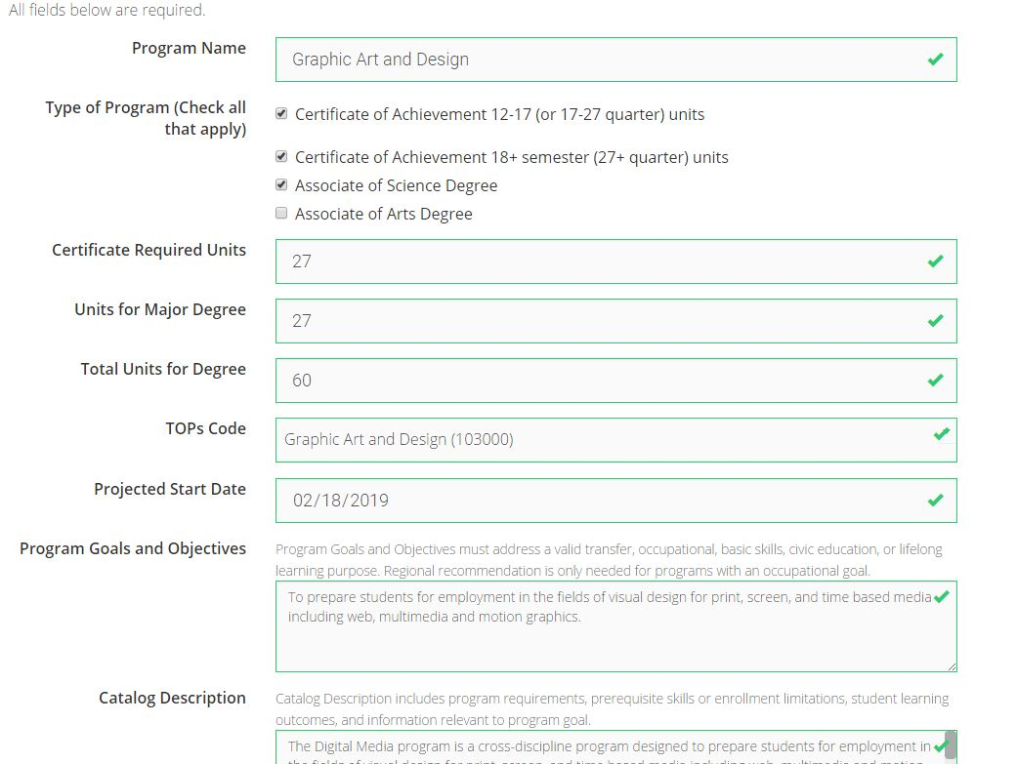
Step 3 - Complete Online Proposal Form - 3 steps!
2.
1.
3.
Notes:
Basically, three screens to complete – attach LMI and Advisory Committee Minutes, and SUBMIT!
The online submission tracks all readers’ comments for the originator to respond.
Tracks dates for two readings.

Slide 17
Step 5 - Submit
NO MORE PAPER FORMS!!!!!!!

Slide 18
C-ID Submissions
C-ID Project is beginning to include CTE – WHY?
Align with recommendations from the Strong Workforce Task Force
Greater alignment of competencies across the state, allowing students to continue their program at a new college
Collaboration with industry to ensure student are achieving desired competencies and improve employability
Check the C-ID page for draft and final descriptors in the following fields:
Agriculture
Graphic Design
Culinary
Licensed Vocational Nursing
Water and Wastewater Technology
Digital Media
Engineering Technology
Real Estate

Slide 19
Chancellor’s Office Review and Chaptering – Credit Courses
All credit courses must be submitted to the Chancellor’s Office (using the Curriculum Inventory) to receive a control number
If your college has submitted a certification memo, all credit courses (except CWE) will receive a control number within 24 hours through automated approval.
All courses are subject to periodic review by Chancellor’s Office staff

Slide 20
Chancellor’s Office Review and Chaptering – Credit Awards
All degree and certificate programs must be submitted to the Chancellor’s Office for approval.
Colleges must submit recent LMI data and documentation of review by the regional consortia for all new programs.
Colleges must submit new LMI data if a degree or certificate has gone through substantial revision.

Slide 21
Chancellor’s Office Review and Chaptering – Credit Awards
Currently, all certificate programs of 18 units or higher must be submitted for approval. Additionally, certificates between 12 – 17.5 units may be submitted for approval.
Title 5 revisions (55070) will be adopted in July that requires all certificates 16 units or higher to be submitted for approval. Additionally, certificates between 8 and 15.5 units may be submitted for approval.
If these programs have never been submitted to the CO, they will need to be submitted to the regional consortia first!

Slide 22
Chancellor’s Office Review and Chaptering – Noncredit Curriculum
Currently all noncredit courses and certificates must be submitted to the Chancellor’s Office in the Curriculum Inventory, reviewed by Chancellor’s Office staff, and approved prior to being offered.
The Chancellor’s Office recently dedicated more staff to reviewing and approving noncredit proposals to decrease approval time.
The California Community College’s Curriculum Committee (5C) is exploring automated approval of noncredit certificates that would give colleges control numbers for new and revised noncredit certificates in 24 hours. This probably won’t be available in 2018.

Slide 23
Program Review
And like the Circle of Life…
Sometimes it is time for us to review programs and courses for health and wellbeing… “viability.”
Might it be time to:
Deactivate
Momentarily Park
Continue with a resuscitation plan
Continue

Slide 24
Questions?

Slide 25
Resources
ASCCC. The Course Outline of Record: A Curriculum Reference Guide Revisited. 2017.
ASCCC. Effective Practices for Educational Program Development. 2017.
California Community Colleges Chancellor’s Office. Program and Course Approval Handbook, 6th edition.

