Slide 1
Curriculum Processes, Laws, and Regulations for Noncredit
Randy Beach, ASCCC Executive Committee Jan Young, ASCCC Noncredit Committee, Glendale Community College
2018 ASCCC Career and Noncredit Education Leadership Institute May 3-5, 2018 Westin South Coast Plaza

Slide 2
Description
Noncredit and credit curriculum follow similar processes for development and approval, but there are notably important distinctions between them that faculty should be aware of as they explore and expand noncredit offerings as well as notable differences in laws and regulations. Attendees at this breakout will learn about the commonalities and differences between the two processes, the evolving laws and regulations concerning noncredit, and the role of the Chancellor’s Office in approving noncredit.
2018 ASCCC Career and Noncredit Education Leadership Institute Westin South Coast Plaza

Slide 3
Today’s Learning Outcomes
Why are you here today?
What would you like to learn?
Understand the statutes and regulations guiding:
noncredit curriculum
apportionment
minimum qualifications
Understand Noncredit Curriculum Standards
Understand Noncredit Curriculum Approval Process
2018 ASCCC Career and Noncredit Education Leadership Institute Westin South Coast Plaza

Slide 4
Where Have We Been? Where Are We Going?
The priority of policy makers and the legislature is to move students through to completion and subsequently to transfer and/or careers, as evidenced by:
Realignment of Adult Education from K-12 to CCCs and funding of AEBG.
Equalization of CDCP noncredit apportionment rate with credit.
Establishment of the Strong Workforce Program.
$150 million for Guided Pathways in 2017-2018 budget.
Noncredit can play an integral role in meeting this priority.
2018 ASCCC Career and Noncredit Education Leadership Institute Westin South Coast Plaza

Slide 5
Laws and Regulations: Noncredit Curriculum
Credit and noncredit course standards and COR, Title 5 §55002
Approval of noncredit courses and programs § 55150
Noncredit certificates, §55151
Open-Entry/Open-Exit, §58164
Adult High School Diploma, §55154
Noncredit course repetition, §55002(c)(4)
Apportionment for Course Enrollment, § 58161
Enhanced CDCP Funding, § 55151, pursuant to EC § 84750.5 and 84760.5
2018 ASCCC Career and Noncredit Education Leadership Institute Westin South Coast Plaza

Slide 6
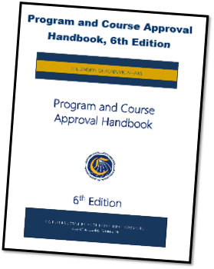
PROGRAM AND COURSE APPROVAL HANDBOOK (PCAH) 6th EDITION
•Part III…Noncredit Curriculum

Slide 7
Laws and Regulations: Student Contact Hours
§ 58006. Application of Actual Student Contact Hours of Attendance Procedure
For noncredit, the actual student contact hours of attendance procedure is based upon a count of students present at each course meeting
Applies to
All open entry/open exit courses
All noncredit courses otherwise eligible for state aid (some exceptions)
Students actively enrolled in apprenticeship courses of related and supplemental instruction
§ 58007 Addresses Noncredit attendance accounting
2018 ASCCC Career and Noncredit Education Leadership Institute Westin South Coast Plaza

Slide 8
Laws and Regulations: Distance Education
Noncredit can be taught online
Course Outline of Record must indicate instructional hours, out-of-class hours, and instructor contact hours
Must calculate “WSCH factor “ which includes class instruction, out-of-class time, and instructor contact (as defined by Title 5 Section 55376(b) and found in Attendance Manual p. 3.13)
Calculate 1/5 and 3/5 points of attendance hours using WSCH factor and taking an average
FTES may be less than using traditional formula for calculating FTES
2018 ASCCC Career and Noncredit Education Leadership Institute Westin South Coast Plaza

Slide 9
Laws and Regulations: Minimum Qualifications
“Basic MQs” for credit instructors, counselors, and librarians are the minimum degree and experience requirements specified in Title 5 §53410.
Discipline-specific MQs in the Disciplines List
Define the fields of study or professional experience to required to fit within a discipline.
Must conform to the degree and experience requirements of §53410.
2018 ASCCC Career and Noncredit Education Leadership Institute Westin South Coast Plaza

Slide 10
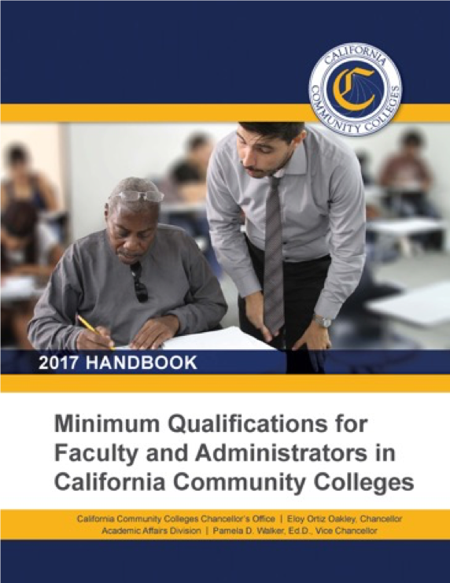
Laws and Regulations: Minimum Qualifications
“Specialized” Minimum Qualifications
Established in Title 5 regulations separately from the Disciplines List
Noncredit included in title 5 and the Minimum Qualifications for Faculty and Administrators in California Community Colleges Handbook(2017)
2018 ASCCC Career and Noncredit Education Leadership Institute Westin South Coast Plaza

Slide 11
Laws and Regulations: Equivalency
Governing boards may grant faculty equivalency to the minimum qualifications.
Every district must have an equivalency process, with process, criteria, and standards by which the governing board determines that faculty possess qualifications at least equal to the minimum qualifications (Ed Code §87359).
“The process, as well as criteria and standards…shall be developed and agreed upon jointly by …the [local] governing board and the [local] academic senate” and “that the governing board relies primarily upon the advice and judgment of the academic senate” (Ed Code §87359/Title 5 §53430).
2018 ASCCC Career and Noncredit Education Leadership Institute Westin South Coast Plaza

Slide 12
Laws and Regulations: Funding
84750.5(d) (d) The board of governors shall develop the criteria and standards within the following statewide minimum requirements: (1) The calculations of each community college district’s revenue level for each fiscal year (2) community college districts to receive an annual allocation based on the number of colleges and comprehensive centers in the community college district…credit instruction funded at $4,367 per FTES (3) Noncredit instruction funded at $2,626 per FTES
2018 ASCCC Career and Noncredit Education Leadership Institute Westin South Coast Plaza

Slide 13
Laws and Regulations: Funding
84750.5(d) (continued) (4) CDCP (career development and college preparation), as authorized pursuant to Section 84760.5, shall be provided as follows: FY 2006–07, funded at $3,092 per FTES FY 2015-16, funded at same level as credit (currently $4724 per FTES)
2018 ASCCC Career and Noncredit Education Leadership Institute Westin South Coast Plaza

Slide 14
Noncredit Courses: Standards and Criteria (55002(c)
A noncredit course is a course which, at a minimum is
Recommended by the college and/or district curriculum committee
Approved by the district governing board as a course meeting the needs of enrolled students
Noncredit Restrictions
CORs for courses intended for special populations must clearly demonstrate that the course meets the needs of those populations (Immigrant Education, Parenting, Persons with Substantial Disabilities, Older Adults)
2018 ASCCC Career and Noncredit Education Leadership Institute Westin South Coast Plaza

Slide 15
Noncredit Courses: Standards and Criteria 55002(c)
Apportionment by positive attendance, not census
Title 5 § 58130 “No state aid or apportionment may be claimed on account of attendance of students in noncredit classes in dancing or recreational physical education”
2018 ASCCC Career and Noncredit Education Leadership Institute Westin South Coast Plaza

Slide 16
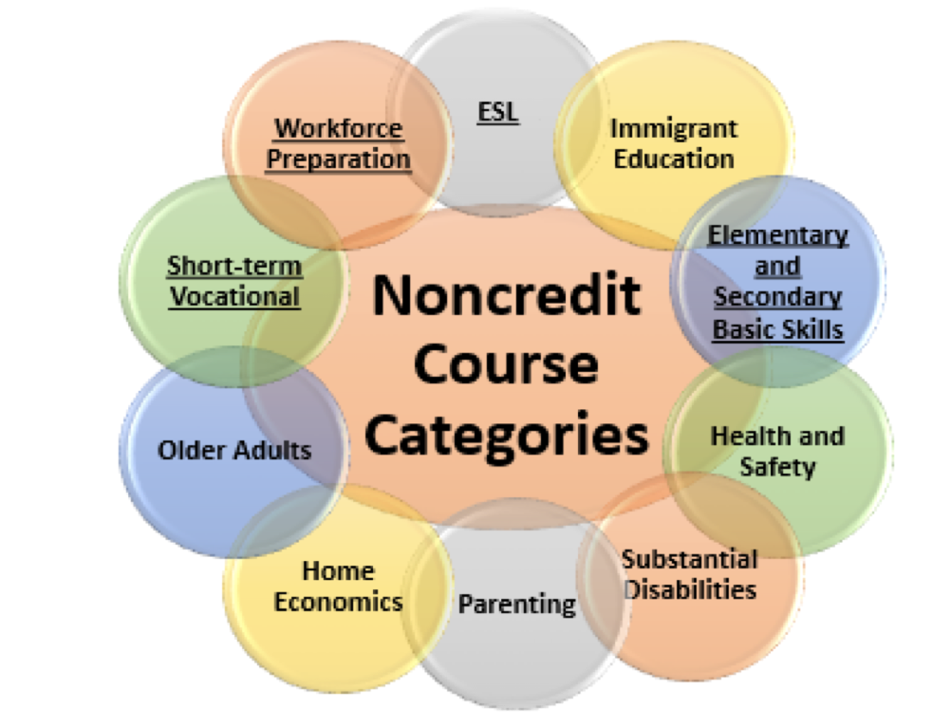
Noncredit Courses: Ten Categories
English as a Second Language (ESL)*
Immigrant Education
Elementary and Secondary Basic Skills*
Health and Safety
Substantial Disabilities
Parenting
Home Economics
Courses for Older Adults
Short-term Vocational*
Workforce Preparation*
*Areas (1), (3), (9), (10) are eligible for Enhanced Funding if associated with an approved noncredit program.
2018 ASCCC Career and Noncredit Education Leadership Institute Westin South Coast Plaza

Slide 17
Tale of the Tape: Side by Side Comparison
Credit and CTE
Generate apportionment; student fees apply
Fees
Unit granting
Degree applicable and non-degree applicable (basic skills)
Certificates of Achievement
Not designated as repeatable (except in limited circumstances)
Auto-approval and chaptering at the CCCCO
Noncredit
Generate apportionment—two levels (noncredit and enhanced noncredit)
No student fees
No units (positive attendance taken)
Certificates of Competency & Completion
Designated as repeatable
Requires CCCCO approval
2018 ASCCC Career and Noncredit Education Leadership Institute Westin South Coast Plaza

Slide 18
Elements of the Course Outline of Record
Credit Noncredit
Course number and title
Unit value
Total student learning hours (In & out of class)
Prerequisites, corequisites, advisories on recommended preparation (if any)
Catalog description
Objectives
Content - specific body of knowledge
Types or examples of assignments
Instructional methodology
Methods of evaluation
Course number and title
Minimum/Maximum Contact Hours
Advisories on recommended preparation (if any)
Catalog description
Objectives
Content - specific body of knowledge
Types or examples of assignments
Instructional methodology
Methods of evaluation
2018 ASCCC Career and Noncredit Education Leadership Institute Westin South Coast Plaza

Slide 19
CDCP Funding
EC 84750.5 (d)
Established uniform funding rate for noncredit courses and an enhanced rate for CDCP
FY 2014-15, the California State Legislature approved the enhanced CDCP noncredit rate to be equivalent to the credit FTES funding rate, effective July 1, 2015
2015-16 budget included $49 million to fund the rate increase
2018 ASCCC Career and Noncredit Education Leadership Institute Westin South Coast Plaza

Slide 20
CDCP Funding
 | 2006-07 | 2016-17 | 2017-18
Basic (Regular) Noncredit | $2626 | $2840 | $3050
Enhanced Noncredit (CDCP) | $3254 | $4724 | $5072
Credit | $4367 | $4724 | $5072
2018 ASCCC Career and Noncredit Education Leadership Institute Westin South Coast Plaza

Slide 21
Prerequisites and Corequisites
Noncredit typically does not place requisites on other noncredit courses
Courses may be listed as “advisory” or “recommended preparation”
Much discussion around noncredit as prerequisite or corequisite with credit due to AB 705 and Guided Pathways
2018 ASCCC Career and Noncredit Education Leadership Institute Westin South Coast Plaza

Slide 22
Mirrored Classes
Mirrored – Dual Listed – Cross Listed
NOT Dual Enrollment
Credit courses that have exact same noncredit version
Same course outlines
Same faculty, time, syllabi
Listed in Schedule of Courses
Usually CTE, some ESL
2018 ASCCC Career and Noncredit Education Leadership Institute Westin South Coast Plaza

Slide 23
Mirrored Classes
Noncredit version of course is created
Curriculum approval process is the same
CRN created by CCCCO
Number of noncredit seats held at registration
Noncredit student registers for noncredit course
Students attend class first day
Students attend, do the work and all assignments
Can receive a grade of Pass/No Pass
No cost to the student
2018 ASCCC Career and Noncredit Education Leadership Institute Westin South Coast Plaza

Slide 24
Noncredit Programs
Title 5 § 55155
Any noncredit educational program leading to a certificate must be approved by College curriculum committee and District governing board
(b) All noncredit educational programs leading to a noncredit certificate of completion or Noncredit certificate of competency must be approved by the Chancellor pursuant to section title 5, section 55151 – Career Development and College Preparation
2018 ASCCC Career and Noncredit Education Leadership Institute Westin South Coast Plaza

Slide 25
Noncredit Programs
§ 55151. Career Development and College Preparation, subsection (h) (h) For purposes of this article, the term “certificate of completion” means a document confirming that a student has completed a noncredit educational program of noncredit courses that prepares him or her to progress in a career path or to undertake degree-applicable or non-degree-applicable credit courses. The document must include the name of the certificate and the date awarded, be identified by a Taxonomy of Programs (T.O.P.) Code number and program discipline, identify the goal of the program, and list the courses completed by the student. Ex): Short-term Vocational or Workforce Preparation programs
2018 ASCCC Career and Noncredit Education Leadership Institute Westin South Coast Plaza

Slide 26
Noncredit Programs
§ 55151. Career Development and College Preparation, subsection (i) (i) For purposes of this article, the term “certificate of competency” means a document confirming that a student enrolled in a noncredit educational program of noncredit courses has demonstrated achievement of a set of competencies that prepares him or her to progress in a career path or to undertake degree-applicable or nondegree-applicable credit courses. The document must include the name of the certificate and the date awarded, be identified by a T.O.P. Code number and program discipline, and list the relevant competencies achieved by the student. Ex): ESL or Basic Skills certificate programs
2018 ASCCC Career and Noncredit Education Leadership Institute Westin South Coast Plaza

Slide 27
Noncredit Curriculum Approval Processes
Currently, all noncredit curriculum is approved by the CCCCO
Courses must be approved prior to programs
System partners are recommending Title 5 language change to allow for local approval of noncredit
2018 ASCCC Career and Noncredit Education Leadership Institute Westin South Coast Plaza

Slide 28
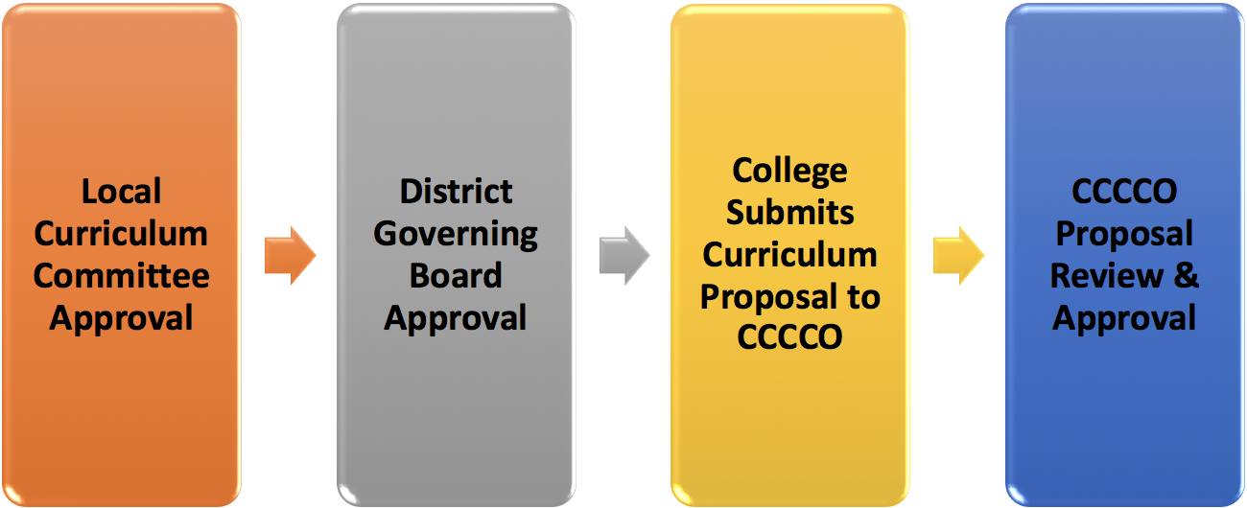
Curriculum Review and Timelines
2018 ASCCC Career and Noncredit Education Leadership Institute Westin South Coast Plaza

Slide 29
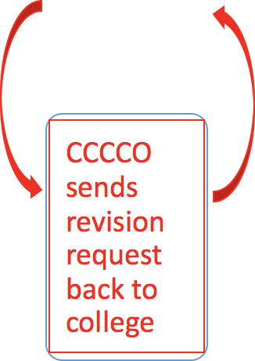
Curriculum Review and Timelines
2018 ASCCC Career and Noncredit Education Leadership Institute Westin South Coast Plaza

Slide 30
What’s New in Legislation
*AB 3101 (Carrillo) CCCApply This bill would require the board, on or before July 31, 2019, to revise the CCCApply application and enrollment process so that only data that is required by the federal government, or that is otherwise necessary, as determined by the board, is collected during the process. The bill would require the board, to the extent that data can be collected from the student at a later time, to delay the collection of that data until after the student is enrolled.
2018 ASCCC Career and Noncredit Education Leadership Institute Westin South Coast Plaza

Slide 31
What’s New in Legislation: CCCApply
•Board of Governors of the CA Community Colleges proposed revisions to Title 5 Regulations: second reading in May
•§ 58003.3. Alien Students. Apportionment for Noncredit Courses.
•Notwithstanding section 68062 of the Education Code, for the purposes of crediting community college attendance for apportionments from the State School Fund, a community college district may claim the attendance of students living in California who have been lawfully admitted to the United States in accordance with all applicable laws of the United States and enrolled in noncredit courses in the district.

Slide 32
Governor’s Proposed Funding Formula
Funding Formula, as originally written, does not address noncredit.
50% apportionment based on FTES
25% for low income students based on number of fee waivers and Pell grants awarded
25% for performance based on degree/certificate completion or transfer
Need to wait for Governor’s May Revise
2018 ASCCC Career and Noncredit Education Leadership Institute Westin South Coast Plaza
Notes:
Medina Bill slow down the process

Slide 33
What’s New in Legislation
*AB 2767 (Medina) Funding Formula Study This bill would require the Legislative Analyst’s Office to conduct a study of the funding formula used to allocate state apportionments by the California Community Colleges for the 2017–18 fiscal year. The bill would require the Legislative Analyst’s Office to submit a report to the Legislature, on or before July 1, 2019, containing its findings from the study and providing recommendations as to various funding formula models the Legislature may wish to adopt for use by the California Community Colleges.
2018 ASCCC Career and Noncredit Education Leadership Institute Westin South Coast Plaza

Slide 34
What’s New in Legislation
Governor has proposed a new fully online college $120 million
Targets 2.5 million adults who have a high school diploma but want more education, specifically Latinos.
Working adults who can’t take time off work to attend school
Colleges question need for separate college instead of using funds to support existing DE programs at colleges.
Target audience is the same for noncredit short-term vocational certificates except DE formula for noncredit courses not fiscally viable
2018 ASCCC Career and Noncredit Education Leadership Institute Westin South Coast Plaza

Slide 35
What’s New in Legislation
*AB 2621 (Medina) Exclusively Online College Feasibility This bill would require the Legislative Analyst’s Office to conduct a study on the feasibility of creating an exclusively online community college and to report its findings to the Legislature on or before July 1, 2019.
2018 ASCCC Career and Noncredit Education Leadership Institute Westin South Coast Plaza

Slide 36
What’s New in Legislation
*AB 1935 (Irwin) Community Colleges: Tutoring. Existing law identifies nine allowable areas for noncredit instruction. AB 1935 adds supervised tutoring for basic skills and for degree-applicable and transfer-level courses as a noncredit category. Noncredit supervised tutoring would be eligible for state apportionment funding. This bill may be merged with SB 1009 (Wilk), which is similar.
2018 ASCCC Career and Noncredit Education Leadership Institute Westin South Coast Plaza

Slide 37
Resources
ASCCC Website - http://asccc.org
Contact the ASCCC – info@asccc.org
Application for Statewide Service - http://asccc.org/content/application-statewide-service
ASCCC Publications - http://asccc.org/publications
ASCCC Events - http://asccc.org/calendar/list/events
ASCCC Services - http://asccc.org/services#
Disciplines List and MQs - http://asccc.org/disciplines-list
2018 ASCCC Career and Noncredit Education Leadership Institute Westin South Coast Plaza

