Slide 1
Curriculum and Emotions – Solving Problems and Managing Conflict
Julie Bruno, Sierra College
April Pavlik, Los Angeles City College

Slide 2
Overview
Temperature Check
Sources of Conflict
Conflict Styles
Considerations
Good Practices
Scenarios

Slide 3
Temperature Check

Slide 4
Conflict Management Typical Sources of Conflict in Curriculum
Conflict between faculty
Conflict between faculty and administration
Conflict between faculty and curriculum specialists
Conflict between Curriculum Chair and committee
Conflict between Curriculum Committee and Senate
What else?

Slide 5
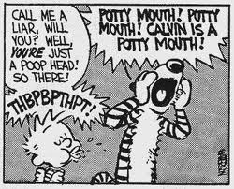
Curriculum Committee and Conflict

Slide 6
Conflict and Emotions
Emotions inherent in decision-making.
Emotions can act as “triggers” to conflict.
Some are able to identify emotions and respond, others react.
Messages to others include both content and relational aspects.
Adaptation is key.

Slide 7
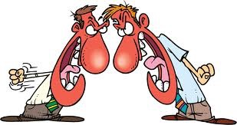
Conflict Management Styles
Avoidance
Accommodation
Competition
Compromise
Collaboration
Constructive or Destructive?

Slide 8
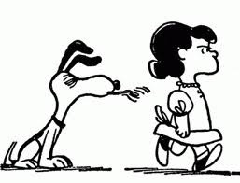
Decide how to manage conflict

Slide 9
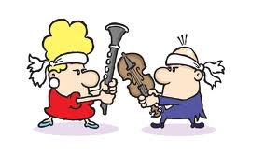
Considerations
What is at issue?
What are the interests?
Who should be involved?
Who should be consulted?
Are there emotions connected to the situation?
What policies, procedures, or processes may affect the issues, interests, problems, or solutions?
What is the conflict culture?

Slide 10
Acknowledge the Different Types of Conflict and Respond Appropriately
Process Conflicts
Ask yourself, “How much control do I have over this process conflict?”
Identify the root cause of the problem and analyze the improvement opportunity
Talk first to the owner of the process.
Describe the current problem and get agreement.
Suggest a workable solution and action plan.
Follow-through on the plan and give recognition to the owner of the process.

Slide 11
Acknowledge the Different Types of Conflict and Respond Appropriately
Role conflict
Ask yourself, “Exactly how do I perceive my role in relation to others involved in this issue?”
Take responsibility for clarifying your role with others involved.
Be prepared to change your perception of your role.
Show your willingness to be flexible in achieving your organization’s goals.
Stay positive. View any role change in terms of the opportunities it presents.

Slide 12
Acknowledge the Different Types of Conflict and Respond Appropriately
Interpersonal Conflict
Reflect on personal biases and prejudices in relation to the conflict
Write down three behaviors that you could change in order to reduce the conflict in this relationship. Commit to following through on these changes for at least three months.
Ask the other person involved how you could defuse the existing conflict. Encourage feedback that might seem brutally honest.
Put yourself in their position. How do you think they view your commitment to reducing conflict in your relationship? Why?
Make a list of 5 strengths that you see in the other person. Then list five ways that improving this relationship would benefit you.

Slide 13
Good Practices to Avert, Manage, or Resolve Conflict
Take nothing personally
Listen, Listen, Listen
Presume good intent
Anticipate interests and personalities
Recognize and address both content and emotion
Adapt and model effective conflict management

Slide 14
Good Practices to Avert, Manage, or Resolve Conflict
Be informed: get as much information as possible before discussing.
Provide Context for discussion.
Define terms and conditions.
Keep the interests of the students and college overall in the forefront of your mind
Guide all participants to do the same.
Share college policy or state regulations that apply to the situation.

Slide 15
Good Practices to Avert, Manage, or Resolve Conflict
Make sure everyone has the opportunity to participate.
Find Agreement where you can.
Take breaks.
Robert’s Rules of Order can help to keep the discussion professional.
Fall on your sword, if necessary.
Resist the urge to pursue or claim personal victories over others.
Notes:
Do not be afraid to claim responsibility for a problem in order to calm a situation, even if it is not really your fault.
Such victories are likely to haunt you later.

Slide 16
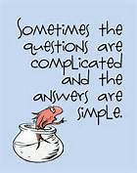

Slide 17
Scenario #1
Your Student Learning Outcomes Committee is a sub- committee of your Curriculum Committee, which in turn reports to the academic senate. The faculty chair of the SLO Committee is resisting requests from the curriculum chair to make more complete reports to the Curriculum Committee and to bring decisions to the Curriculum Committee for ratification. The SLO chair claims that her committee has developed expertise in the area of SLOs beyond that held by the average Curriculum Committee member and that this expertise should be respected by allowing the SLO committee to work without having its decisions questioned. Everyone is frustrated with the situation. How can it be resolved?

Slide 18
Scenario #2
Welcome to the end of the Spring Semester when faculty become increasing concerned about the status of the approval of new courses. As a part of the curriculum process a notification for a new course is sent to the Curriculum Committee members and posted for faculty at large. The proposed new course is an Anthropology course, with an ethnographic component. The student, in the beginning of the semester, is taught the basics of how to use a camera. The Photography department when reviewing the course outline has concerns that this course is teaching photography, and the instructor does not meet minimum qualifications as they teach anthropology. Not only is this concern voiced to the curriculum chair, but also brought as a challenge to the Curriculum committee meeting where the course is reviewed by faculty. Additionally, the concern is brought to the Senate Meeting where the course is approved and forwarded to our board. Everyone is frustrated with the situation. How can it be resolved?

Slide 19
Questions? Comments?
Thank you!

