Slide 1
Curriculum Design and Delivery through an Equity Lens Dr. Wendy Koenig, Associate Professor of Art History & Curriculum Committee Chair, Long Beach City College Dr. Jennifer Taylor-Mendoza, VP of Instruction, Skyline CC Dr. Don Miller, VP of Instruction, College of Alameda

Slide 2
Organizational Inertia
Inertia is a natural barrier to implementing strategic and high impact organizational change because it does not allow for new perspectives to penetrate the structure (Godkin and Allcorn, 2008).

Slide 3
Noble Purpose
•Reconstruction of the Community College
•Institutions must see themselves as “cultural texts”
•Epistemological Disruption
•Rethink and evaluate curriculum to take into account how institutional knowledge is constructed as individuals engage with and within the organization

Slide 4
T3 Framework
A Traditional approach reflects the current approach...which is yielding us the equity gaps...Transitional practice includes modest modifications to the traditional lens...However, a Transformative consciousness and practice addresses the historical and sociopolitical causes of inequities...and encourages educators to engage in data-informed efforts to repair and restore our educational systems.
-Skyline College’s Student Equity Plan, Equity Institute, 2019

Slide 5
Equity in an Online Teaching Environment
Genuine Care: Create an environment that values all students
Equity: Address access to technology, hardware, and software
Flexibility: Establish a balance between asynchronous and synchronous engagement, including course materials and online tools

Slide 6
Peralta Online Equity Rubric
https://web.peralta.edu/de/files/2019/05/Peralta-Online-Equity-Rubric-2.0-May-2019.pdf
https://web.peralta.edu/de/files/2019/08/Describing-the-Peralta-Equity-Rubric-Aug-2019.pdf
https://web.peralta.edu/de/files/2019/08/Peralta-Equity-Rubric-Research-for-Criteria-Aug-2019.pdf

Slide 7
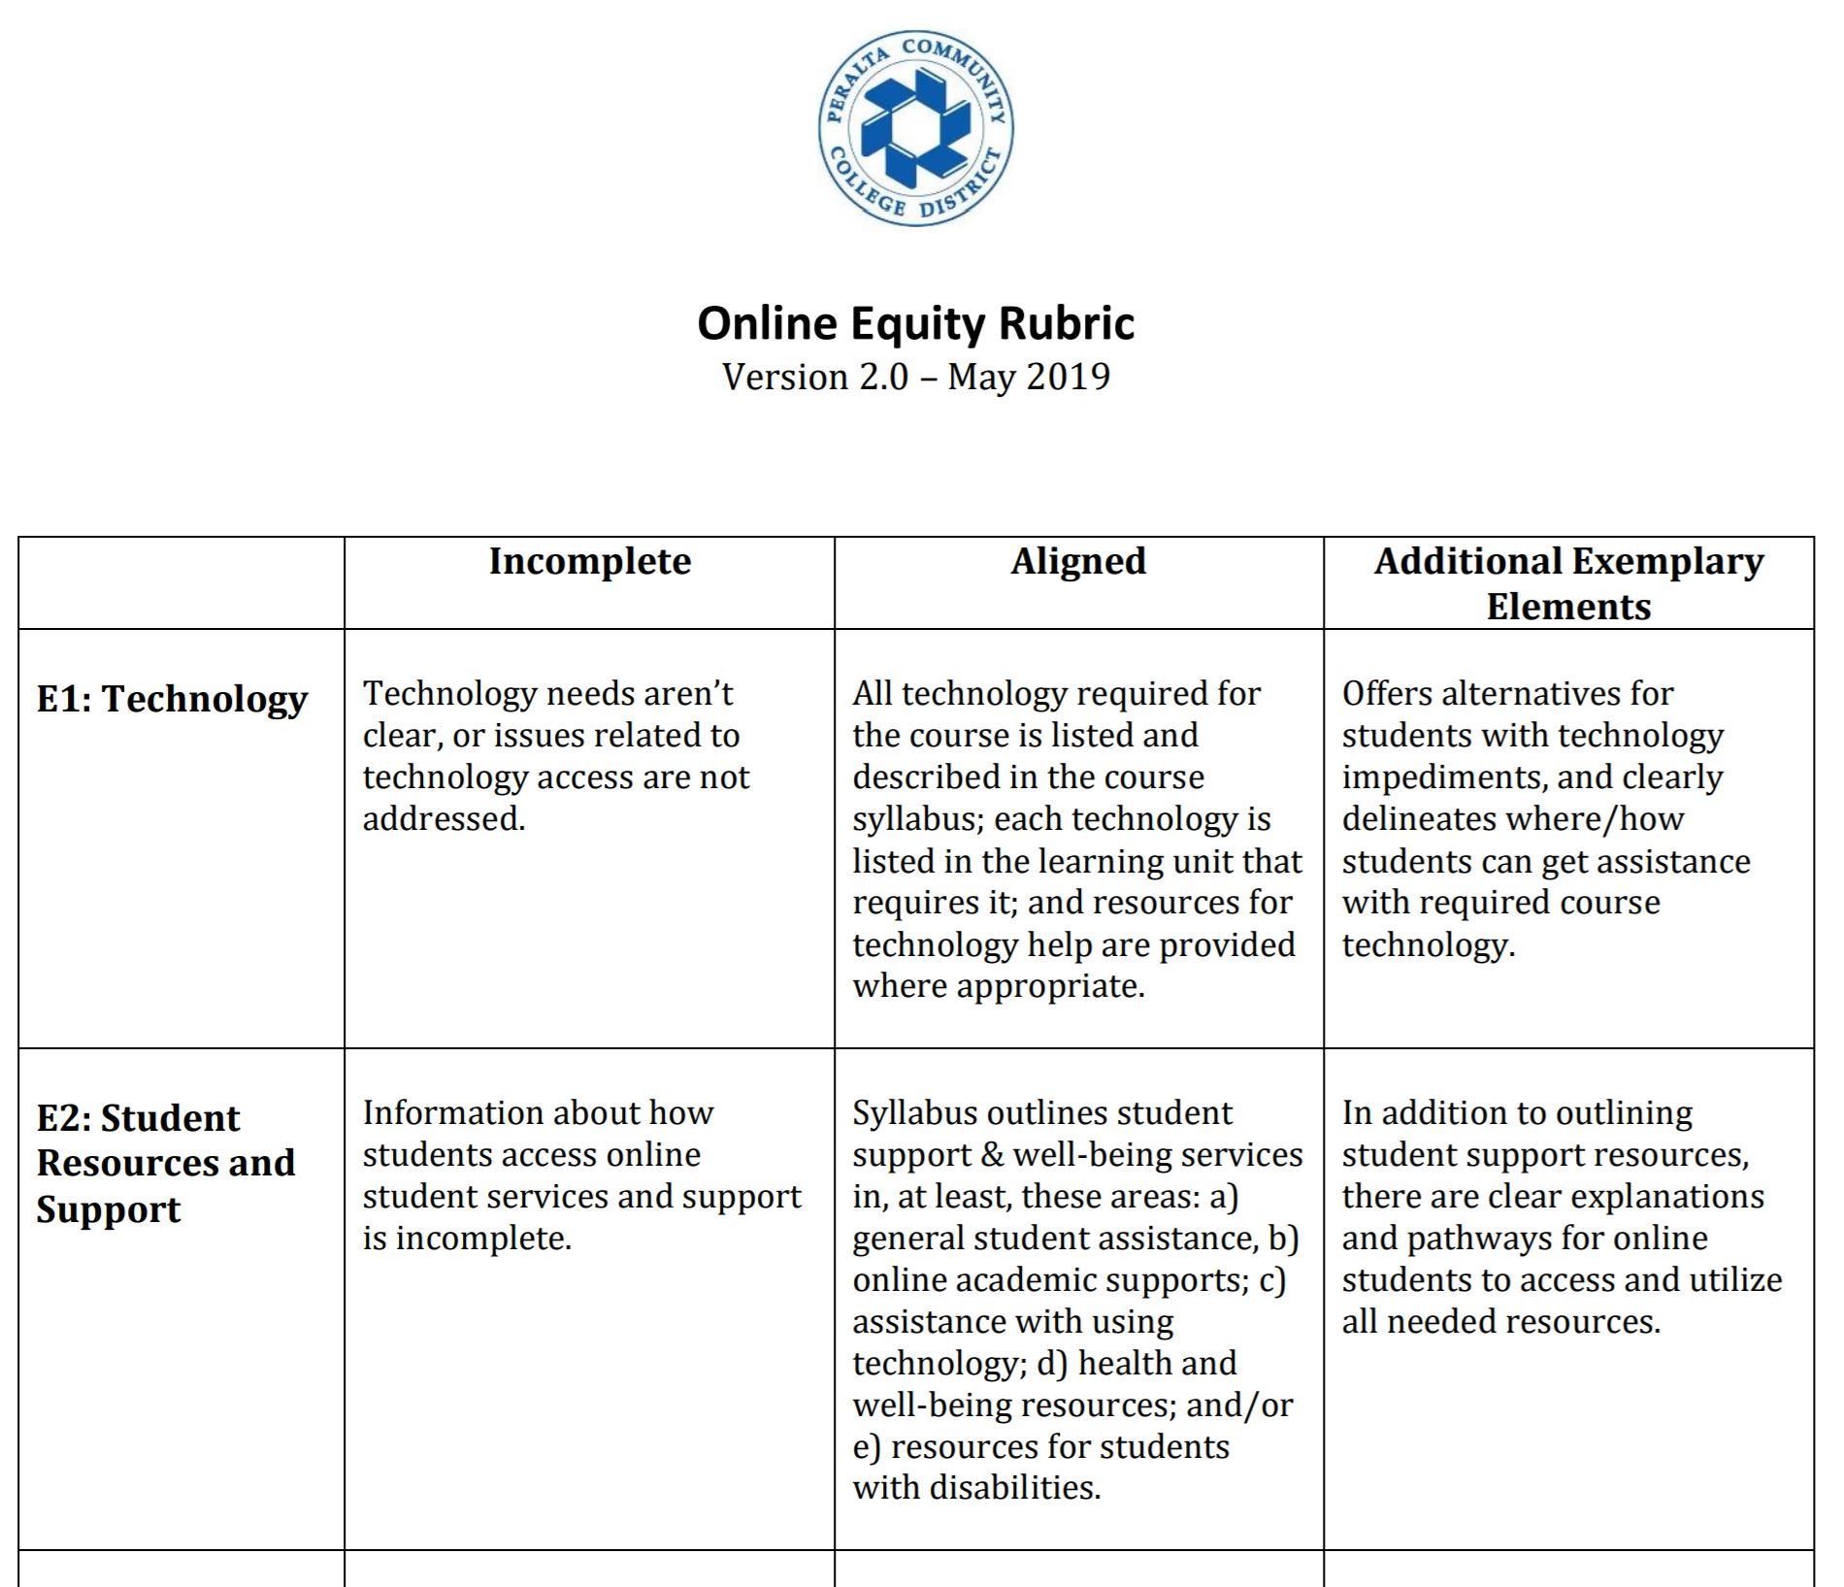
Online Equity Rubric
The overall goal of the Peralta CTE Online Equity Initiative is to improve educational equity and outcomes for online CTE students, both at Peralta and at other California community colleges (CCCs).
The rubric is grounded in recent research on equity strategies for college student engagement and lists eight criteria for instructors to use in designing or evaluating an online course.
These criteria were designed to be used in conjunction with, and not separate from, the CVC-OEI Course Design Rubric.
3-minute video about Online Equity Rubric

Slide 8
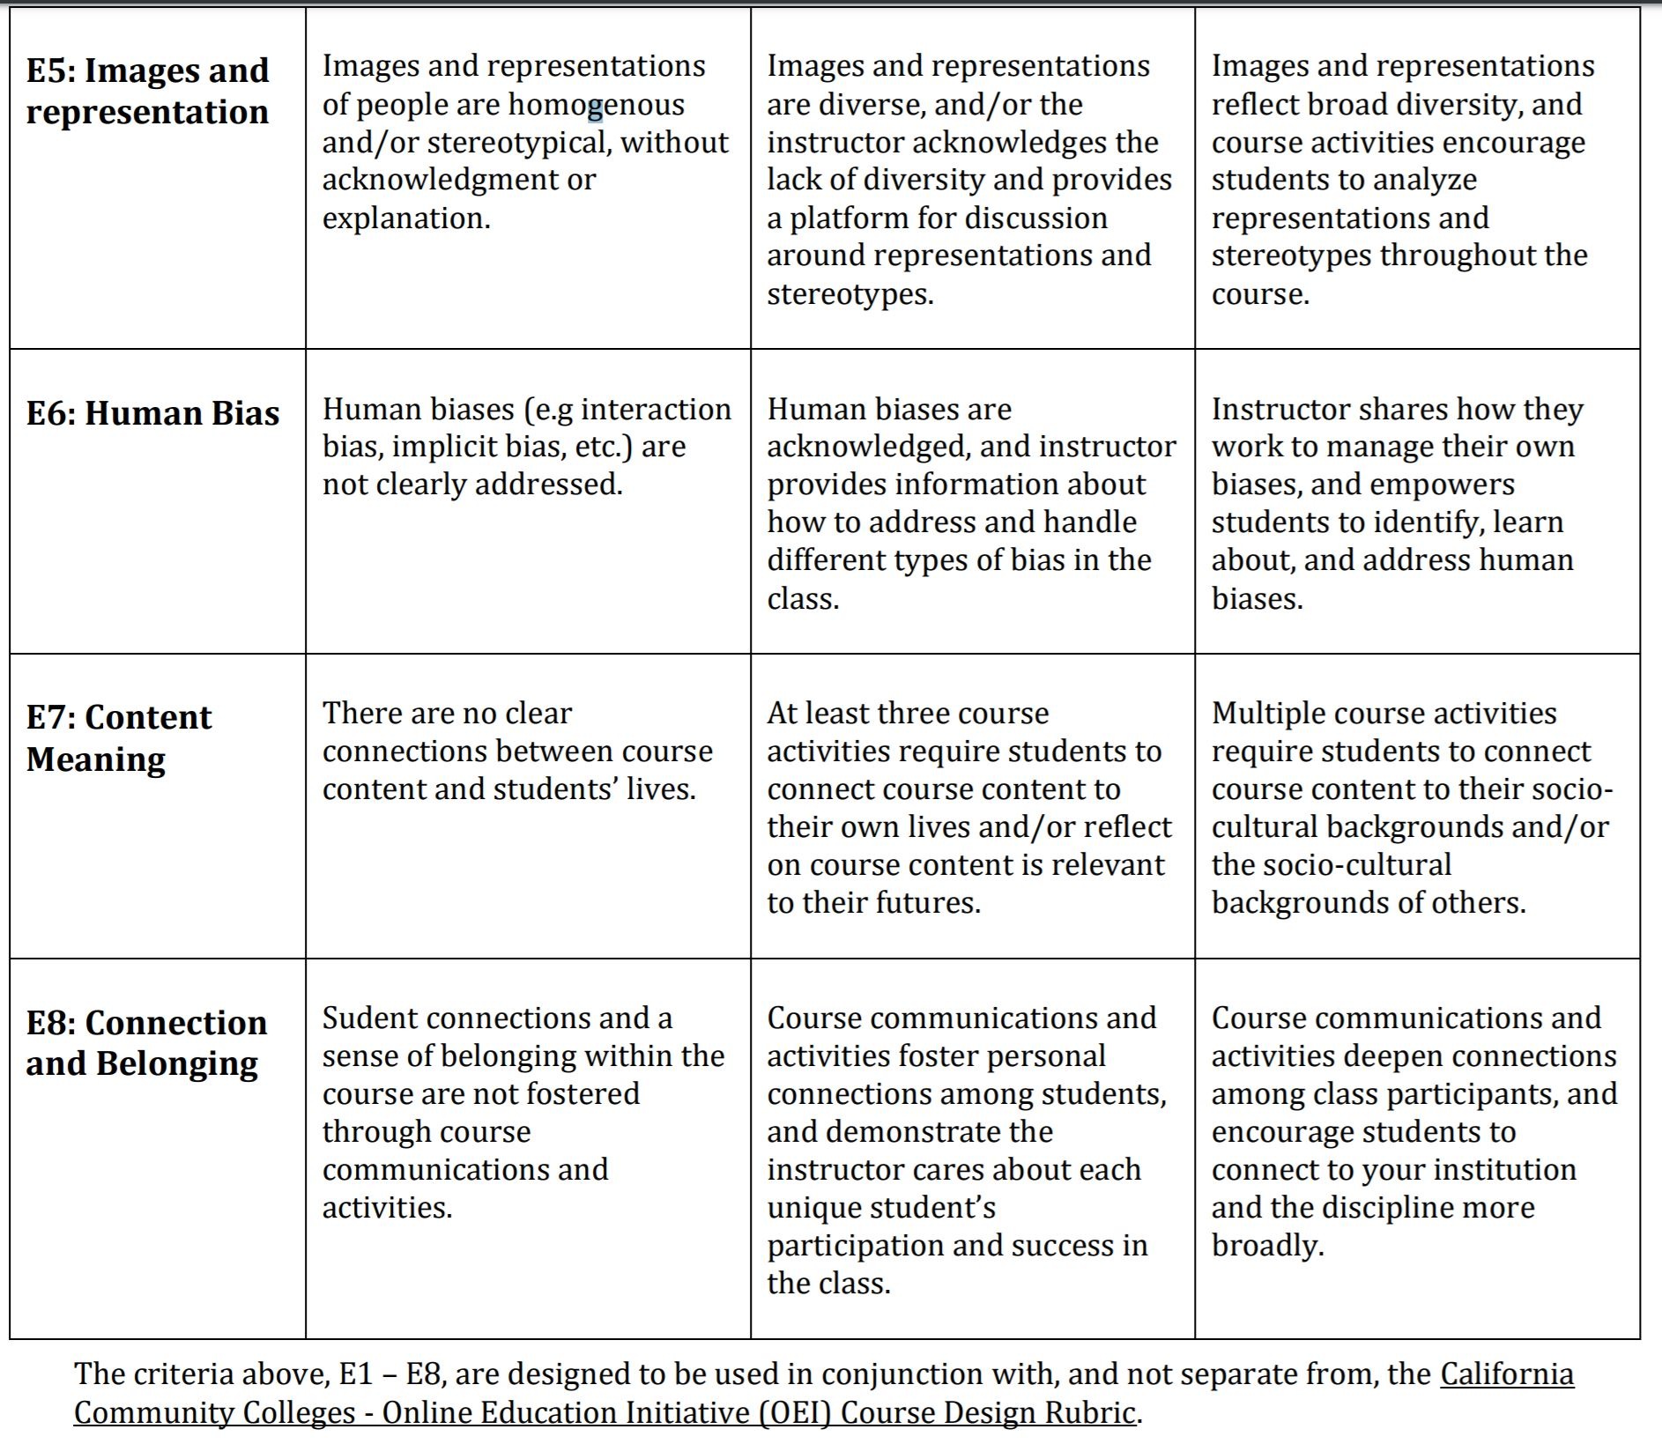
Online Equity Rubric

Slide 9
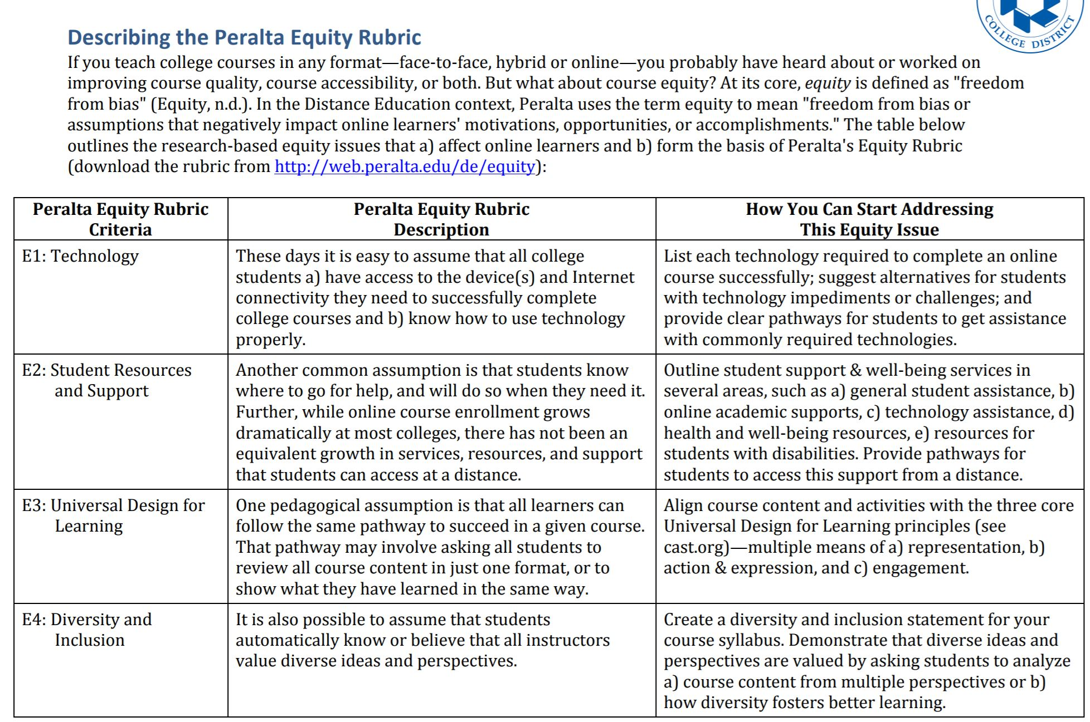
Describing the Online Equity Rubric

Slide 10
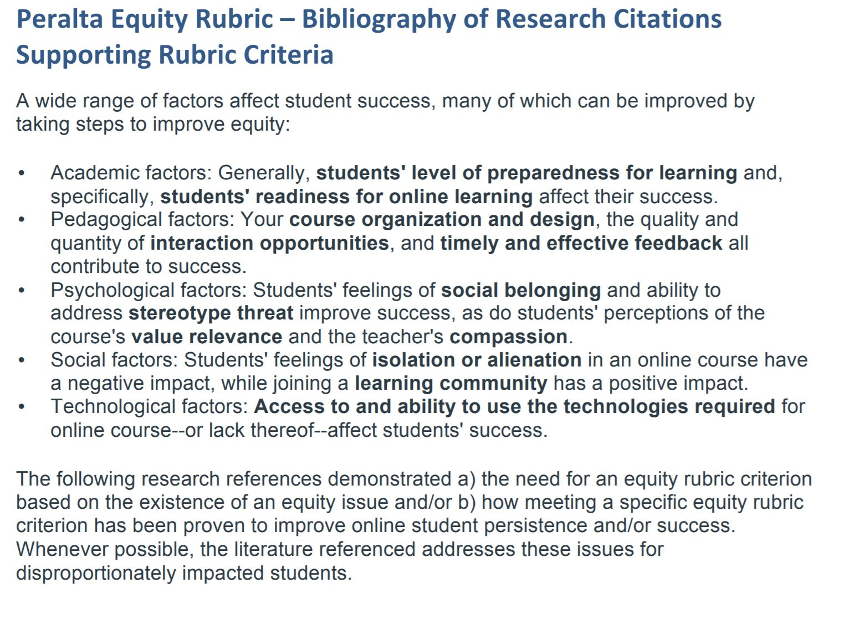
Online Equity Research

Slide 11
PCCD Online Equity Training Course
Totally online
5-week long
Helps you align your course(s) with OER
Based on theories, analysis and practice
The coursework should take roughly 5-7 hours per week, and you will have two assignments to complete with two different weekly deadlines.
In order to pass the course, you will need to receive an 80% or better on each of the assignments.
Week 1: Getting Started & Discussing Equity and Our Courses
Week 2: E1 and E2: Focus on Technology and Student Resources & Support
Week 3: E3 and E4: Focus on Universal Design and Diversity & Inclusion
Week 4: E5 and E6: Focus on Images & Representation and Human Bias
Week 5: E7 and E8: Focus on Content Meaning and Connection & Belonging

Slide 12
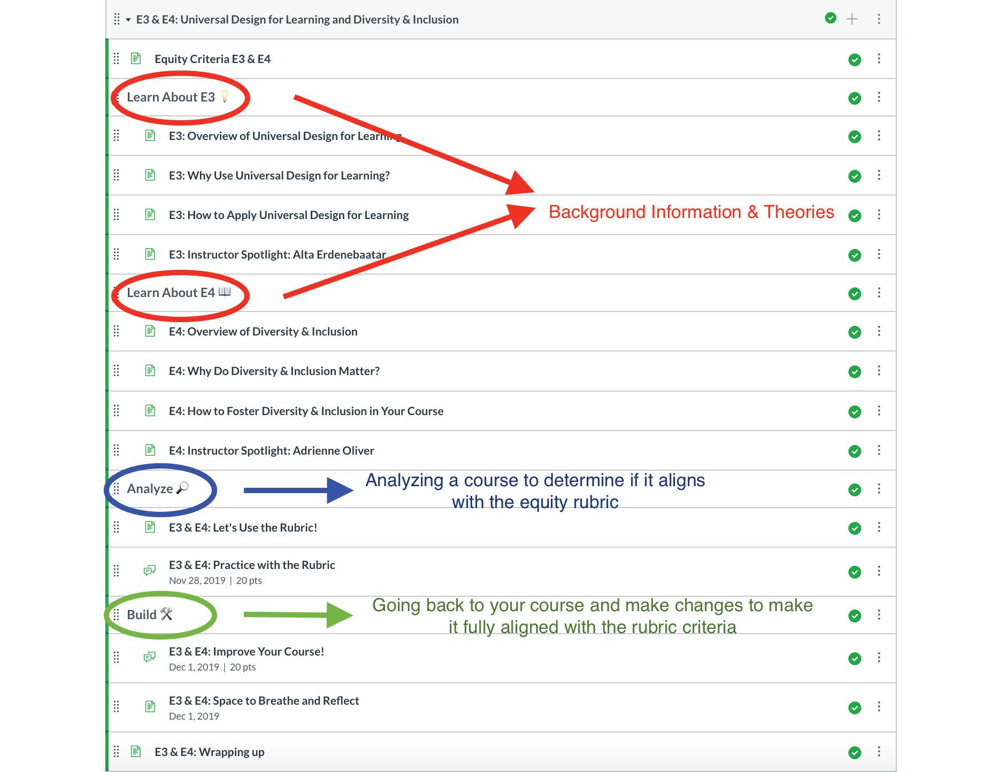
Online Equity Training Course

Slide 13
Curriculum Design through an Equity Lens
Conducting a cultural curriculum audit:
An example from Long Beach City College
“The Cultural Curriculum Audit will engage a small cohort of faculty in a collaborative evaluation and redesign of their courses. Each faculty participant will choose one course that they wish to enhance or re-design. Sessions will provide training in reviewing and possibly revising the COR (Course Outline of Record), syllabi, assignments, grading and teaching practices and outcomes. The focus will be on developing culturally responsive, engaging and relevant materials, high impact teaching practices, and developing equity-mindedness in the spirit of Guided Pathways.”
This event was held in summer 2019 and winter 2020 and a version focusing upon online instruction will be held in July-August 2020.

Slide 14
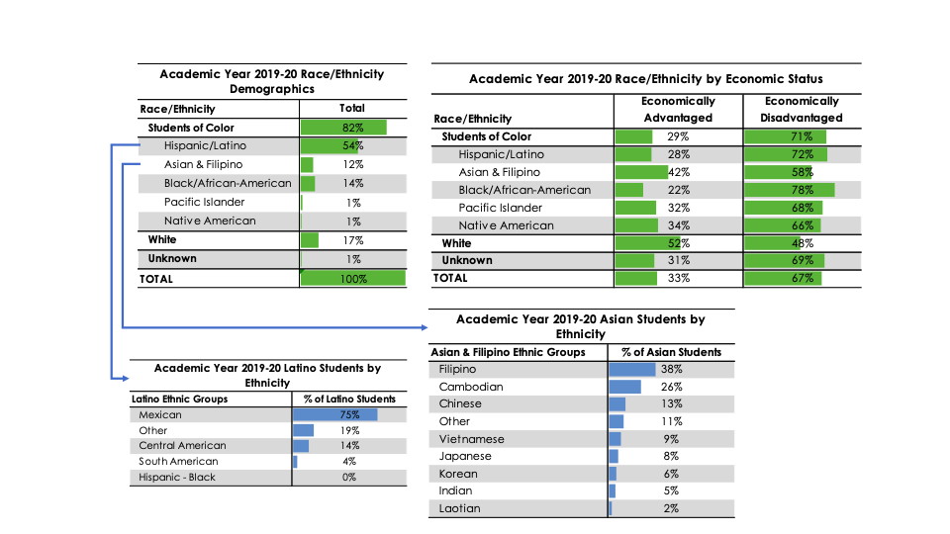
THEORY IN PRACTICE: Starting with demographic information about the student population at Long Beach City College

Slide 15
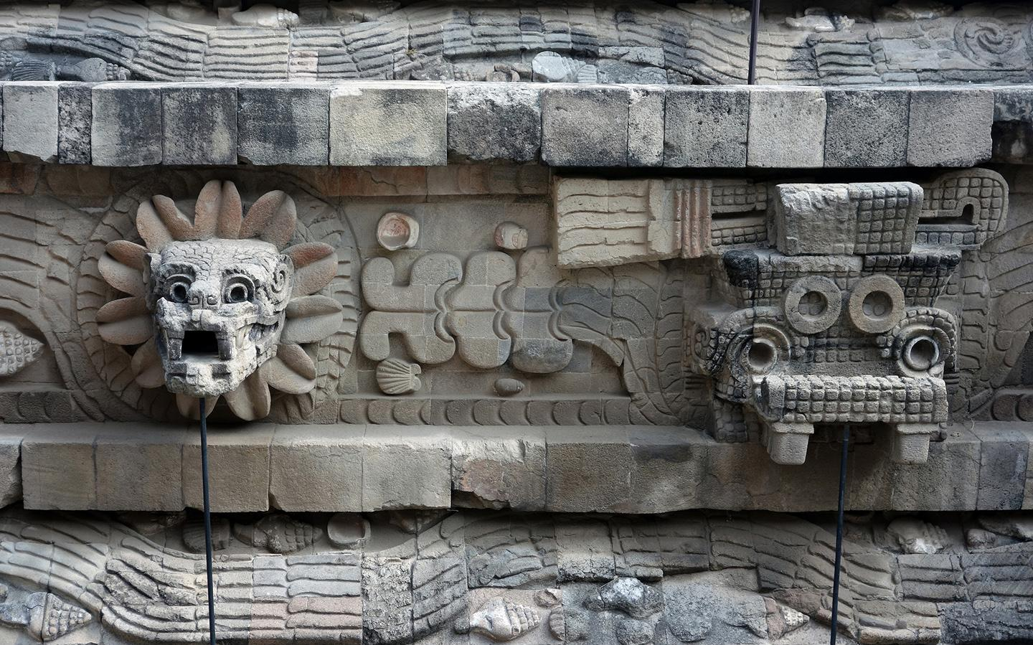
ART 11: PreColumbian Art
Long Beach City College
AN EXAMPLE OF COURSE OUTLINE REVISION

Slide 16
SIDE BY SIDE COMPARISON OF ART 11 TITLES AND DESCRIPTIONS
PRECOLUMBIAN ART
PRE-COLUMBIAN ART FROM MEXICO, CENTRAL AND SOUTH AMERICA WILL BE EXPLORED THROUGH THE STUDY OF MAJOR MONUMENTS OF SCULPTURE, ARCHITECTURE, CERAMICS, TEXTILES AND PAINTING. THE SLIDE-LECTURE FORMAT WILL BE COMPLEMENTED BY MUSIC, FILMS AND ARTIFACTS. INCLUDES INFLUENCES OF PRE-COLUMBIAN ART ON MODERN AND CONTEMPORARY ARTISTS. FOR MAJORS AND NON-ART MAJORS.
LATIN AMERICAN ART AND ARCHITECTURE
AN INTRODUCTORY HISTORICAL SURVEY OF THE VISUAL ART AND ARCHITECTURE OF MEXICO, CENTRAL AMERICA, SOUTH AMERICA AND PARTS OF THE CARIBBEAN FROM 1500 BCE TO THE LATE 20TH CENTURY. MAJOR ARTWORKS, MONUMENTS AND THEMES WILL BE EXAMINED AND INTERPRETED USING VARIOUS ANALYTICAL AND CONTEXTUAL PERSPECTIVES (FORMAL, FUNCTIONAL, ICONOGRAPHIC, SOCIOLOGICAL, POLITICAL AND RELIGIOUS) IN ORDER TO PROVIDE AN UNDERSTANDING OF THE WORKS IN CULTURAL CONTEXT. THE COURSE IS APPROPRIATE FOR ART AND NON-ART MAJORS.

Slide 17
COURSE OBJECTIVES
1. BE SENSITIVE TO AND AWARE OF THE VARIETY, RICHNESS AND DIVERSITY OF THE CONTRIBUTIONS OF THE MINORITY CULTURES WHICH HAVE BROUGHT A DEPTH OF EXPRESSION TO AMERICAN SOCIETY.
2. BE FAMILIAR WITH AND ACHIEVE GREATER APPRECIATION FOR THE SIGNIFICANT ARTISTIC CONTRIBUTIONS OF CULTURES OUTSIDE THE WESTERN ART TRADITION.
3. BECOME AWARE OF THE IMPORTANCE OF INSIGHTS PROVIDED BY ETHNIC STUDIES FOR ACHIEVING GREATER INTEGRATION AND UNITY AMONG AMERICANS.
4. ACCURATELY DESCRIBE AND ANALYZE A WORK OF ART BY RECOGNIZING BOTH SPECIFIC AND INTUITIVE ELEMENTS OF FORM.
THE MINORITY STUDENT WILL ALSO:
1. FIND WITHIN THE VISUAL FORMS AN AVENUE TOWARDS PERSONAL GROWTH, SELF-REALIZATION AND MATURITY.
2. DEVELOP AN UNDERSTANDING OF PRIDE IN THE ARTISTIC HERITAGE OF HIS OR HER PEOPLE.
1. RECOGNIZE AND DIFFERENTIATE BETWEEN MAJOR STYLES IN MESOAMERICAN ART FROM OLMEC TO AZTEC AND IN ANDEAN ART FROM CHAVIN DE HUANTAR TO THE INCA.
2. EXAMINE AND DISCUSS THE ART AND ARCHITECTURE OF LATIN AMERICA DURING THE COLONIAL ERA, POST-INDEPENDENCE AND IN RELATION TO MAJOR REVOLUTIONS (MEXICO, CUBA, NICARAGUA).
3. IDENTIFY AND DESCRIBE THE ART ELEMENTS AND DESIGN PRINCIPLES IN A WORK OF ART.
4. DISTINGUISH AND CLASSIFY DIFFERENT MEDIA AND TECHNIQUES EMPLOYED IN THE MAKING OF ART.
5. LIST AND DESCRIBE DATES, EVENTS AND MAJOR CHARACTERISTICS OF ART AND ARCHITECTURE ASSOCIATED WITH THE OLMEC, TEOTIHUACAN, MONTE ALBAN, MAYA, AZTECS, CHAVIN, MOCHE AND INCA.
6. DESCRIBE AND INTERPRET THE RELATIONSHIP BETWEEN FORM, CONTENT AND CULTURAL CONTEXT IN THE GENESIS OF AN ARTWORK.
7. EXAMINE THE ROLE OF PATRONAGE IN THE CREATION OF THE ARTWORK.
8. COMPARE AND CONTRAST ART MOVEMENTS ACROSS CULTURES AND TIME PERIODS.
9. ASSESS THE PHILOSOPHICAL MOVEMENTS, RELIGIOUS CONCEPTS, HISTORICAL FIGURES, PLACES AND EVENTS WHICH INFLUENCE WORKS OF ART.
10. ANALYZE THE INFLUENCE OF EARLIER ART ON LATER TRADITIONS.
11. ASSEMBLE AND SYNTHESIZE SOLID EVIDENCE IN SUPPORT OF PERSONAL AND CULTURAL INTERPRETATIONS.
12. ARTICULATE AND EXPLAIN ONE’S OWN IDEAS AND SIGNIFICANT CONCEPTS ABOUT ART AND ITS HISTORY IN WRITTEN ASSIGNMENTS.

Slide 18
CONTENT CHANGES
PREHISTORIC AND PRECLASSIC CULTURES (OLMEC)
CLASSIC CULTURES: TEOTIHUACAN, MONTE ALBAN
POSTCLASSIC: TOLTECS, MIXTECS, AZTECS
MAYA
INTERMEDIATE CULTURES: COSTA RICA, NICARAGUA, PANAMA, COLOMBIA, SOUTH AMERICA
PRE-INCAN CULTURES: CHAVIN, PARACAS, MOCHICA, NAZCA
CITY BUILDERS: CHIMU, CHANCAY VALLEY
INCA
PRE-CLASSIC CULTURES, OLMEC
CLASSIC CULTURES: MONTE ALBAN, WEST MEXICO, TEOTIHUACAN
MAYA
TOLTECS, MIXTECS, AZTECS
ART OF THE ANDES: CHAVIN DE HUANTAR, PARACAS, NAZCA, MOCHE, TEWANAKU, WARI, INCA
COLONIAL PERIOD TO 19TH CENTURY INDEPENDENCE MOVEMENTS
ART AND REVOLUTION IN 20TH CENTURY: MEXICO, CUBA, NICARAGUA
GROUP PRESENTATIONS ON CONTEMPORARY ARTISTS

Slide 19
TEXTBOOK CHANGES
GEORGE KUBLER. ART & ARCHITECTURE OF ANCIENT AMERICA: THE MEXICAN, MAYA AND ANDEAN PEOPLES. (NEW HAVEN: YALE UNIVERSITY PRESS, 1984)
THE ART OF MESOAMERICA, MARY ELLEN MILLER, 5TH EDITION (THAMES & HUDSON, 2012)
ART OF THE ANDES: FROM CHAVIN TO INCA, REBECCA R. STONE, 3RD EDITION (THAMES AND HUDSON, 2012)
CONTEMPORARY ART IN LATIN AMERICA, NIKOS KOTSOPOULOS, ED., (BLACK DOG PUBLISHING, 2010)
LATIN AMERICAN ART OF THE 20TH CENTURY, EDWARD LUCIE SMITH, 2ND EDITION (THAMES AND HUDSON, 2004)

Slide 20
MAKING ASSIGNMENTS CULTURALLY RESPONSIVE
Long Beach City College
ART 1: ART AND CIVILIZATION
(PALEOLITHIC TO GOTHIC ERA)
THIS COURSE EXPLORES THE ARTISTIC HERITAGE OF WESTERN CIVILIZATION FROM PREHISTORY TO THE END OF THE GOTHIC PERIOD THROUGH THE STUDY OF MAJOR MONUMENTS OF PAINTING, SCULPTURE AND ARCHITECTURE. IT EMPHASIZES THE DEVELOPMENT OF ART FORMS AS REFLECTIVE OF THE SOCIAL, POLITICAL, RELIGIOUS, AND AESTHETIC SENSIBILITIES OF THE HISTORICAL PERIODS COVERED.

Slide 21
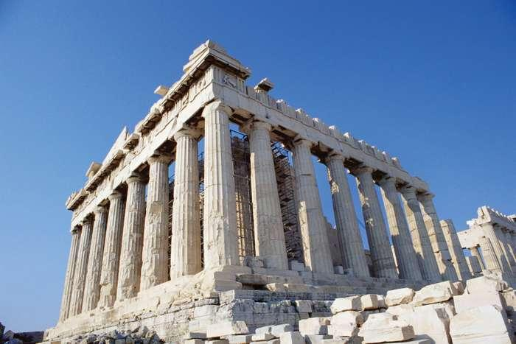
AN EXAMPLE OF AN ASSIGNMENT REVISION
FOR MANY YEARS, ONE OF THE GROUP ASSIGNMENTS IN ART 1 WAS AN IN-CLASS DEBATE ABOUT THE REPATRIATION OF THE PARTHENON (ELGIN) MARBLES.
GREECE HAS REQUESTED THE RETURN OF MARBLE STATUES AND METOPES THAT WERE TAKEN (ARGUABLY LEGALLY) FROM THE ACROPOLIS IN ATHENS IN THE EARLY 19TH CENTURY BY THOMAS BRUCE, LORD ELGIN. GREECE WAS THEN PART OF THE OTTOMAN EMPIRE.
THE MARBLES HAVE BEEN OWNED BY THE BRITISH GOVERNMENT AND HOUSED IN THE BRITISH MUSEUM SINCE 1816.
THE DEBATE WAS A GOOD METHOD TO ENCOURAGE COLLABORATION AND CLASS PARTICIPATION BUT I FEARED THAT THE TOPIC DID NOT HIT HOME FOR MANY STUDENTS.

Slide 22
REPATRIATION
MUSEUMS ARE HOME TO MILLIONS OF ARTWORKS AND CULTURAL ARTIFACTS. THE METROPOLITAN MUSEUM OF ART ALONE HOLDS TWO MILLION OBJECTS. THE HERMITAGE HAS THREE MILLION. THE BRITISH MUSEUM, EIGHT MILLION.
SOME OF THESE OBJECTS HAVE MADE THEIR WAY TO THESE INSTITUTIONS THROUGH UNJUST MEANS. SOME WERE STOLEN OR PLUNDERED, OTHERS ACQUIRED THROUGH COERCED OR EXPLOITATIVE TRANSACTIONS. SHOULD THESE INJUSTICES BE RECTIFIED, AND IF SO, HOW? SOME ARGUE THAT THERE ARE OBJECTS IN MUSEUM COLLECTIONS THAT SHOULD BE REPATRIATED, RETURNED TO THEIR COUNTRY, CULTURE, OR OWNER OF ORIGIN.
ERICH HATALA MATTHES, REPATRIATION AND THE RADICAL REDISTRIBUTION OF ART

Slide 23
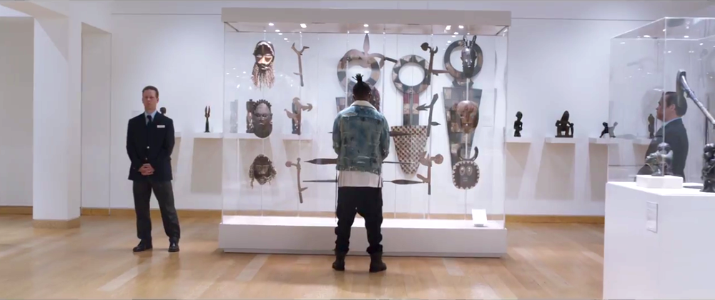
SINCE THERE ARE MANY EXAMPLES OF NATIONS OR PEOPLES REQUESTING THE RETURN OF WORKS OF CULTURAL HERITAGE, WHY NOT OPEN UP THE ASSIGNMENT TO ALLOW STUDENTS TO SELECT THEIR OWN TOPIC?
THEY ARE STILL LEARNING ABOUT THE CONCEPT OF REPATRIATION AND THEY ALSO HAVE THE OPTION TO INVESTIGATE AN EXAMPLE RELATED TO THEIR OWN HERITAGE OR THEIR OWN ARTISTIC INTERESTS.

Slide 24
SAMPLE OF TOPICS CHOSEN BY STUDENTS AS A RESULT OF THE MODIFICATION OF THE REPATRIATION ASSIGNMENT IN ART 1 HONORS FALL 2019

Slide 25
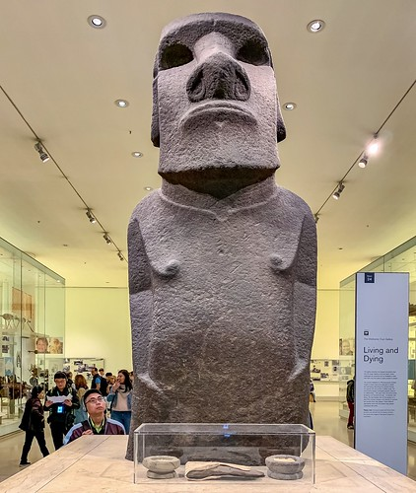
REQUEST FOR THE RETURN OF HOA HAKANANAI’A
TAKEN FROM EASTER ISLAND (RAPA NUI) BY COMMODORE RICHARD POWELL IN 1868, GIFTED TO QUEEN VICTORIA IN 1869 AND NOW HELD BY THE BRITISH MUSEUM

Slide 26
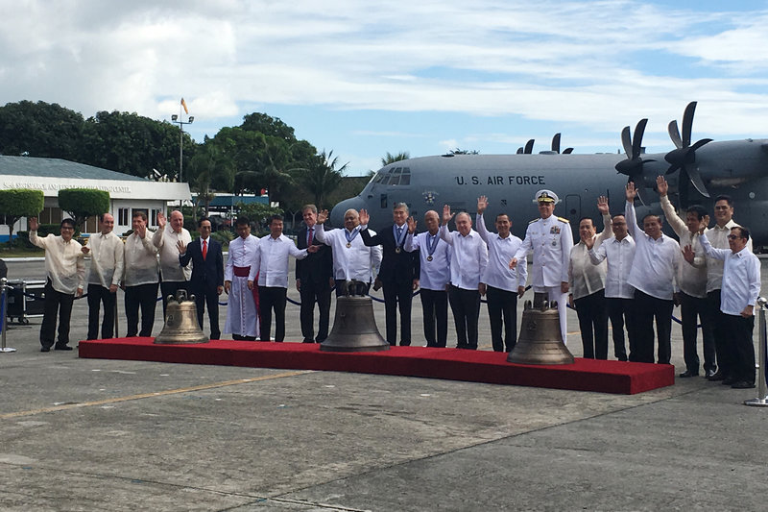
U.S. SOLDIERS CARTED THREE OF THE BALANGIGA TOWN'S CHURCH BELLS OFF AS WAR TROPHIES DURING THE 1899-1902 PHILIPPINE-AMERICAN WAR. THE PHILIPPINES HAS ARGUED FOR DECADES THAT IT WAS A HISTORICAL WRONG THAT NEED RIGHTING.
THE BALANGIGA BELLS WERE RETURNED BY THE U.S. GOVERNMENT IN DECEMBER 2018.

Slide 27
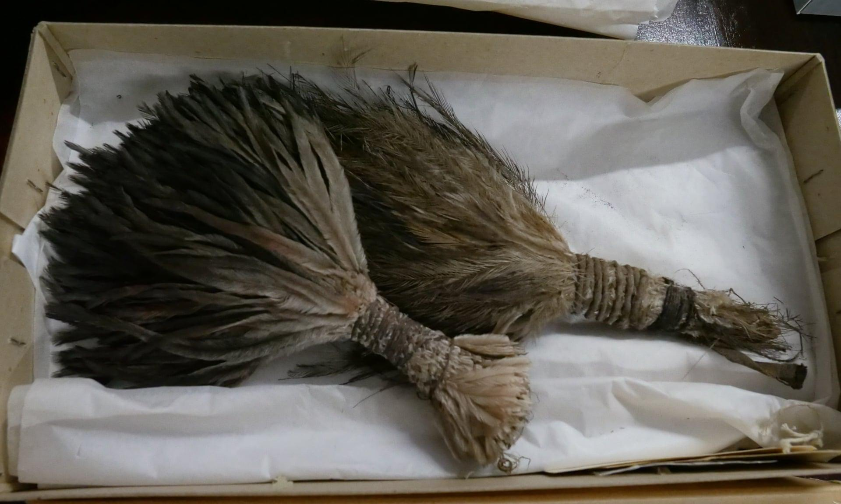
AUSTRALIAN INSTITUTE OF ABORIGINAL AND TORRES STRAIT ISLANDER STUDIES AND THE QUEST FOR THE REPATRIATION OF ARTIFACTS OF INDIGENOUS POPULATIONS.
ONE SET OF ARTIFACTS WAS FORMALLY HANDED BACK TO REPRESENTATIVES FROM THE INDIGENOUS GANGALIDDA GARAWA GROUP, WHOSE HERITAGE IS SAID TO DATE BACK MORE THAN 70,000 YEARS, IN A SACRED CEREMONY AT MANCHESTER MUSEUM IN 2019.

Slide 28
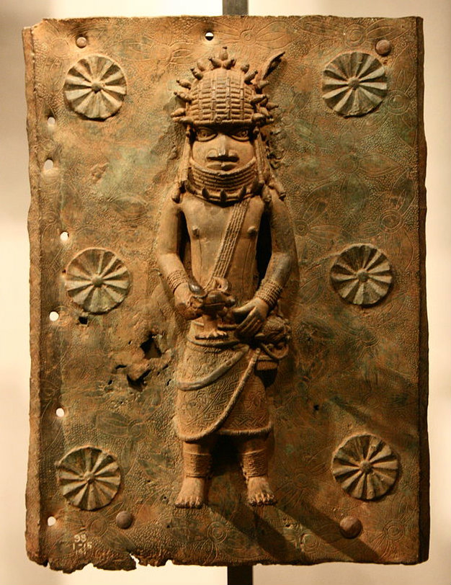
REQUEST FROM NIGERIA FOR THE RETURN OF BENIN BRONZES EXHIBITED IN THE BRITISH MUSEUM. THE ART HISTORICAL TREASURES FROM THE FORMER KINGDOM OF BENIN (MODERN-DAY SOUTHERN NIGERIA) WERE PLUNDERED BY THE BRITISH IN 1897 DURING A PUNITIVE EXPEDITION. IN TOTAL, SOME 4,000 OF INTRICATE SCULPTURES WERE REMOVED FROM THE OBA’S (KING’S) PALACE, GIFTED AND SOLD, AND MANY ENDED UP IN MUSEUMS IN BRITAIN, GERMANY, AND THE US.

Slide 29
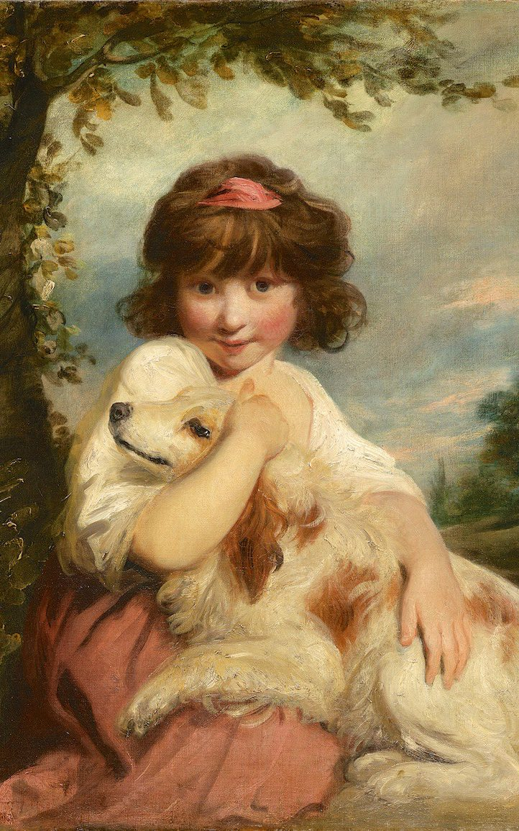
A WORK BY ENGLISH PAINTER JOSHUA REYNOLDS
A JAPANESE MUSEUM REFUSES TO RETURN A £1 MILLION JOSHUA REYNOLDS PAINTING STOLEN FROM A SUSSEX HOME IN 1984 UNLESS IT RECEIVES “JUST AND REASONABLE COMPENSATION”.
THE OIL-ON-CANVAS PORTRAIT WAS PAINTED IN ABOUT 1780 BUT STOLEN FROM THE HOME OF SIR HENRY AND LADY PRICE WITH A NUMBER OF OTHER WORKS OF ART AND FAMILY HEIRLOOMS.
FOUR YEARS AFTER THE THEFT, THE PAINTING IS THOUGHT TO HAVE BEEN AUCTIONED AT SOTHEBY’S IN LONDON TO AN ART DEALER, WHO SOLD IT TO THE TOKYO FUJI ART MUSEUM IN 1990.

Slide 30
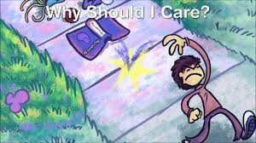
Assignment revision: BIO 41: Contemporary Biology
Course Description:
This course covers the general principles of biology, such as molecular biology, organic evolution, taxonomy, basic similarities of living patterns, genetic continuity and environmental biology. Significant problems of modern biology are included.

Slide 31
Assignment revision: BIO 41: Contemporary Biology
This is a lecture/lab course taken by non-Biology majors.
In order to engage with current events, the instructor asks students for topics for discussion, news stories that are on their minds.
As racial tensions and the concept of “white supremacy” have been raised, one assignment involves watching “The Biology of Skin Color.”

Slide 32
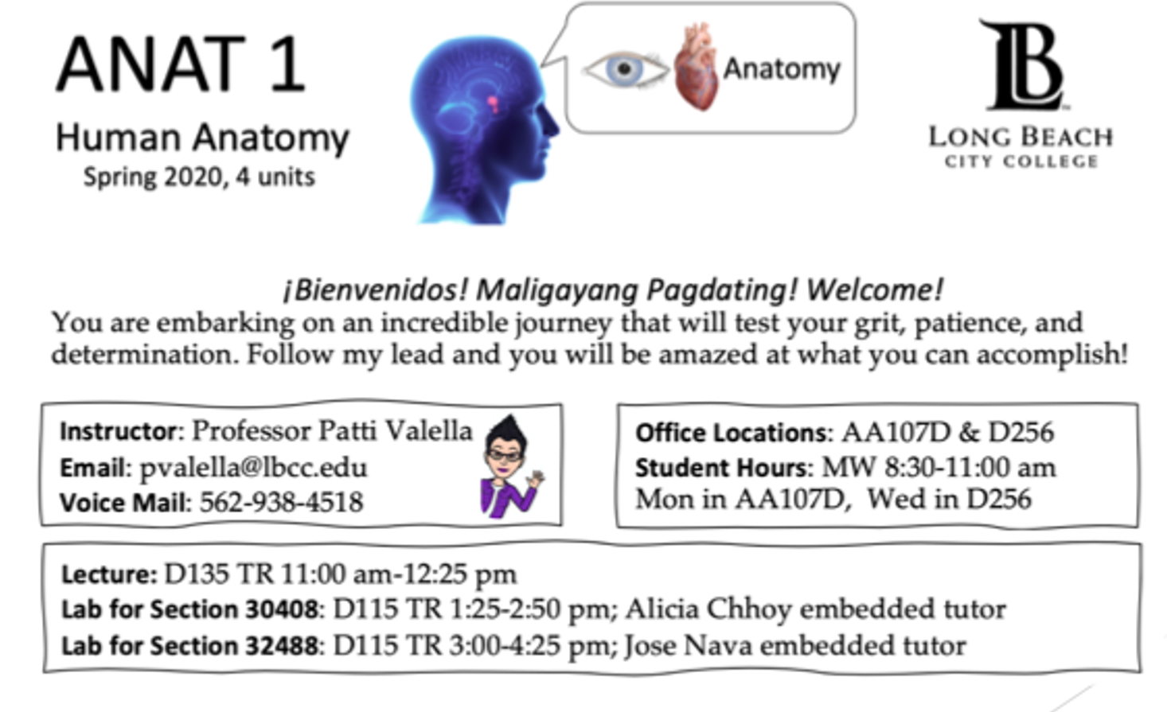
Equitized Syllabus Layout and wording changed to create a more welcoming document

Slide 33
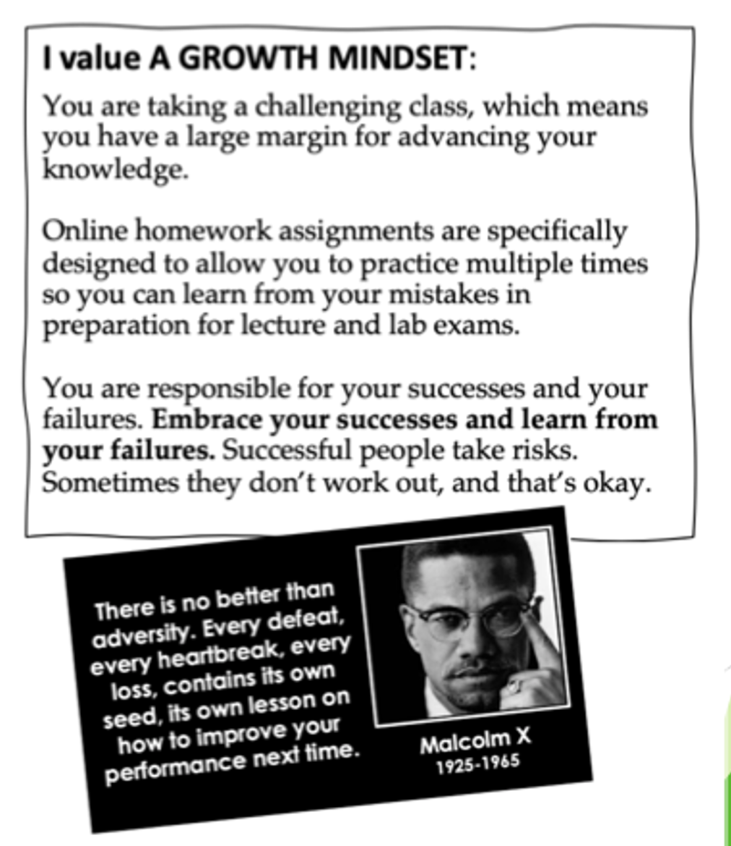
Equitized Syllabus
Syllabus reflects my values as an educator
Growth mindset
Punctuality
Reliability
Respect

Slide 34
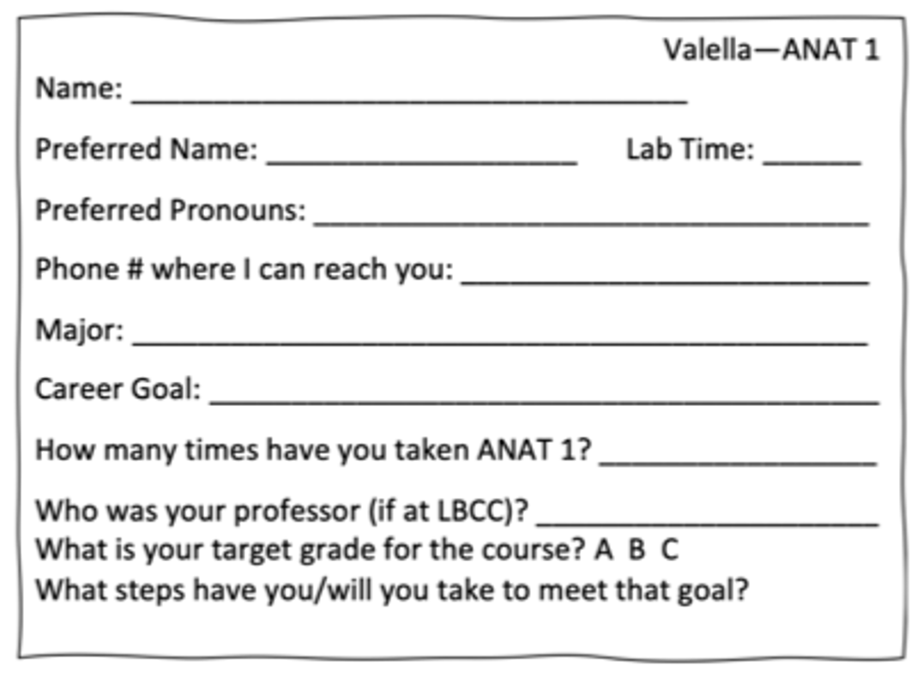
Equitized Syllabus
First day of classes students fill out an Introduction Card
Students can let me know their preferred name and preferred pronouns

Slide 35
Additional Resources
Appleton, Nayantara Sheoran. "Do Not 'Decolonize'...If You Are Not Decolonizing: Progressive Language and Planning Beyond a Hollow Academic Rebranding." 4 February 2019. Critical Ethnic Studies. http://www.criticalethnicstudiesjournal.org/blog/2019/1/21/do-not-decolonize-if-you-are-not-decolonizing-alternate-language-to-navigate-desires-for-progressive-academia-6y5sg, accessed 29 March 2020.
Baker, R., Dee, T., Evans, B. & John, J. (March 2018). "Biases in Online Classes: Evidence from a Field Experiment." Stanford/Institute for Economic Policy Research (SIEPR). https://siepr.stanford.edu/sites/default/files/publications/18-055.pdf, accessed 28 March 2020.
DeChavez, Yvette. "It's Time to Decolonize Your Syllabus." 8 October 2018. The Los Angeles Times. https://www.latimes.com/books/la-et-jc-decolonize-syllabus-20181008-story.html, accessed 29 March 2020.

