Slide 1
Curriculum Basics Lesley Agostino - Program Coordinator, Senior (Curriculum), Diablo Valley College Michelle Grimes – Vice President of Instruction, Orange Coast College Henry Young – ASCCC Curriculum Committee, Victor Valley College

Slide 2
Who is in the Room?
Pathable Poll
Your name and role at your college.
What is your experience level with curriculum?
What is your greatest concern about your role in curriculum?

Slide 3
Today’s Agenda
Language of Curriculum
Ed Code, Title 5, and local guidelines
Program and Course Approval Handbook (PCAH)
Course/Program Outline of Record
Local Culture vs. Reality
Communication Strategies and Managing Conflicts
Other Resources
Wrap up and Q&A
Notes:
lesley

Slide 4
Language of Curriculum – The Basics
Acronym | Definition
AA-T/AS-T | Associate in Art/Science for Transfer
AB | Assembly Bill
ACCJC | Accrediting Commission for Community and Junior Colleges
ADT | Associate Degree for Transfer
ASCCC | Academic Senate for California Community Colleges
ASSIST | Articulation System Stimulating Interinstitutional Student Transfer
C-ID | Course Identification Numbering System
CDCP | Career Development and College Preparation
CE/CTE | Career Technical Education
Acronym | Definition
CIP | Classification of Instructional Program
COR/POR | Course/Program Outline of Record
FTES | Full-time Equivalent Students
HBA | Hours by Arrangement
LMI | Labor Market Information
MIS | Management Information Systems
PCAH | Program and Course Approval Handbook
SAM | Student Accountability Model
TOP | Taxonomy of Programs
Full list of acronyms on page 31 of the PCAH
Notes:
Lesley

Slide 5
Educational Code and Curriculum
California Educationa Code – since 1977
Ed Code sections are created or changed by the governor and Legislature when they make laws. Local school boards and county offices of education are responsible for complying with these provisions. The Ed Code is permissive, which means that school districts are free to take any action not specifically prohibited. Additional regulations affecting education are contained in the California Administrative Code, Titles 5 and 8, the Government Code, and general statutes.
Title 3 Postsecondary Education: Division 7 Community Colleges
Statue and determined by Legislation

Slide 6
Title 5 Code of Regulations
Interprets Ed Code into regulations
Title 5; Division 6 California Community Colleges
Determined by Board of Governors
Establishes the structure of Curriculum Committees - Title 5, §55002
The college and/or district curriculum committee recommending the course shall be established by the mutual agreement of the college and/or district administration and the academic senate.
The committee shall be either a committee of the academic senate or a committee that includes faculty and is otherwise comprised in a way that is mutually agreeable to the college and/or district administration and the academic senate.

Slide 7
Academic and Professional Matters *Also known as “10+1”
Curriculum, including establishing prerequisites and placing courses within disciplines.
Degree and certificate requirements.
Grading policies.
Educational program development.
Standards or policies regarding student preparation and success.
College governance structures, as related to faculty roles.
Faculty roles and involvement in accreditation processes, including self-study and annual reports.
Policies for faculty professional development activities.
Processes for program review.
Processes for institutional planning and budget development, and
Other academic and professional matters as mutually agreed upon between the governing board and the academic senate.
Title 5 §53200 (b): Academic Senate means an organization whose primary function is to make recommendations with respect to academic and professional matters. In Section 53200 (c), “Academic and professional matters” means the following policy development and implementation matters:
Notes:
Lesley & Henry

Slide 8
Local Guidelines & Committees
Curriculum Committee
Bylaws
Academic Senate
Senate constitution or bylaws
College Council
College procedures
Governing Board
Academic, business, curriculum/instruction policies
Academic Senate for Community Colleges (ASCCC)
Authors papers/resolutions, provides resources, and provide professional development
California Community Colleges Curriculum Committee (5C)
Development and revisions of all T5 regulations related to curriculum & instruction
Notes:
Lesley & Henry

Slide 9
Program and Course Approval Handbook
Chancellor’s Office is required to prepare/distribute handbook
Title §55000.5
Consists of general guidelines and instructions for the submission of curriculum for approval and maintenance.
Current PCAH is the 7th Edition
8th Edition Update
Notes:
Lesley

Slide 10
Course & Program Outline of Record
“COR”
Legal document that represents a contract between the faculty, students, institution, and the state. Title §55002
Must include elements defined in the PCAH.
Requires local senate and board approval.
Chancellor’s office “chaptering”
Required Components Include
Units, contact hours, outside of class hours, and total hours
Pre/Co-requisites and advisories
Description, objectives, content
Examples of:
Reading/writing requirements
Outside of class assignments
Instructional methodology
Methods of evaluation
Notes:
Lesley

Slide 11
Course & Program Outline of Record
Additional elements of the COR:
Course number/title
Course status (noncredit/credit)
Enrollment limitations
Repeatability
Field trips
SLOs
Textbooks/Zero-Cost Information
DEI in Curriculum: Model Principles and Practices
Recommended priorities that focuses on championing equity-minded curriculum and practices for credit and noncredit instruction.
How to Use Equity Tools to Have Equity Conversations
Saturday, 9:00 a.m.
Notes:
Lesley

Slide 12
Course & Program Outline of Record
Program Outline of Record “POR”
Required elements are listed the PCAH
Associate in Arts for Transfer (AA-T)
Associate in Science for Transfer (AS-T)
Associate in Arts (AA)
Associate in Science (AS)
Certificate of Achievement
Noncredit certificates
CDCP
Local certificates
Chancellor’s office will chapter local degrees however, ADTs and career education programs require a full review.
Career Education degrees and certificates have additional required documentation including LMI, advisory board approval, and regional consortium approval.
Notes:
Lesley

Slide 13
Local Culture vs. Reality
10+1 can vary from district to district
Local curriculum handbooks further refine standards and processes
Technology can often make processes more esoteric at a college or district
Local chairs, committees can, over time, emphasize some standards over others based on the experiences and “pet peeves” of committee members
Lots of myths and misconceptions about what Title 5 says and does not say
Title 5 is “permissive”...doesn’t say we can...doesn’t say we can’t
Each college (and sometimes the district) Academic Senate may have different parameters than other colleges regarding what comes to the senate and what does not
Notes:
Interactive; Question break? Michelle, Lesley, & Henry

Slide 14
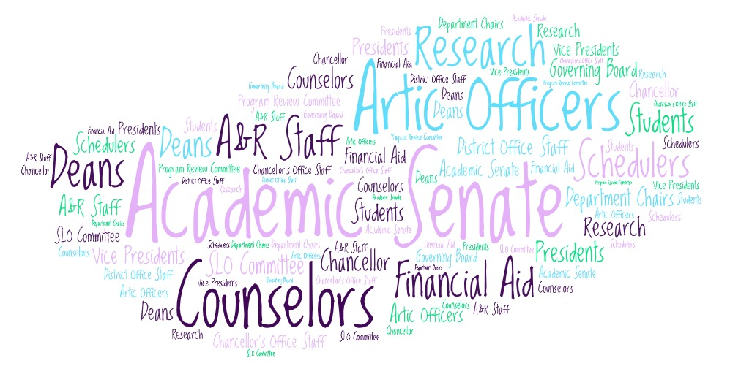
Communication Strategies and Managing Conflicts
Who do we communicate with?

Slide 15
Communication Strategies and Managing Conflicts
Communication between discipline faculty and the curriculum committee is essential for smooth processes.
Regularly attend leadership meetings; maintain regular contact with local committee/department chairs.
Relay direction from local board policies, administrative procedures, and faculty contract.
Build and maintain working relationships with faculty, classified staff, and administration.
Mutual understanding of roles/responsibilities and genuine respect for your colleagues.
Inclusivity, transparency, diplomacy in decision making.
Demonstrate integrity, creativity, and wisdom.
Communication will be key with upcoming legislation including AB 928, AB 1111, and the Ethnic Studies requirement for community colleges.
Notes:
Henry & Michelle

Slide 16
Communication Strategies and Managing Conflicts
Accept conflict. Remember that conflict is natural and happens in every ongoing relationship. Conflict is a sign of a need for change and an opportunity for growth, new understanding, and improved communication. Conflict can not be resolved unless it is addressed with the appropriate individual(s).
Move past positions. A position is the desired outcome of a conflict. A position is something like “We need to approve this change” or “This prerequisite will ensure that students are prepared.” Positions are not negotiable and result in impasse.
Share your interests. To solve conflict, all parties must talk about their interests or the WHYs behind their positions. They must share their true interests and work together to find a solution that satisfies those interests. An interest might be, “We want our courses to include the most up-to-date technology so our students are prepared for the workforce.”
Notes:
Henry & Michelle

Slide 17
Communication Strategies and Managing Conflicts
According to the Thomas-Kilmann Conflict Instrument, there are five key styles for managing conflict:
Forcing — using your formal authority or power to satisfy your concerns without regard to the other party’s concerns
Accommodating — allowing the other party to satisfy their concerns while neglecting your own
Avoiding — not paying attention to the conflict and not taking any action to resolve it
Compromising — attempting to resolve the conflict by identifying a solution that is partially satisfactory to both parties but completely satisfactory to neither
Collaborating — co-operating with the other party to understand their concerns in an effort to find a mutually satisfying solution
Notes:
Henry & Michelle

Slide 18
Questions?

Slide 19
Resources & Contacts
Program and Course Approval Handbook
Academic Senate for California Community Colleges
Local Senates Handbook
California Community College Chancellor’s Office
California Community College Curriculum Committee
Title 5 – Division 6 California Community Colleges
California Law – Education Code
Course Identification Numbering System (C-ID)
Templates for Approved Transfer Model Curriculum
ASSIST
Management Information Systems (MIS) Data Mart
Taxonomy of Programs (TOP)
Classification of Instructional Programs (CIP)
The Course Outline of Record: A Curriculum Reference Guide Revisited
Data Element Dictionary

Slide 20
Resources & Contacts
Contact Information:
Lesley Agostino – lagostino@dvc.edu
Michelle Grimes-Hillman – mgrimes@cccd.edu
Henry Young – Henry.Young@vvc.edu

