Slide 1
Curriculum Champions Pre-Session Amber Gillis – ASCCC South Representative, ASCCC Curriculum, 5C Nili Kirschner – Woodland College, ASCCC Curriculum, 5C Henry Young – Victor Valley College, ASCCC Curriculum

Slide 2
Breakout Description
The Academic Senate for California Community Colleges (ASCCC) champions the various leadership roles of faculty at their colleges and at the state level while fostering effective faculty participation in governance to effect change. This session is intended to explore the various supportive faculty leadership roles at a local college and learn how the ASCCC facilitates and supports the ongoing development of faculty leaders.

Slide 3
Pre-Session Learning Outcomes
In this pre-session, we will:
Meet fellow faculty champions and discover various roles on campus that support and overlap with curriculum
Discuss IDEAA as theme of institute and foundation for curriculum
Connect ongoing campus initiatives to IDEAA in curriculum
Ethnic Studies Requirement
Open Educational Resources (OER)
Guided Pathways
Credit for Prior Learning (CPL)
Share ideas for professional development and ASCCC support
Notes:
Amber

Slide 4
Introductions and Interests
Pathable Polls:
Who is in this session?
Pathable Chat:
What college are you from?
Padlet:
What curriculum issues interest you?
Why are you at CI?

Slide 5
Why are you at CI?
Notes:
https://padlet.com/ambergillis123/3iklg5bojcd9gq4x

Slide 6
What curriculum issues interest you?
Notes:
https://padlet.com/ambergillis123/4kdj1zd1y2oytii

Slide 7
What does it mean to be a curriculum champion?
You don't have to be on the curriculum committee to support curriculum efforts!
Notes:
Henry

Slide 8
How does your work relate to Curriculum?
Faculty Equity, Guided Pathways, Counseling, Tutorial, Library, Online Education, Instructional Design, Professional Development and other areas are integral to the curriculum process
Curriculum Developers and Committees need a wide variety of expertise to ensure our curriculum is equitable and intentional to meet student needs
Subject expertise is essential but it is also important to bring in other voices and ideas
Faculty not only have the role of creating curriculum but also implementing. Many faculty roles are there to support and improve that implementation and make sure that it is student focused.
Notes:
Henry

Slide 9
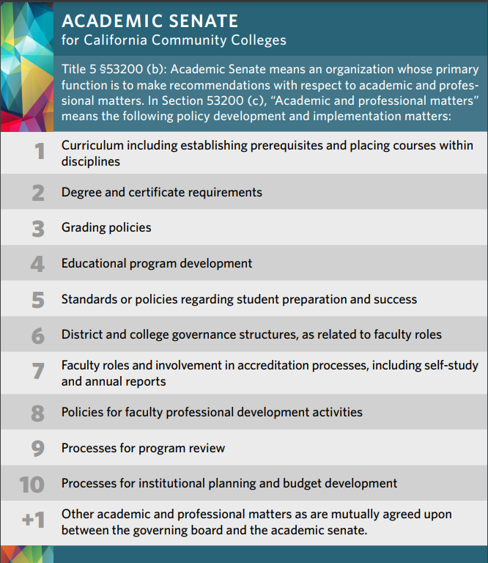
Faculty role defined in "10+1"
Curriculum including establishing prerequisites and placing courses within disciplines
Degree and certificate requirements
Grading policies
Educational program development
Standards or policies regarding student preparation and success
District and college governance structures, as related to faculty roles
Faculty roles and involvement in accreditation processes, including self-study and annual reports
Policies for faculty professional development activities
Processes for program review
Processes for institutional planning and budget development
+ 1. Other academic and professional matters as are mutually agreed upon between the governing board and the academic senate.
Notes:
Henry

Slide 10
IDEAA in Curriculum
What is it? Why does it matter?
Whose responsibility is it?
Notes:
Nili

Slide 11
The Main IDEAA: Eyes on the Prize
The theme of this institute is IDEAA: Inclusivity, Diversity, Equity, Anti-Racism, and Accessibility
Why? ASCCC Call to action - “prioritize culturally responsive curricular redesign”
Who? All of us! This work is hard and we need all hands on deck
When? Now. Mutiple regulatory changes in the pipeline – Ethnic Studies requirement, DEIA in curriculum standards and faculty tenure evaluations
How? Multiple session at this institute will address this, starting today!
Notes:
Nili

Slide 12
Initiatives that Build on IDEAA
Your college may already be engaging in initiatives that build on the foundation of IDEAA:
Ethnic Studies Requirement
Open Educational Resources (OER)
Guided Pathways
Credit for Prior Learning (CPL)
IDEAA
Ethnic Studies
OER
Guided Pathways
CPL
Notes:
Nili

Slide 13
Break time

Slide 14
Ethnic Studies Requirement
Fall 2020 ASCCC resolutions 9.04 and 9.05 support an ethnic studies graduation requirement.
The resolutions define ethnic studies as an interdisciplinary and comparative study of race and ethnicity with special focus on four historically defined racialized core groups: Native Americans, African Americans, Asian Americans, and Latina/o Americans.
Notes:
Nili

Slide 15
Ethnic Studies Implementation Updates
July 2021: BOG approved adding an ethnic studies graduation requirement (title 5, section 55063)
CSU and UC have added ethnic studies to General Education (Area F/Area 7)
CCCCO Memo ESS 22-300-008 provides detailed timeline; main takeaway is:
"While colleges are encouraged to establish the needed ethnic studies programs and courses now, all colleges must have the course offerings needed to fulfill this new ethnic studies graduation requirement by fall 2024."
Notes:
Nili

Slide 16
What does this mean for our colleges?
Most colleges will need new or additional ethnic studies curriculum
Students will need counseling and tutorial support for new requirement
College faculty – including counselors – will need professional development on the new requirement including its role in equity
Senates will need to collaborate to update local graduation requirements and advocate for hiring ethnic studies faculty
Articulation officers will need support to make sure courses are articulated and students can use them to meet graduation and transfer requirements
Librarians will need to increase ethnic studies materials to support instruction
These things need to be done collectively and collaboratively with area experts. Who on your campus should be involved in these discussions?
Notes:
Nili

Slide 17
IDEAA and OER
Open Educational Resources create opportunities:
Improvements in design in open authoring and publishing
Culturally responsive teaching with culturally responsive textbook examples
Creating resources relevant to your students
Challenge: At what point do you engage your students in the co-creation of classroom content and assignments?
Notes:
Amber

Slide 18
OER and IDEAA
“Cisgender, White men from Western countries make up about 20 percent of the global population and yet they are writing 80 percent about the world.”
Siko Bourterse
Open educational resources allow you to modify anything…
We need:
Diverse authors and artists to tell multiple stories and perspectives
To think about who our audience is
Notes:
Amber

Slide 19
If it’s open, you can fix it...
Type “teacher” in Google Images and see what pops up even with a CC BY license.
But what if we went to Disabled And Here: Photography featuring disabled BIPOC (Black, Indigenous, people of color), varied body sizes/types, sexual orientations, and gender identities in the Pacific Northwest; License CC BY 4.0
Improvements can vary from small to large:
Biology text: Updating images and case studies to reflect our student body; including current understanding of sex and gender; adding diverse scientists.
Spanish text: Modifications of gender pronouns
Psychology text: Presenting gender as a non-binary concept
Statistics for Social Justice Studies
Collaborations
Notes:
Amber

Slide 20
Guided Pathways
Four Pillars of Guided Pathways
Notes:
Henry

Slide 21
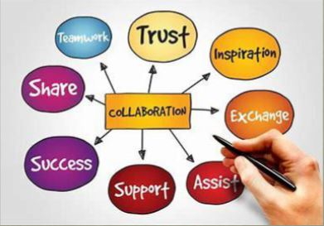
Why Guided Pathways?
Guided pathways is a student-centered approach designed to assist in retention and promote completion of educational goals at VVC in a more effective and efficient way, while closing equity gaps.
Simplifying students’ choices with default program maps developed by faculty and advisors for all academic and vocational programs that show students a clear pathway to completion, further education, and employment in fields of importance to the region.
Notes:
Henry

Slide 22
Guided Pathways and Equity Considerations
Students are more likely to graduate on time if they identify a major early on, have a clear outline of the courses required for completion, and are provided consistent ongoing guidance and support throughout their program of study.
California has made investments to improve student outcomes at community colleges by providing student intake and guidance services, requiring colleges to focus on closing achievement gaps, improving basic skills instruction and placements, providing enhanced student services for remedial students, and streamlining and simplifying the transfer process to four-year universities.
Providing community colleges with strategic, one-time state investments and technical assistance will enable colleges to integrate existing student-success programs and provide students with predictable course schedules and frequent feedback and support services to ensure that they can complete academic programs more efficiently.
Providing students who are pursuing an associate degree with a full two-year sequence of courses that can serve as a default plan will help to ensure that these students are positioned to complete their program on time.
Notes:
Henry

Slide 23
Guided Pathways Pillars (1 and 2)
Clarify the Path: Mapping Pathways to Student End Goals
Simplifying students’ choices with default program maps developed by faculty and advisors for all academic and vocational programs that show students a clear pathway to completion, further education, and employment in fields of importance to the region.
Enter the Path: Helping Students Choose and Enter a Program Pathway
Redesigning traditional remediation as an “on-ramp” to a program of study, which helps students explore academic and career options from the beginning of their college experience, aligns math and other foundation skills coursework with a student’s program of study, and integrates and contextualizes instruction to build academic and nonacademic foundation skills throughout the college-level curriculum, particularly in program “gateway” courses.
Notes:
Henry

Slide 24
Guided Pathways Pillars (3 and 4)
Stay on the Path: Keeping Students on the Path
Implementing procedures and systems, supported by appropriate technology, to monitor students’ progress toward completing their academic plans, to identify students who are at risk of not progressing in a program, and to intervene promptly with advising and other academic supports to help those students to resume progress or to revise their plans.
Ensure Learning: Ensuring that Students Are Learning. Furthermore, each of these pillar areas also includes a series of equity considerations to help
Establishing program-level learning outcomes that are aligned with the requirements for success in employment and further education in a given field and applying the results of learning outcomes assessments to improve the effectiveness of instruction across programs.
Notes:
Henry

Slide 25
Guided Pathways
Designing with the Student in Mind...or better yet with the Students
Curriculum is not only in the ASCCC 10+1 but also in the Students 9+ 1
Guided Pathways is about dismantling barriers in policies and processes. Curriculum is full of both…
It's time to ask “why do we do this?”, “is this the best thing for students?”
Guided Pathways gives us the opportunity to disrupt and dismantle structures that hurt students.
Has your college holistically looked at your curriculum processes and procedures and have you included your students in that review.
Notes:
Henry

Slide 26
Credit for Prior Learning (CPL)
According to the Success Center for California Community Colleges:
Many non-traditional students (adults age 25+) come to California community colleges with skills gained through military, workplace, and civic experiences. They hold industry credentials, are graduates of public service academies, and were trained for military occupations. At a time when our Vision for Success goals demand us to increase certificate and degree completion and reduce achievement gaps, helping students get through faster is a win for colleges and students alike. Credit for prior learning (CPL) is a strategy to help students get credit for what they already know and can do, saving them time and money on their educational path.
Notes:
Amber

Slide 27
Why CPL?
Research indicates that students who earn CPL:
are roughly twice as likely to complete a degree than those who do not
accumulate more credits through coursework at the institution than their counterparts, which translates to increased enrollment for colleges
save an average of 6-10 months in time to degree compared to their non-CPL counterparts
In 2018, two bills mandate CPL in California Community Colleges
SB1071 - (focus on awarding military and veterans who have an official Joint Services Transcript course credit) Required by Dec. 31, 2020 that each CC district to have updated policy to be consistent with the policy developed by the chancellor and post online
AB 1786 - establish an initiative to expand the use of course credit at California Community Colleges for students with prior learning
Findings and Recommendations to expand CPL as a Vision for Success Strategy
Statewide policy recommendations
Locally Integrate CPL into Guided Pathways
Collaborate with four-year segments to ensure transfer of credit
Notes:
Amber

Slide 28
Current CPL Practices
CPL practices varies widely in California Community College
Many award credit for military training (81% approx.)
Fewer award for workplace training (13% approx.)
Current methods for assessing prior learning
Credit by Exam (Title 5 §55050)
Review of Joint Services Transcripts or other military service documents
Standardized Exams - (e.g. AP Credit Exams (Title 5§55052), IB, CLEP and DSST exams)
Notes:
Amber

Slide 29
Activity Time
Padlet survey:
Which of these areas is your college progressing in?
Are there any areas your college struggling with?
What are your main recommendations or questions to take back to your college?
What types of professional development does your college need?
Do you have resources to suggest or share?
Notes:
Amber - https://padlet.com/ambergillis123/7zj4zue00vjsmlme

Slide 30
Break time

Slide 31
Debrief and Discuss
What are some of the areas where colleges are making progress?
What are some of the main areas where colleges are struggling?
What professional development resources are needed?
What resources have been shared?
Notes:
All

Slide 32
What can ASCCC do for you?
Is this a local issue or a statewide issue?
Papers, resolutions, and resources for research
Local visits...let's talk
info@asccc.org
Notes:
Amber

Slide 33
Additional Resources
Ethnic Studies
Ethnic Studies: Looking Back; Looking Forward
CCCCO Memo ESS 22-300-008
The Passage of AB 1460 and Its Impact on the CCCs
OER
ASCCC-OERI.org > Resources > ASCCC OER Quick Guides > Articulation, Curriculum and OER: https://asccc-oeri.org/articulation-curriculum-and-open-educational-resources/
Guided Pathways
ASCCC Guided Pathways
CCCCO Guided Pathways
Student Success Metrics
Inland Empire Guided Pathways Support
CBE/CPL
CPL - Success Center for California Community Colleges
Fueling the Race to Postsecondary Success - CAEL (March 2010)
Credit for Prior Learning Initiative: Findings and Recommendations to Expand Credit for Prior Learning as a Vision for Success Strategy

