Slide 1
What to Expect When You’re Expecting… The Visiting Team and Distance Education Review
Dolores Davison, Foothill College
Tracy Schaelen, Southwestern College

Slide 2
What We’ll Be Covering
Common issues in online courses and distance education review
What your college should (hopefully) have in place
What to expect from the visiting team
What are “equitable student services” in an online course environment

Slide 3
Distance Education (traditional definition)
The student and the instructor are separated by a distance.
Online Education
Instruction is conducted online with frequent faculty initiated contact between student and instructor.
Correspondence Education
Materials are shared between the instructor and student electronically or via mail; contact is typically initiated by the student and it is not regular or substantive; typically self-paced.
Traditional Education
“Face-to-face”
“Brick and mortar”
Web Enhanced
Online activities are included as part of a traditional class. No class time is replaced by online work.
Hybrid
A blend of online and traditional instruction

Slide 4
Definition of a Correspondence Course in Federal Regulations
Correspondence course:
(1) A course provided by an institution under which the
institution provides instructional materials, by mail or electronic
transmission, including examinations on the materials, to students
who are separated from the instructor. Interaction between the
instructor and student is limited, is not regular and
substantive, and is primarily initiated by the student.
Correspondence courses are typically self-paced.
(2) If a course is part correspondence and part residential training,
the Secretary considers the course to be a correspondence course.
(3) A correspondence course is not distance education.
34 C.F.R. § 602.3.

Slide 5
Definition of “Distance Education” in Federal Regulations
From US Department of Education
“Distance education is defined, for the purpose of accreditation review as a formal interaction which uses one or more technologies to deliver instruction to students who are separated from the instructor and which supports regular and substantive interaction between the students and instructor, either synchronously or
asynchronously.”

Slide 6
Title 5 Language
Title 5 section 55200 Definition:
Distance education means instruction in which the instructor and student are separated by distance and interact through the assistance of communication technology.
55204. Instructor Contact.
In addition to the requirements of section 55002 and any locally established requirements applicable to all courses, district governing boards shall ensure that:
(a) Any portion of a course conducted through distance education includes regular effective contact between instructor and students, through group or individual meetings, orientation and review sessions, supplemental seminar or study sessions, field trips, library workshops, telephone contact, correspondence, voice mail, email, or other activities.

Slide 7
According to ACCJC
Regular and substantive interaction between student and teacher:
Is central in determining whether a course is distance education rather than correspondence education.
Is needed in every course that is fully online and in the online elements of courses otherwise on-site.
Must be demonstrable and documented.
Is vital to a college’s relationship with the U.S. Department of Education for student financial aid eligibility.
Is key to quality education and the student outcomes required by the ACCJC Accreditation Standards.

Slide 8
Terminology Differences
US Dept. of Ed & ACCJC: “regular and substantive interaction between the students and faculty”
Title 5: “Regular and Effective Contact”
Used to be “Regular and In-Person Contact”

Slide 9
Translation
Regular Effective Contact is mandated in all forms of DE courses...and the ACCJC team will be looking for it

Slide 10
Does your college have a Regular and Effective Contact policy?
If not, you should develop a policy in consultation with your Academic Senate, including your Curriculum Committee & DE Committee (if you do not have a faculty led or co-led DE committee, you should work on that as well)
Policies often contain:
Definition of REC (use Title 5 language)
Instructor initiated focus
Guidelines for frequency of contact
Syllabus information
Variety of methods that constitute “contact”
Need for contact to be ongoing and consistent throughout semester
Best practices for engaging with students

Slide 11
Example: Foothill College

Slide 12
REC Policy Examples
Foothill College REC Policy: http://www.foothill.edu/fga/rec.php
Mt. San Antonio College REC Policy (AP 4105): http://www.mtsac.edu/instruction/learning/dlc/reports.html
Mt. San Jacinto College REC Policy: http://www.msjc.edu/CollegeInformation/Administration/Committees/CurriculumCommittee/Documents/Regular_Effective_Contactv5.pdf

Slide 13
What Constitutes REC?
Email (most common form of interaction for 81% of faculty)
Discussion boards (76%)
Chat Rooms (16%)
Blackboard Collaborate in Moodlerooms (6%)
Face-to-face meetings (5%)
Mail (5%)
Phone calls
Video Conferencing
Social Networking Sites (Facebook, Twitter, Tumblr, etc)
Fax
Blogging
Text messaging
CCC Confer (Call, Meet, Teach, Office Hours)
Statistics from: http://californiacommunitycolleges.cccco.edu/Portals/0/reportsTB/REPORT_DistanceEducation2013_090313.pdf

Slide 14
What constitutes REC?
The three major elements:
Activities
Frequency
Quality
And the types:
Instructor initiated activity
Student initiated activity
Student to faculty
Faculty to student
Student to student

Slide 15
Some Examples
The Majority of the Contact Should Come Through Some Kind of Instructor Initiated Activity
Discussion Forums
Q & A
Analysis/Synthesis of course content
Announcements—Value Added
Email—for private issues
Phone conversation
Chatroom Discussions
Office hours
CCC Confer/synchronous

Slide 16
Other Things to Remember for Regular and Effective Contact
Tone/Personality
Instructors use their own language rather than “academic speak”
Sign everything so the students know it is from you
Instructor created materials
Stories and personal items (depending on the course and comfort level)
Create an avatar, VoiceThreads, etc.

Slide 17
What Will the Team Be Looking For?
All DE must have contact between the instructor and the student.
It has to be regular, effective, substantive, and engaged.
Contact has to happen in fully and partially online courses.
Your college should have a clear policy on REC.
Students should be regularly engaged.
Team members can request to look at any class.
Faculty presence in the courses is expected (and desirable).
Accessibility issues are also starting to come up.

Slide 18
A Tale from the Trenches
What documents were especially important?
college’s DE Plan
college policy for Regular Effective Contact
What was important in review of our courses?
examination of a wide variety of courses and disciplines
evidence of regular instructor-student contact, especially in announcements and class discussions
student privacy and authentication in activities outside of LMS: publisher websites, instructor websites
college’s DE Handbook
accessibility of course materials

Slide 19
Preparing Online Faculty
Workshops & webinars (click to access)

Slide 20
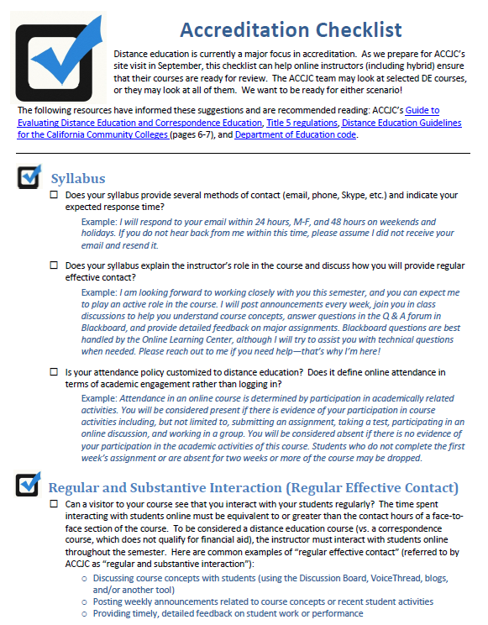
Preparing Online Faculty
background
guidelines
checklists
resources

Slide 21
What Else Should Be in Place
Colleges must have
Evidence that the institution develops, implements, and evaluates counseling and/or academic advising that takes into account the needs of students enrolled in DE/CE programs
Evidence that admissions practices and placement instruments are regularly evaluated and that they are effective for DE/CE students
Description of the services provided that are developed to address the needs of students with remote access to the institution
Evidence that there is access to library and LSS for remote students/staff, and there are institutional policies on remote access, including personnel policies that describe access provided to educational staff
Evidence of academic honesty policies and how these policies on academic honesty are disseminated to students enrolled in DE/CE programs

Slide 22
Resources
Foothill College REC Policy: http://www.foothill.edu/fga/rec.php
Mt. San Antonio College REC Policy (AP 4105): http://www.mtsac.edu/instruction/learning/dlc/reports.html
Mt. San Jacinto College REC Policy: http://www.msjc.edu/CollegeInformation/Administration/Committees/CurriculumCommittee/Documents/Regular_Effective_Contactv5.pdf
Chancellor’s Office Report:
http://californiacommunitycolleges.cccco.edu/Portals/0/reportsTB/REPORT_DistanceEducation2013_090313.pdf
Southwestern College Accreditation Checklist: http://swcdistanceeducation.weebly.com/uploads/5/5/6/2/55629853/accreditation_site_visit_checklist.pdf
ACCJC Guide to Evaluating DE and CE: http://www.accjc.org/wp-content/uploads/2013/08/Guide_to_Evaluating_DE_and_CE_2013.pdf
ASCCC Website: www.asccc.org

Slide 23
Thank You!
Dolores Davison (davisondolores@foothill.edu)
Tracy Schaelen (tschaelen@swccd.edu)

