Slide 1
.
Data Implications for Spring 2020
May 26, 2020 | 2:00 – 3:00
ASCCC – Janet Fulks, Ginni May, Meridith Selden
RP Group – Erik Cooper, Jacob Kevari, Alyssa Nguyen
Notes:
Ginni

Slide 2
During Presentation
Use the chat to share…
What is your college doing?
What are your concerns?
We will respond in the chat or orally.
Notes:
Ginni

Slide 3
Today’s Plan
Introduce Presenters
Burning Questions:
  What impact will COVID-19 have on our collective understanding of student equity and success for spring 2020?
  Should we dismiss the data?
  How can we learn from the data?
Observations and Considerations:
  From the Point of View of Institutional Research, Planning, and Effectiveness (IRPE) professionals
  From the Point of View of Faculty Leaders
Notes:
Ginni

Slide 4

Presenters
ASCCC
Janet Fulks, Guided Pathways Task Force Lead
  Bakersfield College Biology Faculty (Retired)
Ginni May, Treasurer, Guided Pathways Task Force Chair
  Sacramento City College Mathematics/Statistics Faculty
Meridith Selden, Guided Pathways Task Force Lead
  Yuba College Psychology Faculty
RP Group
Erik Cooper, President-Elect
  Sierra College Dean of Planning, Research and Resource Development
Jacob Kevari, Southern Officer
  Moreno Valley College Dean of Institutional Effectiveness
Alyssa Nguyen, Director of Research and Evaluation
Notes:
All

Slide 5
Goals for Today
Addressing the Burning Questions
Understand and identify concerns and implications about spring 2020 and other relevant data
Describe a few potential plans to collect and analyze appropriate data
Communicate potential impacts in order to plan future strategies
Notes:
Meridith

Slide 6
From the POV of IRPE
Data Literacy – What is an EW?
Calculation adjustments – Implications for Course Success Rates
Major initiatives
AB 705
Guided Pathways
What can we learn from data?
Analysis of EWs for Disproportionate Impact
Students needs for online environment
Notes:
Erik, Jake or Alyssa

Slide 7
What are EW grades?
WITHDRAWAL – § 55024
(1) “Excused Withdrawal” (EW) occurs when a student is permitted to withdraw from a course(s) due to specific events beyond the control of the student ...Upon verification of these conditions and consistent with the district’s required documentation substantiating the condition, an excused withdrawal symbol may be assigned at any time after the period established by the governing board during which no notation is made for withdrawals. The withdrawal symbol so assigned shall be an “EW.”
(2) Excused withdrawal shall not be counted in progress probation and dismissal calculations.
(3) Excused withdrawal shall not be counted toward the permitted number of withdrawals or counted as an enrollment attempt.
Notes:
Erik

Slide 8
EW grades will affect:
Course outcome rates
  Success Counts & Success Rates*
  Completion Counts & Completion Rates*
Completion
  Degrees/certificates
  Transfer
Initiatives
  AB 705, Guided Pathways, Equity
Notes:
Erik, Jake or Alyssa

Slide 9
Considerations for Unpacking
NEED TO DISAGGREGATE – FOCUS ON EQUITY
  Disaggregate grades by student characteristics and focus on EW
    Are students disproportionately impacted? Which groups?
    Do we include EW in the overall course outcomes or leave out to understand course performance?
    How does this vary by pathways?
Notes:
Erik

Slide 10


College Snapshots
Notes:
Erik and Jake

Slide 11
Spring 2020 Withdrawals*
*As of 5/11/2020
Notes:
Erik
As of Monday 5/11

Slide 12
Spring 2020 Excused Withdrawals*
*As of 5/11/2020
Notes:
Erik
As of Monday 5/11

Slide 13
Spring 2020 Exits – Selected Groups
*As of 5/11/2020
Notes:
Erik
As of Monday 5/11

Slide 14
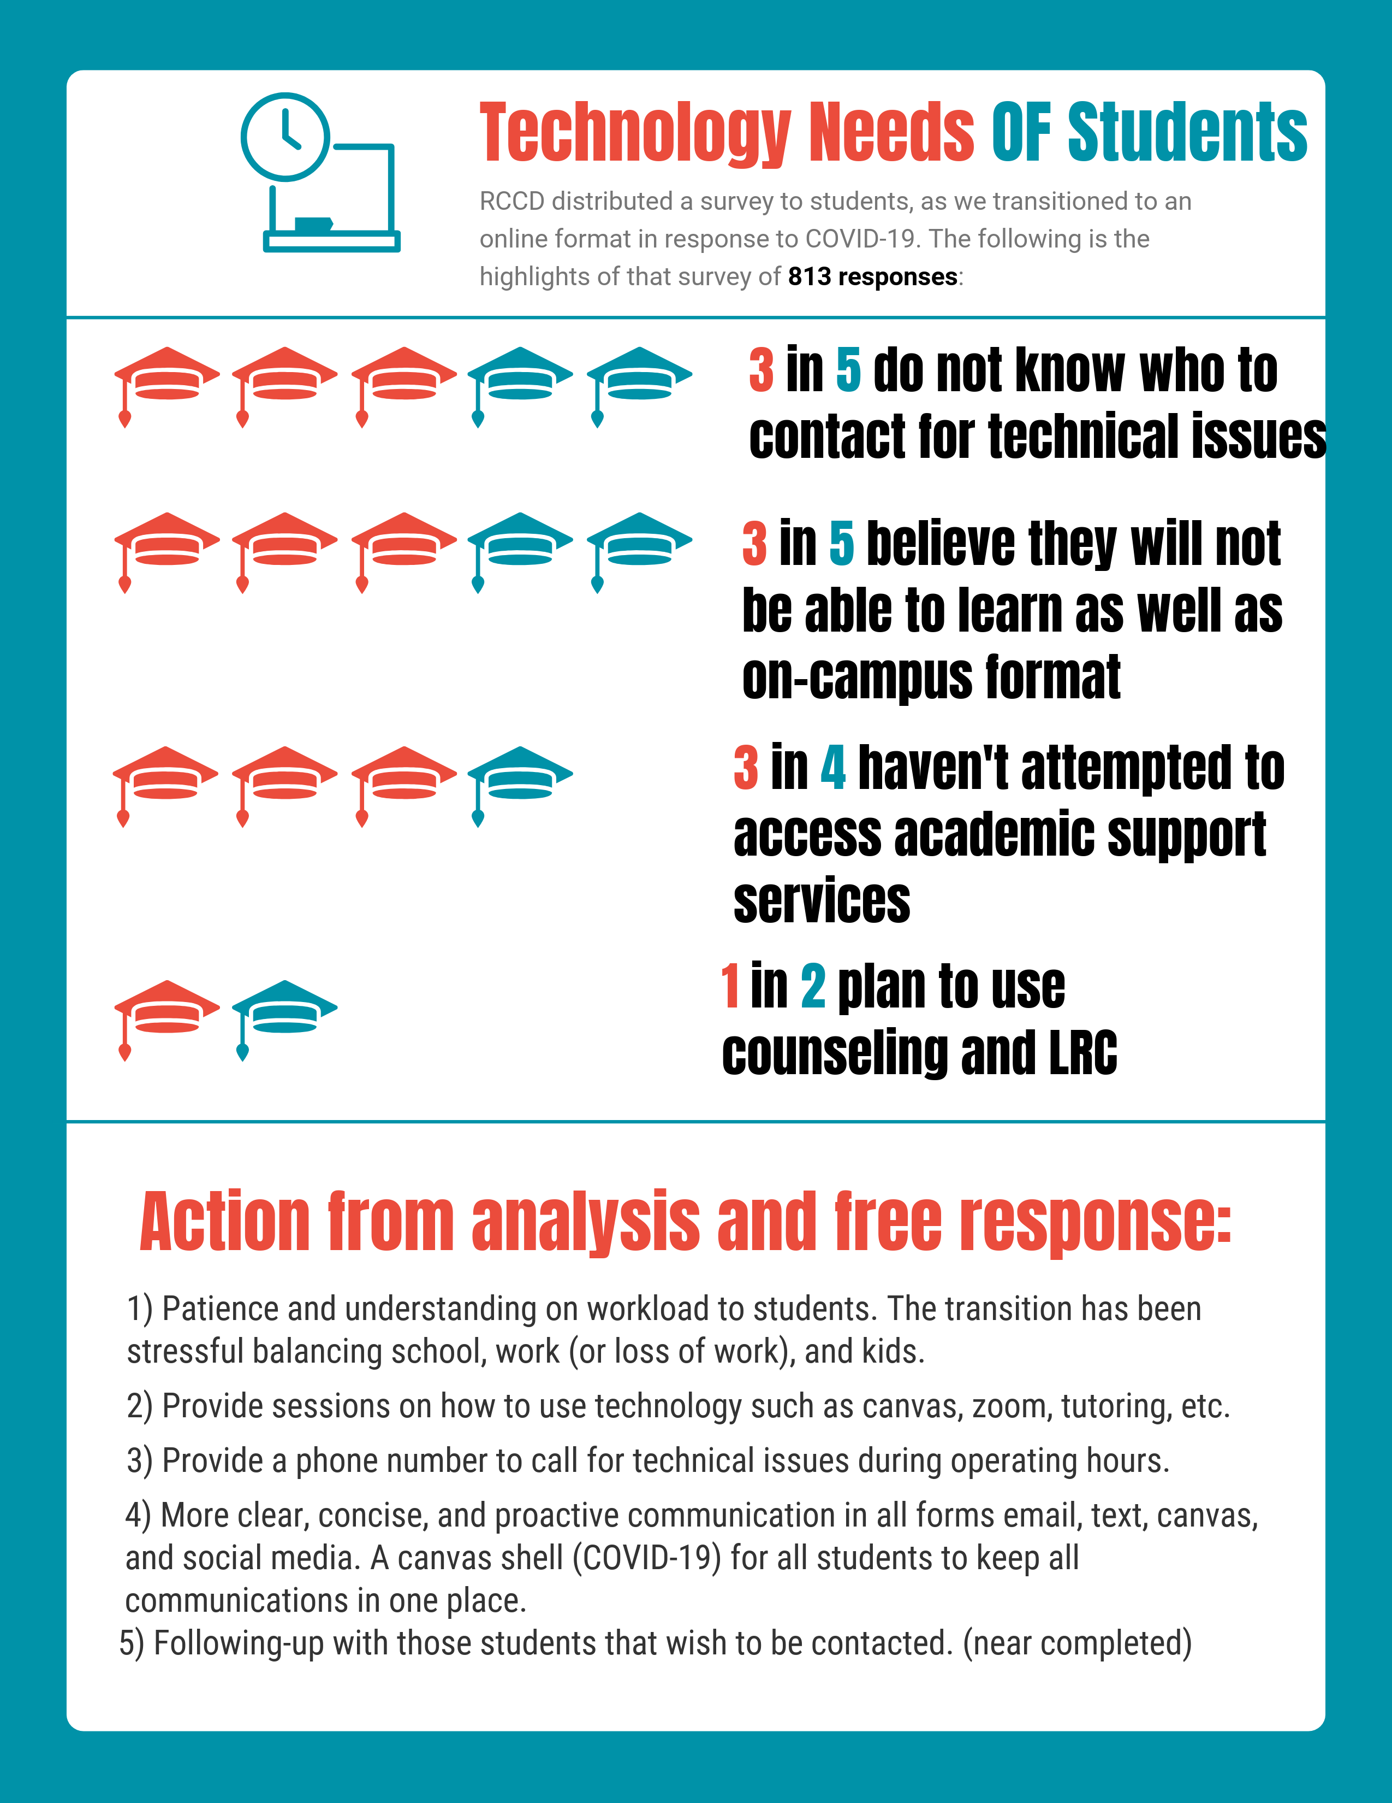
Surveys - Identifying Needs
Technology Needs
Drop Reasons (collecting responses)
Professional Development for Students
Notes:
Jake
What are students going to need be successful in an online environment if physical distancing guidelines continue into fall and beyond?

Slide 15
From the POV of Faculty
Data is going to be very different for spring 2020:
2nd term of full AB705 implementation – what will throughput look like?
Some classes canceled mid term due to COVID-19 crisis
Students could drop with EW even after taking final exam
Students opting for P/NP or IP grades
Reports on fluctuation in student performance after SIP orders
Notes:
Ginni
Students dropping with EW after final – what does this do to throughput? Success?
EW’s are not counted in the denominator – this will effect success and throughput rates at the state level
Your college can evaluate spring 2020 data – both with and without EWs, which will be more meaningful
We will be looking at some areas that are being discussed among faculty, and hopefully considered broadly
Fluctuations in student performance – what does it mean? DE is a success? DE is a failure? Assessment integrity issues? How will students perform in subsequent terms? What if they have gaps in content from courses taken in the spring 2020?
Some faculty kept their courses synchronous providing a virtual format as close to the F2F format as possible. Some faculty opted to make their courses asynchronous and change the format of their courses and assessment as well – both had intended and unintended consequences for students and for faculty, and most likely data.
Are we coding our courses accurately with the new CB25 and CB26 codes?

Slide 16
From the POV of Faculty
The Great Recession – beginning about 2008:
Enrollment increased
Funding for colleges decreased
COVID-19 Recession: 2020
Enrollment may increase: no jobs so need to retrain, students coming from 4-year institutions,
Enrollment may decrease: online education is a barrier for some
Funding for colleges will be decreased per the Governor’ May revise
Notes:
The Great Recession saw increase to enrollments and decrease to college funding – displaced workers were looking to retrain to gain new job skills for employment
With current COVID recession, we could see much of the same – there are and will continue to be limitations on physical access to colleges
The current budget is up in the air, with lots of opinions, as of yesterday, colleges are expected to maintain same level of support, access and sections with no additional support, and it is looking like an estimated 10% decrease in funding.
Summer enrollments at many colleges are skyrocketing – students meeting to finish requirements not met in spring 2020, students from 4-year institutions, displaced workers looking to retrain
Janet to talk about Atlantic and the article - https://www.theatlantic.com/ideas/archive/2020/05/community-colleges-could-help-students-through-pandemic/611884/ May 22, 2020 Sara Goldrick-Rab
Professor of sociology and medicine at Temple University
America Sabotaged the Solution to Its New Higher-Education Crisis: Many families are turning to community colleges amid the pandemic, but the schools aren’t equipped to handle an influx of students.
“Many of these families—plus millions of students already midway through a college degree—are going to turn to an institution often overlooked in the national discourse about higher education: community college. And why shouldn’t they?”

Slide 17
Fluctuation in Student Performance
Exam #2 was directly AFTER the transition to emergency remote education
Notes:
Meridith – Ginni can get more, if you think we should. Shift to remote education – what it means for the faculty and the student. Meridith learned to do an online test by exam 3. Ultimate conclusions not sure yet but looking at the factors contributing to data. Differences in sticking to syllabus and conducting class as on ground but remote.
When the shift was made some faculty taught course synchronously and others went asynchronously. The amount of work and other changes will impact data – there will be differences in student performance and by discipline.
Online course acceptance??

Slide 18
Fluctuation in Student Performance
Far fewer “D”s….

Slide 19
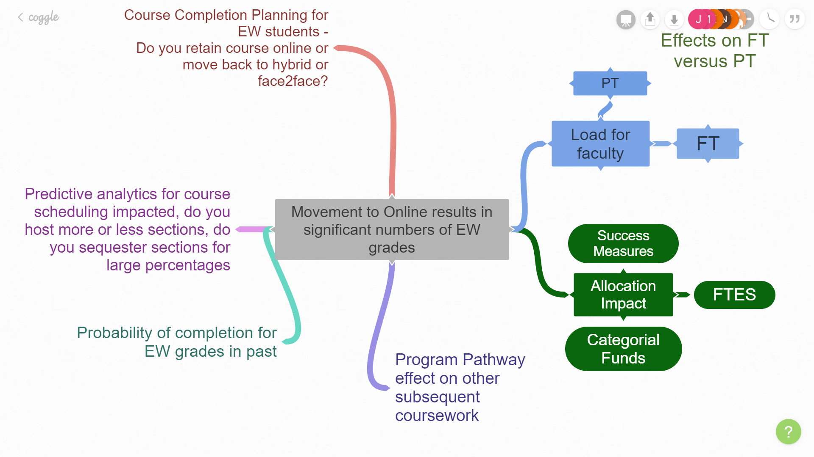
Notes:
Janet There are many aspects of the data and thinking about these helps us to get a more well-rounded picture.
However, our questions can only be answered by the best data

Slide 20
Data on Placement Strategies
Many changes occurred?
What data do we examine?
Fall 2019 Spring 2020?
Assessment will depend on coding
Notes:
Janet –
Also see MMAP webinar n AB 705
RP MMAP: AB 705 Evaluation https://bit.ly/MMAP2020

Slide 21
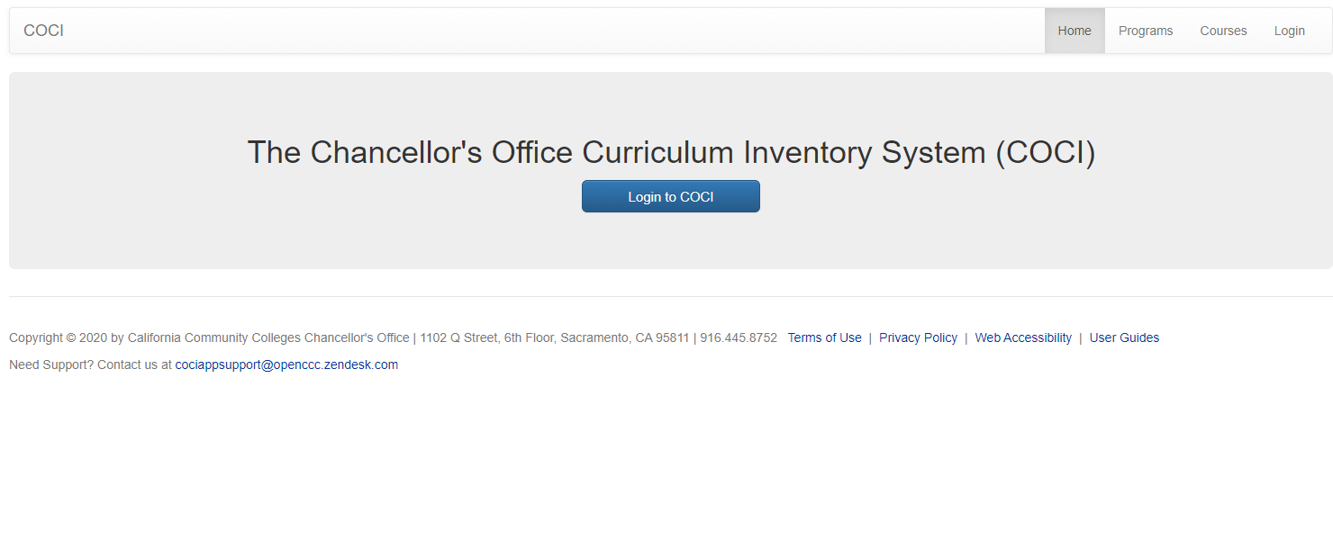
https://coci2.ccctechcenter.org/courses

Slide 22
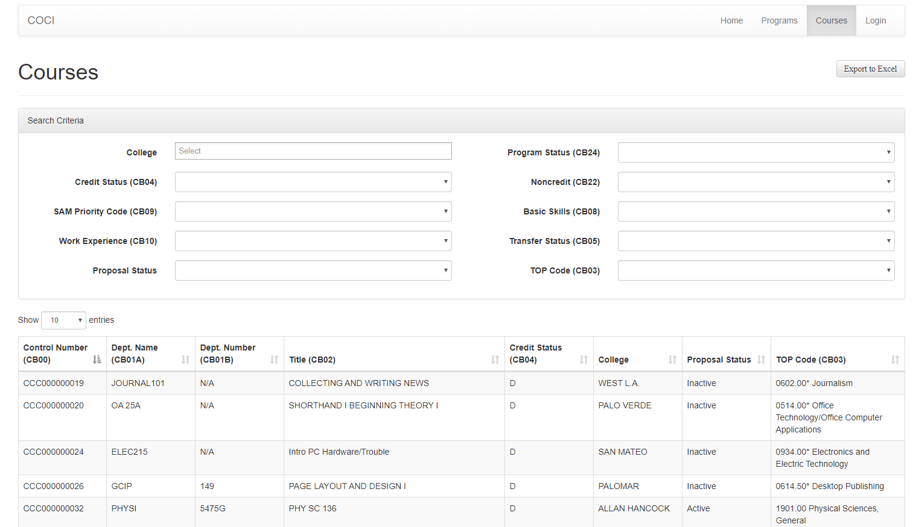
https://coci2.ccctechcenter.org/courses
Notes:
Use link above, do not log in and export to excel for a huge data dump with lots of info

Slide 23
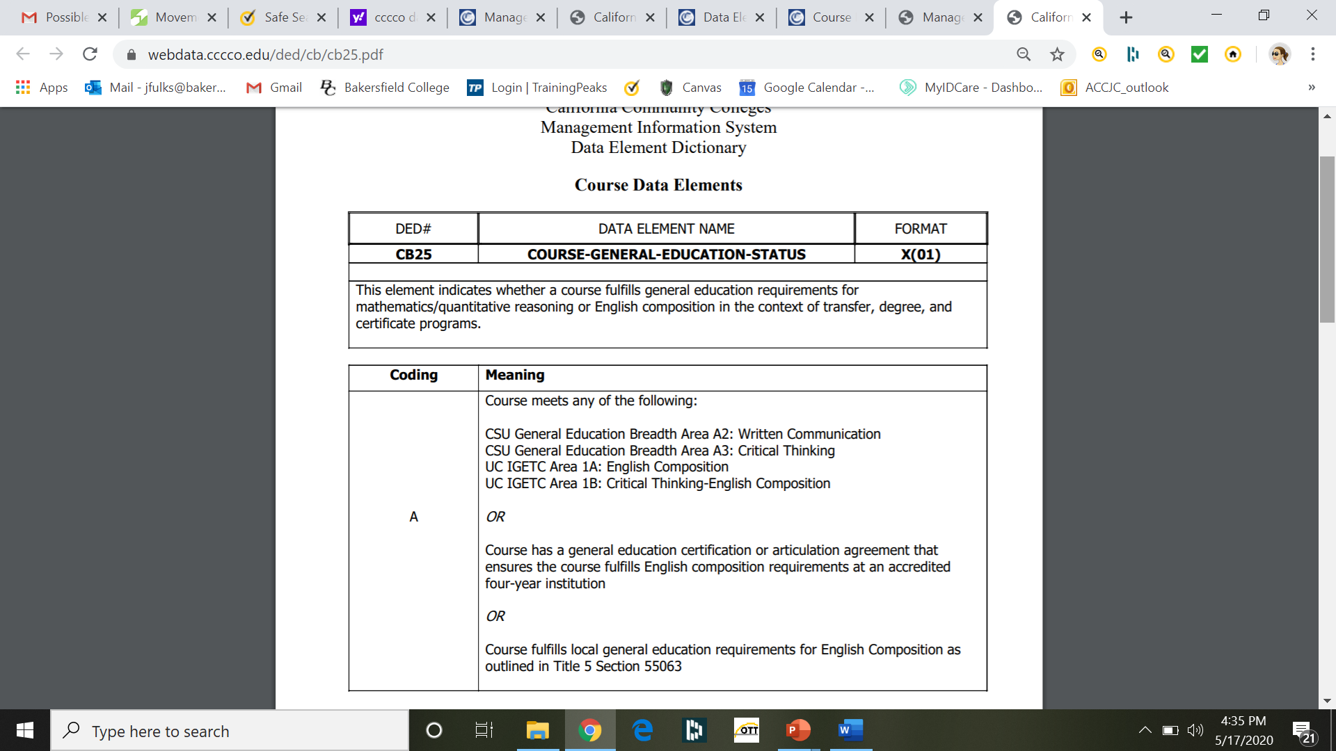
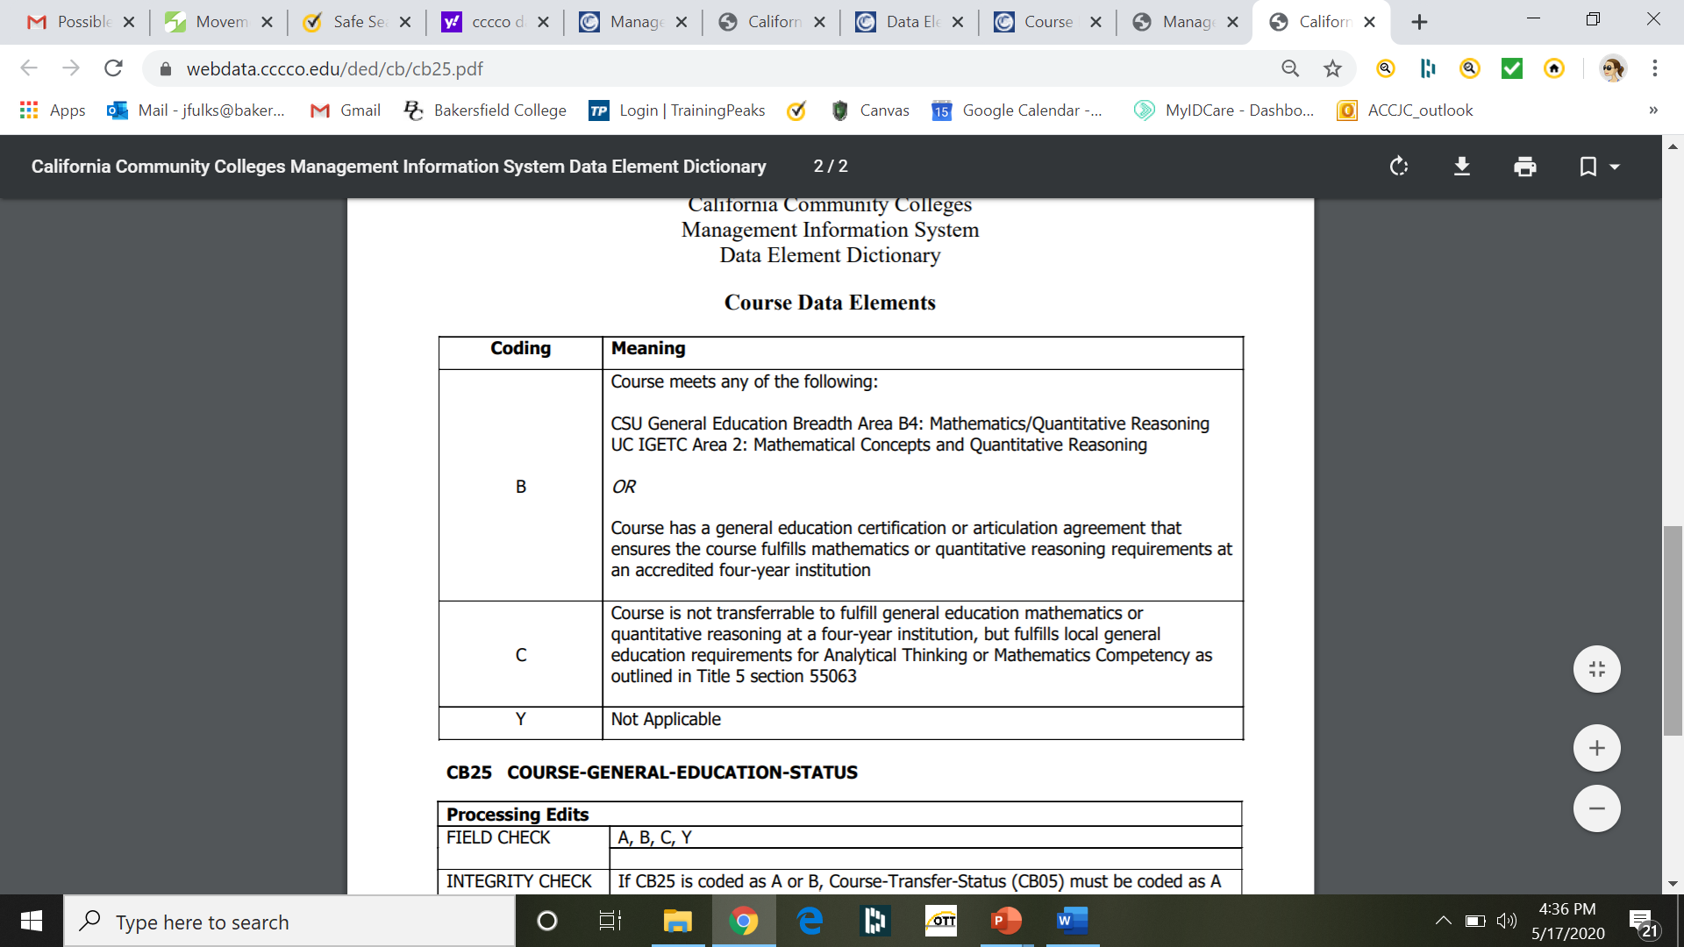
CB 25 General Education
https://webdata.cccco.edu/ded/cb/cb25.pdf
Notes:
Janet
https://webdata.cccco.edu/ded/cb/cb.htm
From the COCI data courses (CB05 A –transferable to UC and CSU) with CB25 A 347 Courses with CB 25 B 628 Courses with CB 25 C135 Courses with Y 53789 total courses 88496

Slide 24
Some thoughts about coding
2018 there were 179 CSU area A2 (Written Communication) courses and 161 IGETC area 1A: English Composition approved.
COCI 2.0 indicates 347 coded CB 25 – implications
  Many colleges have now created multiple courses with support (are they approved)
  CB 25 includes CSU A3 critical thinking & IGETC 1B critical thinking
1628 CSU area B4 (Mathematics and Quantitative Reasoning) and 1344 IGETC area 2 (Mathematical Concepts and Quantitative Reasoning)
COCI 2.0 indicates 628 courses marked for CB25
  Math has not been updated to the same extent
Notes:
This does not equate to CSU and IGETC articulation numbers of 179 CUS and 161 IGETC possibly because colleges in place of Composition alone now have 3 or 4 (College Composition with 1 hour lab, College Comp with 2 hour lab etc. or Composition and Reading & Composition and Reading with Support& Composition and Honors or Intensive Composition and Reading Stretch: First Quarter and Intensive Composition and Reading Stretch: Second Quarter)
Overall it is worth reviewing these codes for accuracy. There were many coded that made me think twice about its coding e.g. COMPUTER LITERACY FOR THE LIBERAL ARTS STUDENT, OIL PAINTING III
In preparation for coding changes we found in 2018 there were 179 CSU A2 (Composition) courses and 161 IGETC approved.
1344 IGETC (av 11.8 courses per college)
Incorrect for Math Just in Time Support for College Algebra & Fundamentals of Scientific Computing (MATLAB) should not be CB 25 but CB 26

Slide 25
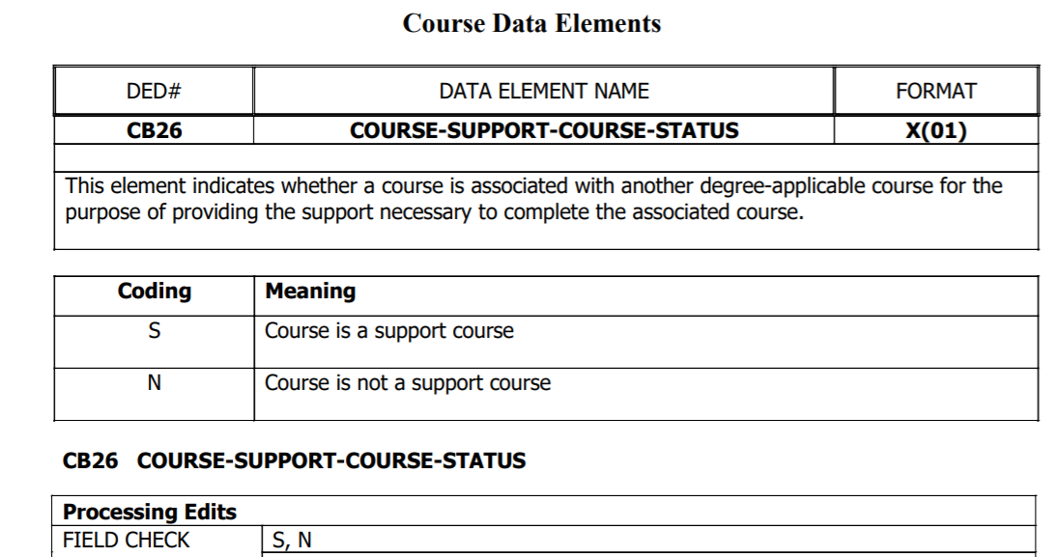
CB 26 Course Support Status https://webdata.cccco.edu/ded/cb/cb26.pdf
Notes:
Janet
https://webdata.cccco.edu/ded/cb/cb.htm
Some are at transfer level and some are not both should be coded to enable analysis of your current placement

Slide 26
Course Basic Coding for English/Math Support
COLLEGE | TITLE (CB02) | Support Course Status (CB26) | Credit or Noncredit | TOP CODE (CB03)
CHAFFEY | Mathematical Foundations | S | NC | 1702.00 Mathematics Skills
CHAFFEY | Skill Building for Math 420 | S | NC | 1702.00 Mathematics Skills
CHAFFEY | Skill Building for Math 450 | S | NC | 1702.00 Mathematics Skills
CHAFFEY | Skill Building for Stat 10 | S | NC | 1702.00 Mathematics Skills
CHAFFEY | Skill Building for Math 25 | S | NC | 1702.00 Mathematics Skills
COMPTON | Supervised Tutoring: Mathematics | S | NC | 4930.09 Supervised Tutoring
FOOTHILL | English Bridge | S | NC | 1501.00 English
FOOTHILL | Bridge to transfer English | S | NC | 1501.00 English
FOOTHILL | Critical Thinking: Student-Managed Portfolio Development | S | NC | 1501.00 English
FOOTHILL | Critical Thinking: Portfolio Management and Publication | S | NC | 1501.00 English
PALO VERDE | Preparatory Mathematics | S | NC | 1702.00 Mathematics Skills
MISSION | English Composition with Additional Support | S | Credit | 1501.00 English
L.A. TRADE-TECH | Statistics with Support | S | Credit | 1701.00 Mathematics, General
L.A. TRADE-TECH | Just in Time Support for College Algebra | S | Credit | 1702.00 Mathematics Skills
GOLDEN WEST | Freshman Composition With Support | S | Credit | 1501.00 English
Notes:
Janet
These are the only CB 26 coded English Noncredit support.
Janet Over 613 sections/over 175 noncredit courses of TOP Code 1501 or 1701 & 1702 but only 11 coded appropriately as support. A full list of the courses is posted with all the colleges at the ASCCC website. Check your coding.
Ventura CCD Moorpark MATHM905S CCC000603784 Support for College Algebra- Mathematics Skills-170200 Noncredit Not transferable
Peralta CCD Laney ENGL 508A CCC000602205 Academic Composition Skills English-150100 Noncredit Not transferable
History of Radio DJs Approved C 1 Y S 0604.00* Radio and Television
In addition there should be many colleges with credit CB 26 support coding but there are very few
Alternative topics noted as support need to be reviewed but include Various Top Codes coded for General Education Requirements 0103.00* Plant Science 0401.00 Biology, General 0499.00 Other Biological Sciences 0501.00* Business and Commerce, General 0504.00* Banking and Finance 0505.00* Business Administration 0506.00* Business Management 0514.00* Office Technology/Office Computer Applications 0601.00 Media and Communications, General 0602.00* Journalism 0701.00* Information Technology, General 0706.00 Computer Science (Transfer) 0707.10* Computer Programming 0801.00 Education, General 0835.00 Physical Education 1002.10 Painting and Drawing 1223.00* Health Information Technology 1501.00 English 1503.00 Comparative Literature 1506.00 Speech Communication 1507.00 Creative Writing 1509.00 Philosophy 1601.00 Library Science, General 1701.00 Mathematics, General 1702.00 Mathematics Skills 1799.00 Other Mathematics 1901.00 Physical Sciences, General 1902.00 Physics, General 2001.00 Psychology, General 2003.00 Behavioral Science 2099.00 Other Psychology 2105.00* Administration of Justice 2201.00 Social Sciences, General 2202.00 Anthropology 2204.00 Economics 2205.00 History 2207.00 Political Science 2208.00 Sociology 4930.13 Academic Guidance 4930.84 English as a Second Language - Writing 4930.87 English as a Second Language - Integrated

Slide 27
Notes:
Why is coding important?
Because we know that some of our strategies are working and some are not.
This is some data we are examining in the Guided Pathways Taskforce. Faculty POV may vary from other POV. For instance, I was reviewing a MMAP presentation of data from a college that showed success and throughput rates. It included a comment about the throughput rate increasing even with a “slight decrease” in success. But that “slight decrease” meant that as many students as were succeeding were now failing. And when the failures are disaggregated new stories come to light. Here the success rates of White non-Hispanic students are compared with the other ethnicities regarding success rates. Some refer to this as an equity gap.

Slide 28
Notes:
Can we use our Fall 20109 data to improve our serve? The foster youth data on placement into transfer, as well as other special populations (, needs some review

Slide 29
The Spring 2020 data will be anomalous
Begin thinking now about potential context
Prioritize data that will help improve practices
Include discussions about data that will benefit efficiency and most students
Don’t be afraid to ask questions
Do seek out context from students and faculty
Not all disciplines will have the same data

Slide 30


Q & A
Still have questions?
So do we!!!

