Slide 1
Fostering Innovation: Effective Practices for Department Chairs Supporting a Student-Centered Culture
Susan Bangasser, Dean of Science, San Bernardino Valley College
John Stanskas, ASCCC Executive Committee

Slide 2
Overview
What is innovation? culture?
Department chairs & Division Deans
How to cultivate a culture of engaged and creative faculty
Discussion

Slide 3
Innovation & Culture
Innovation: The introduction of something new. A new idea, method or device
Culture: a way of thinking, behaving, or working that exists in a place or organization
Notes:
Who’s in the room?
Definitions from Webster
Culture “The way things are done around here”

Slide 4
Innovation
Completely New Idea
Implementing something already in use elsewhere
Can be big (experimental curriculum)
Can be small (non-astounding teaching device)
Notes:
Innovation cannot exist in certain cultures
There is great external pressure to innovate right now…

Slide 5
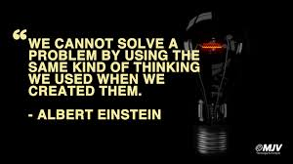
Pressure to Innovate

Slide 6
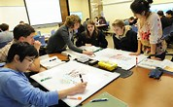
A Culture that Improves Student Engagement and Success

Slide 7
Culture
What is the culture of your department?
Are there competitive subcultures/fragmentations?
Is your department hierarchical?
Are adjunct included in departmental dialog?

Slide 8
Culture
Do you like each other?
Do you value each other?
Do you have a community of practitioners or a group of similarly assigned individuals?
Notes:
What works better for student learning?

Slide 9
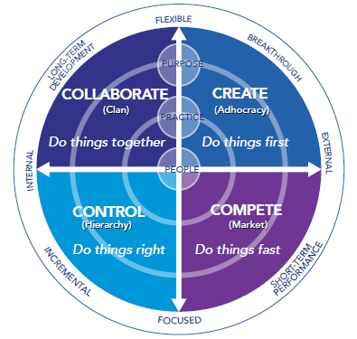
Notes:
One example to think about culture of a small group

Slide 10
What do Department Chairs Do
Class Schedule
Identify adjunct faculty
Textbook orders
Run faculty meetings
Shepherd curriculum review
Programmatic review
Represent the department at institutional meetings
Other?

Slide 11
Strategies to Improve Culture of a Department
Include adjunct in discussion
Schedules that facilitate informal interaction between faculty
Mentoring/coaching
Meetings at the beginning of term
Student celebration at the end of term
Experimental curriculum implementation support
Supporting professional development
Departmental goals – long and short term
Notes:
Does this support student learning?

Slide 12
How Do Academic Deans And Department Chairs Support a Culture of Innovation?
Mentor faculty during evaluation
Support minority opinions for change
Encourage observation
Book Club

Slide 13
How Do Academic Deans And Department Chairs Support a Culture of Innovation?
What do you think?

Slide 14
Innovation
Innovation occurs in a supportive and safe culture where faculty voices are valued – allows creativity
Change is scary – need a safe environment to succeed

Slide 15
Barriers to Innovation
We can’t do that because…
What have you heard?

Slide 16
What Can You Do?
When I get back to my college, I am going to…

Slide 17
What Can You Do?
When I get back to my college, I am going to…

Slide 18
Resources
“Six ideas to promote innovation in your workplace”
http://www.forbes.com/sites/theyec/2012/12/31/6-ideas-to-promote-innovation-in-your-workplace-this-year/
”Leadership Skills and Emotional Intelligence” http://www.ccl.org/Leadership/pdf/assessments/skills_intelligence.pdf
“Clifton Strengths Finder” http://strengthstest.com/strengthsfinderthemes/strengths-themes.html
Books for further reading:
What the Best College Teachers Do by Ken Bain
Learner Centered Teaching by Maryellen Weimer
The Engaged Teacher: What Works with Today’s Students by Nancy Vader-McCormick
Teaching College in an Age of Accountability, Richard Lyons
Make it Stick: The Science of Successful Learning, P. Brown, H. Roediger, and M. McDaniel

Slide 19
Thank You
Susan Bangasser: sbangasser@valleycollege.edu
John Stanskas: jstanskas@valleycollege.edu

