Slide 1
Designing Support Structures to Facilitate Student Transfer

Slide 2
Presenters
Stephanie Curry, ASCCC Area A Representative
LaTonya Parker, ASCCC Area D Representative
Robert L. Stewart Jr, ASCCC Area C Representative
Notes:
Stephanie

Slide 3
Breakout Description
Come and discuss how innovative programs and support services e.g. Counseling Services, Guided Pathways, OER, Career Exploration, and Online Education can support student transfer.
Notes:
Stephanie

Slide 4
Areas of Focus for today's session
Counseling
Career Counseling/ Exploration
Experiential/Applied Learning
Guided Pathways
OER
Online Education

Slide 5
Holistically Supporting Student Transfer
Support beyond the Classroom
All in the college support transfer
How can we increase student transfer velocity? --Discussion across campus
How can we support students who complete degrees but do not transfer
Transfer addresses equity barriers and is avenue for social and economic mobility for our communities
Notes:
LaTonya

Slide 6
Through the Gate
Transfer addresses equity barriers and is avenue for social and economic mobility for our communities
# of Students who complete AA and indicate they wish to transfer but do not
How can we support---
• Transfer achievers: Students who made it through the gate by transferring to any university, with or without a degree.
• Students at the gate: Transfer-ready students who completed 60± transferable units (including transfer-level English and math) and/or an AD-T, but had not yet transferred.
• Students near the gate: Transfer-prepared students who completed 60± transferable units, but who were missing transfer-level English and/or math and had not yet transferred.
Notes:
Stephanie

Slide 7
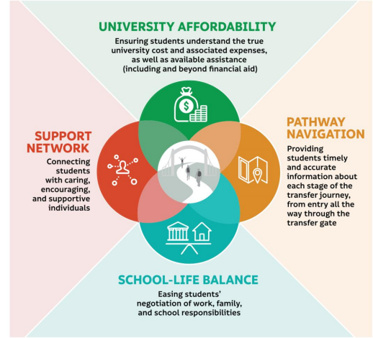
Need for Transfer Support
Transfer Rate- California Community Colleges
Four Year Transfer Rate= 23%
Six Year Transfer Rate= 39%
Datamart
Notes:
SC

Slide 8
Counseling
Counselors are a key support for student transfer
Starting with the End in Mind assisting students with their Student Education Plan (SEP)
Seeing the bigger picture beyond college
Working with students in creating/identifying educational goals
Provide ongoing support and intervention strategies (case management)
Working with faculty on Early Alert Support to keep students on their path
Notes:
LaTonya

Slide 9
Career Exploration and Counseling
Early identification of programs (especially important in STEM fields)
Understanding job opportunities and future income potential with different programs
Help students aligning their interests with potential careers
What job options are there in their chosen pathway (too many, too few, regional options)
Understand what education level/experience is needed for their desired careers
Career exploration should start early and preferably in high school and reinforced at CCC
Notes:
LaTonya

Slide 10
Experiential and Applied Learning
Encourages students to explore their career options
Apply what they have learned in the classroom to real life scenarios
Determine if their areas of interest what they really what to do in a career
Reveal aptitude or areas of improvement for future careers
Some program already have this type of learning built in...CTE and STEM
Students can use this experience in application to transfer or scholarships
Notes:
Robert will talk about applied learning in STEM
Stephanie talk about application to beyond traditional applied learning

Slide 11
Supporting Transfer with Guided Pathways
Holistically supporting each student to complete their educational goals
Clear Program Maps
Student Success Teams
Student Engagement in Pathways and Beyond
Intrusive Educational Advisement from Pathways Faculty
Wrap Around Student Services- Addressing Basic Needs
Transfer Support and Exploration Opportunities aligned to Pathways
Student Centered Pedagogy
Dismantling barriers to student transfer with policies, procedures and support
Notes:
SC

Slide 12
OER
OER gaining traction in the past 4 years
Addresses textbook cost barriers for students (supporting basic skills)
Students may be able to take more classes or complete classes if have access to textbooks
Studies show students class patterns are significantly impacted by textbook costs (how many classes)
Linked to increased retention (students need books from day one of class). Students will be less likely to drop courses if have textbooks
May help with transfer rate and student completing programs in reasonable time
Notes:
Robert

Slide 13
Online Education
Provides flexibility of options for students
Fewer disruptions to students path to transfer if they have options for multiple modalities
Fully Online Pathways--options for students who need full flexibility
Lower Cost
Notes:
Robert

Slide 14
Working together to Support Student Transfer
Student does not see job titles just people who can help
Recommend these groups for today's topics work together and with other groups to strategically plan how they can work together to support student transfer
Bring in students to ask them what they need and how they can be supported
Regularly look at transfer data and identify and act on how to address barriers
Notes:
Robert

Slide 15
Resources
Through the Gate (RP Studies)
Effective and Equitable Transfer Practices in the California Community Colleges
ASCCC Guided Pathways Page
ASCCC OERI Webpage
The Role of Counseling Faculty and Delivery of Counseling in the California Community Colleges
Counseling Faculty Modeling Transformational Leadership to Bring About Change

