Slide 1
Destination = SUCCESS!
Janet Fulks
ASCCC Guided Pathways Faculty Lead, Capacity Building
Carrie Roberson
ASCCC Guided Pathways Task Force, Chair

Slide 2
Overview
Why Career & Technical Education (CTE)?
Why General Education (GE)?
CTE/ GE and…
Program Mapping
Meta-Majors
Problem-Solving
Take-Away Activity…
Notes:
Carrie- Mission of community colleges…morph?

Slide 3
WHY? Career & Technical Education (CTE)
Notes:
Alignment with local labor market demand (certificates and degrees)
Job Market & Careers
Informed Choices- Core requirements – general education

Slide 4
WHY? General Education (GE)
Notes:
General Education Requirements are treated like they are your little sibling that you HAVE to take everywhere you go. They take up space, require an explanation when your friends ask why you had to take them and in general feel like a loss of freedom.
For most people, Gen Eds are a "waste of time" and they get in the way of classes pertinent towards your major. But why do Gen Eds exist? Everyone hears the "they are to widen your educational borders" or "they are to help you find what you want to study for the rest of your life" speeches at orientation. When I heard these speeches I thought "they just want to give us filler classes so they can collect another year of tuition." But this year, I learned what General Education Requirements are really for: to help you find interests outside of your major and for you to become a well-rounded student. While I would love to learn in all the political science and journalism classes, there exists a world of interesting subjects outside my major. This year I realized that some of the topics learned in Gen Eds can carry over into your major. For example, I took an Environmental Science Course this summer to fulfill a requirement. I thought I would never hear the terms "Tragedy of the Commons" or "freeriding" again. But then my politics class came around and I heard all the terms all over again! I was two steps ahead of my fellow classmates. We cannot just be classroom carbon copies. What I mean by that is we can not function in society by just talking about journalism or political science theories. This is most obvious when people ask us what we do outside of the classroom. There is a reason interviewers ask that. Companies do not want to hire people that are a walking syllabus; they want well rounded individuals that are passionate about a wide variety of things. We will meet people at mixers and galas that will be amazed to know that we are 19th century poetry enthusiasts or have an interest in the cosmos. We become more well rounded and people will love us for that. When you look at your Gen Ed requirement list do not see it as a "get it over with" check list. See it as an opportunity to learn more. There will never be another time in your life when you will have the opportunity to learn about marine biology, art history, or Buddhism! You might even find a passion that will stick with you for the rest of your life.

Slide 5
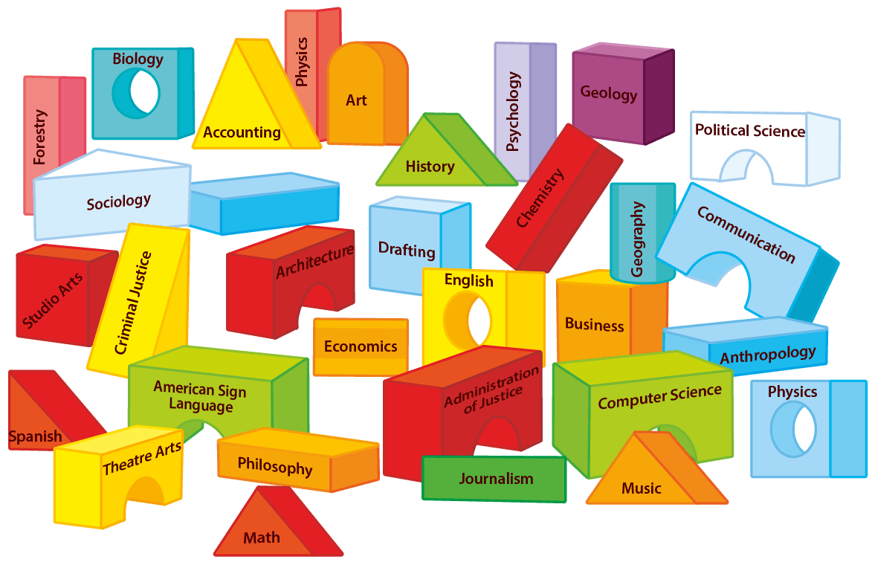

Slide 6
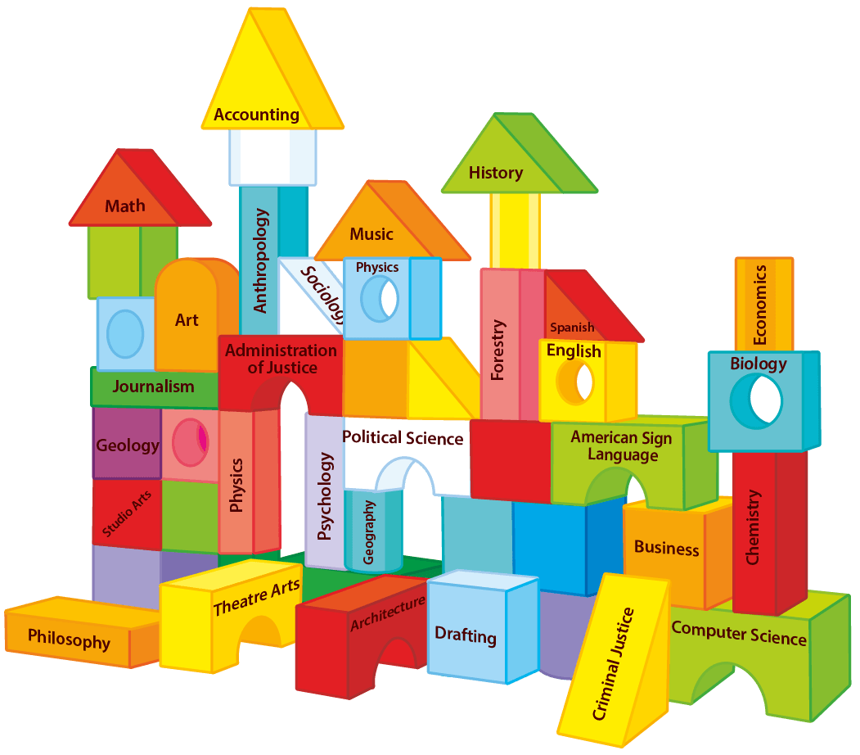

Slide 7
Local CTE/ GE in Context
How do your CTE programs align with employment and industry need?
How does your local GE requirements relate to CSU GE Breadth and IGETC?
Should there be a connection?
Notes:
Whole student experience in context!
Discuss local degrees and need for connection

Slide 8
The Impact of CSU breadth
College A Subject area | Sections 2014-2015 |  | Sections 2015-2016 | Sections 2016-2017
Area A – English Language Communication and Critical Thinking
A1 = Oral Communication Comm 1 Comm 4 Comm 8 | 130 93 10 27 | 130 93 10 27 | 135 99 8 28 | 156 121 9 27
A2 = English Composition | 172 | 172 | 188 | 215
A3 = Critical Thinking Engl 1B Engl 2 Engl 3 Phil 7 Comm 5 | 75 15 2 1 30 27 | 75 15 2 1 30 27 | 80 14 3 2 35 26 | 79 18 3 2 32 24
Notes:
Janet

Slide 9
Can ________ students finish?
evening
weekend
online
part-time
_______?

Slide 10
SCHEDULING
Considering the schedule currently available to your students:
Are you serving your students well?
Is there room for improvement or a need for change?
Do your students believe they are well-served?
Do your students have the opportunity to fill requirements elsewhere?
Could guided pathways be the answer?
Notes:
Do you know if all requirements are offered considering all student need?

Slide 11
Program Mapping & Meta Majors
How do you get started with mapping programs and creating meta-majors?
What are the guiding principles to help colleges build relevant groupings for meta-majors and considerations to map programs accordingly?
How can these principles/groupings serve the students and the college?
How can this process clarify pathways for the college and student support efforts?

Slide 12
Meta-Majors with Program Mapping
Notes:
Quantitative Reasoning the Next “Across the Curriculum” Movement by (AACU) Susan Elrod, 2014 https://www.aacu.org/peerreview/2014/summer/elrod
Better Guidance at All Levels
Helps to Find Majors
Exploration
Demonstrates the Starting and Ending Points
Informs Choices
Reduce Excess Units
Related Careers and Salaries
Register for the Correct Math and General Education
Math Pathways – Depends on Major

Slide 13
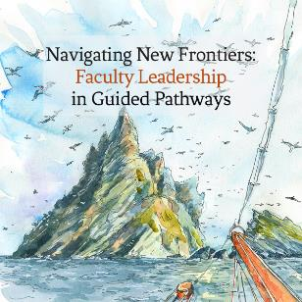
Your expertise, please…
TRANSFORMING the INSTITUTIONAL LANDSCAPE!
Communication, engagement, implementation
Structural Innovation
Student Equity
Student Services
Onboarding
Student Voice
Wayfinding
Integrated Planning
Scheduling/ Strategic Enrollment Management
& COLLABORATION!
Notes:
STUDENTS 1st!
Academy focus… what we know and what we need to know!

Slide 14
ACTIVITY
How can a college communicate pathways to prospective students?
How could pathways be presented to students?
How could a college indicate pathway requirements to students?
How could a college help students make informed choices about pathways?
What role do orientations, first-year experience/student success courses align with pathways?
Notes:
Considering effective practices of CTE programs, GE requirements, other and the student voice…

Slide 15
Notes:
TIME BENDER!

