Slide 1
Development of New CTE Programs
Dianna Chiabotti, Napa Valley College
Brandi Asmus, Woodland Community College
Notes:
Thais

Slide 2
So you want to start a new program. . .
………….WHY?
PROGRAM?
Notes:
Brainstorm why do it

Slide 3
Elements of a CTE program?
Industry need
Labor market
Course outline
Learning outcomes
Ongoing costs
Student fee issues
Curriculum process
Regional process
Number of potential students
Faculty expertise
Undue impact on other colleges
Others?

Slide 4
First . . .
Will program completers need a certificate or degree?
How will you count your student successes?
Notes:
Dianna

Slide 5
CTE Associate Degrees and Certificates
A.A. or A.S.
Certificate of Achievement
Title 5, §55070: 16 units or higher to be submitted for approval. Additionally, certificates between 8 and 15.5 units may be submitted for approval.
Local Certificate
Industry Certification??
Notes:
Dianna

Slide 6
When is a Program or Class CTE?
Assigned a TOP Code designated as vocational in the TOP manual.
Assigned a SAM code (courses)
Notes:
Dianna

Slide 7
TOP Code Manual

Slide 8
SAM Code
A | Apprenticeship
B | Advanced Occupational
C | Clearly Occupational
D | Possibly Occupational
E | Non-Occupational
Notes:
A
B
C
D
E
Apprenticeship (offered to apprentices only) The course is designed for an apprentice and must have the approval of the State of California, Department of Industrial Relations, Division of Apprenticeship Standards. Some examples of apprenticeship courses are: Carpentry, Plumbing and Electrician.
Advanced Occupational (not limited to apprentices) Courses are those taken by students in the advanced stages of their occupational programs. A “B” course is offered in one specific occupational area only and clearly labels its taker as a major in this area.
. Priority letter “B” should be assigned sparingly; in most cases no more than two courses in any one
program should be labeled “B”. Each “B” level course must have a “C” level prerequisite in the same program area. Some examples of “B” level courses are: Dental Pathology, Advanced Radiology Technology, Fire Hydraulics, Livestock and Dairy Selections, Real Estate Finance, Cost Accounting.
Clearly Occupational (but not advanced) Courses will generally be taken by students in the middle stages of their rograms and should be of difficulty level sufficient to detract “drop-ins”. A “C” level course may be offered in several occupational programs within a broad area such as business or agriculture. The “C” priority, however, should also be used for courses within a specific program area when the criteria for “B” classification are not met. A “C” level course should provide the student with entry-level job skills. Some examples of “C” level courses are: Soils, Principles of Advertising, Air Transportation, Clinical Techniques, Principles of Patient Care, Food and Nutrition, Sanitation/Safety, Small Business Management, Advanced Keyboarding, Technical Engineering.
Possibly Occupational
“D” courses are those taken by students in the beginning stages of their occupational programs. The “D” priority can also be used for service (or survey) courses for other occupational Programs. Some examples of “D” level courses are: Technical Mathematics, Graphic Communications, Elementary Mechanical Principles, Fundamentals of Electronics, Keyboarding (Beginning or Intermediate), Accounting (Beginning).
Non-Occupational
These courses are non-occupational.
The course may be a “capstone course” that is
taken as the last requirement for a career technical education program

Slide 9
Important to remember, CTE
May include transfer preparation
Courses must count specifically toward a major after transfer
Courses required in the lower division (associate degree) will not have to be repeated in the upper division
The associate degree satisfies all lower-division major requirements
Notes:
Dianna

Slide 10
Credit or Non-Credit ?
Notes:
Dianna

Slide 11
Non-Credit Courses
Non-degree applicable
No credit awarded
No student tuition
Based on hours of instruction, not units
Accessible to all students
May be repeatable
Approval: local process + full approval process by CO
Notes:
Dianna

Slide 12
Non-Credit – Course Categories
CDCP (Career Development & College Preparation) | Other Categories Allowed
Elementary & secondary basic skills and remedial education ESL Short-term vocational programs Workforce preparation | Parenting education Citizenship Education programs for persons with disabilities Education programs for older adults Home economics Health and safety education
Apportionment equal to credit courses if part of a Certificate Program
Apportionment less than credit courses
Notes:
Dianna

Slide 13
Some Non Credit Considerations
Do students need financial aid?
Will students need
Units?
Completion of coursework?
Certificate?
Are you trying to reach an underserved or disadvantaged population?
How many hours of instruction will you need in the course or program?
Notes:
Dianna

Slide 14
Consider these Elements of Non Credit
Free! (No registration fees)
Positive Attendance
Managed Enrollment OR Open Entry/Open Exit
Rigor!
Assessment and Grading
P/SP/NP
Could be graded A-F (local decision)
Open courses (like credit)
No lecture or lab designation
Minimum Qualifications
Notes:
Dianna

Slide 15
(CDCP) Career Development College Prep
Equalized funding when 2+2 courses linked to a noncredit certificate
Certificates
Workforce Preparation
Short Term Vocational (with High Employment Potential)
Notes:
Dianna
55151
Certificate of Competency
A certificate in a recognized career field articulated with degree-applicable coursework, completion of an associate degree, or transfer to a baccalaureate institution
Certificate of Completion
A certificate leading to improved employability or job opportunities

Slide 16
And, Non-Credit Doesn’t Require
LMI (labor market information)
Advisory Committee Recommendation
Regional Consortium Recommendation
Notes:
Dianna

Slide 17
Ready, Set,………….
Notes:
Brandi

Slide 18
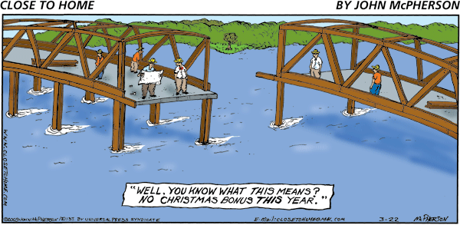
Poor Planning Can Cause Major Delay
Notes:
Brandi

Slide 19
Credit Program
Notes:
Brandi

Slide 20
New & Substantive Revisions Require . .
Advisory Committee Recommendation
Regional Consortium Recommendation
Requires Labor Market Information (LMI)
Notes:
Brandi

Slide 21
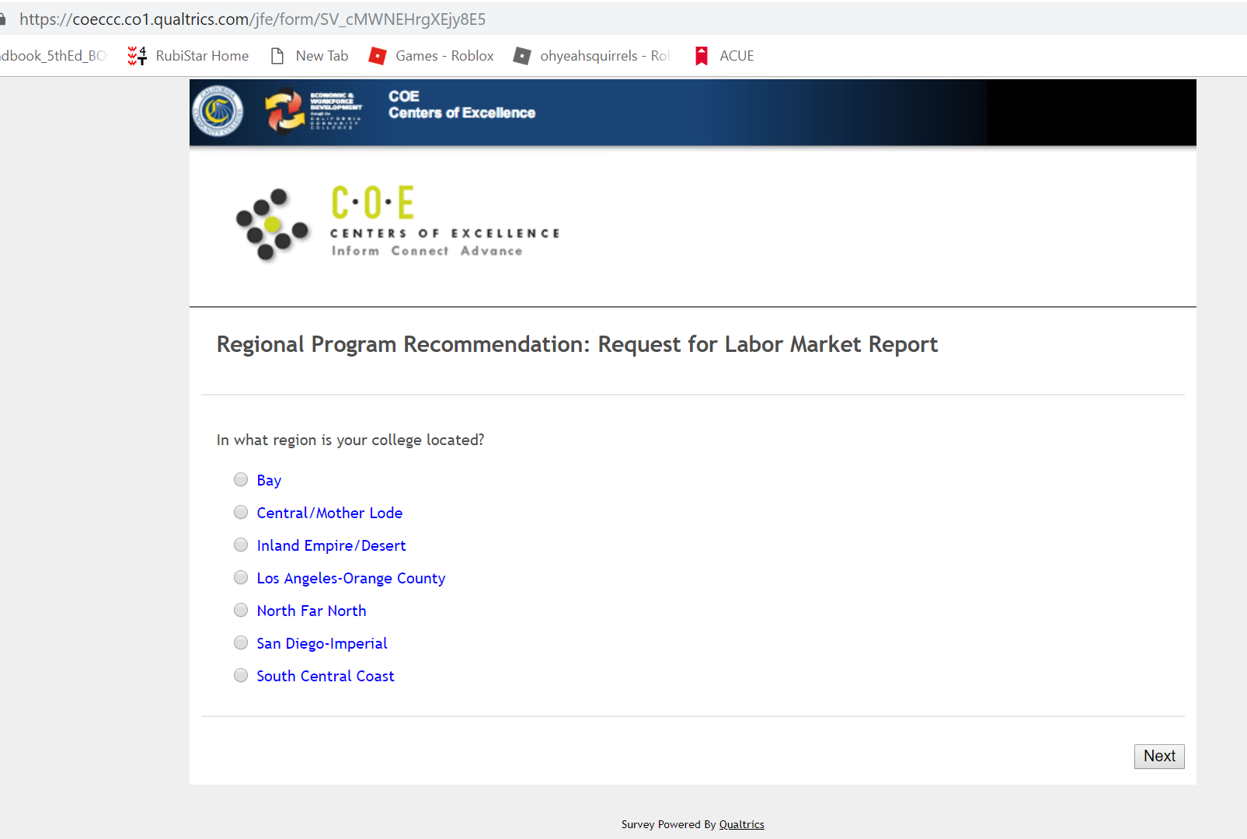
Other LMI
Notes:
Brandi

Slide 22
Must Submit to CO
Program narrative
CORs for all courses
Advisory Committee minutes
Regional Consortium recommendation
Appropriate ASSIST, if applicable
Notes:
Brandi
Program narrative (Chancellor’s Office Narrative Templates for CTE Degrees and Certificates)
Appropriate ASSISTand other transfer documentation if degree program designed for both CTE and transfer

Slide 23
Program Narrative, includes . . .
Program Goals and Objectives
must address transfer preparation or a valid workforce need
Notes:
Brand

Slide 24
Program Narrative, includes . . .
Catalog Description
includes program requirements,
prerequisite skills or enrollment limitations,
student learning outcomes, and
information relevant to program goal
Notes:
Brandi

Slide 25
Program Narrative, includes . . .
3. Program Requirements
includes course requirements & sequencing that reflect program goals.
The GE pattern and the calculations used to reach the degree total must be shown.
Notes:
Brandi

Slide 26
Program Narrative, includes . . .
Master Planning
how it fits in the mission, curriculum, & master planning of the college and higher education in California
Notes:
Brandi

Slide 27
Program Narrative, includes . . .
5. Enrollment and Completer Projections
projection of number of students to earn degree or certificate annually
Notes:
Brandi

Slide 28
Program Narrative, includes . . .
6. Place of Program in Curriculum/Similar Programs
how it fits in college’s existing program inventory
Notes:
Brandi

Slide 29
Program Narrative, includes . . .
Similar Programs at Other Colleges in Service Area
justification of need for program in the region
Notes:
Brandi

Slide 30
Program Narrative, includes . . .
8. Transfer preparation information
for CTE-transfer degrees
Notes:
Brandi

Slide 31
Non-Credit CDCP Program
Notes:
Dianna

Slide 32
Non-Credit CDCP Program
Certificate of Competency
A certificate in a recognized career field articulated with degree-applicable coursework, completion of an associate degree, or transfer to a baccalaureate institution
Notes:
Diana
55151
Certificate of Competency
A certificate in a recognized career field articulated with degree-applicable coursework, completion of an associate degree, or transfer to a baccalaureate institution
Certificate of Completion
A certificate leading to improved employability or job opportunities

Slide 33
Non-Credit CDCP Program
Certificate of Completion
A certificate leading to improved employability or job opportunities
Notes:
Diana
55151
Certificate of Competency
A certificate in a recognized career field articulated with degree-applicable coursework, completion of an associate degree, or transfer to a baccalaureate institution
Certificate of Completion
A certificate leading to improved employability or job opportunities

Slide 34
Non-Credit CDCP Program
If bundled into one of these,
Certificate of Competency
Certificate of Completion
Earn higher apportionment
Submission for approval requires a narrative document similar to credit programs
Notes:
Diana
55151
Certificate of Competency
A certificate in a recognized career field articulated with degree-applicable coursework, completion of an associate degree, or transfer to a baccalaureate institution
Certificate of Completion
A certificate leading to improved employability or job opportunities

Slide 35
Program Approvals – Best Advice
Don’t wait until after local board approval to start assembling documents
Notes:
Diana

Slide 36
Program Approvals – Best Advice
Wherever appropriate, use the program narrative, LMI data, and other documentation to guide the program-approval process at the local level
Notes:
Diana

Slide 37
Program Approvals – Best Advice
Develop a checklist or process for program approvals so all components can easily be tracked and managed
Notes:
Diana

Slide 38
Questions?
Notes:
Diana

Slide 39
Resources
Program and Course Approval Handbook, 6th edition
Taxonomy of Programs, 6th edition
Data Element Dictionary, SAM Code
Title 5, Division 6, Chapter 6
COE Supply Demand Tables
Occupational Information Network Online
Notes:
Diana

