Slide 1
Gathering and Using Disaggregated SLO Data
ASCCC 4th SLO Symposium
North Orange County Community College District
February 3, 2017
Katryn Wiese City College of San Francisco
www.ccsf.edu/slo

Slide 2
AGENDA – Disaggregated SLOs
Overview – What and Why
Overview – How
Application: Course-Level and Gen Education-Level Evaluation
Application: Program-Level Evaluation
Application: Institutional Learning Outcome Evaluation
Responses: Curriculum to College-Wide Initiatives
Q&A

Slide 3
In 2014, the ACCJC adopted revised Standards with increased emphasis on student learning and achievement, including this new Standard:
Accreditation Standard I.B.6.
The institution disaggregates and analyzes learning outcomes and achievement for subpopulations of students. When the institution identifies performance gaps, it implements strategies, which may include allocation or reallocation of human, fiscal and other resources, to mitigate those gaps and evaluates the efficacy of those strategies [emphasis added]

Slide 4
Glossary definitions for learning outcomes and achievement per the ACCJC’s Guide to Evaluating and Improving Institutions, July 2015, page 12:
“Student Learning: Competencies in skill and knowledge gained by students who are at the institution. The knowledge and competencies are expressed for segments of study or activity through measurable learning outcomes at the institutional, program, degree, and course levels.”
“Student Achievement: Student attainment that can be measured at defined points of completion, including successful course, certificate and degree completion, licensure examination passage, post-program employment, and other similar elements.”

Slide 5
Feb/Mar/April 2015: CurricUNET Software and Training Development
Notes:
Start first with the actual outcome reports

Slide 6
May/June 2015: CurricUNET Instructors enter data each semester, each section, for each student
Notes:
Start first with the actual outcome reports

Slide 7
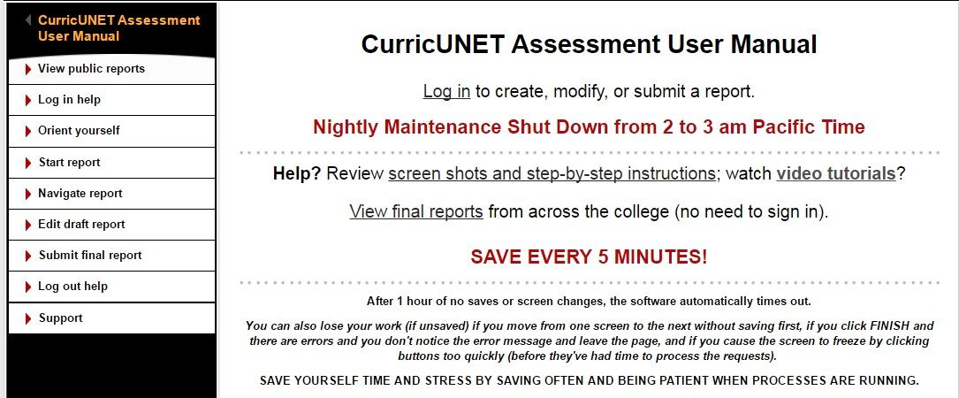
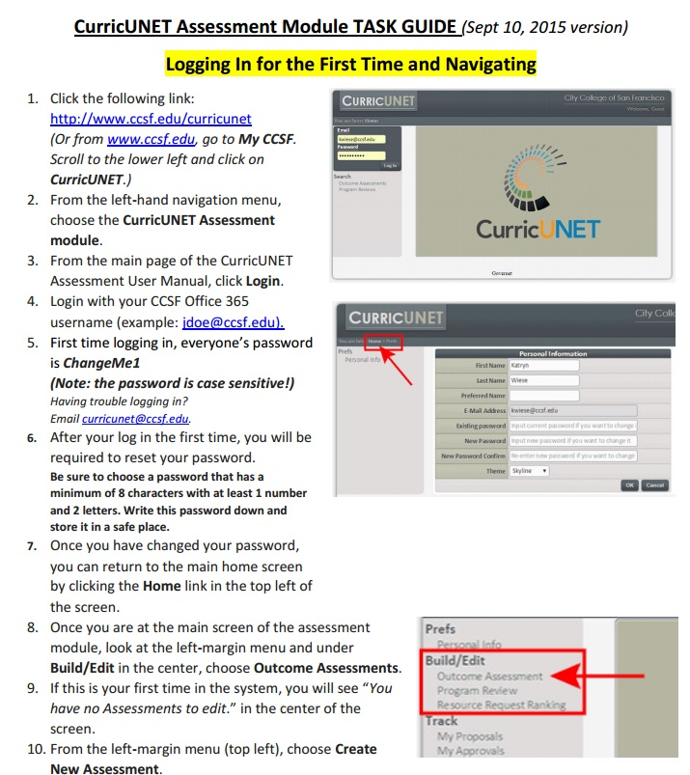
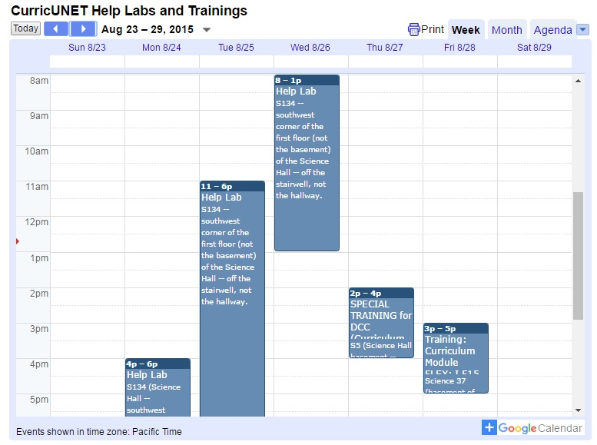
SLO Coordinator Team CurricUNET Administrator provide support
What do you mean I have to clear my cache?
This is a wste of time!
Whais a browser?
Notes:
Start first with the actual outcome reports

Slide 8
SLO Coordinator Team and CurricUNET Administrator provide ALL KINDS OF SUPPORT
Tell me what to do – I don’t want to read or watch a video.
My password doesn’t work!
Who’s going to see this?
WHY?
This is a waste of time!
What is a browser?
I should be paid more to do this!
I’m just a part-timer. I shouldn’t have to do this!
Thank you!
Notes:
Start first with the actual outcome reports

Slide 9
95% participation rates resulted from:
Faculty evaluation language (negotiated with union)
Completes required paperwork/submissions on time
Effectively assesses Student Learning Outcomes as stated in approved departmental documents (e.g. course outlines) and demonstrates the use of data to improve instruction and/or program.
Department chair evaluation language: Facilitates faculty and staff involvement in the assessment of Student Learning Outcomes as stated in approved departmental documents (e.g., course outlines) and demonstrates the use of data to improve instruction and/or programs
Administrator evaluation language: Additionally, at least one goal that assesses effectiveness in promoting the achievement of the institution’s Student Learning Outcomes, Student Services Outcomes, or Administrative Unit Outcomes in the area(s) supervised is included

Slide 10
95% participation rates resulted from:
Publicize missing CRN-level reports before and after deadline online (instructor + CRN) and through email to faculty, chairs, and deans (who follow up one on one)
Integrated with program review
Reports annually publicized and addressed (narrative explanation of missing reports) through public program review
Departments addressing demographic trends from both completion data AND SLO data for a particular course/program.
Pulled into college-wide Degree, Certificate, and General Education/Institutional assessments.
Show Cause + Restoration!

Slide 11
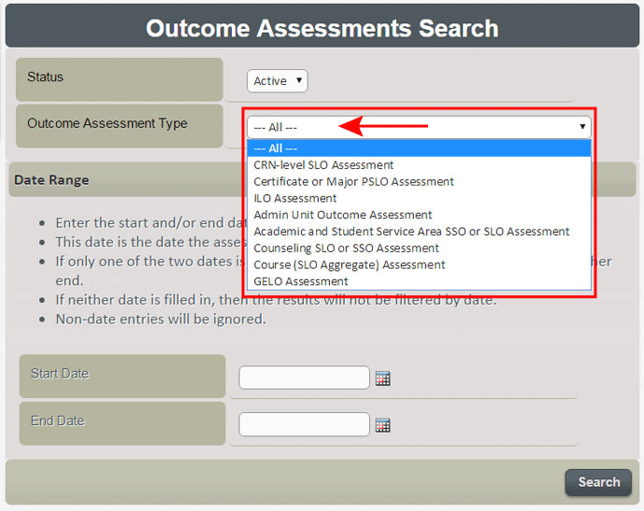
DATA publicly viewable immediately in CurricUNET

Slide 12
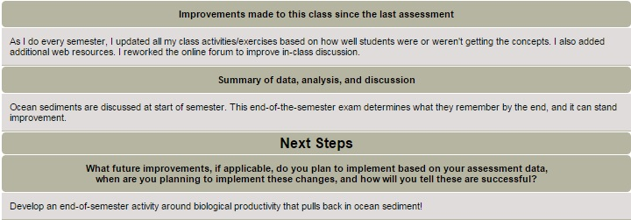
Student names are removed Totals are produced

Slide 13
ARGOS Data Viewer
What? CurricUNET SLO data + BANNER student completion and demographic data
What for? View and filter data by term, GE Areas, Age, Gender, Ethnicity and more…
Who uses it? Anyone can! (Deans, Chairs, Course Coordinators, Teaching Faculty)
LATINO STUDENTS |  | SLO DATA |  |  |  | COMPLETION DATA
 |  | Total Assessed | Meets SLO |  |  | Total Enrolled | Course Success*
COURSE |  | # | # | % |  | # | # | %
HIST | 1 | 294 | 209 | 71% |  | 1,204 | 585 | 49%
HIST | 17A | 146 | 115 | 79% |  | 130 | 61 | 47%
HIST | 17B | 47 | 45 | 96% |  | 1,041 | 535 | 51%
LALS | 1 | 326 | 196 | 60% |  | 2,143 | 1,577 | 74%
POLS | 1 | 927 | 691 | 75% |  | 3,132 | 39 | 65%
Total |  | 1,860 | 1,339 | 72% |  | 9,047 | 2,026 | 61%

Slide 14
ILOs and GELOs
Due: EVERY 4 YEARS
Reviews: up to 4 years of CRN data through mapped courses (GELOs) and programs (ILOs)
Submitted by: SLO Coordinator and corresponding workgroups
ILOs
GELOs
PROGRAM
Due: EVERY 3 YEARS
Reviews: up to 3 years of CRN data through mapped courses
Submitted by: program coordinator
Geography AA-T (Major)
COURSE AGGREGATE
Due: EVERY 3 YEARS
Reviews: up to 3 years of CRN data
Submitted by: course coordinator
GEOG 1
GEOG 7
GIS 111
CRN
Due: EVERY SEMESTER
Reviews: one semester’s worth of data for an individual course section
Submitted by: primary instructor of section
Spring 2015 Online
Spring 2015
Online
Spring 2015
T 6-9 pm
Fall 2015 T/Th 9:30-11 am
Spring 2015
W 2-5 pm
Spring 2016 Online
Spring 2016
Online
Spring 2016
T 6-9 pm
Fall 2016 T/Th 9:30-11 am
Fall 2015
W 2-5 pm
Spring 2017 Online
Spring 2017
Online
Spring 2017
T 6-9 pm
Fall 2017 T/Th 9:30-11 am
Spring 2016
W 2-5 pm
Fall 2015
T/Th 1-2:30 pm
Fall 2015
T 6-9 pm
Fall 2015 M/W/F 9-10 am
Fall 2015 Online
Fall 2016
W 2-5 pm
Fall 2016
T/Th 1-2:30 pm
Fall 2016
T 6-9 pm
Fall 2016 M/W/F 9-10 am
Fall 2016 Online
Spring 2017
W 2-5 pm
Fall 2017
T/Th 1-2:30 pm
Fall 2017
T 6-9 pm
Fall 2017 M/W/F 9-10 am
Fall 2017 Online
Fall 2017
W 2-5 pm
Summer 2015
MTWTh 12-2:30 pm
Summer 2016
MTWTh 12-2:30 pm
Summer 2017
MTWTh 12-2:30 pm

Slide 15
CurricUNET: Mapping Course SLO to GELO
Checkboxes during Course-level updates.
Courses updated at least once every 6 years.
Mappings reviewed and approved by Curriculum Committee.
Mappings to GELOs validated by GELO Assessment Workgroups.
Notes:
Mapping made easier and cleaner by CurricUNET. This step has also taught many faculty about gen education alignment and systems. GELO mapping integrated into Curr Comm processes. Seen by tech reviewer, Articulation Officer, and SLO Coordinator. Integrity of mapping is crucial: impacts gen ed assessment; understanding of graduation and transfer skills. One of the beauties of gelo assessment is workgroup review of mapping, which also enables and recontextualizes ongoing critique of course outcomes for focus, wording, measurability, and purpose. Ensuring valid data produced by mapping. GELO mapping report shows all course outcomes mapping up to GELOs.

Slide 16
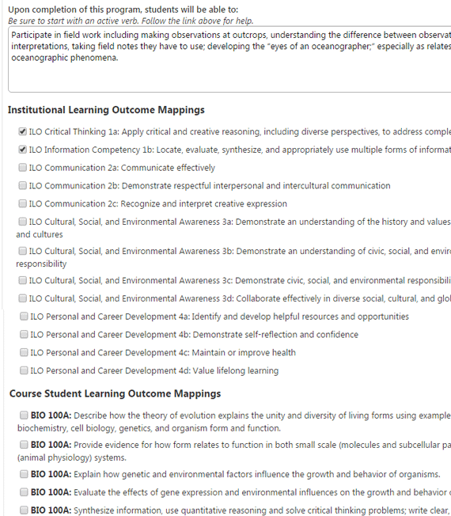
CurricUNET: Major/Certificate to Course & ILO
Checkboxes during Program-level updates.
Programs updated at least once every 6 years.
Mappings reviewed and approved by Curriculum Committee.
Mappings to ILOs reviewed and modified as needed by SLO Committee.
Notes:
Start first with the actual outcome reports

Slide 17
Application: Course-Level and General Education-Level Assessments
POLITICAL SCIENCE 1
COURSE-LEVEL AGGREGATE
Overall course success: reflection, conversation, cohesion
Across multiple semesters and sections
Comparison with other courses satisfying that GENERAL EDUCATION AREA
Achievement Gaps
Improvements and Next Steps
Notes:
Pulling together many assessments to reinforce the programmatic and institutional contexts in which we operate. Fosters sometimes challenging conversations and analysis, especially in a vast, busy institution. Puts us in position to think more across subjects and to reflect more on where we’ve been and where we’re going, as well as the position we’re in which we are putting transferring students. How is the methodology working? Any patterns among the courses? Any needs, such as funding, advisories, professional development, facilities, scheduling?

Slide 18
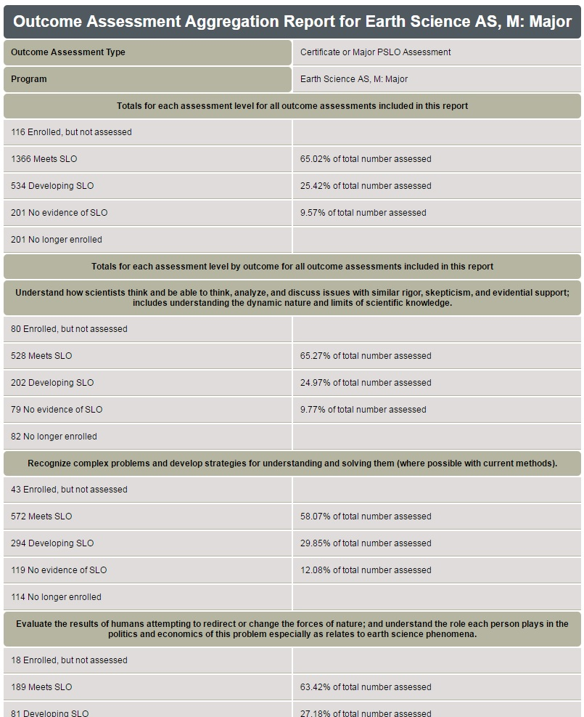
Application: Program-Level Assessments (Majors and Certificates)
Analyze and discuss scientific issues with rigor, skepticism, and evidential support, within the limits of current knowledge.
Notes:
Pulling together many assessments to reinforce the programmatic and institutional contexts in which we operate. Fosters sometimes challenging conversations and analysis, especially in a vast, busy institution. Puts us in position to think more across subjects and to reflect more on where we’ve been and where we’re going, as well as the position we’re in which we are putting transferring students. How is the methodology working? Any patterns among the courses? Any needs, such as funding, advisories, professional development, facilities, scheduling?

Slide 19
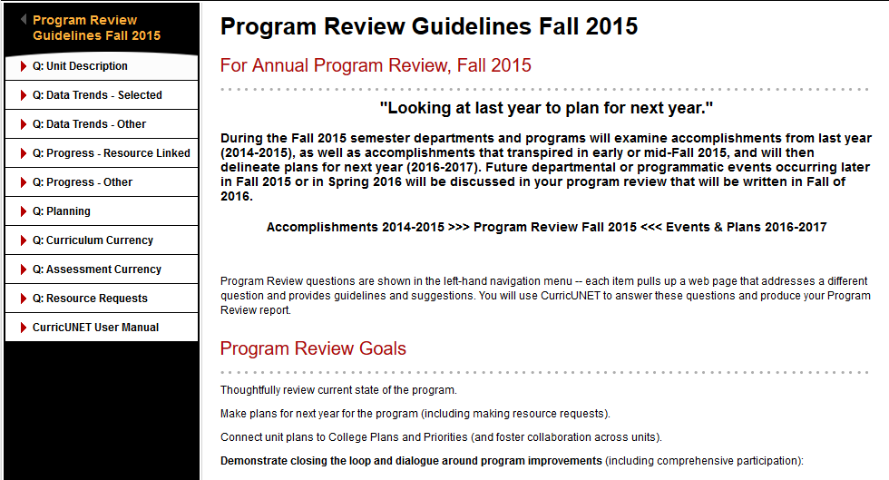
Application: Program (Unit/Department) Review
Notes:
Equity Funding College-wide Trends FLEX and other PD

Slide 20
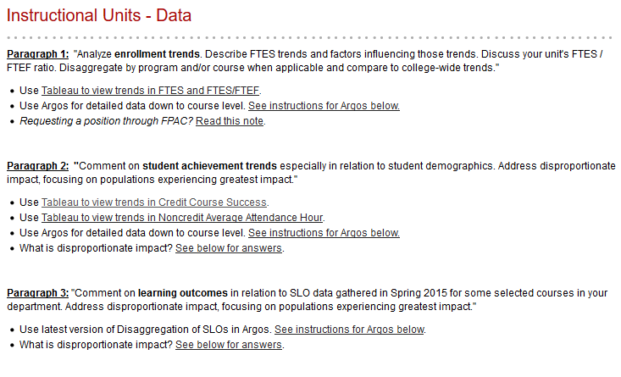
Instructional Units
Notes:
Equity Funding College-wide Trends FLEX and other PD

Slide 21
Application: Institutional Learning Outcome Assessments
Notes:
Pulling together many assessments to reinforce the programmatic and institutional contexts in which we operate. Fosters sometimes challenging conversations and analysis, especially in a vast, busy institution. Puts us in position to think more across subjects and to reflect more on where we’ve been and where we’re going, as well as the position we’re in which we are putting transferring students. How is the methodology working? Any patterns among the courses? Any needs, such as funding, advisories, professional development, facilities, scheduling?

Slide 22
Response: Resequencing English 1A
56% (69 of 123) meets | 59% (73 of 123) meets | 85% (105 of 123) meets | 50% (62 of 123) meets
GELO B1: Analyze, synthesize, evaluate and critically read college-level texts. | GELO B2: Compose organized and coherent source-based essays that demonstrate critical thinking and rhetorical strategies. | GELO B3: Demonstrate control over all major conventions of Standard English grammar and punctuation. | GELO B4: Select and integrate reliable, credible, and scholarly sources to support essays, using MLA format.
English L
100%
1,121students
English 91
English 92
English 93
English 1A
8%
87 students
English 96
Sequence redesign:
6-credit 86
6-credit 88
4-credit 1A
Notes:
Only one course. Analysis of spring '15 ENGL 1A outcomes assessment data and course completion success ratios for Area B GELO brought together brewing composition sequence and achievement/equity gap issues: convergence and change...
--raised important questions and pushed conversations about the meaning of 1A, which in turn raised questions (clarify questions/issues) about the backward-designed course sequence from basic skills to transfer level
--1A as a GE course, not just an English course --the analysis overlapped with growth of parallel accelerated pathway composition sequence --GELO assessment triggered flex meetings and a long series of "What is 1A?" meetings
--contextualized learning, reading issues, library and learning support relations --Results: revision of 1A from a 3-unit to a 4-unit class, plus the replacement of what had once been four (not counting L) 3-unit classes with two 6-unit courses, providing more intensity and contact with fewer exit points and less time Slide brainstorming

Slide 23
Response: Curriculum – Course Outline Updates
What? Updates to COURSE OUTLINE and PROGRAM DESCRIPTIONS
Requisites
SLOs
Mapping
Who?
Faculty curriculum development
Chairs and Deans review and approval
Curriculum Committee review and approval

Slide 24
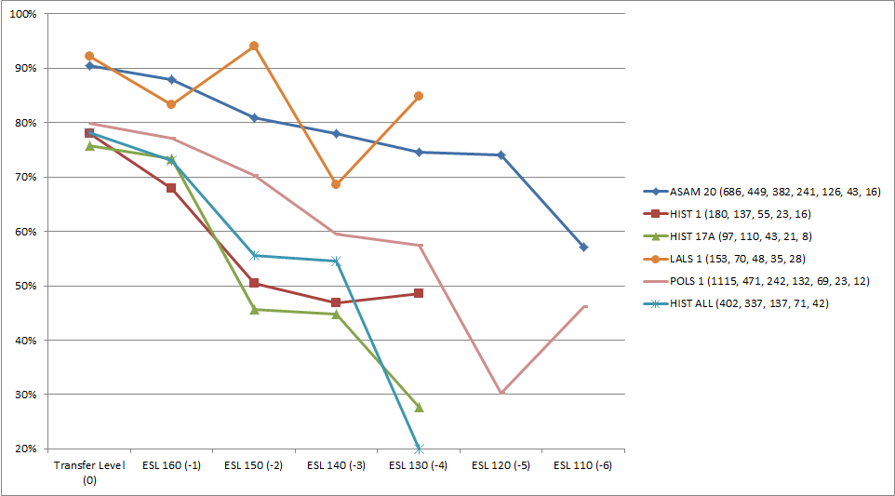
Response: Curriculum Requisite Review
Course completion success by ESL Level for US History and Constitution GE Area courses from Summer 2011 to Fall 2015. (*Note: data pulled only from courses with sufficient student enrollment in each category to provide meaningful data.)
Completion rates of students at varying English preparation levels for US History and Constitution GE Area courses from Summer 2011 to Fall 2015:
 | HIST 1 | HIST 17A
ENGL 1A | 73.6% (1429) | 76.7% (1140)
ENGL 96 | 51.6% (376) | 57.5% (296)
ENGL 93 | 46.6% (217) | 48.6% (226)
ENGL 92 | 34.3% (131) | 37.1% (122)
ENGL 91 | 32.0% (66) | 26.8% (48)
ENGL L | 15.4% (10) | 22.4% (13)
TOTAL* | 56.3% (2,588) | 58.6% (2250)

Slide 25
Q&A
For more information see:
www.ccsf.edu/SLO
www.ccsf.edu/ProgramReview
www.ccsf.edu/CurricUNET
Or contact:
slocoordinator@ccsf.edu
research@ccsf.edu
curricunet@ccsf.edu

