Slide 1
FAQS on the Disciplines List and Minimum Qualifications
Angela C. Echeverri, ASCCC Standards & Practices Committee
Sharon Sampson, ASCCC Standards & Practices Committee
Julie Oliver, ASCCC Area A Representative

Slide 2
Land Acknowledgement

Slide 3
FAQs for today
What is the History of the Disciplines List?
Is there a Handbook listing all the MQs?
What is Equivalency?
What is the Disciplines List Review Process?
What is the Timeline for the proposal process?
Will there be a Webinar Session to help?
Are there any other Questions?
ss

Slide 4
HISTORY

Slide 5
History
In the late 1980s, the Academic Senate developed a process for determining the initial minimum qualifications for faculty to teach at a California community college.
The California Community Colleges System replaced its former credentialing system with a system of Minimum Qualifications in 1990.

Slide 6
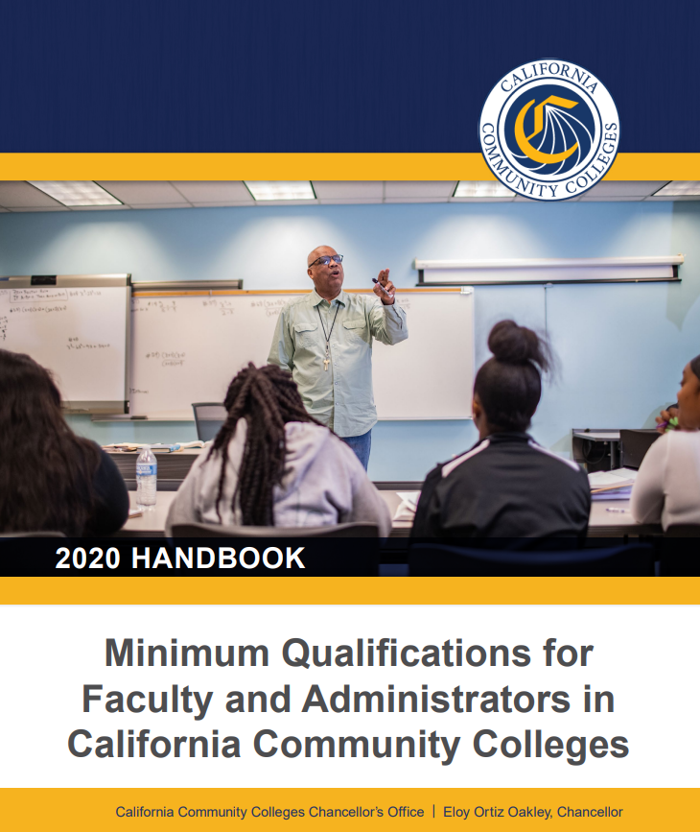
History
The document listing the minimum qualifications (Minimum Qualifications for Faculty and Administrators in California Community Colleges) is commonly called the "Disciplines List."

Slide 7
TITLE 5

Slide 8
Title 5
Separate from the Disciplines List, Title 5 regulations specify minimum qualifications for certain other faculty members, including health service professionals, non-credit instructors, apprenticeship instructors, DSPS personnel, EOPS personnel, learning assistance and tutoring coordinators, and work experience coordinators.
Prior to 1989, the California Community College Board of Governors delegated the Disciplines List Revision process to the Academic Senate and adopted the following Education Code language.

Slide 9
Education Code §87357

Slide 10
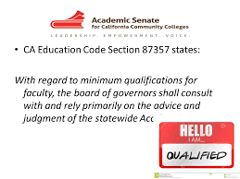
Ed Code §87357
Education Code §87357 (a) In establishing and maintaining minimum qualifications pursuant to Section 87356, the board of governors shall do all of the following:
(1) With regard to minimum qualifications for faculty, consult with, and rely primarily on the advice and judgment of, the statewide Academic Senate, and with regard to minimum qualifications for instructional or student service administrators, consult with, and rely primarily on the advice and judgment of, an appropriate statewide organization of administrators.
In either case, the board of governors shall provide a reasonable opportunity for comment by other statewide representative groups.

Slide 11
HANDBOOK

Slide 12
HANDBOOK
In spring of 2013, the delegates passed resolution 10.07 requesting that the Academic Senate for California Community Colleges (ASCCC) consolidate information related to the Disciplines List Process to ensure that all pertinent information to the process is consistent, housed in one place, and can be used by both faculty at large and the Standards and Practices (S&P) Committee.
In response to this resolution and to the need to ensure that the process is clear and effective, the S&P Committee prepared a handbook to provide faculty members with a guide to the disciplines review process.

Slide 13
EQUIVALENCY

Slide 14
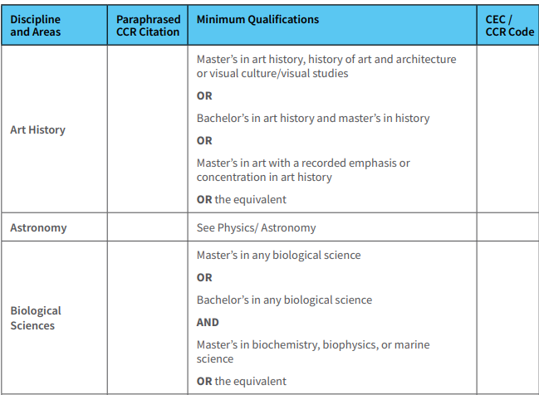
Equivalency Process
Under a given discipline, the phrase “OR the equivalent” refers to the possibility of hiring faculty who do not possess the exact degrees listed, under a process developed and agreed upon by representatives of the governing board and the Academic Senate as provided for in Education Code 87359 and Title 5, section 53430
Equivalency is a local process

Slide 15
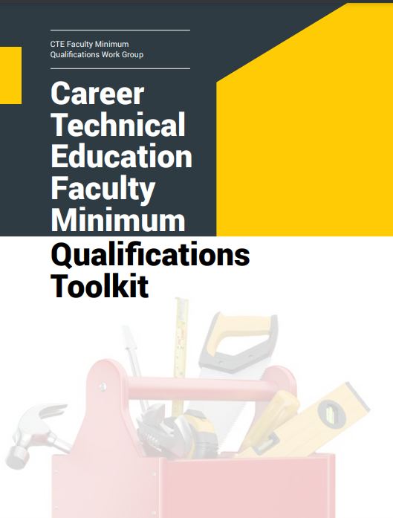
CTE MQ Toolkit
In fall of 2019, the delegates passed resolution 19.01 requesting that the Academic Senate for California Community Colleges (ASCCC) work with faculty, equivalency committees, and other stakeholders to:
Promote dissemination of equivalency resources within the Career Technical Education Faculty Minimum Qualifications Toolkit, including general education equivalency examples and effective equivalency practices.
Provide technical assistance to local academic senates and equivalency committees to aid in implementation of effective equivalency practices for determining equivalencies to the associate’s degree when hiring in career technical education disciplines.

Slide 16
DISCIPLINE LIST REVISION PROCEss

Slide 17
Discipline List Revision Process
Every year the Academic Senate for California Community Colleges conducts a review of the Disciplines List, which establishes the minimum qualifications for the faculty of California community colleges. The annual process was implemented following the adoption of Resolution 10.01 in Fall 2016.
The annual review cycle begins each February. The Senate will distribute the Disciplines List Process to the field. At this point, local senates, discipline or professional organizations, may begin submitting proposals for:
Creation of a new discipline
Revision to an existing discipline
A packet of information about the process including procedure and timeline are sent to a wide variety of constituents including local senate presidents, college presidents, chief instructional officers, curriculum chairs, human resources officers, and discipline professional organizations informing them of the opportunity to propose a change to the Disciplines List.

Slide 18
Proposing Revisions to Disciplines List

Slide 19
TIMELINES

Slide 20
Timelines
The Discipline Process opens each year in February.
From February to September, local academic senates, colleges and districts, students, professional organizations, other interested parties, and CCCCO staff consider recommendations for Disciplines List proposals.
Disciplines List revision proposals received by September 30 that meet all the required criteria will undergo a first hearing at the fall plenary session.
Feedback from the first hearing is shared with the ASCCC Executive Committee at their January meeting, and if the proposal meets all the requirements the committee will forward the proposal to a second hearing at the spring plenary. Proposals in the form of resolutions may be considered for approval by the delegates during voting on Saturday of spring plenary.
Once the process has been completed, the ASCCC consults with the CCCCO on the changes and additions, and any recommendations are forwarded to the Consultation Council for review and then to the Board of Governors for adoption.

Slide 21
Discipline Hearings
Discipline Hearings: two hearings are held so that there is an opportunity for the field to provide oral or written testimony in either support or opposition to the proposal.
For completed proposals received by September 30TH
the first hearing would be held at Fall Plenary and
the second hearing would be held at the subsequent Spring Plenary.

Slide 22
PROPOSALS

Slide 23
Proposals
Any Disciplines List proposal must be submitted on the Revisions to the Discipline List Form. The proposal must include supporting evidence as noted on the form.
Supporting evidence is essential because it provides the S&P Committee, the ASCCC Executive Committee, and the delegates with the rationale about why the change is needed and informs the field that appropriate and sufficient research has been performed to support the proposed change(s).
ASCCC Disciplines List Website has all the forms and other supportive resources.
Links on resource slide.

Slide 24
Proposals
Required investigation and statement of findings of the following:
Contact with the professional organization(s) to determine support of proposal
A professional organization should have three or more of the following attributes:
• a membership of professionals in the discipline
• provides professional development
• has regular publication
• has published standards for professional membership
• has statewide or national recognition
Examples
• MLA (Modern Language Association)
• APS (American Philosophical Society)
• California Humanities (affiliated with the NEH)
• ANA (American Nurses Association)
• IWU (Iron Workers Union)
Showing statewide evidence of the need
Support shown from across the state not just a need for one college, district or region
Best to show evidence from multiple ASCCC Areas

Slide 25
Appeal Process
If a proposal is rejected by the Executive Committee, the initiator may submit a proposal via a resolution through an Area Meeting requesting submission of the proposal into the hearing process for discussion and debate by the body
If a proposal is rejected by the body, then the proposal may be resubmitted but will need to be modified significantly and include new rationale and evidence

Slide 26
WeBINAR SESSIONS

Slide 27
Webinar Session
Join members of the Standards & Practices Committee on
Wednesday May 5th from 12-1pm
for more dialog about the Disciplines List
proposal process and timelines

Slide 28
Resources

Slide 29
Resources
ASCCC Disciplines List Webpage
Disciplines List Proposal Process
Disciplines List Process Timeline
Disciplines List Form
FAQs on Minimum Qualifications
Minimum Qualifications for Faculty and Administrators in California Community Colleges Handbook

Slide 30
Q&A
Send questions to info@asccc.org

Slide 31
Thank you!

