Slide 1
Dual Enrollment
Cheryl Aschenbach, ASCCC North Representative
Michelle Sampat, Mt. San Antonio College

Slide 2
Dual Enrollment

Slide 3
Agenda
Dual Enrollment Overview
AB 288 and Non-AB288
Roles & Responsibilities
Dual Enrollment Timeline
Assessments
M.O.U
Parent/Student Orientations
Instructor Orientation (at Mt SAC and high school)
Questions and Answers

Slide 4
What is Dual Enrollment? The Basics
High school students taking college classes while still enrolled in high school
Credits earned may be applied to both systems
Classes can be offered
On college campus or satellite, including Distance Ed
On high school campus before or after school
On high school campus during school day – open or closed
CCC MQs must be met whether classes taught by CCC or HS instructors

Slide 5
Benefits to Students
Complete high school and college credits at same time
Introduction to/preparation for college life for a smoother transition to college
More time for career and/or college major exploration
Address skills gaps and improve study skills/academic knowledge
Increased confidence and motivation to persist
Students experience the benefits of a college education

Slide 6
AB 288 (Holden, 2015) College and Career Access Partnerships (CCAP)
District level agreement to offer Dual Enrollment
Intended to reach broader range of students, not just highly gifted or advanced scholastic or vocational work
Emphasis on college and career readiness and CTE and transfer pathways
Reduce the number of students needing remedial math and English instruction at the community college level

Slide 7
AB 288 (Holden, 2015) College and Career Access Partnerships (CCAP)
Adds a new option for Dual Enrollment
Does not replace existing models
Colleges can continue with existing dual enrollment programs
Colleges can continue with existing models and also have CCAPs

Slide 8
AB 288 (Holden, 2015) College and Career Access Partnerships (CCAP)
Provides added flexibility in three areas
Limit enrollment in college courses taught on high school campus to high school students
Raise maximum units per term for special high school admits to 15 college credits (but no more than 4 courses)
Provide CCAP students same enrollment priority as Middle College High School students

Slide 9
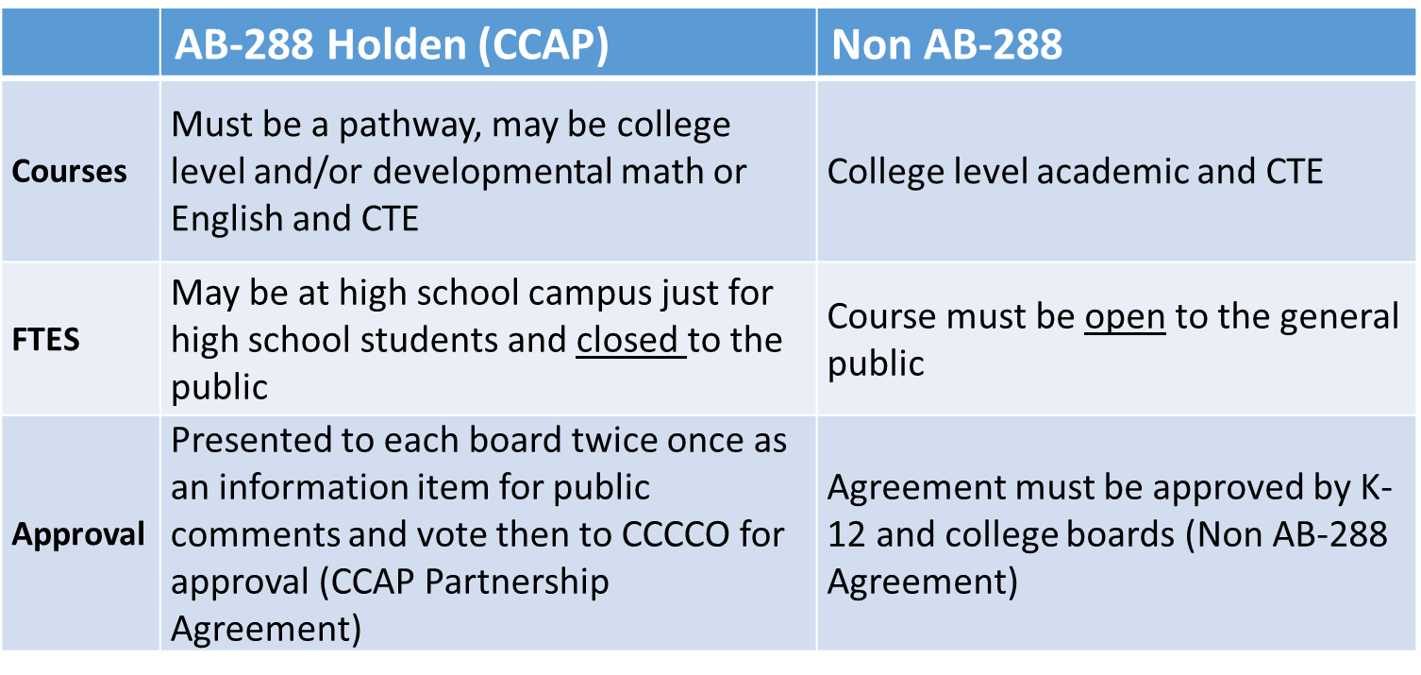
AB288 & Non-AB288
Dual Enrollment is a program that provides high school students the opportunity to enroll in community college credit courses at their HS.

Slide 10
Roles & Responsibilities
College Responsibilities
Faculty shall be hired and evaluated in compliance with the Union/ Faculty Association Agreement
Textbooks & Tuition (free except for students on most visas unless the college agrees to assume these costs)
Supplemental and Support Services provided by the College
High School Responsibilities
Classroom/Instructional facilities
Recruitment and selection of students
Provide a Counselor and Administrator to the program
Report student conduct issues to College
FREE

Slide 11
Roles & Responsibilities
Dedicated High School Counselor
Insure that all students apply and submit all required forms and proper documentation for clearances and registration
Schedule assessments at the school site
Schedule Parent Orientation Session
Dedicated High School Administrator
Work in collaboration with administration and faculty;
Market and promote Dual Enrollment courses at the High School level
Insure that students complete assessment for English and Math.
Provide facility & equipment to host Parent Orientation Session

Slide 12
Timeline
Dual Enrollment Timeline Considerations
Meeting with High School Districts
Applications
Assessment and Testing
MOUs
Orientations
Special Admit Form Collection
Student Clearances
Course Registration

Slide 13
Assessment
English & Math assessment required for courses with English & Math pre-requisites
Assessment at the high school site, at the college site, or online
Paper-form or online assessments
Consider time required for assessment (prepping and distributing materials, instructions, actual test time, and collection of materials)
Time assessments to allow for the development of an MOU

Slide 14
MOU
Memorandum of Understanding
Once classes have been decided by both the high school and the college faculty/departments, an MOU will be sent out to the appropriate district liaison for review and approval.
Once approved, the MOU is sent for Board approval
AB 288 Dual Enrollment requires 2 Board readings. Non-AB 288 agreements requires 1 Board reading.

Slide 15
Parent & Student Orientation
Inform students and their parents/family members about the course(s) being offered at the HS.
Work with the high school to establish an evening orientation
- Room location (tables, seats, etc) - Technical accommodations (laptop, projector, screen, microphone)
High Schools can promote: - Info meetings/ Lunch meetings with interested students (Dual Enrollment staff can assist). We would collect interest cards from students with their contact info (phone and e-mail) for future correspondence - Parent newsletter (mail or e-mail), automated phone messages - Flyer (Dual Enrollment staff can assist with creating)

Slide 16
Instructor Orientation
At the College
- Textbook orders - Canvas/ Software needed - Add/Drop deadlines - Roster spot checks - Communication with the high school DE staff regarding absences or conduct
At the High School
Meet with the high school dual enrollment partners
Walk-through at the school
Room keys
Faculty/ Staff Bathroom
Fire drill / Emergency drill
Parking

Slide 17
Questions?
Cheryl Aschenbach caschenbach@lassencollege.edu
Michelle Sampat msampat@MtSAC.edu
info@asccc.org

