Slide 1
The Numbers Don’t Lie: Putting Data to Work for Your EEO Program
ASCCC Equity and Diversity Action Committee Regional Meetings
Woodland College and Southwestern College
April 6 & 7, 2018

Slide 2
Today’s Discussion
Statewide EEO Program Overview
EEO Longitudinal Data
What is Longitudinal Data?
Title 5 EEO Longitudinal Data Requirements
Why Should I Collect and Analyze Longitudinal Data?
How Do I Use Longitudinal Data?
Examples and Best Practices

Slide 3
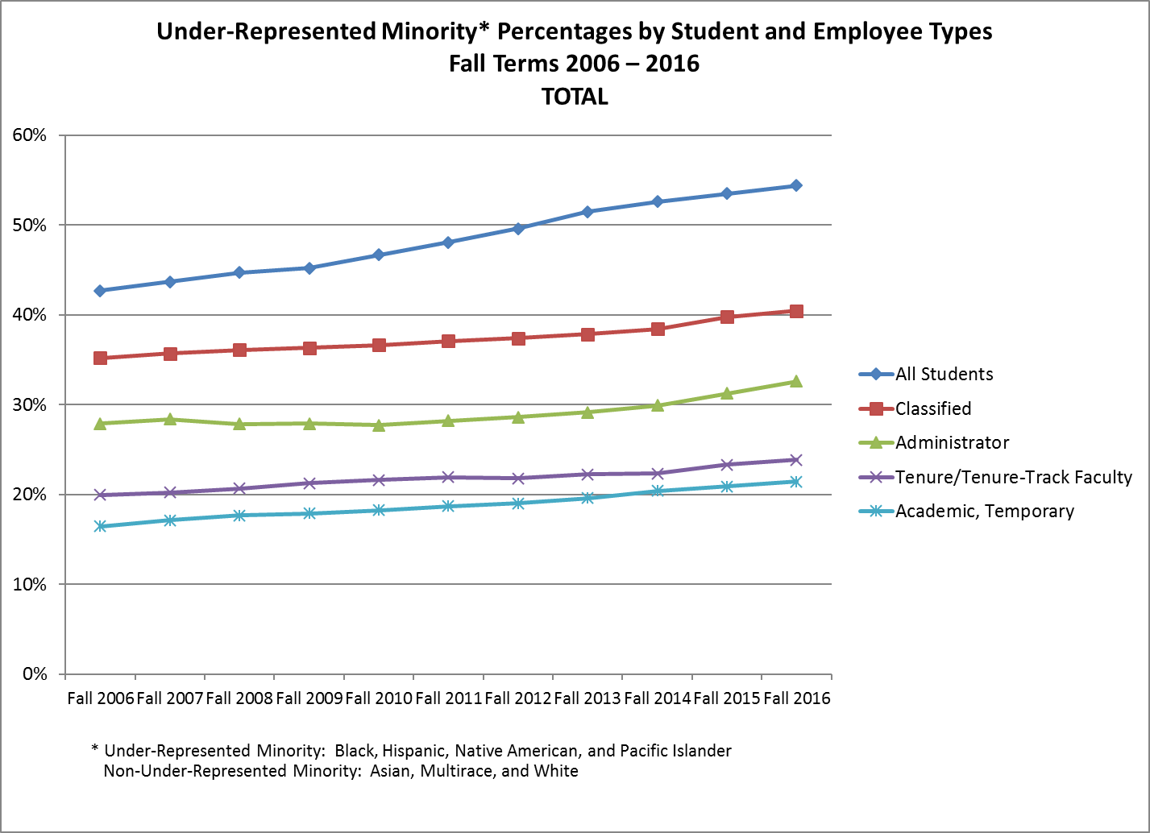

Slide 4
EEO Fund Allocation Model
In 2015, the Statewide EEO and Diversity Advisory Committee and the CCCCO modified the EEO Fund Allocation Model
Historically, EEO Funds were allocated based on FTES
EEO Funds are now allocated to districts that meet “multiple methods of measuring success in promoting equal employment opportunity” -Section 53030(b)(2)

Slide 5
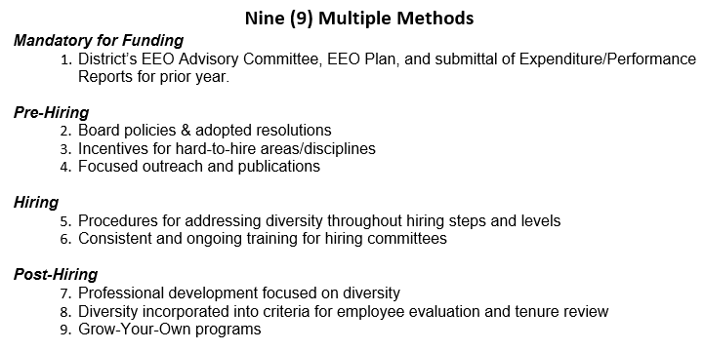
EEO Fund Allocation Model

Slide 7
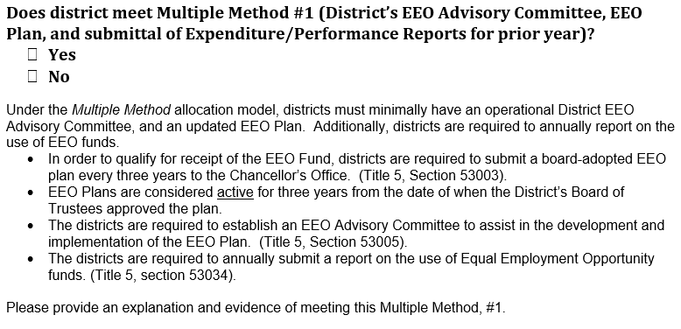
Multiple Method Certification
For 2018, districts must meet multiple method #1, and 6 of the remaining 8 multiple methods
Each local district’s Chief HR Officer, CEO and Board of Trustees must certify compliance by June 1st to receive funds

Slide 8
Increase in EEO Funding
The CCCCO annually allocates EEO Funds to each district to promote local EEO programs and activities
The legislature provided an additional two million dollars in EEO funding to the community college system in fiscal year 2016-2017
For fiscal year 2017-2018, each district that met the multiple methods requirements received $50,000 for local EEO activities

Slide 9
INCREASE IN INTEREST AND OVERSIGHT

Slide 10
EEO and Diversity Best Practices Handbook
The Statewide EEO and Diversity Advisory Committee reviewed all responses to the multiple measures submissions and selected three from each category for inclusion in an EEO and Diversity Best Practices Handbook

Slide 12
EEO Longitudinal Data Guide
The Chancellor’s Office and the Statewide EEO and Diversity Advisory Committee developed a guide for the use of local EEO data
What is Longitudinal Data?
Title 5 EEO Longitudinal Data Requirements
Why Should I Collect and Analyze Longitudinal Data?
How Do I Use Longitudinal Data?
Examples and Best Practices
The EEO Longitudinal Data Guide was released in April of 2018
Training sessions and webinars to follow in Fall 2018

Slide 13
What is Longitudinal Data?
A dataset is longitudinal if it tracks the same type of information over a period of time
Advantage of longitudinal databases: they can identify patterns and measure change
Examples:
Retail: studies showing the short and long term impacts of remodeled stores on consumer spending
Patient-Level Data: studies showing the efficacy of newly developed medications over time
Political Campaigns: studies showing expected voter turnout, targeting advertising to swing voters

Slide 14
Longitudinal Data in Baseball
Longitudinal data is used to project future player performance, including batting average against left or right handed pitching, wins above replacement measures, and comparing player performance accounting for park effects
Data has changed the game significantly in recent years – Sabermetrics and Moneyball*
*(the book, not the movie)

Slide 15
Moneyball
“The math works. Over the course of a season, there's some predictability to baseball. When you play 162 games, you eliminate a lot of random outcomes. There's so much data that you can predict individual players' performances and also the odds that certain strategies will pay off.” - Billy Beane

Slide 16
Longitudinal Data in EEO Programs
An analysis of district recruitment, hiring, retention and promotion data over a period of years may help identify when non job-related factors result in the significant underrepresentation of a monitored group
Helps ensure district policies and procedures do not have an adverse impact on a protected class of individuals
May also demonstrate the impact of changes in local policies on the phases of the employment process

Slide 17
Why Should I Collect and Analyze Longitudinal Data?
The purpose of our EEO programs is to ensure that all qualified individuals have a full and fair opportunity to compete for hiring and promotion and to enjoy the benefits of district employment
EEO should include identifying and eliminating barriers to employment that are not job related
Data is a powerful tool that allows districts to measure the impact of local hiring practices on specific monitored groups over a period of years

Slide 18
#1 - Improving Faculty Diversity Improves Student Outcomes
Studies have shown the educational benefits of a diverse workforce
Recent study showed underrepresented minority students who were taught by underrepresented minority instructors were able to close achievement gaps by 20-50 percent
The identification and elimination of barriers to employment extends employment opportunities to a broader range of individuals, increasing the diversity and talent of the district’s workforce. And our students will benefit from those efforts.

Slide 19
#2 – Improving Faculty Diversity Improves the Quality of Instruction
Industry: Companies in the top quartile for racial and ethnic diversity are 35 percent more likely to have financial returns above industry medians
Diversity provides several institutional benefits to our colleges, including more student-centered approaches to learning and more research focused on issues of race/ethnicity and gender
Increased diversity of ideas and attitudes within faculty ranks is healthy for our system and beneficial to existing faculty

Slide 20
#3 – EEO Data Analysis May Reduce Legal Liability
Employers are prohibited from discriminating against employees based on a number of protected characteristics
Disparate Treatment: when an employer singles out employees and treats them differently based on a protected classification
Disparate Impact: when an employer’s policy or practice has the effect of discriminating against a protected class even though it does not single them out for differential treatment
No intent required. A facially neutral policy may have a disproportionate effect on members of a protected class

Slide 21
#4 – It’s the Right Thing to Do
The purpose of our EEO programs is to ensure that all qualified individuals have a full and fair opportunity to compete for hiring and promotion and to enjoy the benefits of district employment
We owe it to our students, our employees, and the state to ensure our policies and practices comply with applicable laws and produce a strong workforce that meets the needs of our students and communities

Slide 22
#5 – Need Another Reason to Collect and Analyze Longitudinal Data?
IT’S THE LAW!

Slide 23
Title 5 EEO Longitudinal Data Requirements
Each District EEO Plan must include:
“A process for gathering information and periodic, longitudinal analysis of the district’s employees and applicants, broken down by [monitored group status and job categories], to determine whether additional measures are required…and to implement and evaluate the effectiveness of those measures”
- Title 5, section 53003

Slide 24
Title 5 EEO Longitudinal Data Requirements
Each district is required to review the longitudinal information gathered about the district’s employees and applicants “to determine if significant underrepresentation of a monitored group may be the result of non-job related factors in the employment process”
The phases of the employment process “include, but are not limited to recruitment, hiring, retention and promotion”
- Title 5, section 53006

Slide 25
Title 5 EEO Longitudinal Data Requirements
“The composition of the qualified applicant pool shall be reviewed and compared to the composition of the initial applicant pool. If the [CHRO] finds that the composition of the qualified applicant pool may have been influenced by factors which are not job-related, appropriate action will be taken. This applicant pool data shall be reviewed in conducting the [longitudinal] analysis described in section 53006.”
- Title 5, section 53023

Slide 26
How do I Use Longitudinal Data?
There are an unlimited number of interesting, insightful analyses that a district may choose to conduct with an employment data set
Examples: full-time faculty hires by discipline, date of hire or by recruitment method
Our districts are in the best position to know what types of analyses are most useful at the local level and how to best use the information gathered within the local organizational structure
BUT, there are two specific types of analyses required by title 5…

Slide 27
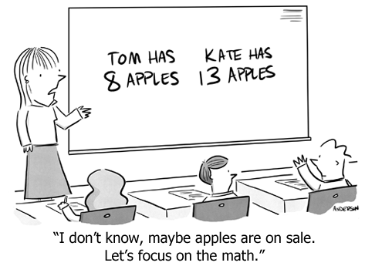
Do We Have Any Math Faculty in Attendance?

Slide 28
Significantly Underrepresented Group Analysis (aka “The 80% Rule”)
Districts are required to identify any “significantly underrepresented groups,” where actual representation is below 80 percent of projected representation
Significantly Underrepresented Group Defined:
“any monitored group for which the percentage of persons from that group employed by the district in any job category…is below eighty percent (80%) of the projected representation for that group in the job category in question.”
-Title 5, section 53001(l)

Slide 29
80% Rule: Projected Representation
Title 5 does not define “projected representation” for purposes of the 80 Percent Rule – it is a local decision
Local districts have the discretion and authority to establish projected representation based on one or more factors, including:
student demographics at the college or district
community demographics in the district’s service area
labor market availability for the job category
previous demographics of job applicants

Slide 30
Example: Colusa CCD
Analysis of Hispanic Employees:
Of the residents in the Colusa Community College District service area, 25 percent identify as Hispanic, and the district has decided to use this measure to establish projected representation for the job class (faculty and other instructional staff)
Are Hispanic employees “significantly underrepresented” under the 80 Percent Rule?

Slide 31
Example: Colusa CCD
Analysis of Hispanic Employees:
Divide the actual representation by the projected representation of the monitored group:
.20 (actual representation) ÷ .25 (projected representation) = .80
The actual representation of Hispanic employees in the faculty and other instructional staff group is exactly 80 percent of the projected representation for that group

Slide 32
Example: Colusa CCD
Remember, title 5 defines “significantly underrepresented group” as any monitored group for which the percentage of persons from that group employed by the district is below 80 percent of the projected representation for that group in the job category in question
Since the actual representation of Hispanic employees is not below 80 percent of the projected representation, Hispanic employees are not a significantly underrepresented group under the 80 Percent Rule

Slide 33
One More: Colusa CCD
Analysis of Black Employees:
Of the residents in the Colusa Community College District service area, 10 percent identify as black, and 5 percent of the District’s faculty/other instructional staff identify as black
Are Black employees “significantly underrepresented” under the 80 Percent Rule?

Slide 34
Example: Colusa CCD
Analysis of Black Employees:
.05 (actual representation) ÷ .10 (projected representation) = .50
The actual representation of black employees in the faculty and other instructional staff group is 50 percent of the projected representation for that group

Slide 35
Example: Colusa CCD
Analysis of Black Employees:
.05 (actual representation) ÷ .10 (projected representation) = .50
Since the actual representation of black employees is below 80 percent of the projected representation, black employees are a significantly underrepresented group under title 5’s 80 Percent Rule

Slide 36
Significantly Underrepresented Group: In Summary
Existence of a “significantly underrepresented group” is not dispositive that discrimination has occurred
A district’s determination that a monitored group is significantly underrepresented in a job category should prompt the district to review existing employment practices to identify any non job-related barriers to employment and amend employment policies and practices as appropriate

Slide 37
EEOC’s Adverse Impact Test (aka “The 4/5ths Test”)
Under the EEOC’s Adverse Impact Test, an adverse impact occurs when the selection rate for any group is less than 4/5ths (80 percent) of the selection rate for the group with the highest selection rate
The EEOC has established a four-step process for employers to follow when conducting the EEOC’s Adverse Impact Test

Slide 38
EEOC’s Four Step Process (“The 4/5ths Test”)
(1) Calculate the rate of selection for each group (divide the number of persons selected from a group by the number of applications from that group)
(2) Observe which group has the highest selection rate
(3) Calculate the impact ratios, by comparing the selection rate for each group with that of the highest group (divide the selection rate for a group by the selection rate for the highest group)
(4) Observe whether the selection rate for any group is substantially less (i.e., less than 4/5ths or 80 percent) than the selection rate for the highest group

Slide 39
Example: Coronado CCD
Calculate the rate of selection for each group
Observe which group has the highest selection rate
(3) Calculate the impact ratios, by comparing the selection rate for each group with that of the highest group
(4) Observe whether the selection rate for any group is less than 4/5ths the selection rate for the highest group

Slide 40
Example: Coronado CCD
Analysis of Black Selection Rate
The black selection rate (30 percent) is 50 percent of the white selection rate (60 percent). Since 50 percent is less than 4/5 (80 percent), an adverse impact exists under the EEOC’s Adverse Impact Test
.30 (black selection rate) ÷ .60 (highest selection rate) = .50 (black selection rate as a percentage of the highest selection rate)
50% < 80%, so Adverse Impact exists

Slide 41
Example: Coronado CCD
Analysis of Hispanic Selection Rate
The Hispanic rate (25 percent) is 42 percent of the white selection rate (60 percent). Since 42 percent is less than 4/5 (80 percent), an adverse impact exists under the EEOC’s Adverse Impact Test
.25 (Hispanic selection rate) ÷ .60 (highest selection rate) = .42 (Hispanic selection rate as a percentage of the highest selection rate)
42% < 80%, so Adverse Impact exists

Slide 42
Adverse Impact Test: In Summary
If a district’s analysis of employment data under the EEOC’s Adverse Impact Test shows that an adverse impact exists, it is not dispositive that discrimination has occurred
The EEOC’s Adverse Impact Test is a self-described “rule of thumb,” and not a legal definition
It is a statistical tool established by the EEOC to determine whether there is an initial inference of adverse impact

Slide 43
Adverse Impact Test: In Summary
When a district finds that a monitored group is adversely impacted, it should assess hiring policies and practices to determine why certain groups were eliminated at a substantially higher rate than other groups
If the elimination was based on non-job related factors, the district has a responsibility to amend its hiring practices to ensure that all applicants have an equal opportunity for employment at the district
4/5ths Test: May be applied to each step along the hiring process (initial – qualified pool, interviews, offers)

Slide 44
Sample Sizes are Important!

Slide 45
Sample Sizes are Important!
Title 5, section 53001, provides that a disparity identified in a district’s selection process will not be considered to constitute adverse impact “if the numbers involved are too small to permit a meaningful comparison”
The longitudinal analysis of employment data involves several local decisions and should be implemented at each district in a manner that makes the most sense at the local level

Slide 46
Collection and Analysis of EEO Data
Does your district collect EEO data and conduct periodic, longitudinal analysis of the district’s employees and applicants, broken down by monitored group status and job categories?
What types of analyses does your district conduct with this data?
Significantly Underrepresented Group Analysis (80% Rule)?
EEOC Adverse Impact Test (4/5ths Test)?
Something more in-depth? A broader statistical analysis?

Slide 47
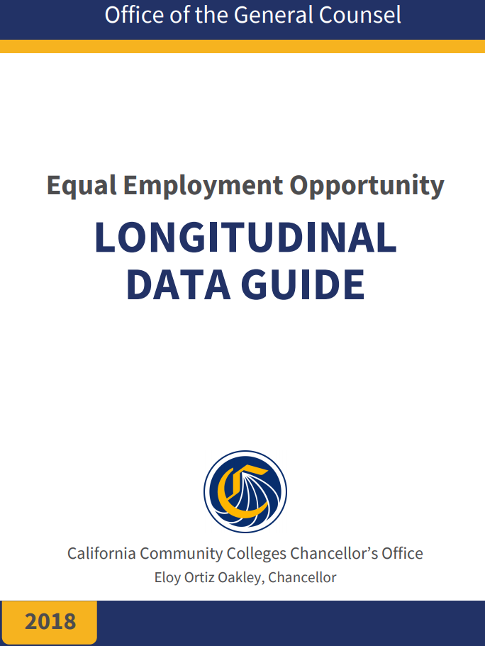
EEO Longitudinal Data Guide
The EEO Longitudinal Data Guide was released in April of 2018
Provides an introduction to the collection and analysis of longitudinal data
http://extranet.cccco.edu/Portals/1/Legal/EEO/2018-Longitudinal-Data-Guide.WEB.pdf

Slide 48
EEO Longitudinal Data Training
The Chancellor’s Office and the Statewide EEO and Diversity Advisory Committee is rolling out a series of regional training sessions on the local use of EEO data this fall
More detailed strategies, advanced analysis tools, panel discussions, hands-on examples
Keep an eye out – sessions will be in late September/early October 2018

Slide 49
Questions?
Best Practices/Examples to Share?

