Slide 1
EOPS Impact Study
Estimating Effects and Inferring Implications
Terrence Willett
Senior Consulting Researcher
RP Group
2016 Academic Academy
Sacramento, CA

Slide 2

Purpose
Explore the effect of the EOPS program by comparing EOPS participants to comparable non-participants on key student outcomes.
First step in developing an ongoing system of collecting and compiling quantitative and qualitative evidence of EOPS impacts.
Conducted in 2012

Slide 3

Study Partners
Research and Planning Group for the California Community Colleges (RP Group)
  RP Group researchers conducting the analyses
California Community College Chancellor’s Office Management Information System (COMIS)
  Data collection and database maintenance and access
Volunteer Community College Districts
  60 districts chose to participate

Slide 4

Security and Privacy
Access to COMIS data via secure VPN to research database.
No SSNs
No birthdates
No full names
No individual student data reported
No individual colleges reported

Slide 5

Related Research
Preising (1979) conducted a telephone survey in 1973 at San José City College and found that EOPS participants were more likely to:
  obtain an associate’s degree,
  be enrolled after two years
  have grade point averages over 2.0, and
  be accepted at a four-year institution than students,
  however the study did not appear to implement any controls for differences in background variables.

Slide 6
Related Research, cont.
Wurtz (2011) at Crafton Hills College compared first-time college EOPS and non-EOPS student enrolled in the same course sections and found:
  similar course completion rates,
  lower EOPS student course success rates, and
  higher EOPS student fall to spring retention.
  Differences in background characteristics between EOPS and non-EOPS students presented a limitation, partially mitigated as students were in same sections.

Slide 7

Methods
707,113 first-time students in fall 2004, 2005, 2006, 2007
60 college districts representing 97 colleges
Tracked for 3 years
64,196 in EOPS sometime in the 3 year window
642,917 did not participate in EOPS in the 3 year window
Statistical control techniques
  Propensity Score Matching (PSM)
  Multivariate Regressions

Slide 8
Control Variables
Age in first term
Gender
African-American indicator
Asian indicator
Hispanic indicator
High school graduate flag
Received disability services
Received Pell grant
Level of first English course
Level of first Math course
Year of first college attendance
First college attended

Slide 15
Outcomes
One-year retention
Two-year retention
Earned degree or certificate within 3 years
Transfer English success within 3 years
Transfer math success within 3 years
Transferable units completed within 3 years
60+ transferable units completed within 3 years
Transferred to a four-year institution within 3 years

Slide 25
Technical Notes and Limitations
PSM and regression produced similar findings
Other possible control variables not available are:
  Parent education level, English proficiency, employment load, responsibility for dependents, personal support networks, individual motivation, health factors, etc.
Only first time students beginning in fall included
Timing and intensity of EOPS not analyzed
12 districts did not participate
Statistical control study only with no qualitative

Slide 26

What Influences Achievement?
Student engagement (Astin, 1984; Tinto, 1993)
Student support
  Counseling and advising
  Tutoring
  Peer networking
  Social activities with college personnel and peers
Increasing student self-efficacy (Rams, 2009)

Slide 27
Student Support (Re)Defined
Kresge Foundation funded project
3 year study (2011-14)
Examined how community college students – particularly African American and Latino – use supports
Identification of strategies that:
  Facilitate persistence and completion among underrepresented students
  Scalable
  Cost-effective

Slide 28
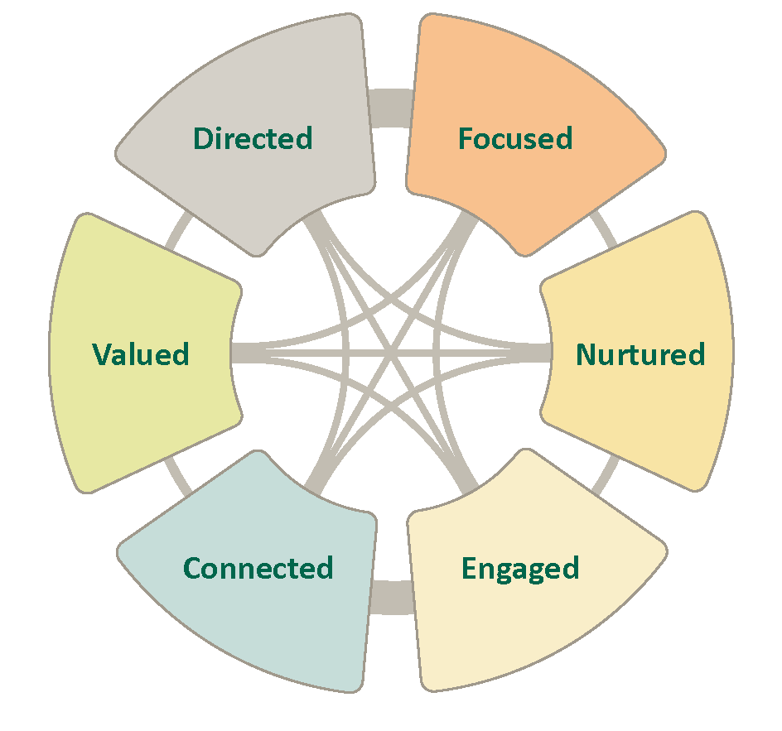
http://rpgroup.org/projects/student-support

Slide 29
New Context for EOPS
Renewed Equity Planning with funding
Student Success and Support Program (SSSP)
Increased focus on completion
Accelerated English and math
  California Assessment Project (CAP)
  Statway, Quantway
Common Assessment Initiative (CAI)
  Multiple Measures Assessment Project (MMAP)

Slide 30

Your Input
How do you expect to use the findings of this study?
How are your EOPS programs and Equity Plans linked?
Knowing this study is limited, what might you like to see in future studies?
Other comments or questions?

Slide 31

Contact Information
Fabio Gonzalez, CCCEOPSA President
San José City College
fabio.gonzalez@sjcc.edu
Will Bruce, CCCEOPSA Past President
Allan Hancock College
wbruce@hancockcollege.edu
RP Group Research Team
Terrence Willett, Principal Investigator, twillett@rpgroup.org
Craig Hayward, Researcher
Darla Cooper, Director of Research and Evaluation
http://www.ccceopsa.org/eops-impact-study

