Slide 1


State Initiative Update:
The Education Planning Initiative
Cynthia Rico, Acting Dean of Counseling and Student Success, San Diego Continuing Education
Cheryl Aschenbach, ASCCC Executive Committee, Facilitator
David Shippen, CCC Technology Center
David Quintanilla, CCC Technology Center
2016 Curriculum Institute
Breakout Session #5

Slide 2
Abstract
In response to Student Success Task Force recommendations and subsequent legislation (SB1456, The Student Success Act of 2012), the Education Planning Initiative will provide statewide tools to support college efforts for student success and support.
This breakout will provide an update on the status of EPI and relationship with other initiatives.

Slide 3

Learning Objectives
Role of Curriculum in EPI – Coin of the Realm
Relationship of EPI to other initiatives
EPI toolset benefits and implementation status
  MyPath – Student Services Portal
  Career Coach – Workforce tool, inputs to goal setting
  Starfish – Supporting Pathways with Curriculum

Slide 4

Follow the Curriculum Path(s)
Portable Career Pathways
Career Planning
Transcripts and Degree Audit
Workforce Sector and Region Inputs
Articulation
Education Planning
College Program or Course
CO Curriculum Inventory
College Catalog
Career Search

Slide 5
Overcoming Obstacles
Success!
CAI
OEI
EPI

Slide 6
Initiative Toolsets Available through MyPath
Online Education Initiative
Exchange
Learner readiness tutorials, orientation
Online tutoring
Canvas
Cranium Café
Education Planning Initiative
MyPath student portal
CareerCoach
Starfish
COCI
C-ID
eTranscripts
Common Assessment Initiative

Slide 7
EPI Program
EPI
Starfish
Degree Audit
Ed Planning
Articulation
ASSIST integration
Curriculum Inventory
MyPath Portal
ETranscript
C-ID
Apply
Orientation
Career
Retention

Slide 8
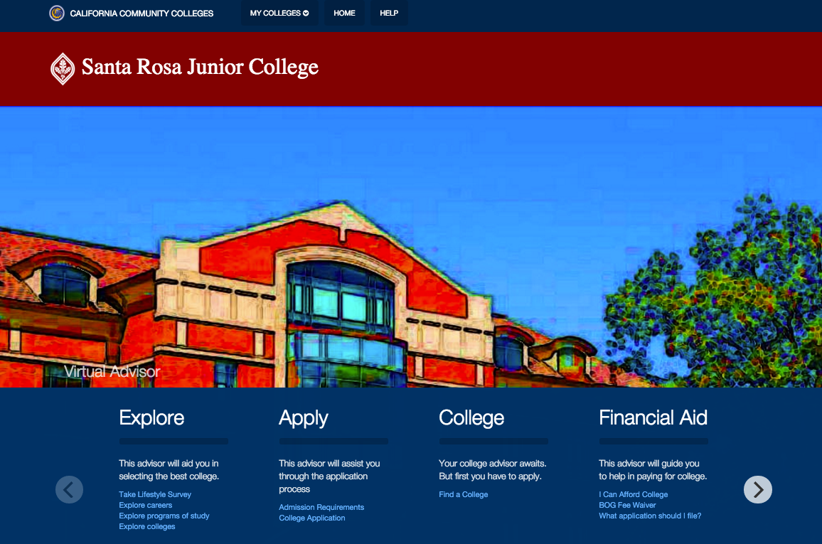
Student Services Portal “MyPath”

Slide 9
Student Services Portal “MyPath”
Open Source portal/web application development
  Smart Form
  Checklist
  New Student Orientation
User Interface
  Mobile
  Accessible
Rules Engine

Slide 10
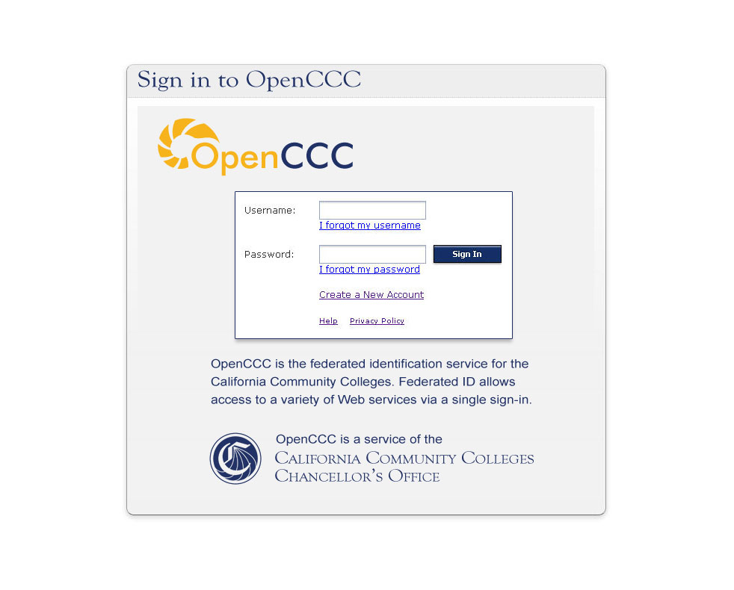
Laying a Foundation – Federated Identity
Working to eliminate duplication of system-wide accounts
CCCID ASX2456
Passed to the college to help eliminate local duplicates
Helps tie student data together as students swirl

Slide 11
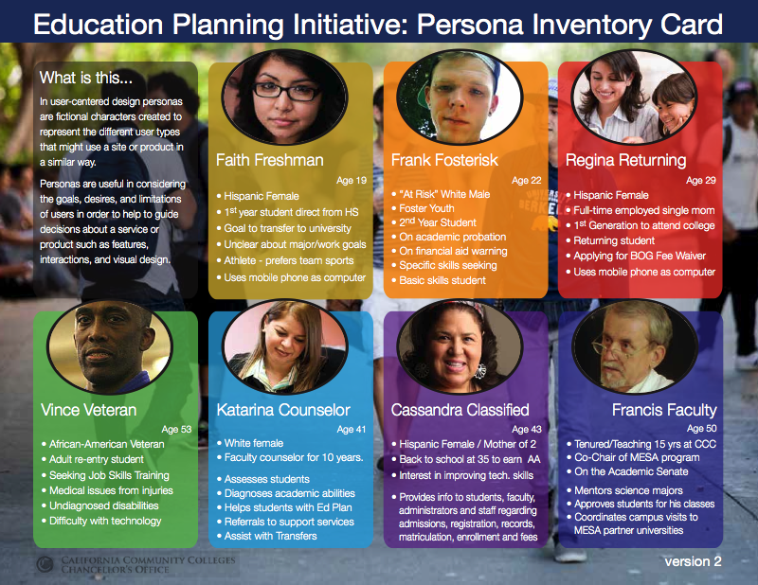
Keeping it Real
“Persona” based design and testing with user stories

Slide 12
Portal Roadmap
UI/UX
MVP Release
Fall Release
Developer Services
Winter Release
Ongoing Work
Profile Service
Rules Engine 1.0 + Machine Learning Portlet
Rules Engine 2.0
Tracking & Analytics
Feature Portlet Development
Enhancement/Defect Resolution
Content Portlet Development
June
September
December

Slide 13
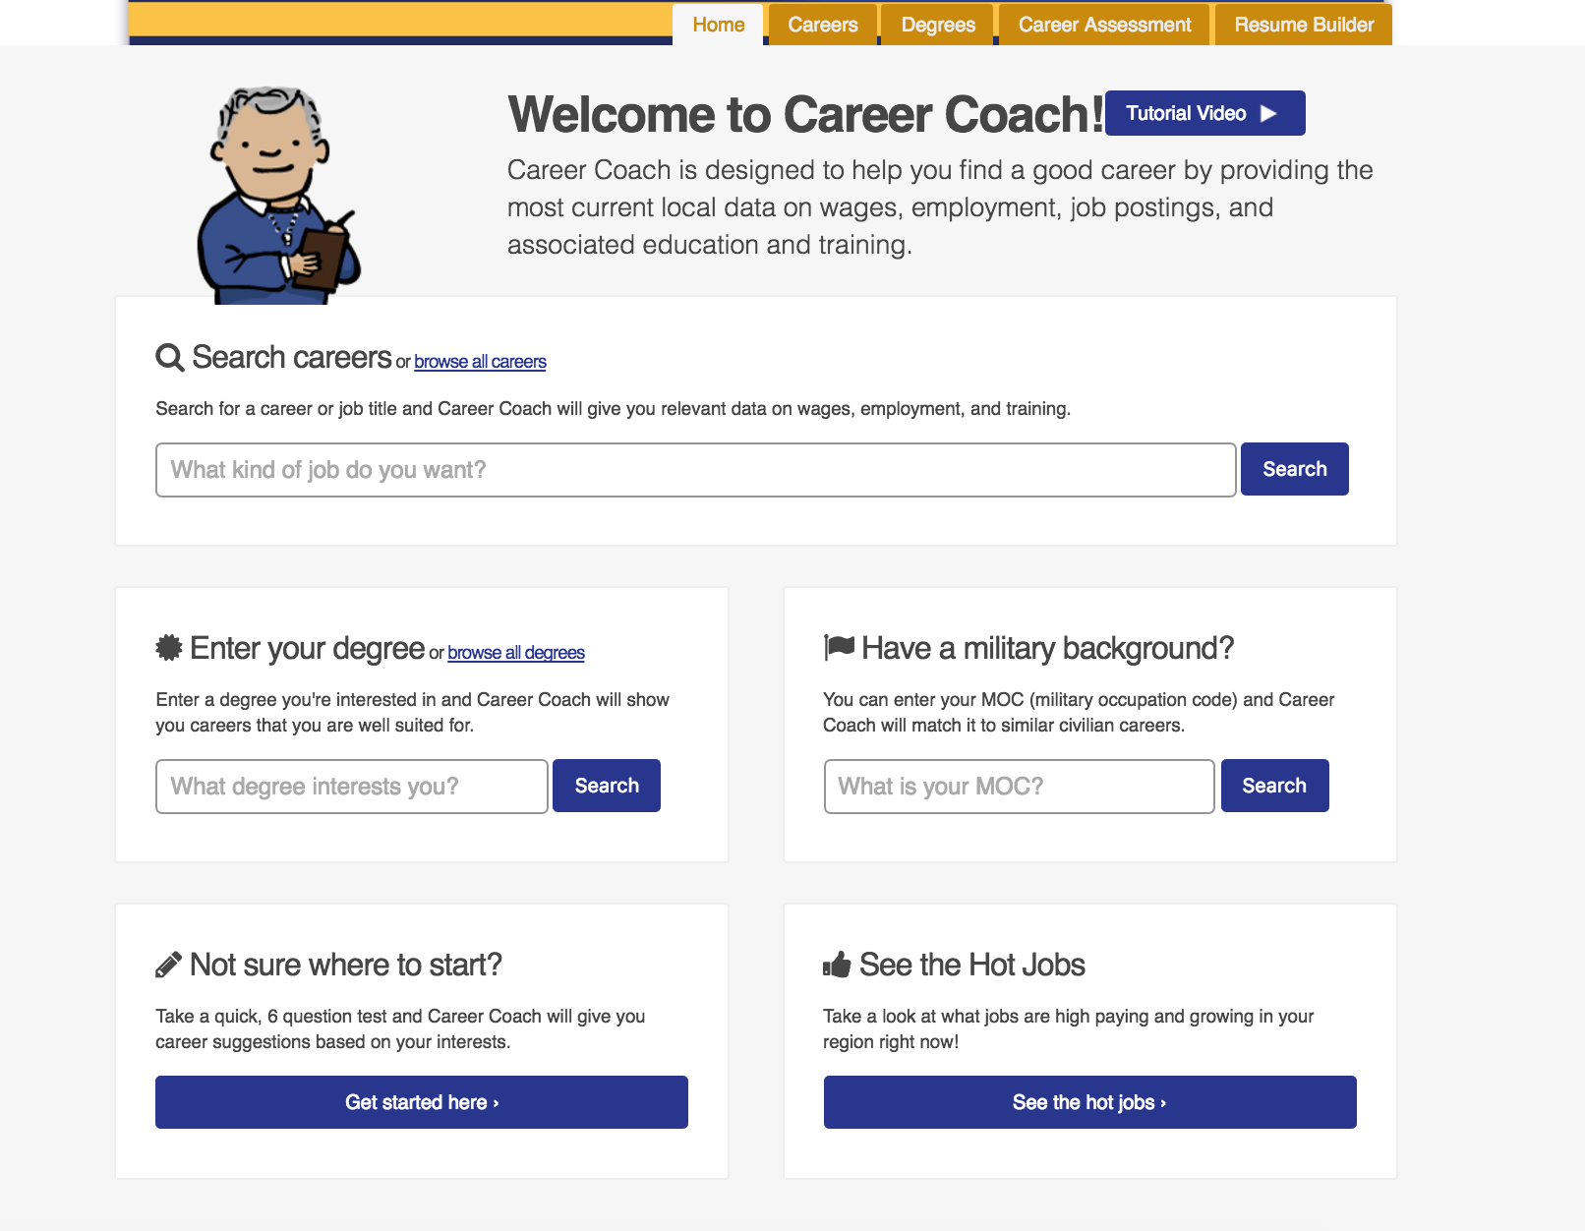
Career Coach
Support students with informed choices on careers with the most current data and ability to see jobs, careers, and programs.

Slide 14
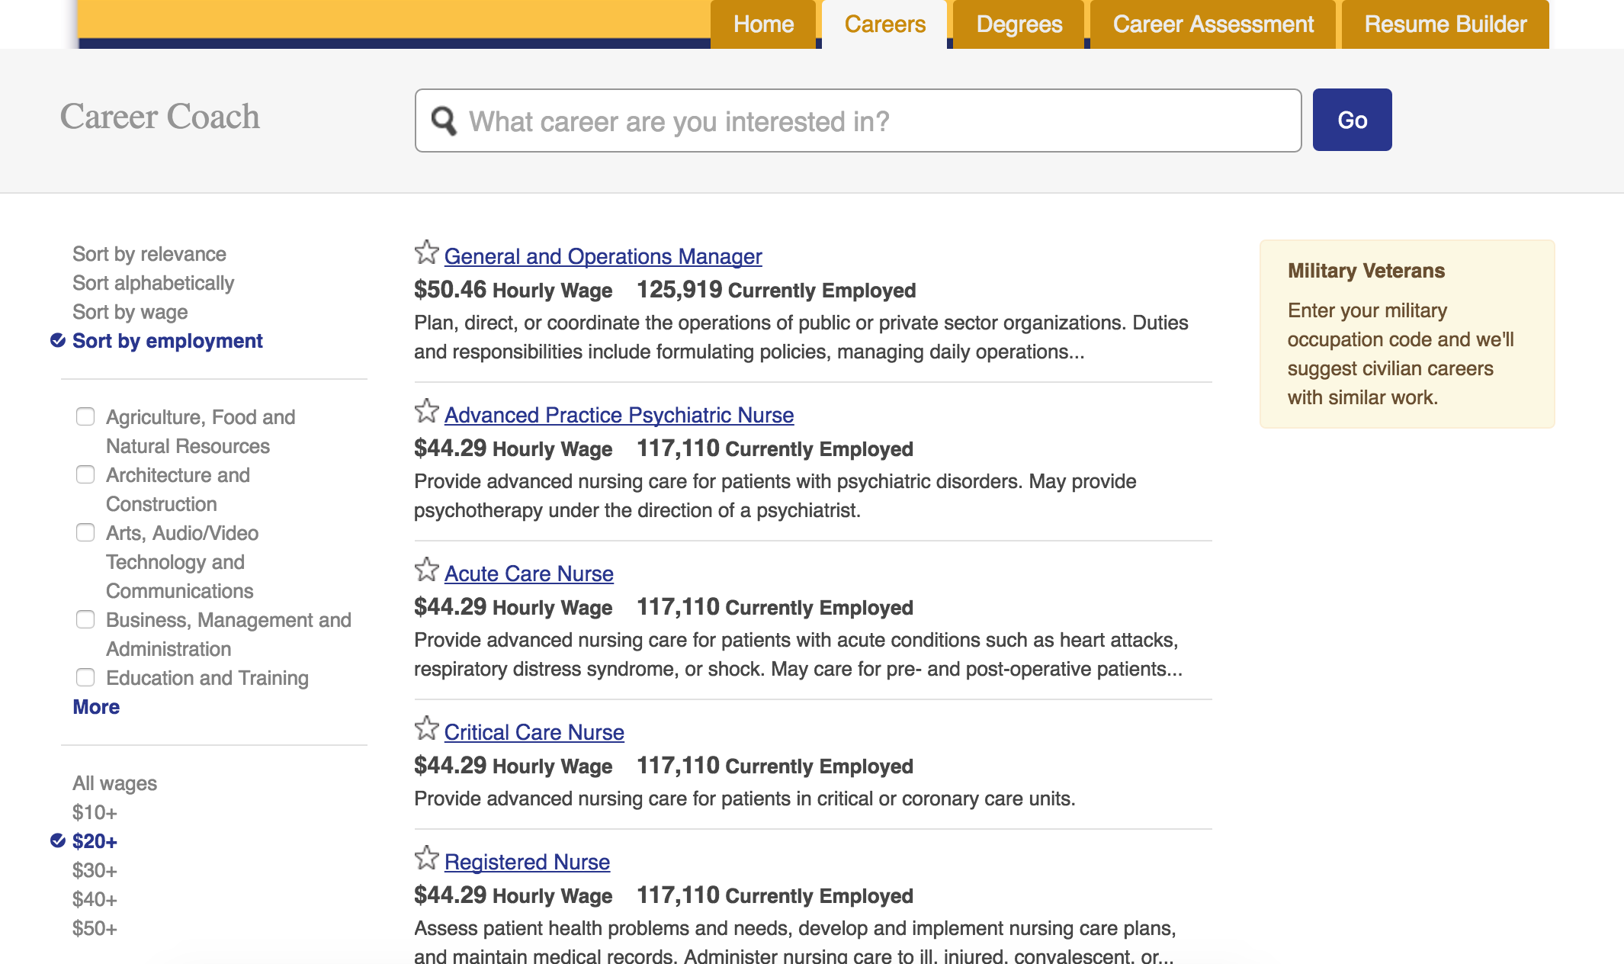

Career Coach

Slide 15
STARFISH
  Assist students in mapping a multi-year educational plan while balancing their daily lives with the commitments they have outside of the classroom.
  Colleges will be able to identify students who are struggling in their courses and breakdown the communication silos so faculty, staff, and students can interact with one another on a proactive basis.

Slide 16
STARFISH Timeline
2011 – Student Success Taskforce
2012 – SB 1456
2013 – EPI Grant
2014 – Statewide Steering Committee Formed
2015 – Vendor Selection/Start-up
2015 – Pilot Programs Begin
2016 – Phase 2 Interest Survey
2016-2018 – Phase 2 Rollout based on best practices

Slide 17



STARFISH Features
Term-by-term degree layouts, multiple plans
Requirement checklists for students to complete objective
Ability to email, print, share education plans
Early Alert system to increase retention
Identify at-risk students, concerns connect with resources
Capture/consolidate notes, tasks, referrals

Slide 18
STARFISH Implementation Status
13 colleges – 8 districts
  City College San Francisco
  Contra Costa CCD (Contra Costa College, Diablo Valley College, Los Medanos)
  El Camino College
  San Bernardino CCD (Crafton Hills College, San Bernardino Valley College)
  Santa Barbara City College (Early Alert and Connect only)
  Santa Rosa Junior College
  State Center CCD (Fresno City College, Reedley College, Clovis Community College)
  Victor Valley College
+16 colleges scheduled through 2017 so far!

Slide 19
STARFISH Implementation Steps
  3-6 month implementation
  Progressive deployment process: First working with a small, logical cohort of students for learning and streamlining of the process prior to a general deployment.
  Critical to identify, recruit, develop, and support roles in-house

Slide 20
Common Challenges
Change management
Acceptance of 3SP as “new work”
Leveraging 3SP funding to access resources
ASSIST integration
Scope Creep
Communication and Rumor control

Slide 21
Recommended Support Roles
Based on experiences gained through the pilot colleges, a number of key positions are recommended to be part of the college project team:
  Project Manager
  IT Lead
  Degree audit lead
  Liaison with instructional and counseling faculty
  Liaison with Academic Senate and Student Senate
  Professional Development Lead
  Public Information Officer (PIO)

Slide 22
CCCTC Support Resources
The Technology Center provides project support for start-up and ongoing support:
User community support and helpdesk
Professional development support
Marketing support
Vendor administration
CCC specific statewide workgroups
Data integration (e.g. “Glue,” ASSIST)

Slide 23
Curriculum Inventory
Three Chunks: Data Harmony, Applications, Deployment
Advisory Committee: In place to guide the effort
Software development is underway per MVP/Roadmap
Schedules for sprint reviews in place

Slide 24
Curriculum Inventory Development
The COCI Team has designed a new Curriculum Inventory System for the Chancellors Office. At the direction of CO Academic Affairs staff, and informed by the COCI Advisory Group, pilot colleges and SACC, the initial release focuses on:
Essential features to submit and approve a course or program
Reducing the net number of clicks per interaction
Database design that can scale in a later release to support integration with the local institutions course and program system of record.
Data migration with validation rules to foster ease of editing/updating existing submissions and a quicker processing time for new submissions

Slide 25
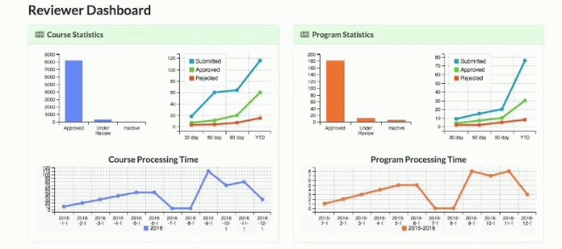
COCI: Improving Visibility and Throughput

Slide 26
C-ID
Maintenance and operations of C-ID 1.0
Coordinating with SAAC, CIO, ASCCC, Mt. SAC, and other constituencies via the CO for C-ID 2.0
“Bonitasoft” workflow tool in use
Discovery complete
Development underway

Slide 27
Development FY 16-17
 | JUL-SEP 2016 | OCT-DEC 2016 | JAN-MAR 2017 | APL-JUN 2017
Maintenance of Existing System
User Interface Build
Pilot and Test
Data Cleanup
Iterative Improvements
Phase 2 Discovery and Design
Phase 2 Build

Slide 28
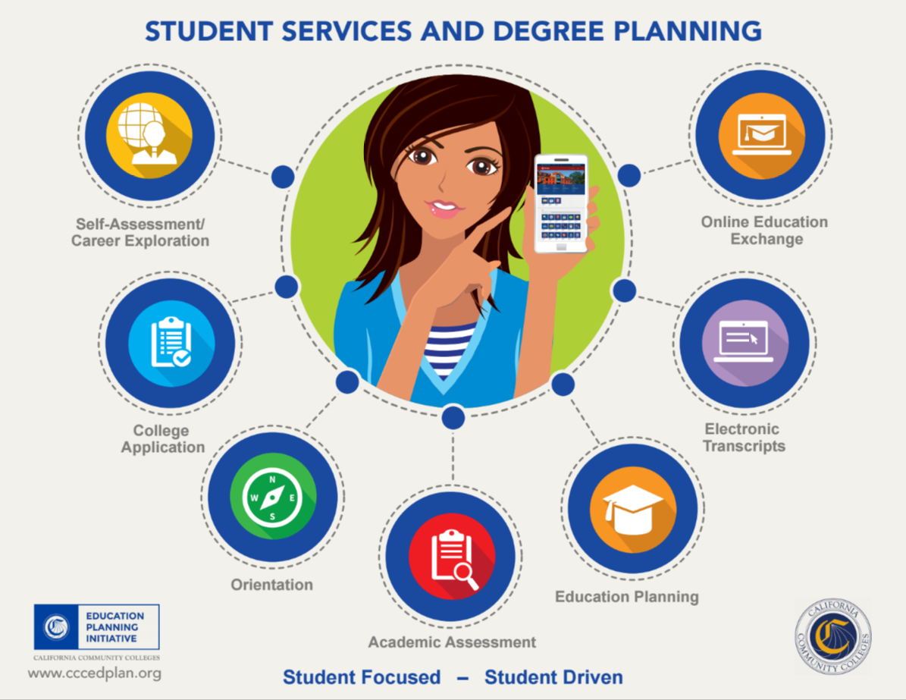
Discussion
Role of Curriculum in EPI – Regina’s Story

Slide 29

Discussion
Requirements and approach to Professional Development
  Preferred learning and training modalities?
  Content development?
  Certification and CE credit?
Check out Professional Learning Network
http://prolearningnetwork.cccco.edu/

Slide 30
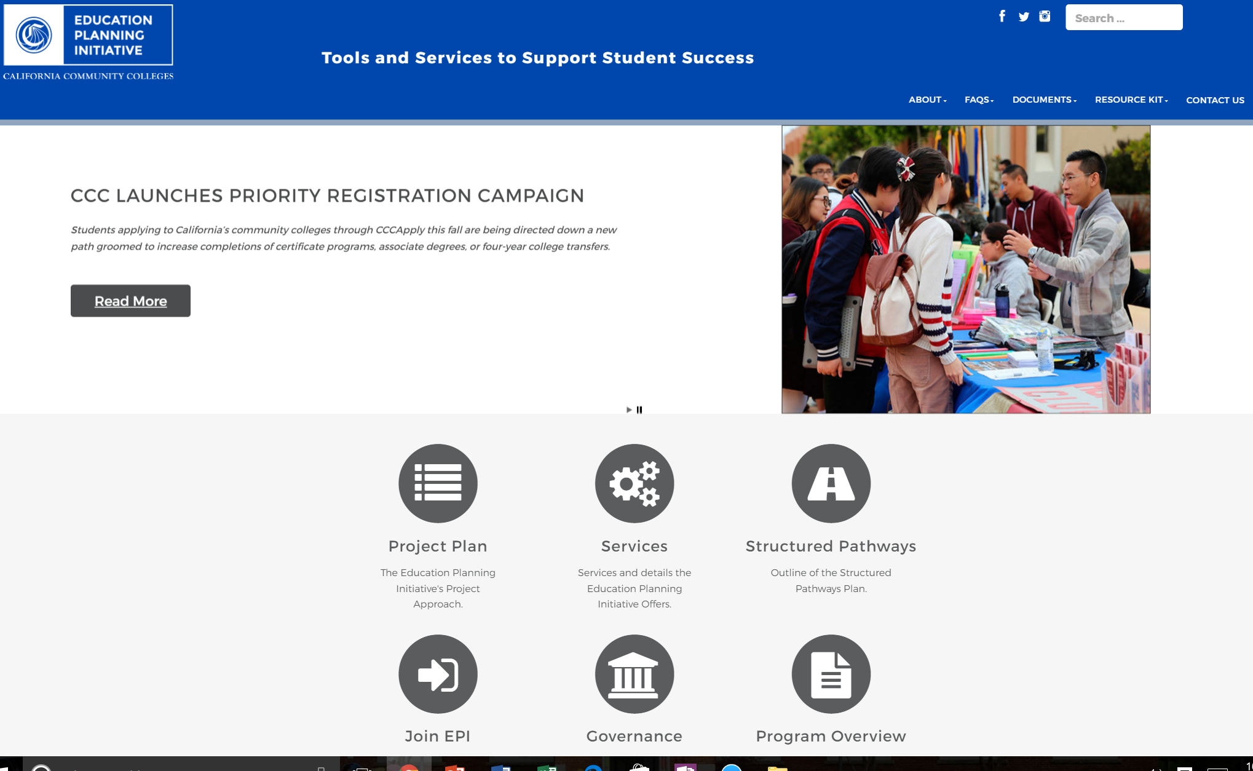
Thank You!
CCCEdPlan.org
  Webinars
  FAQs
  Join the conversation!
Get Involved epi@ccctechcenter.org

