Slide 1
Alphabet Soup: EPI, OEI and Curriculum
Dolores Davison, Foothill College
John Freitas, Los Angeles City College
Cynthia Rico, San Diego Mesa College
ASCCC Curriculum Institute
July 9-11, 2015
Doubletree Anaheim-Orange County

Slide 2
Educational Planning Initiative Product Outcomes
Statewide Student Services Portal
Student Educational Planning Tool
Degree Audit System
Early Alert System
All for no to low cost to CCC!

Slide 3
Portal Team
The steering committee has about 40 members and we have been at it for 16 months
The vendor is

Slide 4
Portal – Messaging Students
Apply for Admission
Education Planning
Orientation
Financial Aid
Order Transcripts
Academic advising
Time Management
Transportation
Child Care
Test Anxiety
Substance Abuse
Food Assistance
Basic skills (reading, writing, math)
CalWorks
Career planning
Counseling - personal
Dream Act
DSPS (Disabled Student Programs and Services)
EOPS (Extended Opportunity Programs and Services)
ESL (English as a Second Language)
Health services
Housing information
Employment assistance
Online classes
Re-entry program (after 5 years out)
Scholarship information
Student government
Testing/assessment
Transfer information
Tutoring services
Veteran’s services
Athletics
Foster Youth
TANF/SSI/General Assistance
LGBT

Slide 5
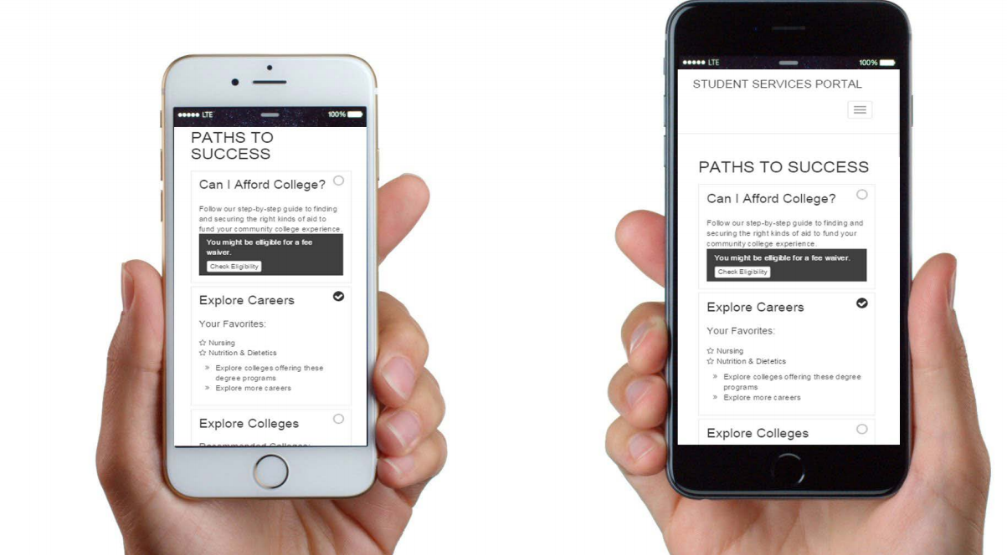
Systemwide Student Portal

Slide 6
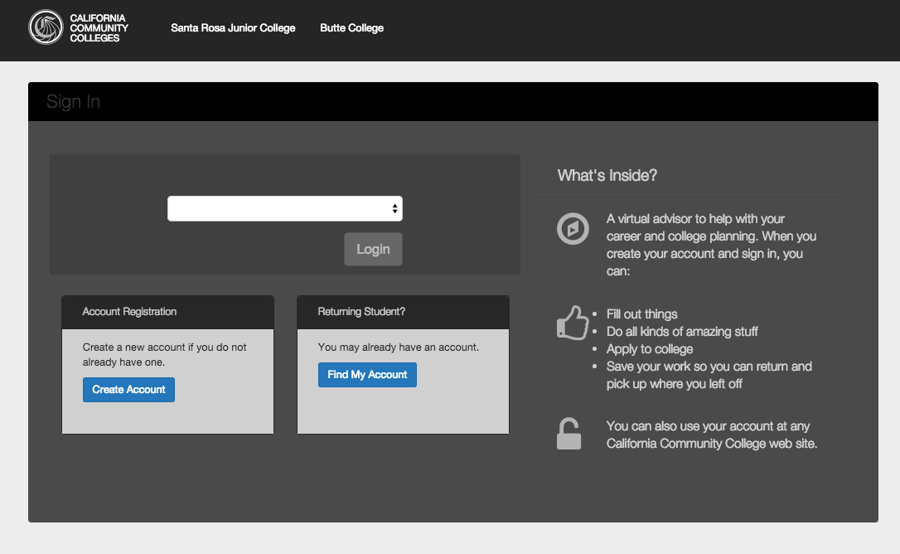
Portal What has been done as of today?

Slide 7
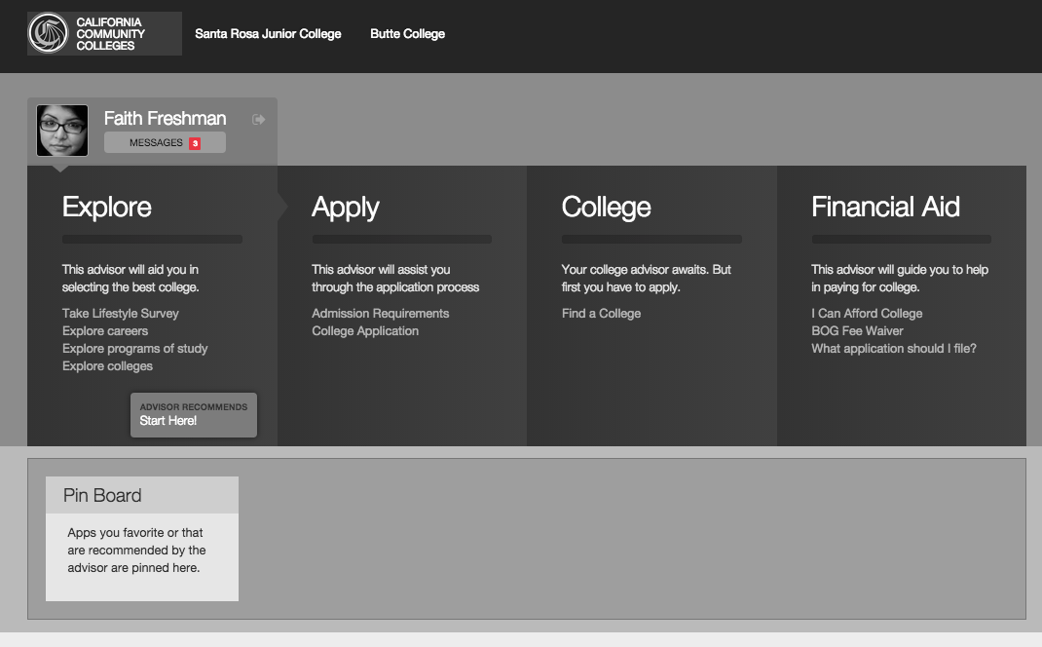
Portal

Slide 8
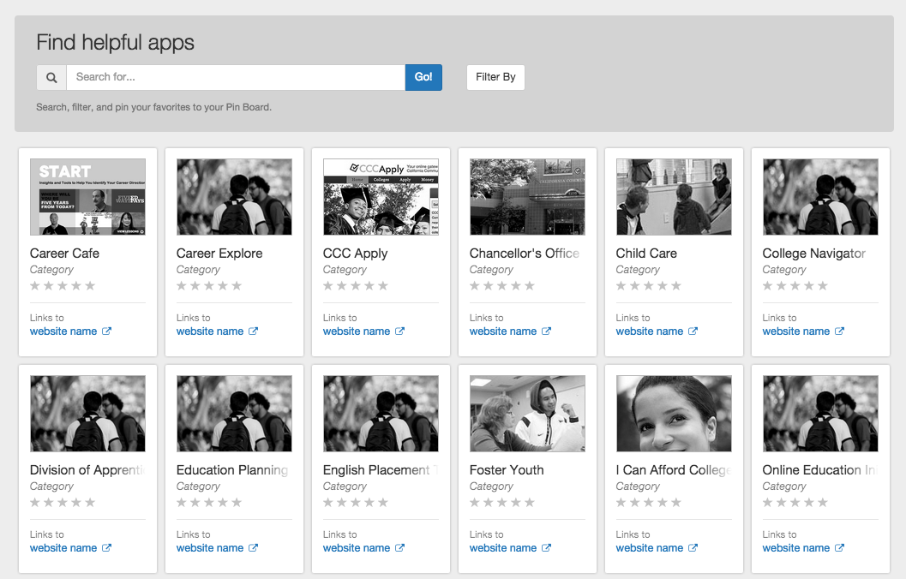
Portal

Slide 9
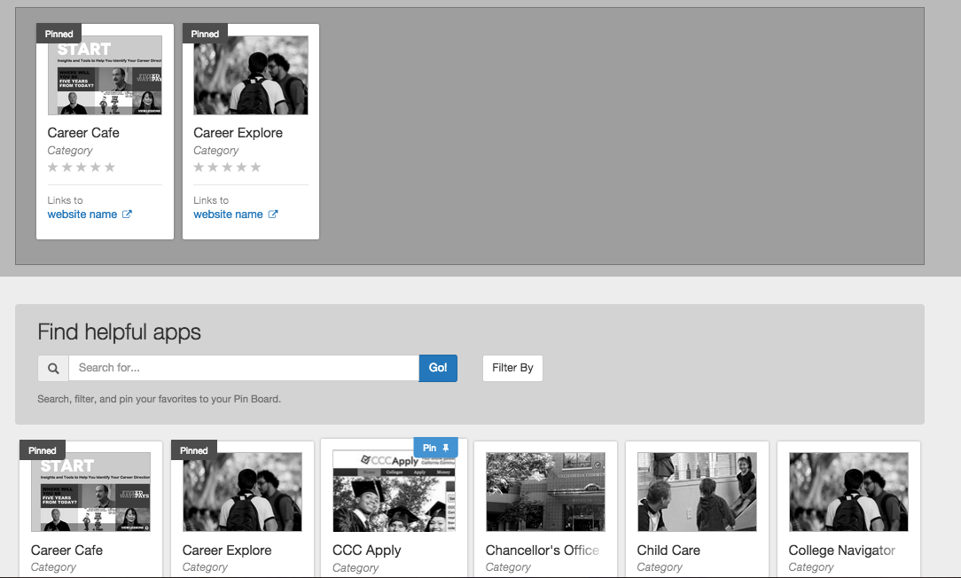
Portal

Slide 10
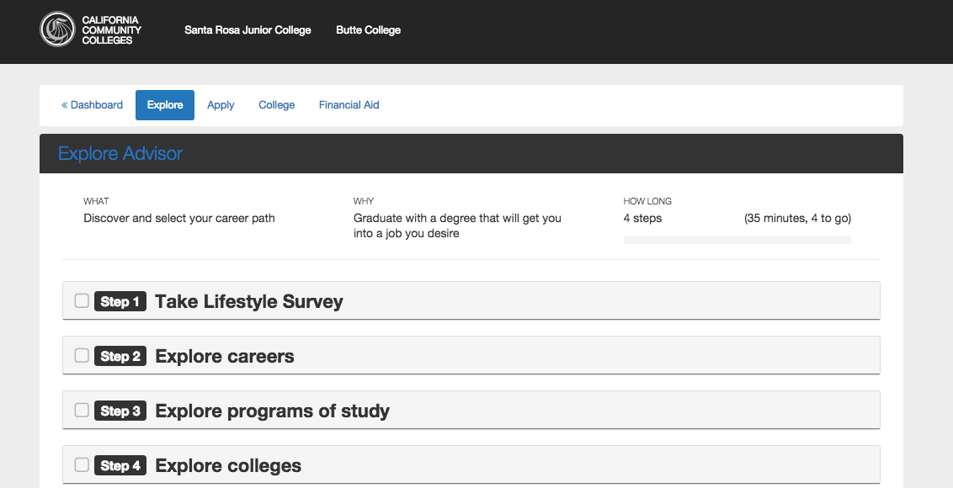
Portal

Slide 11
Educational Planning Tool and Degree Audit System (EPT/DAS)
The team is made up of members of the 8 pilot colleges (40 members)
City College San Francisco
Los Medanos College
Fresno City College
Crafton Hills College
Santa Barbara City College
El Camino College
Victor Valley College
Santa Rosa Junior College

Slide 12
EPT/DAS
Hobsons Solution
Degree Audit
Early Alert
Appt & Case Mgmt
Degree Planner

Slide 13
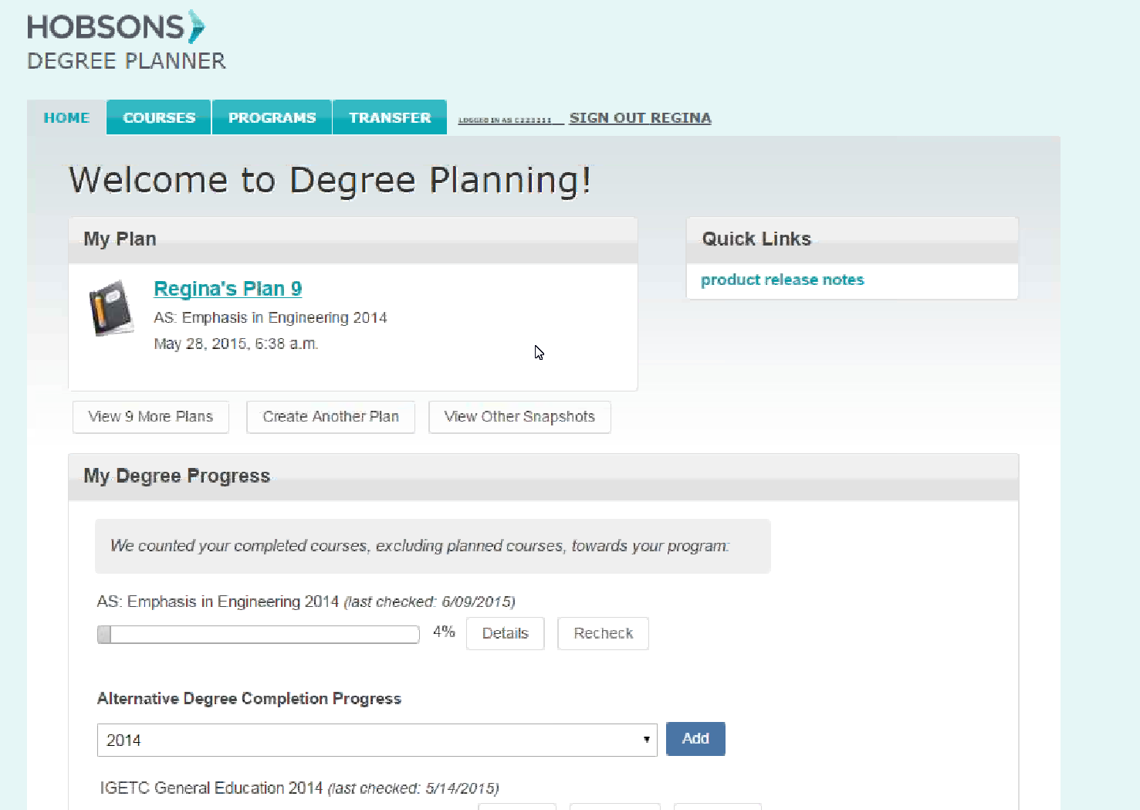

Slide 14
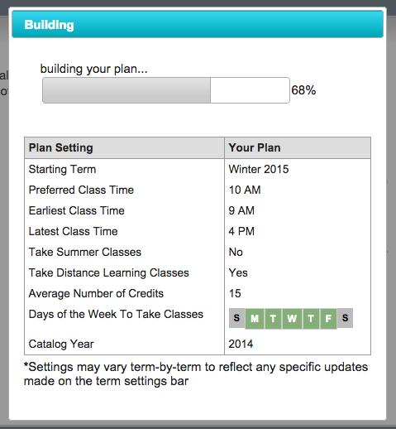
Recipe
Existing credits
Placement test results
Course waivers
Program of study
Classes offered
Order of classes
Regina’s availability
Online courses?

Slide 15
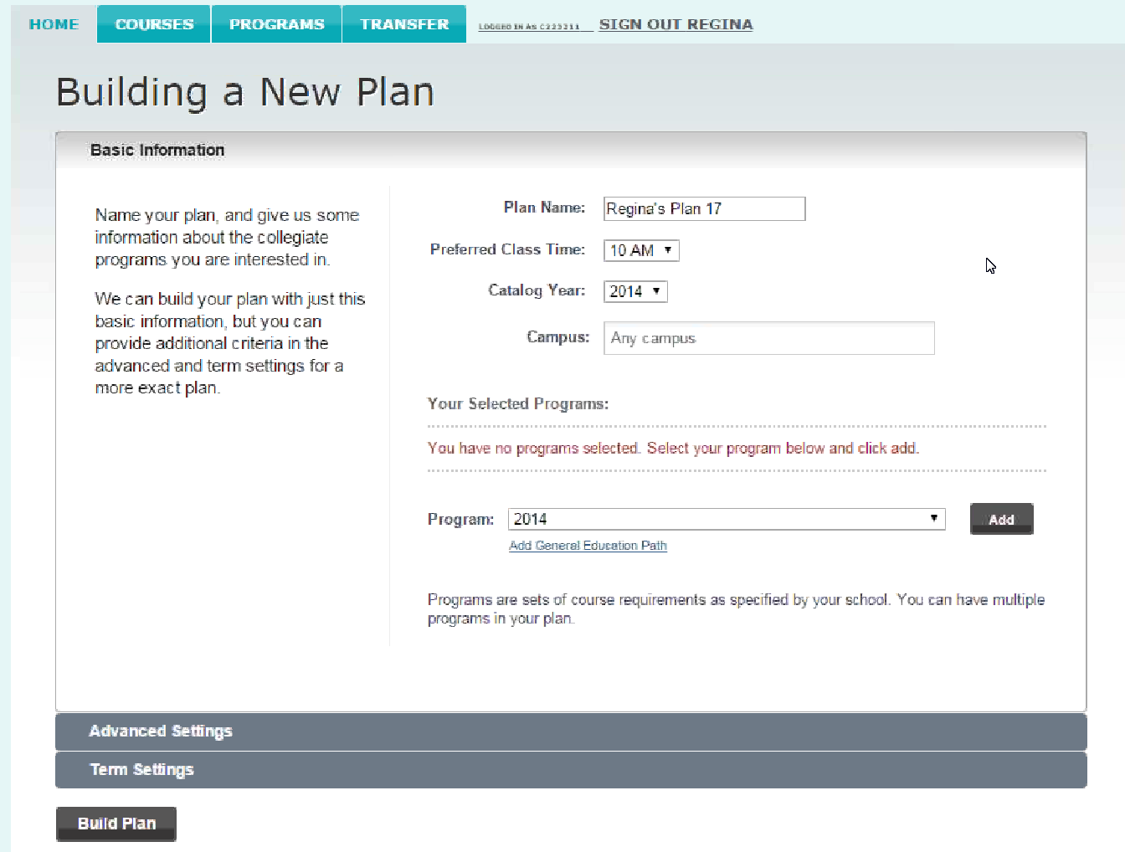

Slide 16
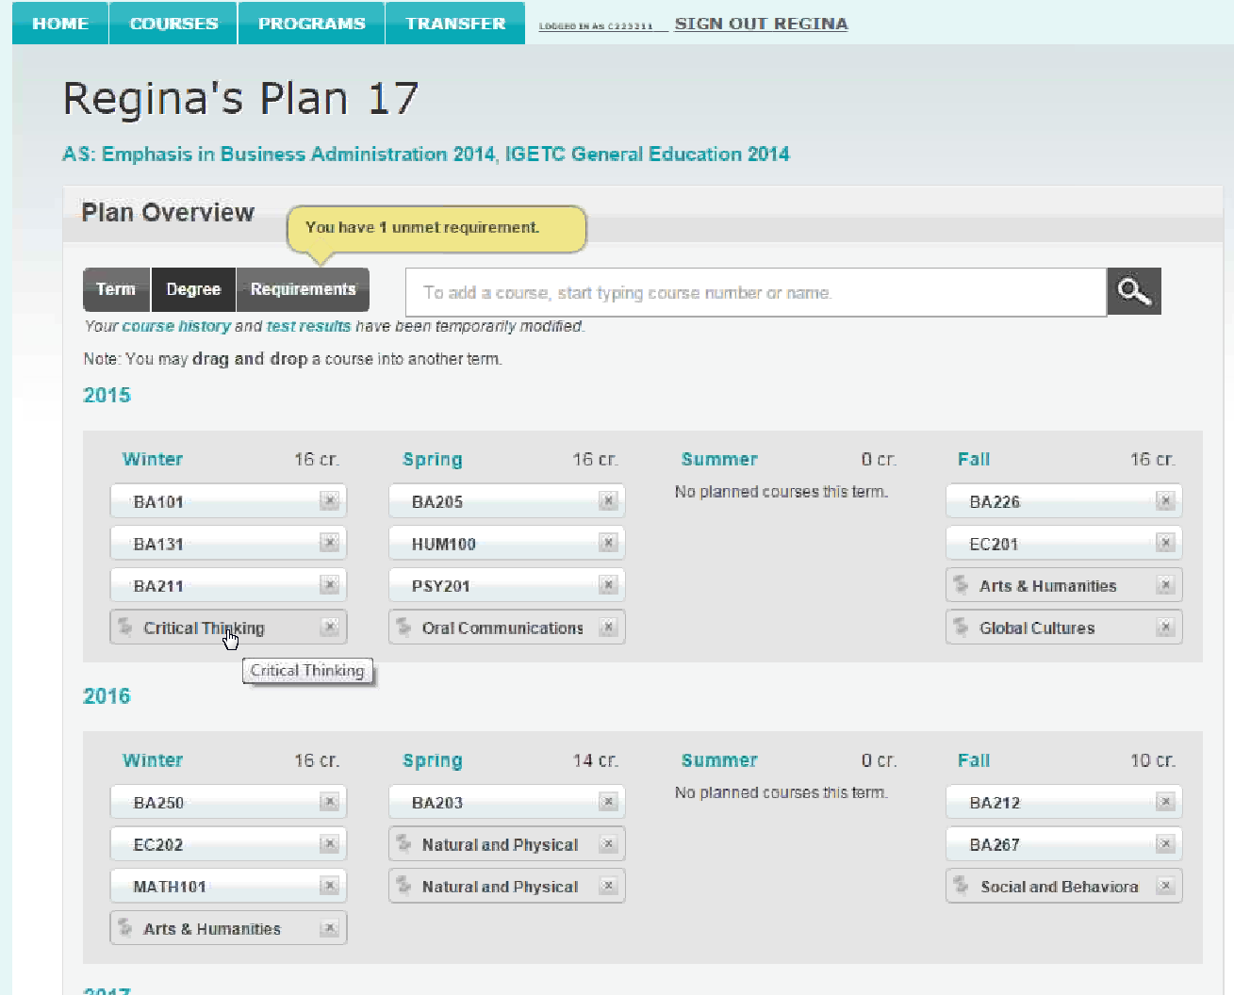

Slide 17
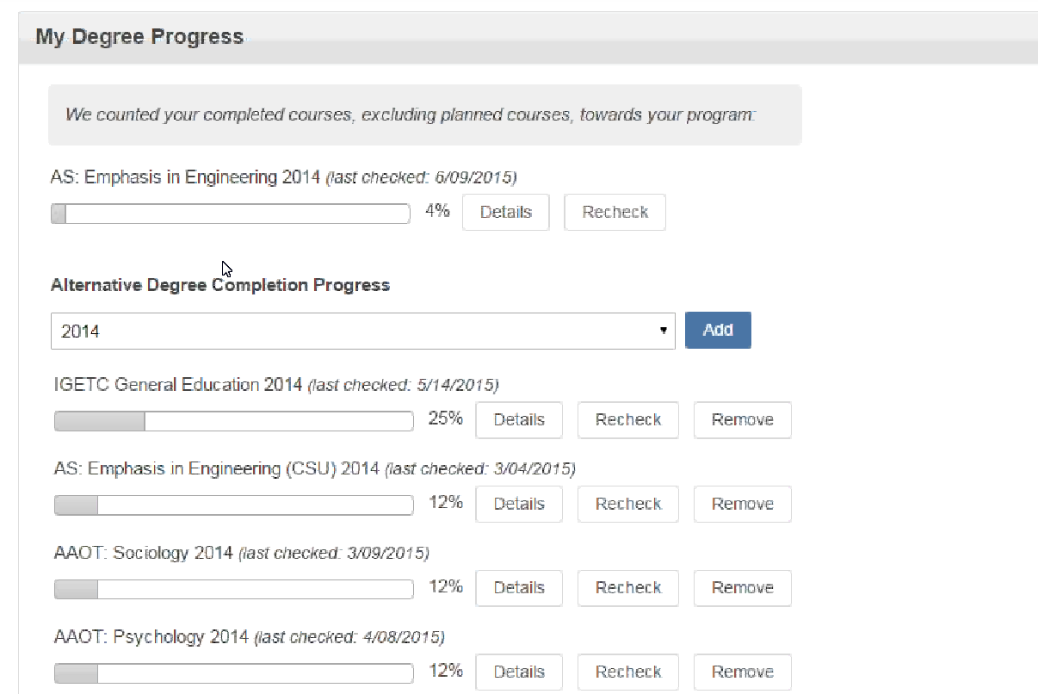

Slide 18
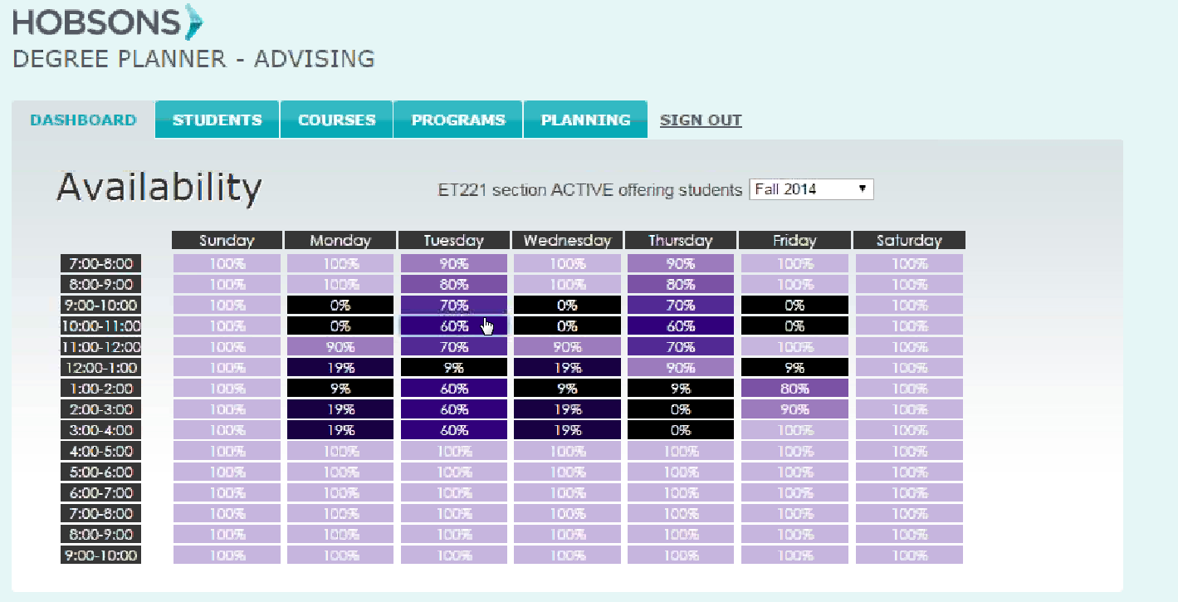

Slide 19
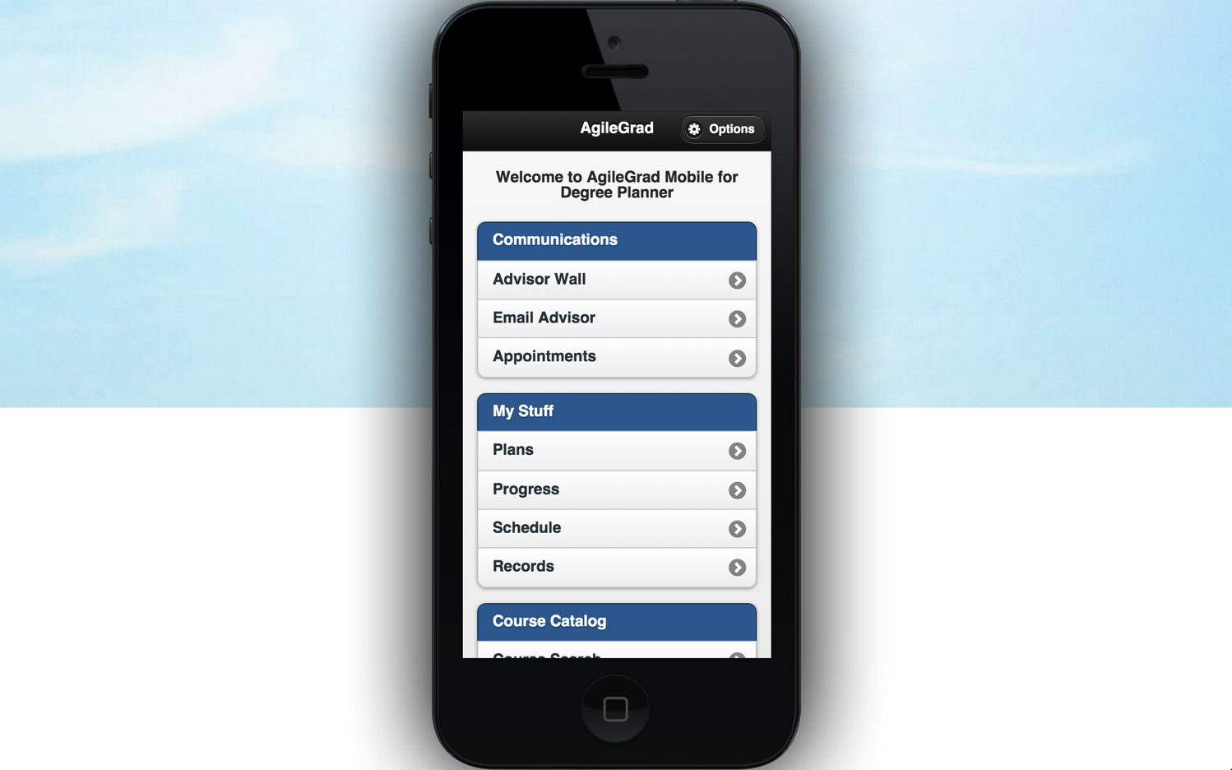
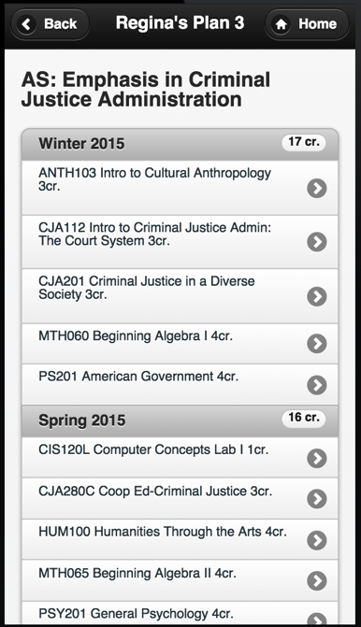
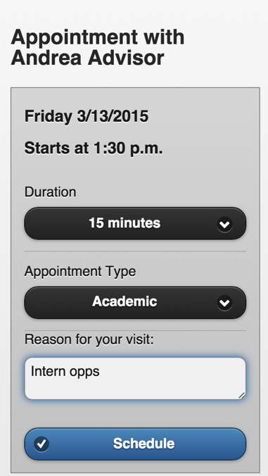
Degree Planner
Welcome to Degree Planner Mobile

Slide 20
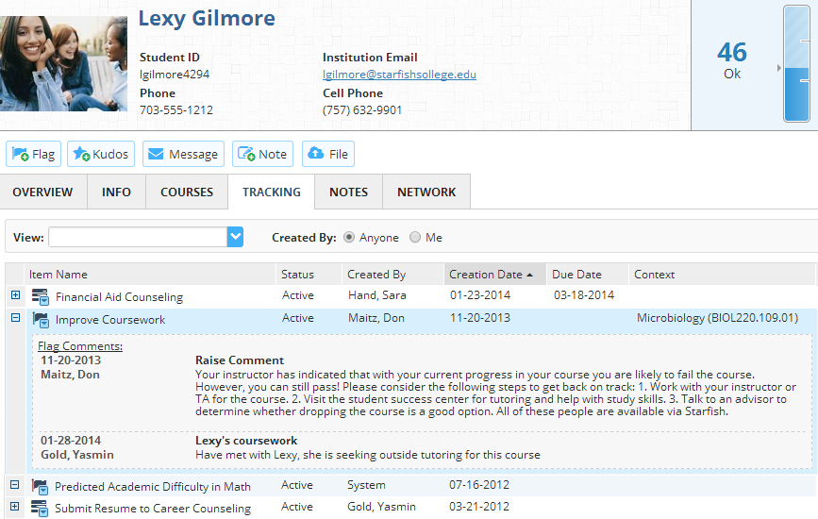
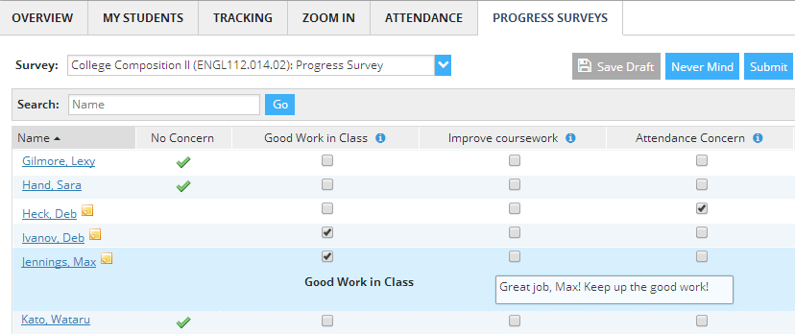
Learn More, Earlier, About Your Students
Starfish Early Alert
Collect as much information as possible, as soon as possible, and let both people and systems trigger alerts and Kudos
Keep everyone on the same page but let departments and groups use information differently
Engage your students in their own progress by keeping them informed and prompting action
✓
✓
✓
✓
Intelligent Data Integration™ with LMS, SIS and other systems
Unlimited flags and flag journals
Faculty-friendly tools for progress surveys, attendance, and grade book analysis
Native support for cohorts and groups

Slide 21
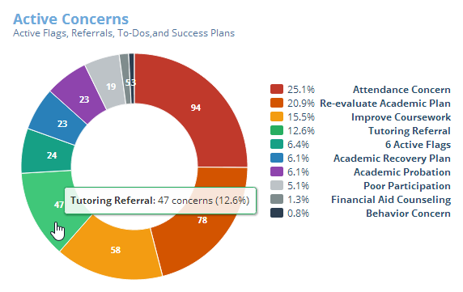
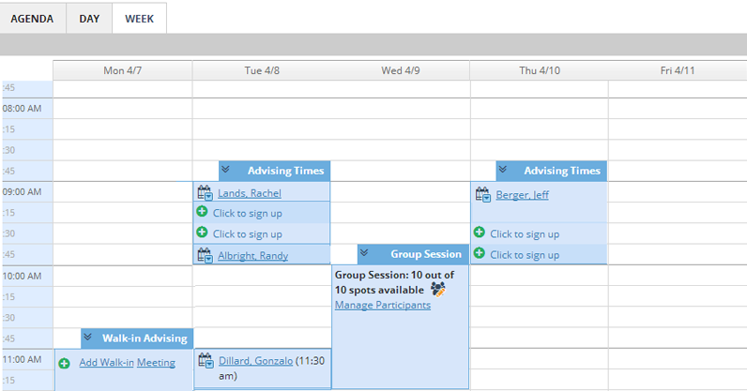
Make it Easy for Students to Engage
Starfish Connect
Remove obstacles by showing students how to connect with the right people and services
Keep everyone on the same page with simple tools that document and share interactions
Give students their next steps whether it’s a simple Referral, a To-Do, or a personal Success Plan
✓
✓
✓
✓
Robust appointment tools that sync with other calendars
Status tracking, meeting notes, and notifications
Unlimited Services Catalogs and Kiosks
Flexible templates for tasks and Success Plans

Slide 22
Timeline
August 2015-system-wide call for colleges beyond the pilots to participate in the adoption of EPI solutions: Letter to leadership, webinars, conference presentations
December 2015-both portal and EPT/DAS functional in pilot Operations
February 2016-initial release of the portal available to all 112 (3) colleges

Slide 23
Online Education Initiative Update

Slide 24
Overarching Goals
Improve success and retention in online courses for the CCC’s
Prepared students
Prepared faculty
Quality course design and content resources
Provide resources to colleges to allow for the addition of quality online courses
Provide students with opportunities to take classes when and where they need them

Slide 25
Pilot Colleges
Readiness | Tutoring | Full-Launch
Antelope Valley | Barstow | Butte
Cabrillo | Columbia | Coastline
College of the Canyons | Imperial Valley | Foothill
Hartnell | Mt. San Antonio | Shasta
Mira Costa | Ohlone | Fresno City
Monterey Peninsula | Pierce | Lake Tahoe
Rio Hondo | Saddleback | Mt. San Jacinto
West Los Angeles | Victor Valley | Ventura

Slide 26
Resources in the Pipeline
Online Tutoring through LinkSystems – available now!
Online Student Readiness modules – free, customizable (Creative Commons), available soon!
Professional Development/Course Design support
Online Counseling
Embedded Basic Skills support for OEI courses
Proctoring and Academic Integrity solutions

Slide 27
Resource Updates!
Tutoring:
Pilots completed at 8 colleges, expanded to 15 colleges and more courses starting summer 2015
WorldWideWhiteboard - No cost platform to connect local tutors to students online for all colleges NOW
NetTutor - Low cost ($25/hour) 24/7 online tutoring for all students available for all colleges NOW
Click Link Systems via the Foundation for the CCCs

Slide 28
Resource Updates!
Online Student Readiness:
Pilots completed at 8 colleges
Extension to all pilot colleges by fall 2015 (no cost…coming soon!)
No cost online student readiness modules will be available to all colleges via Canvas implementation and/or web site
Currently piloting readiness modules combined with Smarter Measure Assessment—need ongoing RFP

Slide 29
Online Learner Readiness Modules (Pilot Phase)
Module 1: Introduction to Online Learning
Module 2: Getting Tech Ready
Module 3: Organizing for Online Success
Module 4: Online Study Skills and Managing Time
Module 5: Communication Skills for Online Learning
Module 6: Online Reading Strategies
Notes:
Picture of screen hyperlinks to the actual module you can show if you want

Slide 30
Resource Updates
Professional Development & Course Design Support
Professional Development Clearinghouse (Summer 2015)
Online Course Design Standards (piloted and revised)
Online Course Review (67 courses in pilot colleges have been reviewed—20 more in process now)
Reviewer Training: Peer Online Course Review (POCR)
Completed March 27th (Foothill College)
Completed May 1st (Cerritos)
Completed May 15 (Mt. San Antonio)
June 17th (OTC: San Diego)
Professional Development Summits
Access to Instructional Designers
Access to Accessibility support
Notes:
Explain the clearing house
Explain the reviewer training: one day meeting and then eligible for week long online reviewer training.

Slide 31
Technology Resources
Common Course Management System – Canvas!
Will be available at no cost for the colleges for at least first 4 years of 5-year contract
Will allow for state wide online community
Enable the deployment of integrated student and faculty resources
Provide no and/or low cost access to an up-to-date, easy to access, fully-functional CMS
Currently researching state wide procurement of add-on tools for online proctoring, plagiarism, etc.

Slide 32
Do all colleges have to move to Canvas?
NO! But…
Ease of use and upgrades will be managed at the system level
Cost will be significantly reduced…i.e. free!
Resources will be integrated for both faculty and students
Partnership with Canvas will allow for customization for the CCC’s
Many resources will still be available to those who stay in their own CMS.
Resources site

Slide 33
What’s the Online Course Exchange?
Will allow students needing courses that are not available at their home college, to seamlessly enroll in those courses, as needed, at other CCCs, thereby, leveling the enrollments in high demand or difficult to fill courses.
Will include access to resources for both colleges and students
Improve degree completion rates across the state.
Participation is not mandatory

Slide 34
The OEI Consortium
Organization to form, initially with 24 pilot institutions as members.
Governing body for implementation decisions that affect the member colleges.
Will be formally convened sometime in June 2015
Pre-consortium activity includes reciprocity summit (April 2015)
Visit with CIO Board
DSPS leadership summit

Slide 35
Potential Curricular Challenges for OEI Consortium
All courses offered in the OEI pilot are C-ID approved. However, there may be challenges, such as…
Reciprocity of co/prerequisites…remember that C-ID co/prerequisites are the minimum
Reciprocity of placement assessment and cut scores
Class sizes
Other?

Slide 36
OEI Governance
27 Member Steering Committee
Chair – Fabiola Torres, Glendale College
Vice-Chair – John Freitas, Los Angeles City College
Representatives of constituent groups: Librarians, A&R, CIO, CSSO, CEO, Students, DE Coordinators, etc.
9 ASCCC faculty representatives
Makes broad policy recommendations to the OEI Management Team (Foothill-De Anza CCD)

Slide 37
Resources
Canvas:
http://www.canvaslms.com/higher-education/
OEI Website
http://CCCOnlineEd.org
Tech Edge Newsletter/Updates Blog
http://ccctechedge.org
Online Tutoring - Foundation Fact Sheet for Colleges
http://www.foundationccc.org/LinkClick.aspx?fileticket=dHov_utMOxg%3d&tabid=489

Slide 38
Contact Information
Dolores Davison davisondolores@fhda.edu
OEI Questions - John Freitas freitaje@lacitycollege.edu
EPI Questions – Cynthia Rico crico@scccd.edu

