Slide 1
Effective Hiring Committee Training
Dr. Walter Jones, Dean of Academic Affairs, West Los Angeles College
Michelle Velasquez Bean, Area C Representative, ASCCC
Academic Academy
Long Beach Queen Mary
Friday, September 13
3:45-5:00 p.m.

Slide 2
Session Description
Hiring committees are required to engage in training programs prior to service, but the quality and scope across our system varies widely. The session will highlight: (a) what the law requires, (b) some obstacles to effective hiring and (c) key considerations for equitable hiring practices

Slide 3
Session Learning Outcomes
Participants will be made aware of hiring criteria and requirements for diversity training as established in Education Code and Title 5
Participants will be able to identify the following: (1) some barriers to equitable hiring and (2) tools for effective hiring

Slide 4
Check-In
Think about your expectations for the session (we will revisit them at the end).
Notes:
Who is in the room?
Faculty
Admin
Students
HR
Others?

Slide 5
Discussion Question
In a group of 3-6 briefly discuss the most bizarre experience you have had on a hiring committee?(3-5 minutes)
Report out and explain what you think went wrong?

Slide 6
Legal Compliance: Ed Code
Sensitivity to and understanding of diversity is the “prime directive”
While Education Code section 87360, leaves faculty hiring criteria, policies, and procedures to be developed jointly by the governing board and the academic senate, it does mandate one criterion that is non-negotiable:
Education Code section 87360(a) provides
“In establishing hiring criteria for faculty and administrators, district governing boards shall … develop criteria that include a sensitivity to and understanding of diverse academic, socioeconomic, cultural, disability, and ethnic backgrounds of community college students.”
In effect, section 87360 requires that sensitivity to and understanding of diversity be included in the district’s final hiring criteria.
Notes:
President John Stanskas wrote about the 2 hiring criteria: https://asccc.org/content/diversifying-leadership-faculty-ranks
It is the responsibility of those serving on the hiring committee to achieve the goal of hiring a culturally competent workforce who enhance and value diversity!

Slide 7
Legal Compliance: Title 5
(a) All screening and selection techniques, including the procedure for developing interview questions, and the selection process as a whole, shall be:
(2) designed to ensure that for faculty and administrative positions, meaningful consideration is given to the extent to which applicants demonstrate a sensitivity to and understanding of the diverse academic, socioeconomic, cultural, disability, gender identity, sexual orientation, and ethnic backgrounds of community college students. “Meaningful consideration” means that candidates shall be required to demonstrate sensitivity to diversity in ways relevant to the specific position
California Code of Regulations Section 53024(a)

Slide 8
Legal Compliance: Why?
Because . . .
“Academic excellence can best be sustained in a climate of acceptance and with the inclusion of persons from a wide variety of backgrounds and preparations to provide service to an increasingly diverse student population.” Education Code section 87100(a)(2)
This is born out in studies that prove the educational benefits of a diverse faculty, which can close opportunity gaps by 20-50%!
Fairlie, R. W., Hoffman, F., Oreopoulos, P. (2014). A Community College Instructor Like Me: Race and Ethnicity Interactions in the Classroom. American Economic Review, 104(8): 2567-2591.

Slide 9
What are some things that can be barriers to effective hiring practices?

Slide 10
Implicit bias
What is Implicit Bias?
The attitudes or stereotypes that affect our understanding, actions, and decisions in an unconscious manner.
Notes:
Definition from Staats, Cheryl. Understanding Implicit Bias: What Educators Should Know. American Educator: Winter 2015-16.
“Operating outside of our conscious awareness, implicit biases are pervasive, and they can challenge even the most well-intentioned and egalitarian-minded individuals, resulting in actions and outcomes that do not necessarily align with explicit intentions.”

Slide 11
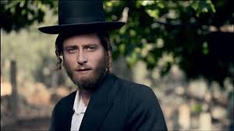
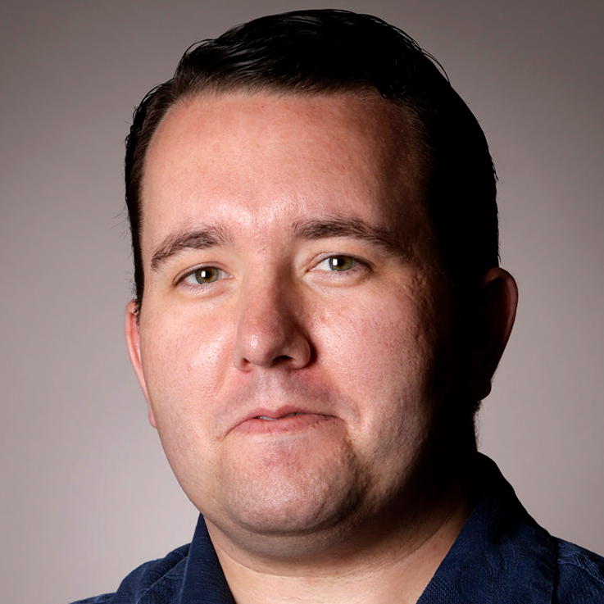
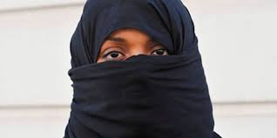
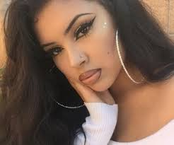
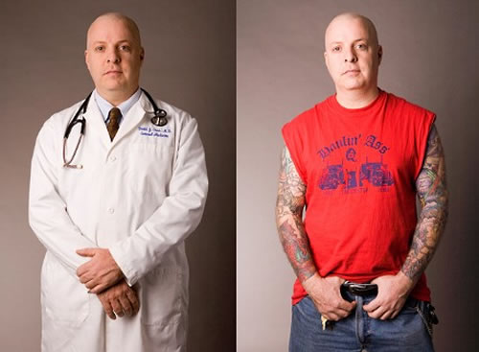
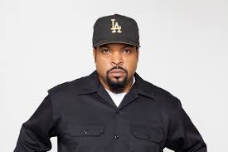
First Impressions and Bias
Notes:
Ask audience:
What are you noticing first?
Do those things (clothing, accessories, tattoos, hair, stance, expressions, gender, race) convey VALUES?
Would you hire someone based on how comfortable you feel they will fit in? Does that exclude others?

Slide 12
Hiring Bias: Diversity and Inclusion Drama
Notes:
Questions for the audience:
Does this resonate with you based on your experience with hiring committees?
What did you do to address the bias in that moment?

Slide 13
Impacts of Implicit Bias
Bias . . .
Includes implicit beliefs (stereotypes) and implicit attitudes (prejudice)
Is pervasive--may lead to “groupthink”
Holds and favors the dominant group “in-group”(not the historically underrepresented)
Often holds the “outgroup” to stricter standards (or claims qualified applicants of color as anomalies or lucky)
Probably does not align with the declared values and mission of the college
WE CAN “DE-BIAS” OUR BRAINS!
Notes:
Group Think--when groups make faulty decisions based on a need to gain harmony instead of allowing for individual input and creativity or varied perspective.
Focus on criteria for the job--not on someone to be your BFF!

Slide 14
Institutional Bias
Institutional bias manifests in hiring for “merit” and “fit”
Merit--the quality of being particularly good or worthy (institutional prestige, degrees, connections, experience)
Merit and fit can impede equitable hiring processes!
Minoritized racial groups have an inequitable access and have been disproportionately impacted in education
Avoid groupthink to include diversity and faculty who support your college and department mission, not your preference of someone who is like you

Slide 15
Identify and Mitigate Implicit Bias
Recognize and identify bias--call out unconscious bias to bring to the conscious level
Dissect your own bias and question your first impressions
Keep an open-mind and challenge assumptions by answering with facts from application
Find your allies and educate others

Slide 16
Scenario: Pre-Hiring
Peaceful City College created a hiring committee with five faculty from the Great Books discipline. The faculty gathered to review to begin the hiring process of a new Great Books full-time faculty member. They started by reviewing the job announcement and description. In addition to the minimum qualifications, they agreed to add a preference of a PhD. One faculty member asked if a review of the student success data could be provided, specifically in identifying historically underrepresented students’ success and retention in the discipline area. The other faculty members dismissed the request based on past practice not allowing for such a review.
What are some of the strengths and weaknesses of this committees’ process?

Slide 17
Key Considerations: Pre-Hiring
Job Description
Avoid bias--be open-minded
Carefully consider preferences that create barriers
Consider review by Equity Coordinator/Committee
Provide examples or template language
Use asset-minded language
Job Announcement and Recruitment
Advocate for advertisement with diverse organizations
Don’t forget industry registries
Consider social media networks and mobile platforms
Notes:
Quantitative factors: We often consider FTES, fill rates, full-time/part-time percentages (FON), even minimum qualifications, and expertise, BUT . . .
Do we intentionally consider qualitative factors in training faculty?
Belonging and Inclusion: Use your voice to support and fight for people the way you would want someone to fight for you!
Bias--all the “isms”: sexism, agism, racism, binary language
Diverse Organizations: AAHHE, A2Mend, API
Journal of Blacks in Higher Education: www.jbhe.com • Hispanic Association of Colleges and Universities: www.HACU.net • www.DiverseEducation.com • www.DiverseAcademia.com via www.CommunityCollegeJobs.com
Consider LOCAL groups and graduate schools!
Social Media: LinkedIn, Facebook, Twitter, Youtube

Slide 18
Job Description: Language Matters
Which description is stronger and why?
Happy Valley College seeks ethnically diverse faculty to help close achievement gaps with minority and nontraditional students.
Lovely Valley College seeks a diverse faculty to join a team committed to transformative education and social justice for a diverse student body.
Notes:
Use equity-focused language instead of deficit-focused language.

Slide 19
Deficit-Minded Language
At-risk/high need
Underprepared/disadvantaged
Untraditional/non-traditional
Underprivileged
Learning styles (*if assuming that someone with X learning style is somehow “other”)
Achievement gap

Slide 20
Asset-Minded Equity Language
Diversity/diverse
Underrepresented/underserved
Multicultural
Students of color
Racial/ethnic equity
Hispanic Serving Institutions (HSI)
Predominantly Black Institution
Ethnicity
Latinx
African-American/Black
Native American
Culture/cultural appreciation
Culturally relevant/responsive pedagogy
Social Justice

Slide 21
Scenario: Diversity Application Question
As an instructor, I create a classroom culture that intentionally welcomes and supports students from different racial, ethnic, and socio-economic backgrounds. I have passionately volunteered as the chaperone to the annual Queer Prom and advisor to the Puente Club for the last five years. My lessons focus on literature from multiple perspectives and cultures, and I expect all students to succeed and connect with others. My aim is to ensure universal learning design in each activity to make learning accessible and motivating.
I have worked as an adjunct instructor in Basic Skills courses at three inner-city schools and feel comfortable working with these diverse students.
Which write-up is stronger and why?

Slide 22
Key Considerations: Application and Interview
Embed equity into every question--DEI is not a checklist or a one-off question! Title 5, section 53024.1(c) requires elimination of bias
Use interview questions that are open-ended to help reveal applicant’s authenticity
Use a rubric or criteria to evaluate the applicant’s ability to foster cultural competency and diversity in addition to academic skills and aptitude
Avoid discussions of the “right” answer--this shows bias!
Discuss EEO Dos and Don’ts
Ensure a diverse pool is sent to the next level interviews
Allow sufficient time to review all applicant materials
Allow individual review before whole committee debriefing to avoid “groupthink”
Be able to defend every decision to accept or reject an applicant

Slide 23
Key Considerations: Selections
Diversity promotes creativity and varied viewpoints for better results
Review board policy and college mission or vision for shared values
Consider all experiences--identify elitism and bias
Establish local equivalencies that broaden the pool instead of narrow it
Ensure a broad and diverse candidate pool
Groups may believe social diversity makes them work harder--yes, they have to challenge their behavior and bias
Transforming culture to eliminate systemic and institutional barriers for students is work that matters
Notes:
Avoid Elitism--why do you “require” PhD? Do they really need CCC experience? Do you really need to know the university they went to--why?
Instead eliminate unnecessary requirements
Yes--maybe extra work reading more applications, BUT isn’t the success of our students worth the extra minutes to ensure breadth and depth in our applicant pools?

Slide 24
Making Meaning: Taking Action
How do we improve training for hiring committees locally?
Investigate the faculty role in updating training processes
Review the student opportunity gaps
Identify the relationship between hiring and student success and equity

Slide 25
Revisit Your Expectations

Slide 26
Thank You!
Any Questions?
Contact Information
Michelle Bean at mbean@riohondo.edu
Walter Jones at joneswc@wlac.edu

Slide 27
Know Your Campus Diversity Data
Check and share the Chancellor’s Office Datamart info
Faculty and staff numbers found at
https://datamart.cccco.edu/Faculty-Staff/Staff_Demo.aspx

Slide 28
Resources
A Re-Examination of Hiring Policies and Procedures. Spring 2018: ASCCC. Retrieved from https://www.asccc.org/sites/default/files/Hiring%20Paper%20Final%203.12.18.pdf
Stanskas, John and Krystinne Mica. Diversifying Leadership in Faculty Ranks. April 2019. ASCCC. Retrieved from https://asccc.org/content/diversifying-leadership-faculty-ranks
Stewart, Abigail & Valian Virginia. Recruit Diverse and Excellent New Faculty. Inside Higher Ed.: July 2018. Retrieved from https://www.insidehighered.com/advice/2018/07/19/advice-deans-department-heads-and-search-committees-recruiting-diverse-faculty
Looking at Equivalency Differently: Rethinking Equivalency to General Education. Retrieved from https://asccc.org/content/looking-equivalency-differently-rethinking-equivalency-general-education
ACCJC Accreditation Standards III.A.1 and III.A.2 for hiring qualified faculty. Retrieved from https://accjc.org/wp-content/uploads/Accreditation-Standards_-Adopted-June-2014.pdf
EEO sections of the Title 5 regulations. Retrieved from https://govt.westlaw.com/calregs/Browse/Home/California/CaliforniaCodeofRegulations?guid=I54116010D48411DEBC02831C6D6C108E&originationContext=documenttoc&transitionType=Default&contextData=(sc.Default)
Hobson, Melody. Color Blind or Color Brave? Ted Talk. May 2014. Youtube. Retrieved from https://www.youtube.com/watch?v=oKtALHe3Y9Q

