Slide 1
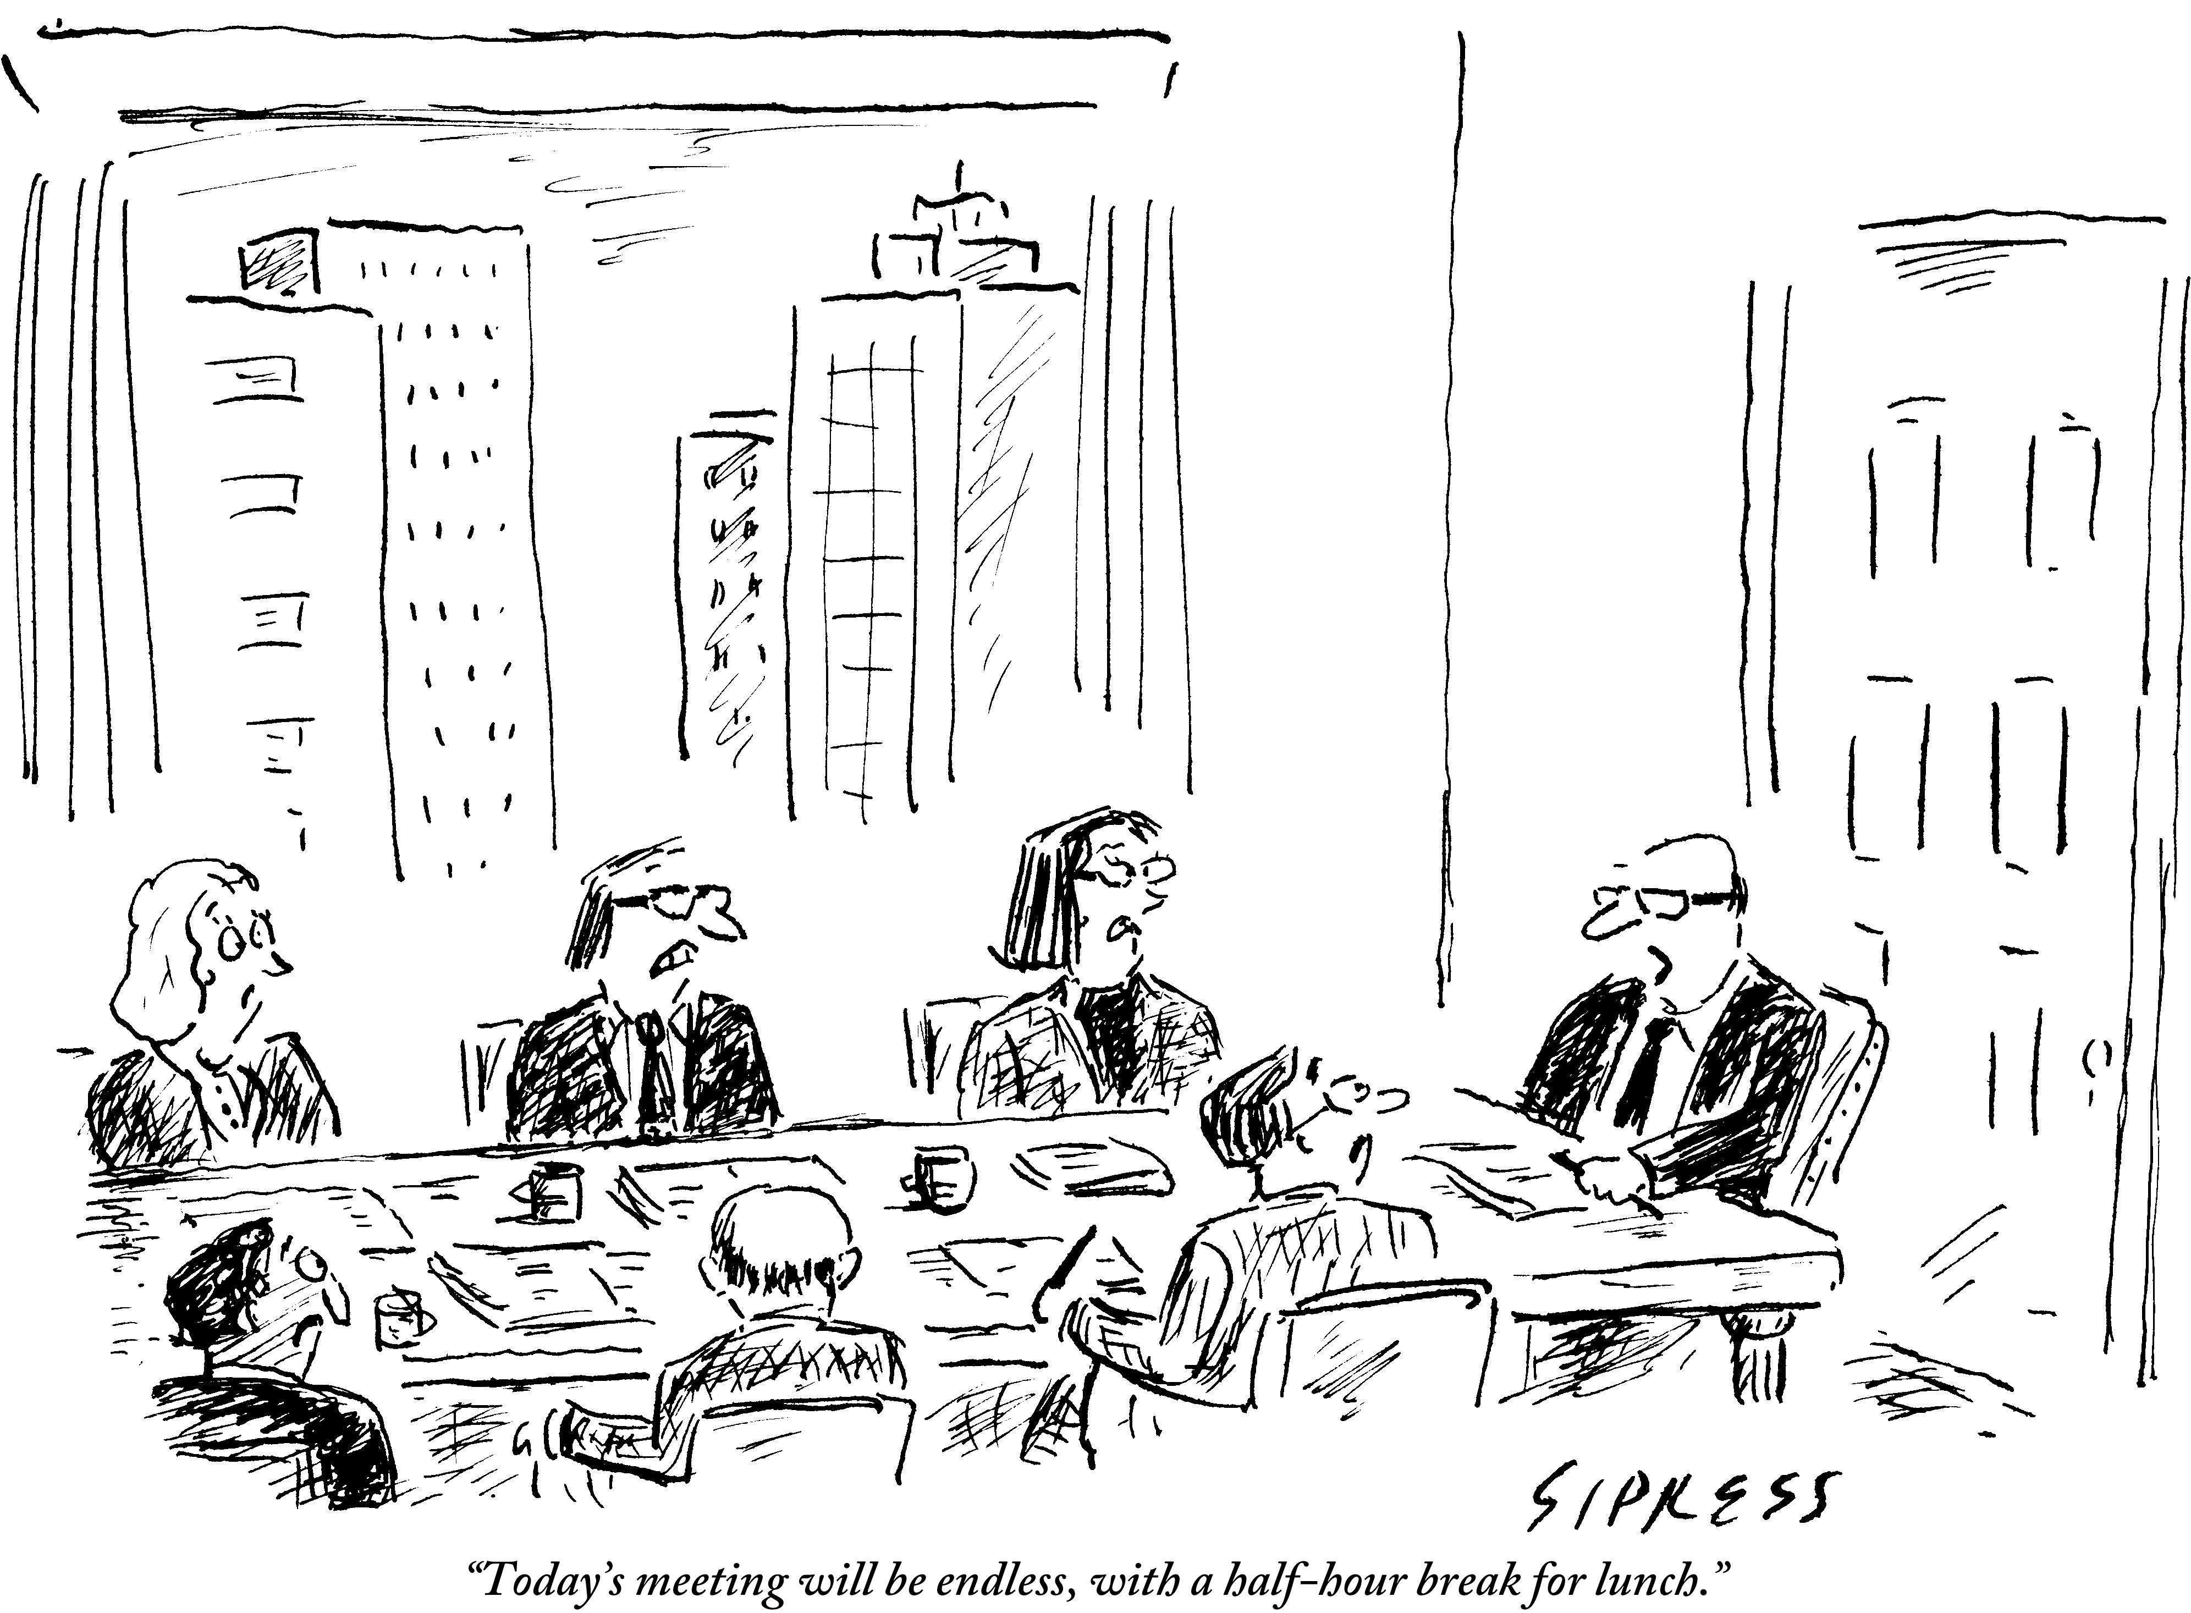
Avoiding a Train Wreck: Ensuring Meetings are Effective and Productive
Dolores Davison, ASCCC Secretary
Grant Goold, ASCCC Area A Representative
2016 ASCCC Leadership Institute

Slide 2
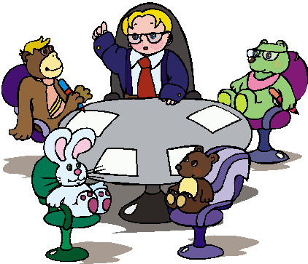
Introductions
Who are we?
Who are you?
What has brought you to this session?

Slide 3
Ineffective Meetings
As difficult as it is to believe, there are many meetings that do not accomplish their intended goals.
Each one of these meetings began with good intentions, but something caused them to become ineffective.
What are some things that make a meeting ineffective?

Slide 4
Relationships
As a faculty leader, your greatest assets are the relationships that you have built with your colleagues.
These relationships can help you anticipate challenging conversations, address possible issues prior to a meetings, and to regain control of a meeting if things start to go badly.

Slide 5
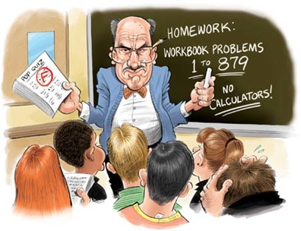
How Would You Handle This?
Your Academic Senate meetings have always been held on Tuesday afternoons, which makes it almost impossible for several divisions (including Athletics and Physical Sciences) to send representatives. The dean of one of the divisions comes to a meeting to say that decisions by the Senate will not be binding on her department because her faculty cannot participate. What do you do?

Slide 6
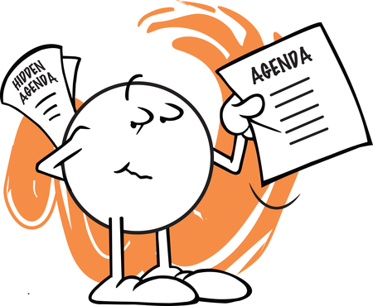
Creating An Agenda
Who is responsible for creating the agenda?
How much information do you include for each agenda item?
Do you give a specific amount of time for discussion on each item?

Slide 7
Effective Agendas
Effective agendas should include the background of all discussion items and not just a series of attached files.
Including information like who, what, when, where, how, and why will minimize the time spent getting everyone on the same page during a meeting and will minimize confusion about why topics are being discussed.
Attachments of relevant materials are also helpful, and should probably be resent each time they are to be discussed.

Slide 8
How Would You Handle This Situation?
Your district chancellor is finalizing a contract with a college in the Philippines to provide educational consulting. Upon hearing about the possible contract, many college faculty are calling for the chancellor’s dismissal. How would you list the item on an agenda for discussion? What information would you include with the agenda?

Slide 9
Managing the Meeting
Even with all of your previous preparation, a meeting can still be a challenge
Have a set of adopted rules (like Robert’s Rules) that govern how the meeting will run
How do you ensure that everyone gets to participate in the discussion?

Slide 10
What Makes a Good Facilitator?
Values people and their ideas
Thinks quick and logically
Excellent communicators
Both product and process oriented

Slide 11
How Would You Handle This?
A faculty member unhappy with her assignments for the following year decides to show up to the Academic Senate meeting to complain. She interrupts the beginning of the meeting to voice her complaint and continues to insert comments into discussions on unrelated items throughout the meeting while claiming that her load is an academic and professional matter.

Slide 12
Managing the Meeting
What do you do if the discussion is getting off topic?
How can you regain control when emotions run high?
Can the chair/president take a position during the discussion?

Slide 13
When Meetings Go Wrong
Things can go terribly wrong for both new and experienced leaders.
Always try to remain calm. People are looking for you to lead them and losing your temper will not help.
Heated arguments and circular discussions happen to everyone.

Slide 14
Suggestions
Properly preparing before the meeting can help you manage the tough situations
Meet with folks before the meetings. See where they are coming from so you know what to expect.
Include some details on your agenda. Some background information will make it clear why you are having these discussions now.
Have established rules that allow you to regain control if things start to go south.

Slide 15
Soapboxes and Rabbit Holes
Have patience and let someone vent when needed, but not too often
Refer the group back to the agenda item
Encourage and model focused statements regarding a specific agenda item
Do not be afraid of professional confrontation
Encourage options be placed in writing for the next meeting
Take the higher road, try and not react to personal attacks

Slide 17
Questions??
Thank you for joining us.

