Slide 1
Effective Practices for Working with CTE Advisory Committees
Wednesday, July 8 1:00pm-2:15pm
Jim Bowen, Faculty
Dr Lynn Shaw, CTE Curriculum Director
Alan Braggins, Statewide Director Advanced Manufacturing

Slide 2
Career and Technical Education Advisory Committees
The Career and Technical Education Advisory Committees include representatives from business, industry, labor, community agencies, faculty, students and other members.
The primary purpose of advisory committees is to provide direction and guidance for the specific career and technical area within the college to strengthen and enhance the success of college programs.

Slide 3
Goals and Objectives Of a Career Education Advisory Committee
Job opportunities
Assist in surveying workforce needs and new and emerging occupations
Advise on the changing nature of the competencies in industry and career fields
Assist in gathering information for job placement of graduates
Inform the program of opportunities to place students in full-or part-time jobs

Slide 4
Goals and Objectives Of a Career Education Advisory Committee
Facilities and program equipment
Consult on existing equipment, facilities, and resources and compare with career norms
Consult on lab equipment and compare with the current and future technology and industry/profession standards
Consult on lab safety program

Slide 5
Goals and Objectives Of a Career Education Advisory Committee
Course content
Consult on the development of educational objectives
Review the program’s sequence and scheduling of courses and delivery options
Review and suggest content for courses of study and standards of proficiency in areas which are essential to becoming successfully employed in a career path

Slide 6
Goals and Objectives Of a Career Education Advisory Committee
Instructional and learning experiences
Identify or suggest resource personnel to enrich the instructional content
Assist in locating and obtaining equipment and supplies on loan, as gifts, or at special prices
Suggest qualified persons for needed instructor/personnel vacancies
Participate as a resource person to enhance the instructional process

Slide 7
Goals and Objectives Of a Career Education Advisory Committee
Promoting education
Participate in programs designed to promote career and technical education
Testify in support of career and technical education at meetings which may be called by local and state officials, boards, and legislative groups
Encourage other businesses to stimulate development of work experience programs
Build interest and understanding between the college and community and professional organizations

Slide 8
Creating a Local Career Education Advisory Committee
Research Local Employers in your Specialty.
Determine Point of Contact and keep a list of Phone # and/or Email
Attempt contacting and follow-up as needed. Request Volunteers
Check with fellow Instructors-full time and Adjunct for Leads.
Follow-up obtaining qualified Volunteers
Check with present/past students, if feasible, working in the field.
Request contacts and follow-up - obtaining volunteers.
Success rate? Questionable and Time Consuming!

Slide 9
Successful Example
Local Career Education Advisory Committee
Advisory Committee for Business and Computer Studies at Antelope Valley College.
Combined meetings with the following Educational Organizations When Possible
Antelope Valley Union School District (8+ High School)
Rosamond High School
Antelope Valley East Kern STEM Network (IT & CyberSecurity Subcommittee)
South Central Coast Regional Consortium
Others as needed.

Slide 10
Antelope Valley Union School District & Rosamond High School Access to the Following Resources:
Director of Industry Liaison & Post Secondary Partnerships for Antelope Valley Unified High School District and Networking Contacts.
Lead Career Education and Secondary Instructors from both School Organizations and their resources and contacts.
Opportunities for Articulations between Antelope Valley College and High Schools. (A+, N+, S+, etc)
Partnerships leading to unofficial "Pathways."

Slide 11
Antelope Valley East Kern STEM Network (IT & CyberSecurity Subcommittee) Access to the Following Industry Resources:
Director of Industry Liason & Post Secondary Partnerships for Antelope Valley Unified High School District and Networking Contacts
Air Force Research Laboratory Edwards, AFB. Educational Outreach Coordinator/ Manager and this Position's Contacts for Edwards, AFB, and AF Plant 42
NASA’s Human Resources Department, Space X, and others at Mojave Space Port
Education and HR Departments of Various Defense Contracts such as Lockheed, General Dynamics, Northrup, and many others

Slide 12
South Central Coast Regional Consortium Resources Available:
Collaborative meetings with all Consortium Members
Colleges
Industry
High Schools
Resources for CyberPatriot and
National Cyber League through CALPOLY San Luis Obispo and the
California Cyber Hub
Competition Judges are Industry looking for future employees and to have input on training

Slide 13
Success=Follow-up+Planning
Encourage Students to register with Linked-In for follow-up
Use Linked-In for future leads, and new Advisory members.
Most Computer Jobs require a background check – Introduce Infraguard.org and encourage it.
Industry Certifications, Microsoft, CompTIA and others are being required to get jobs.

Slide 14
Regional Career Education Advisory Committees
Inland Empire/Desert Region Strong Workforce Pilot Project
Initial Funding in 2016 (Round One) and Renewed in 2019 (Round 4)
Managed by the Regional Directors, Employer Engagement
Administered by a funded Project Director
One Advisory per sector, per year
May meets Perkins Requirements

Slide 15
Regional Career Education Advisory Committees
Community of Practice
LinkedIn Groups for Continuing Relationships
Not a one-and-done event
Skills Panel Format
Industry Speaks – Educators Listen
Advance Review of Curriculum
Submit curriculum to Industry Advisors in advance for Review

Slide 16
Cumulative Attendance

Slide 17
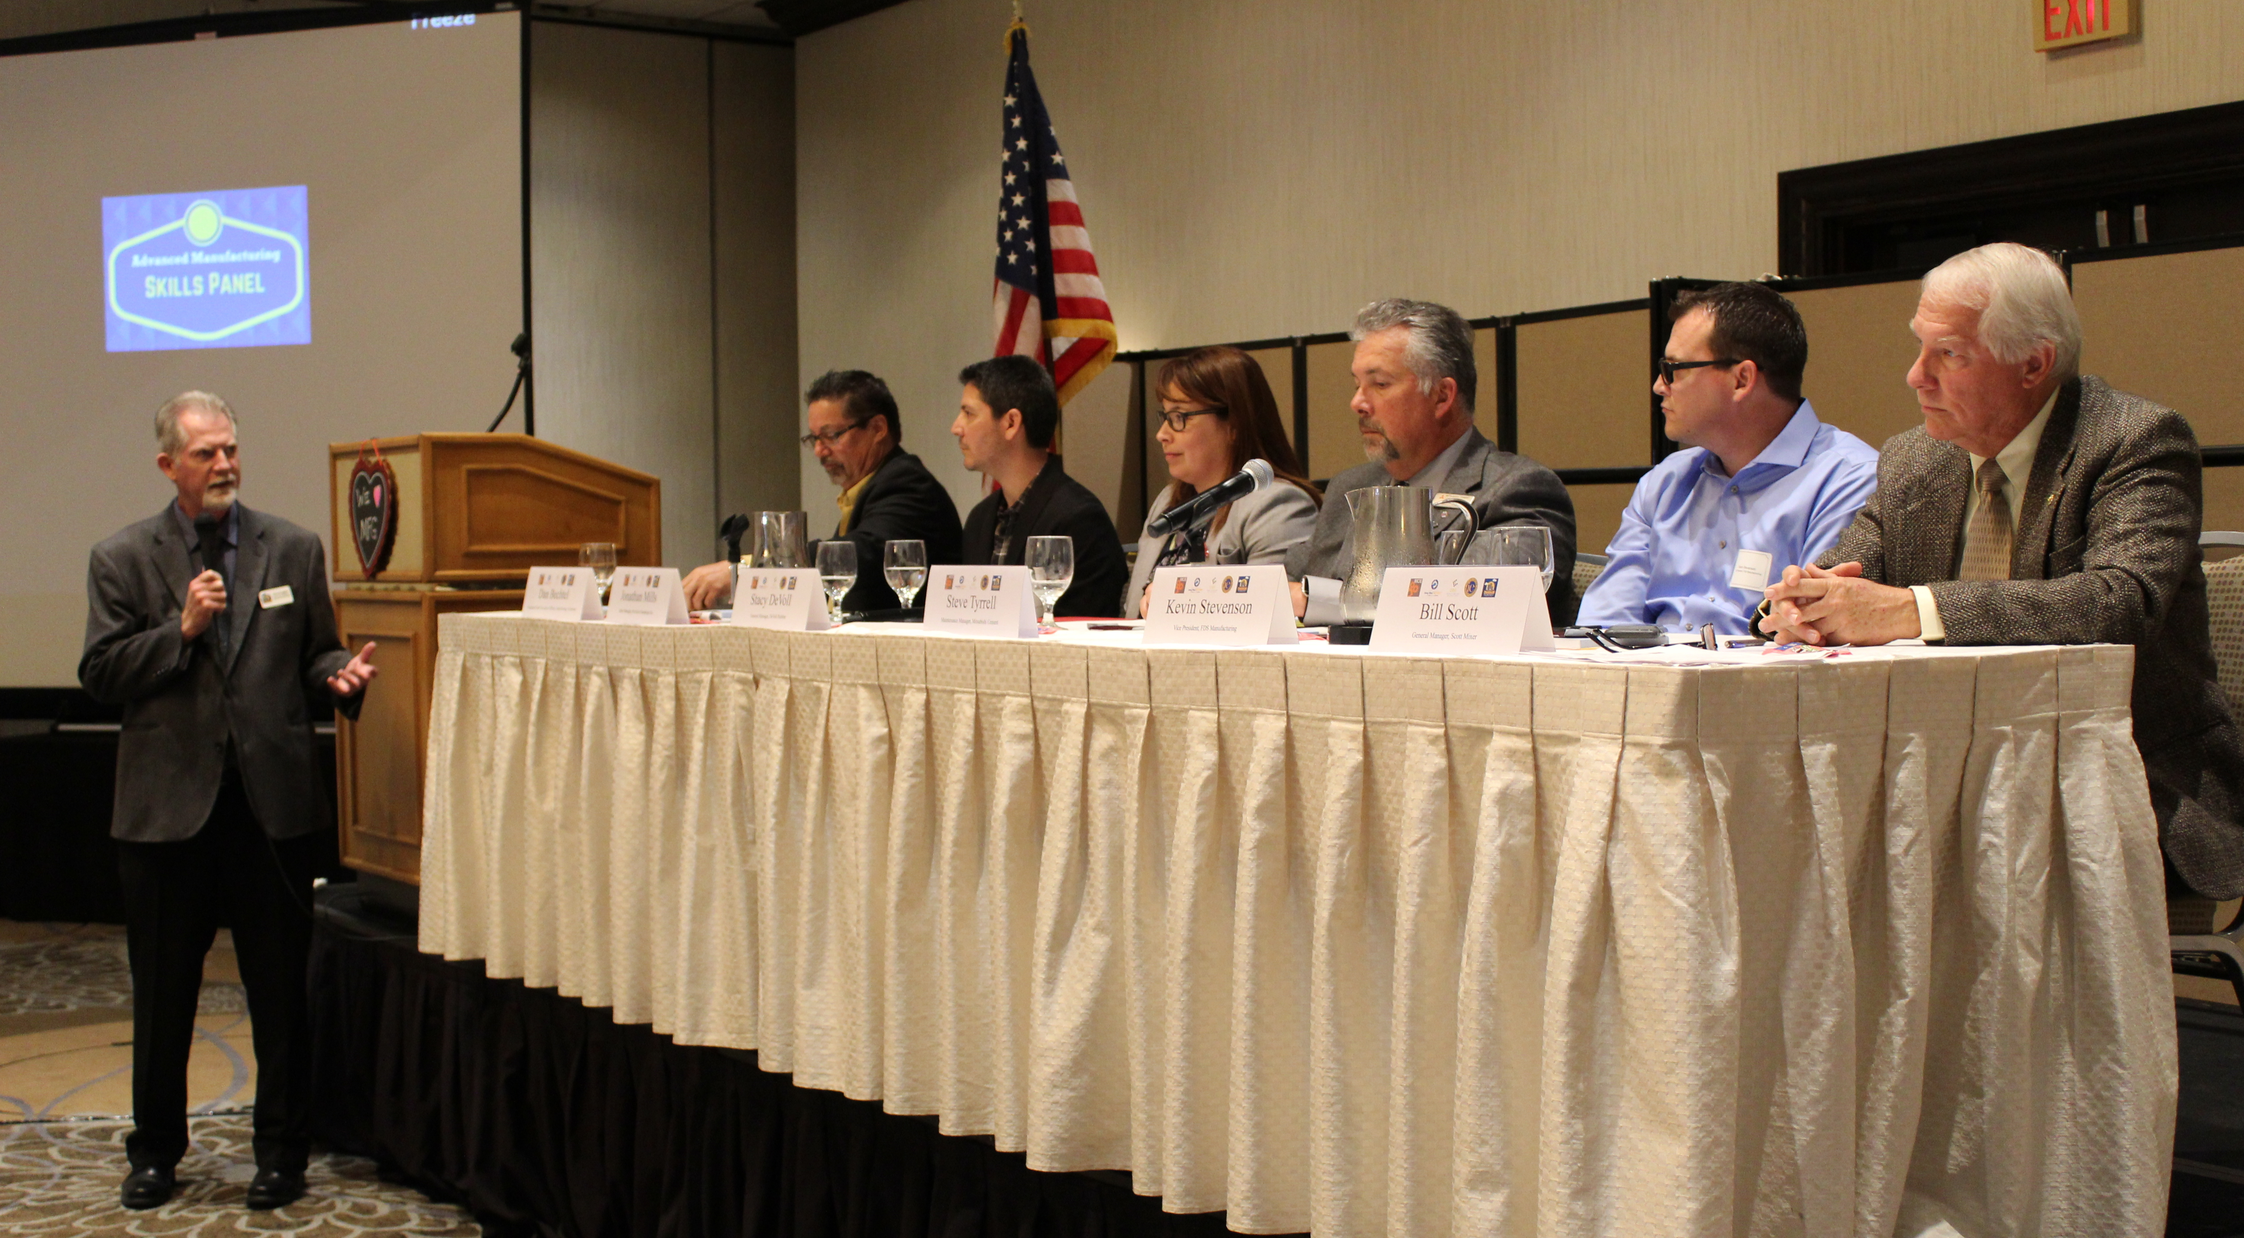
Regional Career Education Advisory Committees Meeting Format
Skills Panel
Curated Q & A by emcee, RDEE or industry guest
Allow limited time for audience questions

Slide 18
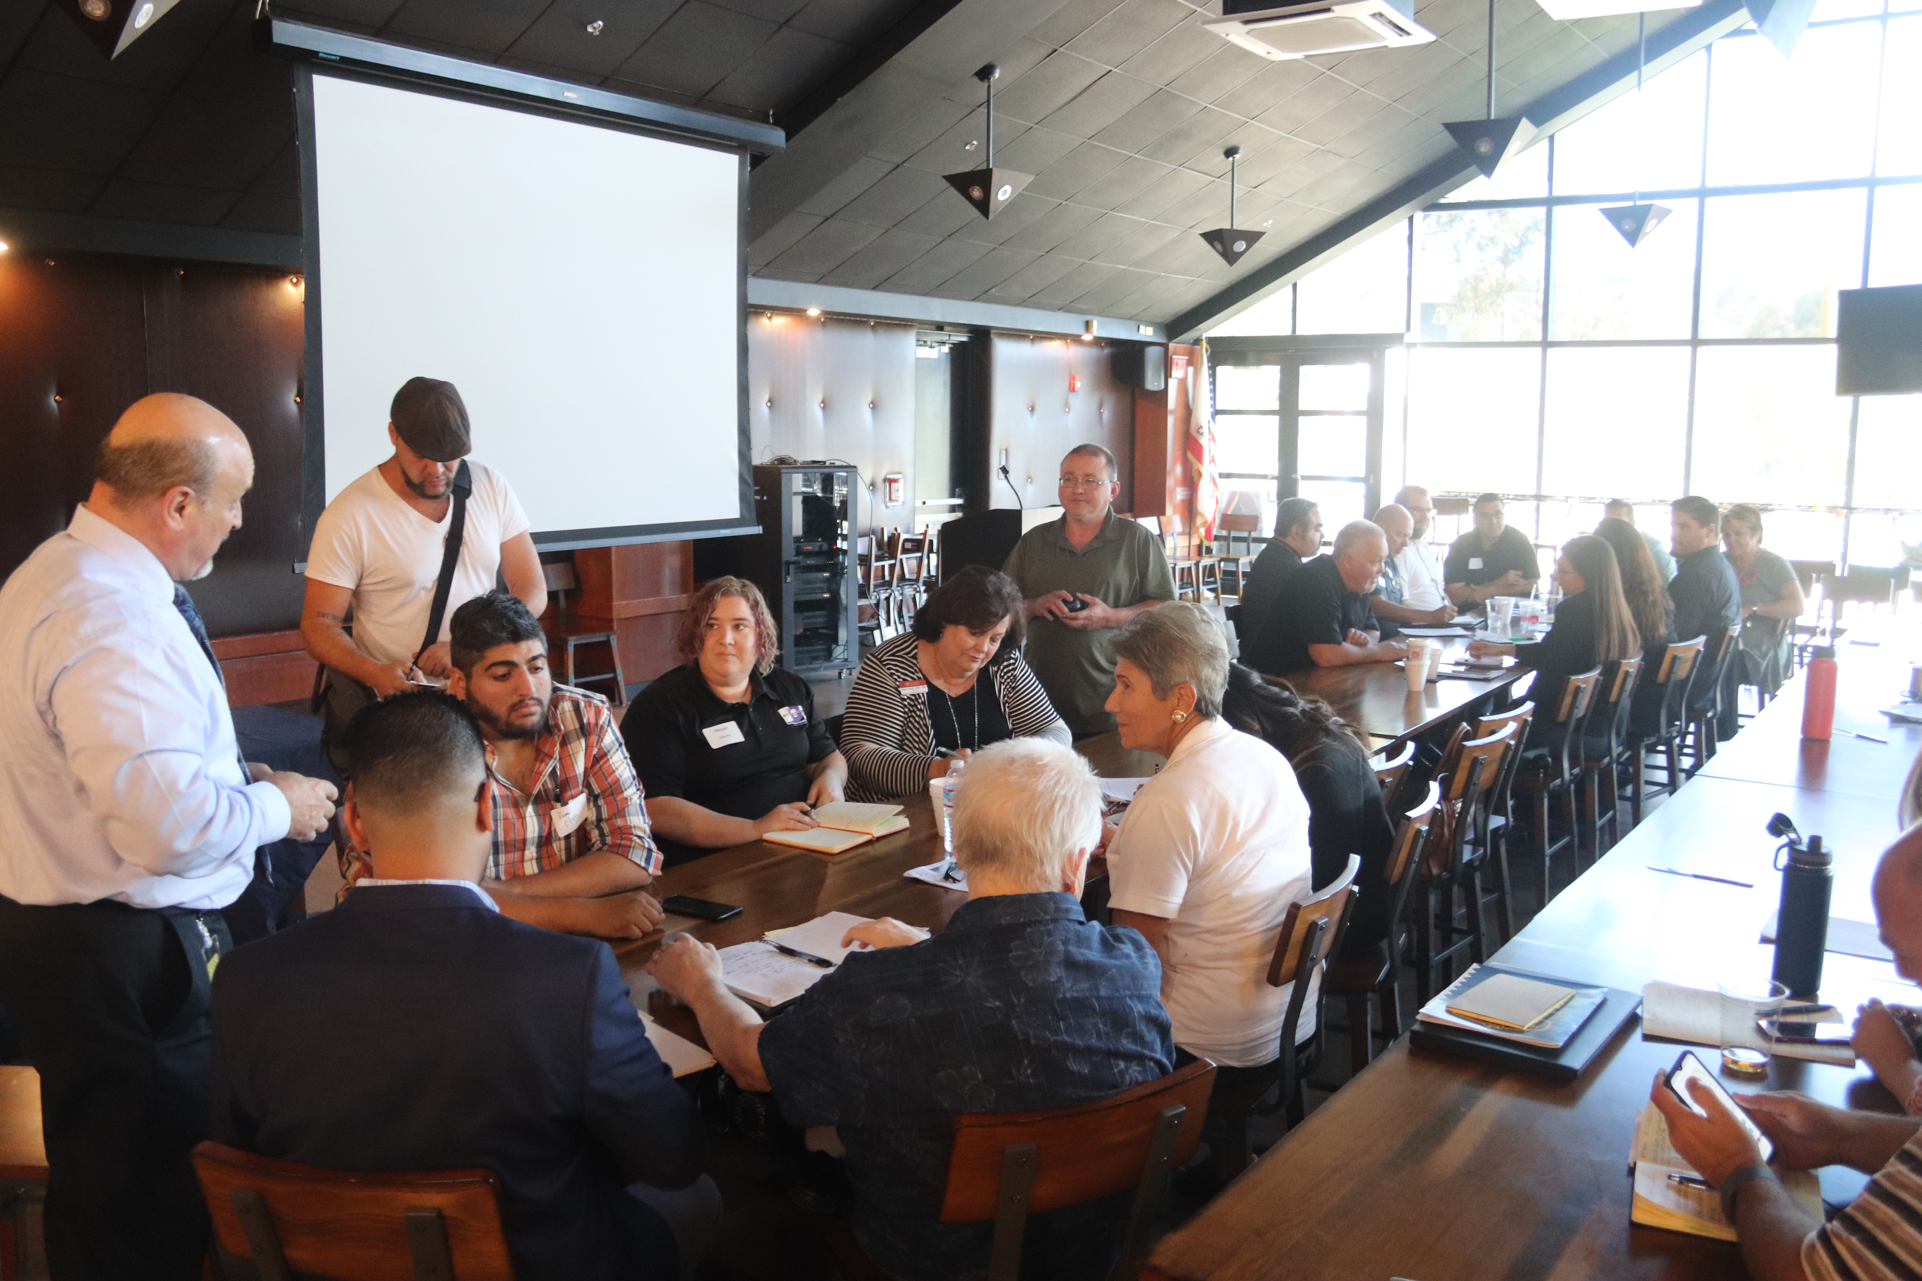
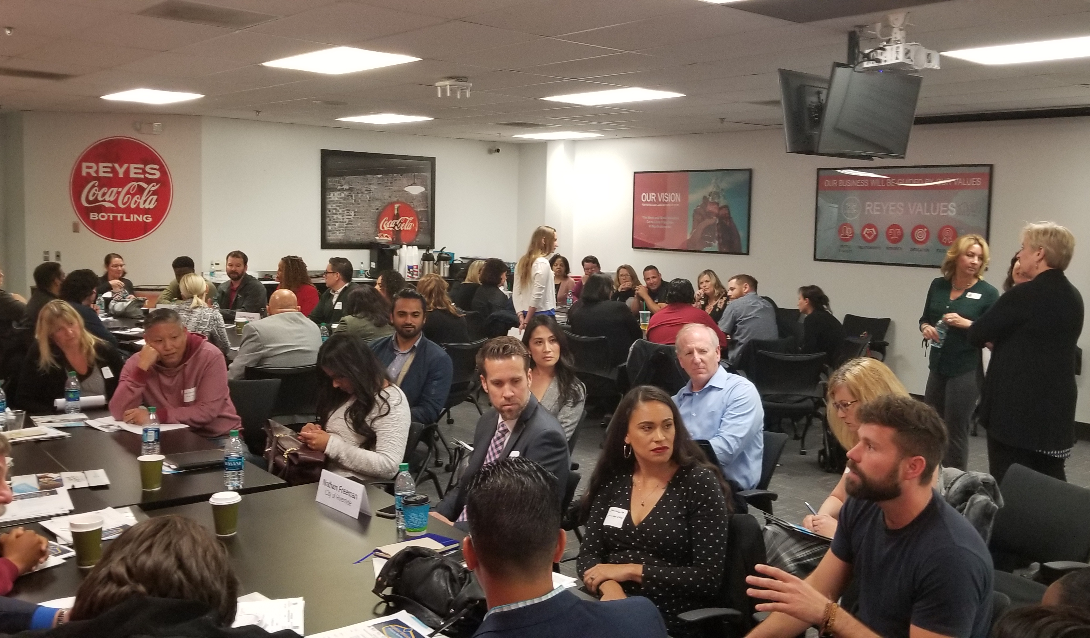
Regional Career Education Advisory Committees Breakout Groups
By Sub Sector Musical Chairs

Slide 19
Regional Career Education Advisory Committees
Contact Information:
Susanne Mata
Regional Director, ICT & Digital Media Sector
SMata@sbccd.edu
Lisa Kiplinger-Kennedy
Regional Director, Business and Entrepreneurship
LisaK.Kennedy@vvc.edu
Alan Braggins
Statewide Director, Advanced Manufacturing
Alan.Braggins@chaffey.edu

Slide 20
Discussion and Questions
Any comments, examples, or advice from the group?

Slide 21
Resources
A listing of the California Community College regional and statewide directors in various industry sectors.
https://www.cccco.edu/About-Us/Chancellors-Office/Divisions/Workforce-and-Economic-Development/Technical-Assistance-Providers
This is a toolkit on steps to adding qualified industry experts to your hiring pool by recognizing industry experience as equivalent.
https://asccc.org/sites/default/files/ADAversion_CTEMinQualsToolkit.pdf
166 page 2019 version of the Program and Course Approval Handbook (know as PACH
https://asccc.org/sites/default/files/CCCCO_Report_Program_Course_Approval-web-102819.pdf

Slide 22
Resources
A listing of State and Regional Directors
https://sectorsnapshots.weebly.com/contact.html
ASCCC CTE Labs Webinar Report
https://drive.google.com/file/d/1TEekzcMsI_a8vIJs0AsG0KUZU-Ji3JQm/view?usp=sharing

Slide 23
Dr. Lynn Shaw shawlynn@gmail.com
Jim Bowen jbowen@avc.edu
Alan Bragggins Alan.Braggins@chaffey.edu

