Slide 1
Effective Leadership Strategies for Adult Education, Noncredit and CTE
Mayra E. Cruz, CTE Leadership Committee
Dr. Elizabeth Walker, Noncredit & Basic Skills Committee
May 1, 2021 9-10 am
Notes:
Welcome and Introductions
Participants to post on the chat their name, college and role
Description: As a CTE and Non-Credit professional you have many challenges on your campus, region, district or even in your career. Often you can feel isolated and have no one to confide in to solve some critical and even controversial issues. Sometimes you want to advance in CTE or Non-Credit issues but cannot see the way forward. After the session you will walk away with practical leadership and problem-solving tips and tricks, both in general and for your current issues.

Slide 3
Participants will…
Learn WHY advance Noncredit Education & CTE
Discuss systemic inequities in Noncredit and CTE
Discuss and learn practical leadership to advance CTE and Noncredit locally

Slide 4
Noncredit & CTE Leadership Poll
Notes:
Create a poll
Title: Noncredit & CTE Leadership
Question: What structures or activities are an integral part of the campus and your local academic senate work to advance Noncredit & CTE.?
Poll options: Select all that apply-
senate standing or adhoc committee
agendize regularly at senate meetings
college advisory committee
robust marketing strategies
clear communication with students
integrated with guided pathways

Slide 5

The Context: The Students We Serve

Slide 6
Student who Completed a Noncredit CTE or Workforce Preparation Course
62%
In 2019 - 2020, this number is among all students enrolled in noncredit on a CTE TOP code or a workforce preparation course, the proportion who completed a noncredit career education or workforce preparation course or had 48 or more contact hours in noncredit career education course(s) or workforce preparation course(s) in the selected year.

Slide 7
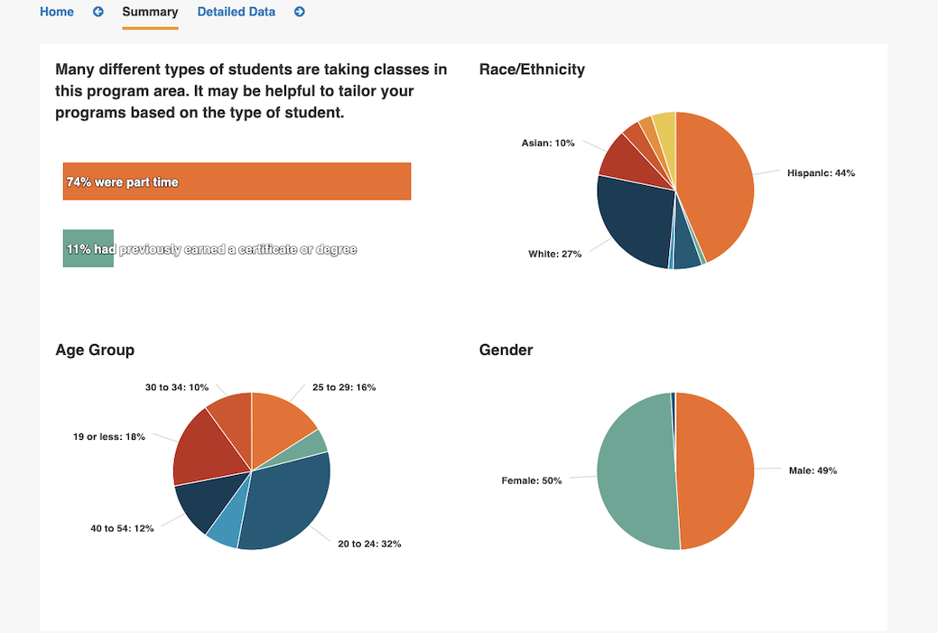
1 out of 2 students are in enrolled in one CTE/Non-Credit Course
Demographic of the CTE student body in 2018 – 2019:
1,008,212 out of the 2 million students who are enrolled in community colleges

Slide 8
The Mission
The California Community Colleges is committed to remaining the backbone of higher education in the state and the leading provider of career and workforce training in the country by keeping up with the changing needs of California and residents like you.
The California Master Plan (1960)
The California Community Colleges have as their primary mission providing academic and vocational instruction for older and younger students through the first two years of undergraduate education (lower division).
In addition to this primary mission, the Community Colleges are authorized to provide:
  remedial instruction,
  English as a Second Language courses,
  adult noncredit instruction,
  community service courses, and
  workforce training services.

Slide 9
Noncredit & CTE Programs
Then, Why are the Programs Overlooked?
Notes:
Activity:
(5 min) in Google doc with the question below for participants to answer.
What programs are more valued at the Community College?
(5 min) to review responses
Google doc link:
https://docs.google.com/document/d/1DhXsYvBYO7e7Sn4BeHW-elumPHkF77tPFLb7_GU1kiA/edit?usp=sharing

Slide 10
Why Noncredit Now
Role played in Guided Pathways
Noncredit to Credit to certificates/degrees

Slide 11
Why CTE is Key to California’s Future
It provides students of all ages with the academic and technical skills, knowledge and training necessary to succeed in future careers and to become lifelong learners.

Slide 12
Structural Racism in Noncredit
How programs are structured
Lack of integration with campus
Isolated programs
Becoming more equity minded
Representation in participatory governance or other committees

Slide 13
Challenges in CTE
CTE Faculty diversification
Engagement of CTE faculty in all participatory governance and in ASCCC
Expediate local curriculum processes
Redesigning curriculum with a focus on equity and antiracism
Innovations and opportunities
  Work-based learning
  Competency Based Education
  Credit for Prior Learning
  Short certificates

Slide 14
Activity
Rise Up:
Share effective leadership strategies in Noncredit & CTE
Notes:
Jamboard/Padlet (sharing)
Title: Effective leadership strategies in Adult Education, Noncredit and CTE at your college/district
https://jamboard.google.com/d/1I4P7C0nb93Wdio-qFMgf2gkhFKlTLgAYV2dw1ZAzH34/edit?usp=sharing
Participants post effective practices at the campus.

Slide 15
Practical Leadership Ideas
Solicit Noncredit & CTE diverse faculty representation
Engage Noncredit and CTE part-time faculty
Let your voice be heard by reviewing Academic
Senate agendas, minutes, and attending meetings
Attend local Academic Senate leadership activities
Notes:
Participants are encouraged to post other suggestions on the Pathable CHAT

Slide 16
Practical Leadership Ideas
Join committees
Compensation for Noncredit and CTE faculty part-time
faculty for serving in committees
Notes:
Participants are encouraged to post other suggestions on the Pathable CHAT

Slide 17


Slide 18
Resources
ASCCC Local Senates Handbook (2020 Revision)
https://indd.adobe.com/view/7f4e2df0-a2c8-42cd-8a88-bb92cfc68ed3
CCCCO Cal-PASS Plus
https://www.calpassplus.org/LaunchBoard/Student-Success-Metrics.aspx
Notes:
Dr. Walker (1 minute)

Slide 19
info@asccc.org
Mayra E. Cruz cruzmayra@deanza.edu
Dr. Elizabeth Walker ewalker@riohondo.edu
Notes:
Dr. Walker (1min)

