Slide 1
Effectively Using the CTE Minimum Qualifications Toolkit to Enhance Diversification of Faculty
May 1, 2021 12:30-1:30
2021 Career Noncredit Education Institute
Notes:
Lynn describes the taskforce and areas of recommendations

Slide 2
Dr. Lynn Shaw, ASCCC CTE Curriculum Director Dr. Marshall T. Fulbright III, VPAA Grossmont College Robert Cabral, Moorpark College, Interim Dean Bill Elarton-Selig, Los Angeles Trade Technical College Kevin Corse, Oxnard College
Presenters
Notes:
Lynn describes the taskforce and areas of recommendations

Slide 3
“Increase the pool of qualified CTE instructors by addressing CTE faculty recruitment and hiring practices.
Clarify legislative and regulatory barriers to hiring CTE instructors who may not meet existing college hiring standards, but possess significant industry experience.
Disseminate effective practices in the recruitment and hiring of diverse faculty and the application of minimum qualifications and equivalencies.
Develop pipelines to recruit community college faculty with industry expertise through collaborations with higher education, business, and industry professional organizations.
Establish a mentorship model that delineates pathways for industry professionals to intern at colleges to gain teaching skills, knowledge, and experience while pursuing an associate degree or an equivalent.”
Notes:
Lynn gives history of the Workgroup

Slide 4
Does your program have challenges hiring CTE faculty?
Chancellor’s Request of a Survey: 43 Colleges
Comments in the survey
recognize the abilities people have who are
eminent or nationally recognized experts in their field, without an Associate Degree
very small pool of applicants, often far less than 10, as opposed to general education areas that get 100’s of applicants.
not understanding their CTE colleagues issues and programs.
Many comment on the irony of college preparing people for work, yet we didn’t accept industry credentials (the very place we are sending students to work) as equivalent to an Associate Degree.
a mismatch of what colleges require and what the industry actually needs and wants. Colleges are preparing people for jobs in industries that sponsor the industry credentials yet the college does not accept the industry experts as instructors with the industry credentials.

Slide 5
How diverse is the current statewide faculty and staff?

Slide 6
How diverse is the current statewide student population?

Slide 7
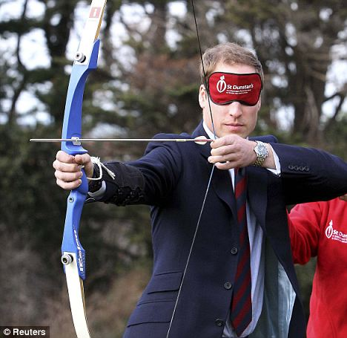
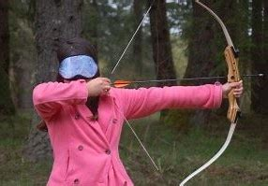
Does your program have challenges hiring diverse CTE faculty?
SEARCHING FOR … ?
DIVERSITY?
DEVELOPING PRACTICES
BIAS AWARENESS
THE RUBRIC(S)

Slide 8
Does your program have challenges hiring diverse CTE faculty?
SEARCHING FOR …?
What is needed? Who are you looking for? What skills are you looking for? Who (students) are you looking to attract?
DIVERSITY
Defining diversity! Why is it important?
Uncomfortable = good!
DEVELOPING PRACTICES
Developing Practices that support diversity.
Job Announcements, supplemental questions, interview questions and the rubric(s)

Slide 9
Does your program have challenges hiring diverse CTE faculty?
BIAS AWARENESS
Awareness is key
THE RUBRIC
Identify what the needs are and score accordingly!
Justifications are crucial

Slide 10
CTE Minimum Qualifications Tool Kit
Equivalency
Faculty Internship
Apprenticeship Minimum Qualifications
Notes:
Grant describes GEEM

Slide 11
CTE Faculty Minimum Qualifications Tool Kit
Sample Contents
Pre-planning checklist for Equivalency by Department
Equivalency Checklist for Human Resources Departments
Model Equivalency Committees Composition and Policies
Information and Checklist for Potential Equivalency Applicants
Credit for Prior Learning
Notes:
Grant describes GEEM

Slide 12
Career Technical Education Minimum Qualifications Tool Kit Apprenticeship Hiring at Los Angeles trade Technical College
Notes:
Grant gives instruction on activity

Slide 13
Career Technical Education Minimum Qualifications Tool Kit Career Technical Education Faculty at Ventura Community College District
Notes:
Grant gives instruction on activity

Slide 14
Training Your Equivalency Committee

Slide 15
Notes:
Lynn facilitates questions and comments

Slide 16
Resources
Technical visits, including training your Equivalency Committee, as requested (https://www.asccc.org/contact/request-services)
Career Technical Education Faculty Minimum Qualifications Toolkit https://asccc.org/sites/default/files/ADAversion_CTEMinQualsToolkit.pdf

Slide 17
Lynn Shaw shawlynn@gmail.com
Marshall Fulbright marshall.fulbright@gcccd.edu
Robert Cabral RCabral@vcccd.edu
Bill Elarton ElartoWD@lattc.edu
Kevin Corse kevin_corse1@vcccd.edu

