Slide 1
Lighting the Fire: Effective Practices for Embedding Ethnic Studies at the Local College

Slide 2
Randy Beach, ASCCC Curriculum Committee, Southwestern College
Karla Kirk, ASCCC North Representative, Fresno City College
Don Miller, CCCCIO President, Vice President, Academic Affairs, Rio Hondo College
Manuel Vélez, ASCCC South Representative, San Diego Mesa College

Slide 3
Description
Instructional relevance and decolonizing the curriculum are critical components that support our disproportionately impacted students throughout the California Community College system. Supporting our students’ understanding of Ethnic Studies competencies through cultural sensitivity and appreciation can help students connect their human experiences with our current institutional and curricular requirements. This breakout/workshop will provide participants with a better understanding of Ethnic Studies competencies and see examples of those competencies in practice. The primary goal of this session is to heighten our equity-focused curriculum for the benefit of students.
2021 ASCCC Curriculum Institute Page 3
Notes:
Randy

Slide 4
Agenda
A brief history of disciplines and the movement for interdisciplinarity
A brief overview of the establishment of Ethnic Studies programs and their purpose
A discussion on theoretical approaches to Ethnic Studies
Discuss some of the principles of Ethnic Studies
Overview of the current state of Ethnic Studies requirements in California
A review of the Ethnic Studies competencies for CSU and CCC
Promising Practices Happening Now
Next steps and ideas for local engagement
Final Q&A
2021 ASCCC Curriculum Institute Page 4
Notes:
Randy

Slide 5
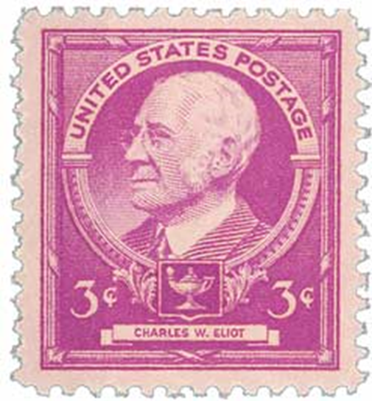
A Brief History of Disciplines “A branch of learning or scholarly instruction” -Oxford Dictionary
The concept of the academic discipline appeared in the Roman era in order to address a need for specialized training in certain areas such as law and medicine.
The Scientific Revolution of the 1500 - 1700s encouraged an increase in the number of academic disciplines as a means of addressing an ever-expanding body of knowledge.
As these disciplines evolved, so did the language, research methods, and theories associated with them; this created an atmosphere of esotericism around disciplines.
By the end of the 1800s most of the modern disciplines that we know today had been established along with teaching settings such as seminars (Germany), laboratories (France), and classrooms (Scotland) and doctorate degrees (Germany).
Today, disciplines are defined by three characteristics: deciding who is taught (majors), what is good research (methodology), and who is qualified to teach (minimum qualifications)
2021 ASCCC Curriculum Institute Page 5
Notes:
Manuel

Slide 6
The Move to Interdisciplinarity
Since the early 1900s there have been calls for interdisciplinary approaches. But the reasons for these calls have varied:
WWI Era: As concerns over a lack of national cultural unity and the over-specialization of disciplines grew, a call for an interdisciplinary approach also grew.
WWII Era: By the 1940s and ‘50s new concerns over the power that disciplines had over bodies of knowledge as well as their growing isolation from each other intensified efforts for interdisciplinarity.
The 1960s and ‘70s: The struggle against racism and other forms of oppression as well as the Vietnam War strengthened the criticism of traditional disciplines and called for more holistic approaches that would address social realities such as racism.
2021 ASCCC Curriculum Institute Page 6
Notes:
Manuel

Slide 7
The Ethnic Studies Disciplines
The founding of Ethnic Studies is attributed to the 1968 and ‘69 student strikes at SFSU and UC Berkeley led primarily by the Third World Liberation Front.
As part of their demands the students called for the establishment of four departments: American Indian Studies, Asian American Studies, Black Studies, and La Raza Studies to be housed under a School of Ethnic Studies
By the end of the Twentieth Century as many as 700 Ethnic Studies programs had been established throughout the U.S. Despite this, these programs continued to struggle for resources and recognition.
The establishment of Ethnic Studies requirements at the CSUs by 2021 and at the CCCs by 2022 gives these disciplines a legitimacy that should equate into more resources.
2021 ASCCC Curriculum Institute Page 7
Notes:
Manuel

Slide 8
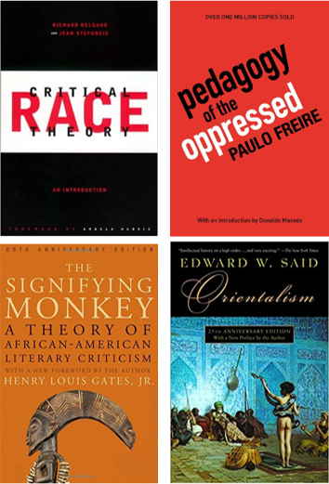
Theoretical Lenses in Ethnic Studies
Ethnic Studies disciplines rely on theoretical approaches that center on the historical experiences and lived realities of communities of color:
Post-Colonialism: Originally developed as a form of literary analysis to analyze the experiences of those affected by colonization
Critical Race Theory: Established in the 1970s by legal scholars to analyze and understand the legacy of Civil Rights era laws, CRT focuses on the role of racism in all aspects of society.
Cultural Populism: A theory embraced by Mexican and Chicano scholars that argues that communities of color can construct oppositional meanings of elements such as popular culture to resist dominant culture.
Critical Pedagogy: Argues that teaching and education are not distinct from social justice and that oppression can be combated through critical consciousness
Indigenous Epistemologies and Pedagogies: the method and practice of teaching that focus on the development of a human being as a whole person, learning through experience, and recognizing the important role that Elders have an important role in passing on wisdom and knowledge.
2021 ASCCC Curriculum Institute Page 8

Slide 9
Principles of Ethnic Studies: Interdisciplinarity
Because Ethnic Studies disciplines focus on a holistic perspective of communities of color, they can and often do touch upon various traditional disciplines in their course catalog.
Students of Ethnic Studies disciplines often take on more than one field in their studies and graduate with academic foundations in both ethnic studies and a traditional discipline.
Ethnic Studies courses also often combine theoretical approaches from different disciplines in order to gain a more holistic understanding of a topic.
Because they stem from the Interdisciplinarity Movement of the 1960s, Ethnic Studies disciplines often challenge traditional notions of academia and disciplines.
2021 ASCCC Curriculum Institute Page 9

Slide 10
Principles of Ethnic Studies: Connection to Community
Unlike traditional disciplines Ethnic Studies disciplines stem from a demand by students.
For these students, Ethnic Studies disciplines were meant to not only serve academic functions, but more importantly to educate and empower community activists to make positive social changes in society.
For many communities of color, Ethnic Studies programs serve as the only spaces on a college campus where students feel a sense of belonging.
In fact, many Ethnic Studies programs maintain strong working relationships with community organizations.

Slide 11
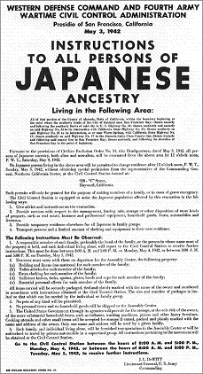
Principles of Ethnic Studies: The POC lens
Ethnic Studies disciplines were created in part to address an absence of the representation of communities of color in college curriculum
For this reason, Ethnic Studies strives to present themes and topics through the lens of the community rather than a dominant lens that tends towards eurocentrism. In this way, one could say that Ethnic Studies participates in the “decolonization” of academia.
Because they are interdisciplinary in nature, ethnic studies disciplines often analyze points of intersectionality between ethnicity and other constructs such as class and gender.
While courses in Ethnic Studies disciplines touch on concepts of social justice, it does so through an ethnic lens.
2021 ASCCC Curriculum Institute Page 11
Notes:
Manuel

Slide 12
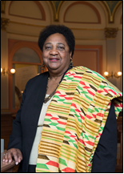
Ethnic Studies Requirements in California
Ethnic Studies Requirement for CSU Undergraduates
AB 1460 (Weber, 2020)
3-unit lower-division course for 2024-25 graduates
Community college students take course (Area F) to transfer
Must meet core competencies & be approved by CSU
Proposed Ethnic Studies Requirement for Associate Degree
AB1040 (Muratsuchi, 2021) going through state Assembly
Also, Board of Governors will vote in July on change in Title 5
Similar legislation may also change high school curriculum
2021 ASCCC Curriculum Institute Page 12
Notes:
Manuel
https://www2.calstate.edu/impact-of-the-csu/diversity/advancement-of-ethnic-studies
https://calmatters.org/education/2020/08/csu-ethnic-studies-ab-1460/
https://edsource.org/2020/how-new-law-requiring-ethnic-studies-at-california-state-university-will-affect-community-colleges/642192
https://www2.calstate.edu/impact-of-the-csu/diversity/advancement-of-ethnic-studies/Documents/final-csuces-core-competencies-oct_8_2020.pdf
https://edsource.org/2021/californias-community-colleges-move-to-require-ethnic-studies/655192?utm_source=newsletter&utm_medium=email

Slide 13
Ethnic Studies Competencies
We, the California State University Council on Ethnic Studies, approve all of the following as our core competencies. These competencies include a minimum number of criteria and a minimum number of learning objectives to be used by campus-specific Ethnic Studies experts and each campus’s academic senate curricular bodies to determine if a lower-division or upper division course meets the Ethnic Studies Graduation Requirement for the California State University in compliance with Assembly Bill 1460 and California Education Code 89032c.
In considering implementation of this CSU Ethnic Studies requirement, we have determined that this requirement cannot be fulfilled through a single CSU General Education area because: 1) Ethnic Studies is an interdisciplinary field and, as a result, Ethnic Studies courses cover multiple GE areas; 2) limiting the requirement to a single GE area would create problems with implementation and time to degree; 3) housing the Ethnic Studies requirement in a single GE area undermines the collaboration and implementation requirements of California Education Code 89032 section (c) because each campus’ General Education Governance Board would have the sole responsibility for implementation of this requirement and not campus-specific Ethnic Studies experts.
2021 ASCCC Curriculum Institute Page 13
Notes:
Karla

Slide 14
Ethnic Studies Competencies
CSU Ethnic Studies Graduation Requirement courses must meet all the following criteria.
Each course must:
CR1: be an existing ethnic studies course or part of a traditional ethnic studies department, unit, or program (e.g. Native American Studies, Latina/o Studies, African American Studies, Asian American Studies); or be proposed, designed and implemented by faculty with expertise in Ethnic Studies (and related disciplines) and be an Ethnic Studies department/unit approved cross-listed course.
CR 2. Ethnic Studies faculty (as described above) will collaborate to develop any additional course criteria with their campus in addition to the minimum criteria above. Such committees must be led/chaired by Ethnic Studies faculty and must be made up of a majority faculty from Ethnic Studies departments/units/programs like Native American Studies, African American Studies, Asian American Studies, and Latina/o Studies faculty.
CR 3. For CSU campuses that have Ethnic Studies, Native American Studies, African American Studies, Asian American Studies and Latina/o Studies departments/programs/units courses that meet the Ethnic Studies requirement should be housed and offered within those departments/units/programs.
2021 ASCCC Curriculum Institute Page 14
Notes:
Karla: Notes: 1. The review, modifications, adaptions, or additions to these criteria are subject to the expert peer evaluation of Ethnic Studies faculty and faculty in traditional Ethnic Studies departments or units (e.g. Native American Studies, African American Studies, Asian American Studies, and Latina/o Studies) in collaboration with the academic senate on each campus. Such committees must be led/chaired by Ethnic Studies faculty and must be made up of a majority faculty from Ethnic Studies departments/units/programs like Native American Studies, African American Studies, Asian American Studies, and Latina/o Studies faculty.

Slide 15
Ethnic Studies Competencies
Each course meeting the Ethnic Studies requirement must fulfill a minimum of three out of the following five learning objectives as appropriate to their lower- or upper-division status. These learning objectives must be used in addition to any learning objectives and criteria established and required by each campus’ Ethnic Studies department/unit/program (as traditionally defined) faculty for all courses meeting the CSU Ethnic Studies graduation requirement:
SLO 1: Analyze and articulate concepts such as race and racism, racialization, ethnicity, equity, ethno-centrism, eurocentrism, white supremacy, self- determination, liberation, decolonization, sovereignty, imperialism, settler colonialism, and anti-racism as analyzed in any one or more of the following: Native American Studies, African American Studies, Asian American Studies, and Latina and Latino American Studies.
SLO 2: Apply theory and knowledge produced by Native American, African American, Asian American, and/or Latina and Latino American communities to describe the critical events, histories, cultures, intellectual traditions, contributions, lived-experiences and social struggles of those groups with a particular emphasis on agency and group-affirmation.
2021 ASCCC Curriculum Institute Page 15
Notes:
Karla: Notes: 1. The review, modifications, adaptions, or additions to these criteria are subject to the expert peer evaluation of Ethnic Studies faculty and faculty in traditional Ethnic Studies departments or units (e.g. Native American Studies, African American Studies, Asian American Studies, and Latina/o Studies) in collaboration with the academic senate on each campus. Such committees must be led/chaired by Ethnic Studies faculty and must be made up of a majority faculty from Ethnic Studies departments/units/programs like Native American Studies, African American Studies, Asian American Studies, and Latina/o Studies faculty.

Slide 16
Ethnic Studies Competencies
SLO 3: Critically analyze the intersection of race and racism as they relate to class, gender, sexuality, religion, spirituality, national origin, immigration status, ability, tribal citizenship, sovereignty, language, and/or age in Native American, African American, Asian American, and/or Latina and Latino American communities.
SLO 4: Explain and assess how struggle, resistance, racial and social justice, solidarity, and liberation, as experienced, enacted, and studied by Native Americans, African Americans, Asian Americans and/or Latina and Latino Americans are relevant to current and structural issues such as communal, national, international, and transnational politics as, for example, in immigration, reparations, settler-colonialism, multiculturalism, language policies.
SLO 5: Describe and actively engage with anti-racist and anti-colonial issues and the practices and movements in Native American, African American, Asian American and/or Latina and Latino communities to build a just and equitable society.
2021 ASCCC Curriculum Institute Page 16
Notes:
Karla: Notes: 1. The review, modifications, adaptions, or additions to these criteria are subject to the expert peer evaluation of Ethnic Studies faculty and faculty in traditional Ethnic Studies departments or units (e.g. Native American Studies, African American Studies, Asian American Studies, and Latina/o Studies) in collaboration with the academic senate on each campus. Such committees must be led/chaired by Ethnic Studies faculty and must be made up of a majority faculty from Ethnic Studies departments/units/programs like Native American Studies, African American Studies, Asian American Studies, and Latina/o Studies faculty.

Slide 17
CSU Area F Ethnic Studies Graduation Requirement
Modifications or adaptations to these learning objectives are subject to the expert peer evaluation of Ethnic Studies faculty in Ethnic Studies departments, units, or programs (e.g. Native American Studies, African American Studies, Asian American Studies, and Latina/o Studies) on each campus.
In addition, Ethnic Studies faculty in Ethnic Studies departments, units, or programs (e.g. Native American Studies, African American Studies, Asian American Studies, and Latina/o Studies) shall review, modify, and approve courses attempting to meet these learning objectives on each campus.
Furthermore, any committee reviewing courses for the CSU Ethnic Studies Graduation Requirement must be chaired by Ethnic Studies faculty; and such committees must have a majority representation from faculty in the following departments/units/programs: Native American Studies, African American Studies, Asian American Studies, and Latina/o Studies faculty.
Finally, any modifications or adaptations must be guided by the fundamental principles that undergird the definition of Ethnic Studies, as birthed from the named core four disciplinary areas (Native American Studies, African American Studies, Asian American Studies, and Latina/o Studies
2021 ASCCC Curriculum Institute Page 17
Notes:
Karla

Slide 18
Breakout Rooms
Step: 1 Ask for a volunteer to add to our shared Google Doc
Step 2: Verbally share your local experience with the CSU process for submitting courses for GE Area F approval. How did it go?
Step 3: Complete the session by adding two or three, maybe more, positive action steps you intend to take at your college regarding the articulation of Ethnic Studies courses to satisfy the CSU GE Area F.
You will have ten minutes for discussion and to add to our shared document
https://docs.google.com/document/d/1_ogTg7WQcqkuQGO9K9LvIY0neOnuvJcdA5IyNFpjbXg/edit?usp=sharing
2021 ASCCC Curriculum Institute Page 18
Notes:
Randy

Slide 19
Promising Efforts Now Underway: College of Alameda – Professor Jody Campbell
Building on existing Curriculum
African American Studies
Asian American Studies
Mexican/Latin American Studies
Creating new curriculum
Ethnic Studies
Indigenous Studies
Faculty and Administration collaboration
Catching the Vision of Ethnic Studies
Updating Curriculum
Putting the FTEF where your mouth is
Building campus spaces for Ethnic Studies
Resources for training (equity at the F2F/virtual classroom core)
2021 ASCCC Curriculum Institute Page 19
Notes:
Don

Slide 20
Promising Efforts Now Underway: Rio Hondo College - (Dr. Juana Mora)
Existing programs - Chicano Studies
Building on existing strengths and our student populations
BSS Division Participants
EGGS - Ethnic, Gender, and Sexuality Studies.
2021 ASCCC Curriculum Institute Page 20
Notes:
Don

Slide 21
RHC Ethnic, Gender, and Sexuality Studies (EGSS)Program
Ethnic, Gender, and Sexuality Studies (EGSS) is an interdisciplinary study of historically marginalized, and underrepresented groups. Using intersectional and decolonial pedagogies, students will explore race, class, gender, ethnicity, sexuality, ability, legal status, age, and Indigeneity in the context of social justice. Students will engage with the historical work of social movements, cultural and artistic productions, legal and public policy activism(s) as well as the recovery, restoration, and healing from generational trauma. The program facilitates student empowerment with the critical thinking and civic engagement skills necessary to participate fully in activism and social movements, locally and globally.
2021 ASCCC Curriculum Institute Page 21
Notes:
Don

Slide 22
Out of the Behavioral and Social Sciences Division...
Irma Valdivia, History
Abbie Perry, History
Ea Madrigal, History
Carol Sigala, Child Development
Adam Wetsman, Anthropology (*Dean of BSS)
Lizette Arevalo, Chicanx Studies
Brian Brutlag, Sociology
Melissa Rufino-Juarez, Sociology
Elizabeth Ramirez, Counseling
Juana Mora, Political Science
2021 ASCCC Curriculum Institute Page 22
Notes:
Don

Slide 23
RHC Ethnic, Gender, and Sexuality Studies (EGSS)Program
Develop and/or Expand Course Offerings, Certificates, and ADTs in the following areas of study:
Chicana/o Studies
Ethnic Studies
African American Studies
Asian American Studies
Native American Studies
Women’s Studies
LGBTQ+ Studies
2021 ASCCC Curriculum Institute Page 23
Notes:
Don

Slide 24
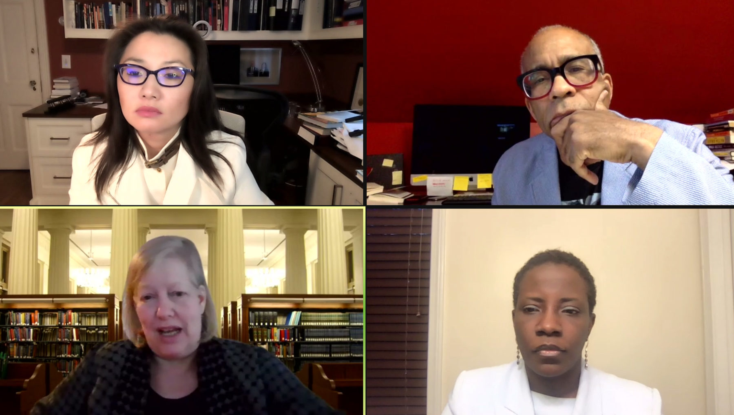
Next Steps for Local Engagement
Emphasize student need first, not only for completion but for representation.
Curriculum chairs, articulation officers, and faculty meet; discuss options and a vision.
Agendize a conversation with the Senate. Ethnic Studies does not have to be an isolated conversation.
Discuss adding an Ethnic Studies course designation with the Curriculum Committee. Do you have one? How will it fit into the existing structure?
Educate faculty on regulations, curriculum standards and state and local approval processes (i.e. double-counting; placing courses in disciplines; dual-designators; minimum qualifications).
2021 ASCCC Curriculum Institute Page 24
Notes:
Randy

Slide 25
Thank you!
info@asccc.org

