Slide 1
Changing the Elections procedures? An idea whose time has come?
Cheryl Aschenbach, ASCCC North Representative
Rebecca Eikey, ASCCC Area C Representative
Erik Reese, Standards & Practices Committee, Moorpark College
THIRD BREAKOUT SESSION
2018 ASCCC Fall Plenary
Irvine Marriott Hotel in Irvine, CA

Slide 2
Background
The Elections Process
Officers and terms defined in the ASCCC Bylaws
Process further clarified in the Academic Senate Rules (By Resolution S15)
Why are we here today?

Slide 3
Composition of the Executive Committee (14+1)
Four Officers: President, Vice President, Secretary, and Treasurer
Ex Officio: Executive Director
Serve for one-year terms (Jun 1- May 31)
Elected each Spring Plenary
President shall serve no more than two consecutive elected one-year terms
Representatives: Area, North, South, At-Large
Serve for two-year terms staggered by even/odd year
Elected each Spring Plenary
Four Area Representatives: Area A, Area B, Area C, Area D
Two North Region Representatives
Two South Region Representatives
Two At-Large Representatives
Notes:
Exec Committee = Board of Directors

Slide 4
Who’s Eligible to Serve on Executive Committee?
Candidates shall meet at least one of these criteria:
Is a Delegate or a local senate president
Has within the last three years immediately preceding the election been a local senate president or a Board of Directors member or officer or
Has been nominated by a resolution of a Member Senate
All elected Board of Directors members must retain their faculty status to continue in office.
Can part-time faculty serve?

Slide 5
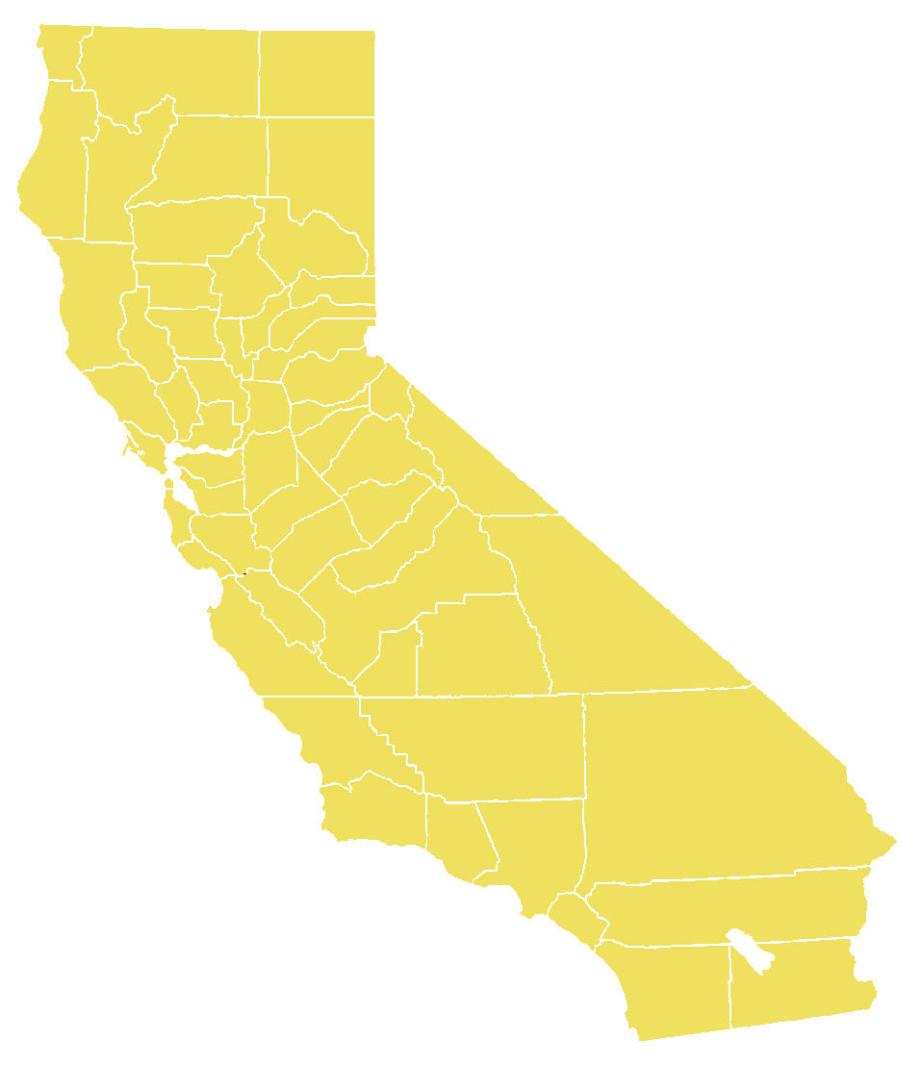
Composition of the Executive Committee
Number of members and/or officers
Geographical areas

Slide 6
Term Lengths and Term Dates
Elected Spring Plenary
Terms Jun 1- May 31

Slide 7
Nominations
Nominations may be made in two ways:
In writing and delivered to the Academic Senate Office;
From the floor at a general session designated for such floor action. The general session for floor nominations should be published in the agenda, and all nominations are closed at the end of that general session.
Nominations may be made only with the consent of the nominee.
Nominees shall indicate whether they wish to stand for other positions for which they are eligible if they do not prevail for the office nominated. (i.e. “Trickle”)
The Academic Senate Office shall provide, at the time of the elections, an announcement board that indicates the Elected Officers and other members of the Board of Directors. This announcement board will be updated as new Board of Directors members are elected, and as vacancies occur.

Slide 8
Nominations Process

Slide 9
Election Procedures – Voting Day!
To be elected, a candidate must receive a vote from a majority of those delegates present and voting.
In the event no candidate for a position receives a majority, the run-off will be limited to the top two candidates with the largest number of votes, including all ties.
The order of the election shall be as follows: President, Vice-president, Secretary, Treasurer, Area Representatives, North Representative, South Representative, and At-Large Representative.
If a candidate runs unopposed, the candidate may be elected by acclamation. The motion to be elected by acclamation must be moved and seconded by Delegates from the floor and must be approved by the body.

Slide 10
Majority Votes
To be elected, a candidate must receive a vote from a majority of those delegates present and voting.
In the event no candidate for a position receives a majority, the run-off will be limited to the top two candidates with the largest number of votes, including all ties.

Slide 11
Order of the Election
The order of the election shall be as follows: President, Vice-president, Secretary, Treasurer, Area Representatives, North Representative, South Representative, and At-Large Representative.

Slide 12
“Trickling”
What are the benefits?
What are the challenges?

Slide 13
Questions?
Cheryl Aschenbach - caschenbach@lassencollege.edu
Rebecca Eikey – Rebecca.Eikey@canyons.edu
Erik Reese – ereese@vcccd.edu

