Slide 1
Embedding Basic Skills Support into Face-to-Face & Online Courses
Barbara Illowsky, PhD
Dean of Basic Skills & OER, OEI
January 22, 2016
billowsky@cccOnlineEd.org
@DrBSI

Slide 2
Why?
Are your students prepared for your classes?
Do you have the time to review non-discipline content?
Would “just-in-time” info assist them?

Slide 3
What?
English
Reading
ESL
Mathematics
Library research

Slide 4
Where?
Class information
Assignments
Web site

Slide 5
How?
Open Educational Resources
ADA compliant
Basic Skills Workgroup, submitted
Embed into all your courses, not just online ones

Slide 6
OEI: Resources for Student Success
Focus on student success in online courses by providing students with well designed resources
Tutoring
Readiness
Counseling/Advising
Basic Skills Support
Streamlined access

Slide 7
In the future…
Repository
Data base search
Our students will be completely prepared!!

Slide 8
Example – ESL (CDEV)
Notes:
Wendy Bass

Slide 9
Example – Library
Assignment: write a paper with two references
Problem: student does not know how to use online libraries and cannot get to school when the on-campus library is open
Solution: “Need help with references?”
https://owl.english.purdue.edu/owl/resource/558/1/

Slide 10
Example - Reading
Assignment: read Chapters 1 – 4 of the text
Problem: student has basic skills need in active reading
Solution: “Need help reading?”
https://lumen.instructure.com/courses/63104/pages/introduction-to-active-reading?module_item_id=952338

Slide 11
Example - Writing
Assignment: write an x-page paper
Problem: student does not know the formatting requirements in writing and has not yet taken English composition
Solution: “Need help with formatting?”
https://www.youtube.com/watch?v=pdAfIqRt60c&list=PL8F43A67F38DE3D5D

Slide 12
Example - Writing
Assignment: write an x-page paper
Problem: student does not understand difference between plagiarism and quoting sources
Solution: “Help with how to quote”
https://lumen.instructure.com/courses/63104/pages/plagiarism-3?module_item_id=952312
https://owl.english.purdue.edu/owl/section/3/33/

Slide 13
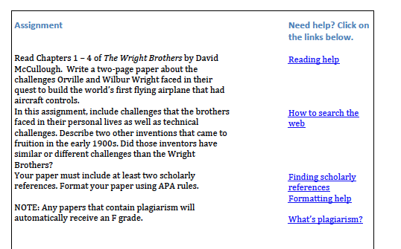

Slide 14
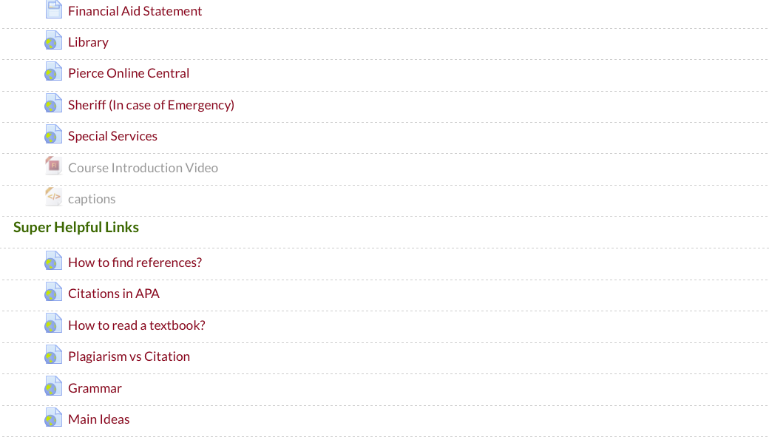
Example – Sociology Course
Notes:
Mitra Hoshiar

Slide 15
Example – Mathematics (ECON)
Economics assignment: find the equilibrium point for a supply/demand problem
Problem: student does not remember how to find intersection point of two lines
Solution: “Need help with finding equilibrium points?”
4-minute video https://www.youtube.com/watch?v=he5HPPIIdVY

Slide 16
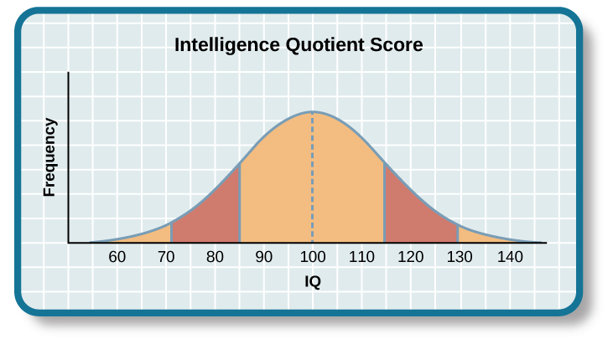
Example – Mathematics (PSYCH)
Solution:
“Need help?”
http://cnx.org/contents/30189442-6998-4686-ac05-ed152b91b9de@17.38:40/Introductory_Statistics
The average IQ score on an IQ test is 100. Standard deviations describe how data are dispersed in a population and give context to large data sets. The bell curve uses the standard deviation to show how all scores are dispersed from the average score (Figure). In modern IQ testing, one standard deviation is 15 points. So a score of 85 would be described as “one standard deviation below the mean.” How would you describe a score of 115 and a score of 70? Any IQ score that falls within one standard deviation above and below the mean (between 85 and 115) is considered average, and 82% of the population has IQ scores in this range. An IQ score of 130 or above is considered a superior level. ** From Psychology by OpenStax College, CC BY

Slide 17
Example - Grammar
Useful for developmental writing courses.
Useful for ESL students.
Useful for review for all learners.
https://www.youtube.com/watch?v=a4I_Wp_HMUY

Slide 18
What’s in it for you?
The supplied modules have already been reviewed for content and ADA compliance.
You can spend your energies on your discipline, not basic skills.
The main reason is to help students in California to complete their educational goals.

Slide 19
More Information
Website: http://CCCOnlineEd.org
Tech Edge Newsletter: http://ccctechedge.org
Barbara’s email: billowsky@CCCOnlineEd.Org

