Slide 1
Emotional Intelligence
Julie Bruno, President
Cheryl Aschenbach, North Representative

Slide 2
Temperature Check
Notes:
How comfortable are you with displays of emotion

Slide 3
Questions
What is Emotional Intelligence?
How does Emotional Intelligence impact work?

Slide 4
Emotional Intelligence
The capacity to be aware of, manage, control and express one’s emotions, and to handle interpersonal relationships judiciously and empathetically.
“[E]ffective emotional knowledge demands a profound level of self-reflection, an active imagination, and an ability not only to envision alternate approaches to a given situation but also to understand that there are entire invisible galaxies of salient emotional facts behind almost every workplace exchange.”

Slide 5
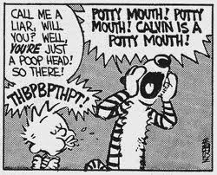
What are Emotions?
Components of Emotions
Physical
Cognitive
Nonverbal

Slide 6
Your Emotional Intelligence
Are you aware of your emotions and the impact they have on your behavior and communication?
Are you aware of others emotions and the impact they have on behavior and communication?
Notes:
Some are able to identify emotions and respond, others react.

Slide 7
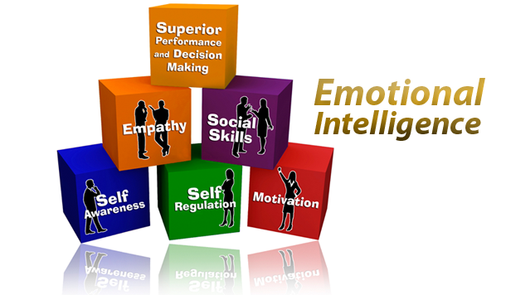

Slide 8
Emotions in Decision-Making
How do our emotions drive our decision making?
Can you think of examples where it became obvious that the decision was based on emotions rather than on more objective evidence or support?
How did you handle the situation?

Slide 9
Emotions in the Workplace
Where and when are emotions most evident?
How do you know?
How do you handle it?
What could you do better?
Notes:
Emotions are inherent in perpectives and decision-making.
Messages to others include both content and relational aspects.
Emotions can act as “triggers” to conflict.

Slide 10
Conflict and Emotional Intelligence
 | Self (Intrapersonal) | Social (Interpersonal)
Recognition/ Awareness | Be self aware: understand emotional cause and effect Develop internal empathy: deal with internal triggers; respond rather than react Become authentic: adhere to inner values, principles, and guidelines; be trustworthy to self | Communicate with respect and information Create resonance and rapport Empathize Seek creative resolution with mutual gains Listen actively View adversaries in a positive way
Regulation/ Management | Cultivate constructive positive emotions (positive psychology) Minimize negative feelings Cultivate positive expectations and abundance thinking Accept personal responsibility Be trustworthy and operate with integrity | Build relationships and establish long-term connections Handle conflict tactically and strategically Negotiate fairly and responsibly Follow up on understandings and agreements Yield to change

Slide 11
Dimensions of Communication
Content
Topic under discussion
Carried through words
Relationship
How parties feel about one another (emotion)
Carried through Nonverbal
Types of Relational Messages
Affinity
Immediacy
Respect
Control

Slide 12
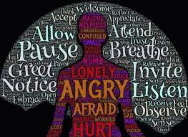
Expressing Emotion
Recognize and identify your feelings
Recognize the difference between feeling, speaking and acting
Expand your emotional vocabulary
Share multiple and nuanced feelings

Slide 13
Expressing Emotions
Consider where and when to express your feelings
Give yourself time to discover the depth of your emotions before expressing
Accept responsibility for your feelings
“I” vs “you”
“You’re making me angry” vs. “I’m getting angry”
“You hurt my feelings” vs. “I feel hurt when you do that”

Slide 14
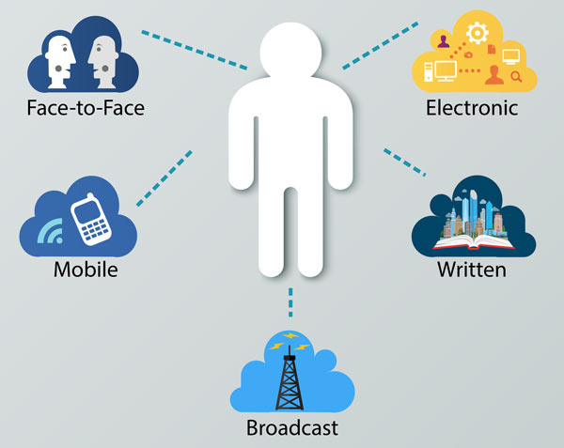
Expressing Emotions
Be mindful of the Communication Channel
In-person vs. Mediated
When is appropriate to use a mediated channel?
Pros and Cons

Slide 15
Tools
DING
Deep breaths
Imagine what the other is feeling and Identify what you are feeling
Name the emotions you and the other person are feeling
Go on. Use observations to move the situation forward.
Perception checking

Slide 16
Apologies
An acknowledgment that the transgression was wrong: “I acted like a jerk.”
A sincere apology: “I’m really sorry. I feel awful for letting you down.”
Some type of compensation: “If I act that way again, you can call me on it.”

Slide 17
Skills to cultivate
Self monitoring and self reflection
Deep and active listening
Paraphrasing
Suspending judgment
Slowing down communication
Comfortable with discomfort

Slide 18
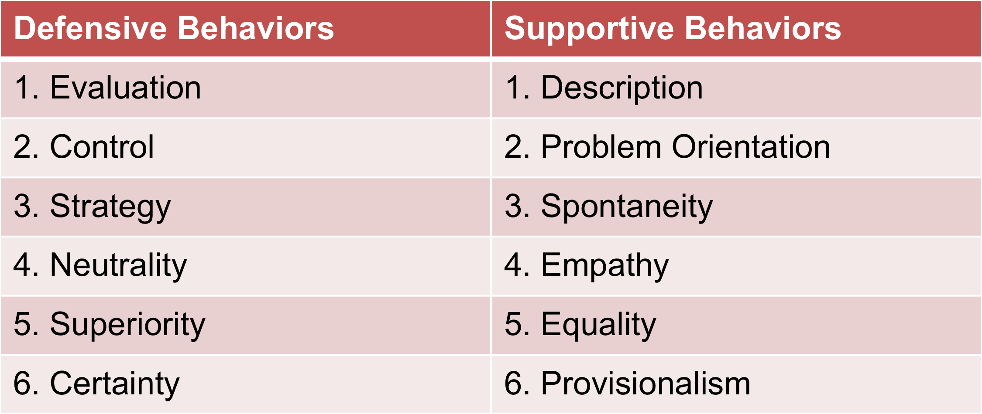
Defensiveness vs. Support

Slide 19
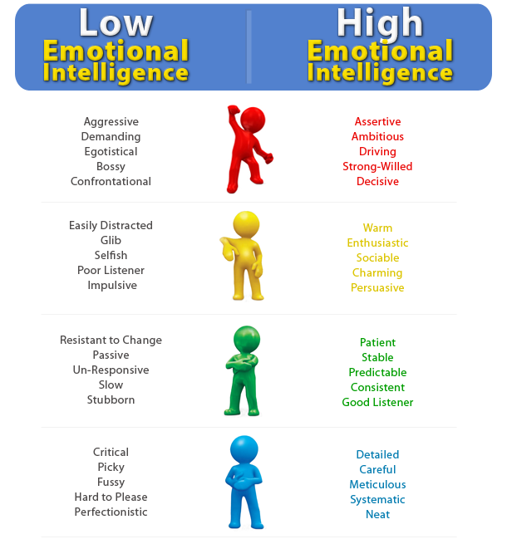

Slide 20
Scenario #1
Your Student Learning Outcomes Committee is a sub- committee of your Curriculum Committee, which in turn reports to the academic senate. The faculty chair of the SLO Committee is resisting requests from the curriculum chair to make more complete reports to the Curriculum Committee and to bring decisions to the Curriculum Committee for ratification. The SLO chair claims that her committee has developed expertise in the area of SLOs beyond that held by the average Curriculum Committee member, and this expertise should be respected by allowing the SLO committee to work without having its decisions questioned. Everyone is frustrated with the situation
Using your emotional intelligence, how would you handle this situation?

Slide 21
Scenario #2
Within a semester, your new college president is making decisions that your academic senate feels have historically been under the Academic Senate purview under the 10+1 and therefore warrant involvement of the academic senate. When you attempt to talk with her about these matters, she asserts that as president she has the right to make these decisions without discussing it with you as senate president.
Using emotional intelligence, how would you handle this situation? What can you do now to help develop a healthy relationship built on mutual respect and trust?

Slide 22
Questions? Comments?

