Slide 1
Emotional Intelligence
Cheryl Aschenbach, ASCCC North Representative
LaTonya Parker, ASCCC South Representative
Carrie Roberson, ASCCC North Representative

Slide 2
Program Description
Some may think of a successful senate leader as someone who capably runs meetings, stays on top of all the issues, and gets things done. However, an even more critical part of succeeding as a faculty leader is successfully managing emotions in the workplace while engaging in difficult conversations, navigating relationships with faculty, classified staff, and administrators, and handling sensitive information. Together, presenters and attendees will explore emotional intelligence, the role it plays in leadership, and what we can do to develop our own emotional intelligence (EQ).

Slide 3
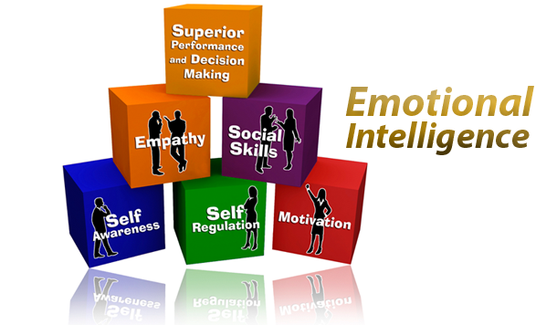
Question…
What IS Emotional Intelligence?

Slide 4
Emotional Intelligence
The capacity to be aware of, manage, control and express one’s emotions, and to handle interpersonal relationships judiciously and empathetically.
EQ!

Slide 5
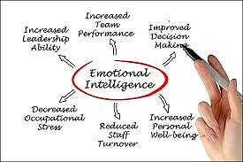
Why is EQ Leadership Important?

Slide 6
What are EQ Leadership Skills?
Social Awareness
Empathy
Decision Making
Positive Influence
According to Darwin Nelson and Gary Low (2011)
“Effective Leadership is people centered, and effective leaders know, understand, and respect the needs, values, and goals of others.”

Slide 7
Assess Your EQ Leadership Skills
On a scale of 1 (low) to ten (high) rate yourself in the following areas:
Social Awareness
Cognitive Focus: How well do you listen to/hear others?
Emotional Focus: How comfortable are you relating to others?
Action Focus: How well do you choose to initiate and build comfortable relationships?

Slide 8
EQ and Empathy
On a scale of 1 (low) to ten (high) rate yourself in the following areas:
Empathy
Are you a good listener, who is patient, compassionate, open minded and nonjudgmental?
Are you capable of true empathetic communication that is caring, friendly, and easy going to others in the work environment?
Do you possess a state of mind that allows you to understand and feel what other people feel?

Slide 9
EQ and Decision Making
Cognitive Focus: How capable are you at resolving problems and conflicts?
Emotional Focus: Are you capable of feeling good about personal choices?
Action Focus: Do you possess the ability to select proactive strategies to solve problems?

Slide 10
EQ and Positive Influence
Cognitive Focus: Are you capable of positively affecting and influencing others?
Emotional Focus: Are there positive feelings associated with personal leadership?
Action Focus: Do you posses the skill set of mentoring and coaching to provide positive influence?

Slide 11
Positive EQ Leadership Through Self-Awareness
Score 3-9: DEVELOP
Score 10-19: STRENGTHEN
Score 20-30: ENHANCE

Slide 12
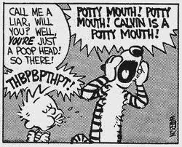
EMoTioNS
Components of Emotions
Physical
Cognitive
Nonverbal

Slide 13
Emotional Intelligence
Are you aware of your emotions and the impact they have on your behavior and communication?
Are you aware of others emotions and the impact they have on their behavior and communication?
Notes:
Some are able to identify emotions and respond, others react.

Slide 14
Emotions in Decision-Making
How do our emotions drive our decision making?
Can you think of examples where it became obvious that the decision was based on emotions rather than on more objective evidence or support?
How did you handle the situation?
Notes:
Emotions are inherent in decision-making.

Slide 15
Emotions in the Workplace
Where and when are emotions most evident?
How do you know?
How do you handle it?
What could you do better?
Notes:
Messages to others include both content and relational aspects.
Emotions can act as “triggers” to conflict.

Slide 16
Conflict and Emotional Intelligence
 | Self (Intrapersonal) | Social (Interpersonal)
Recognition/ Awareness | Be self aware: understand emotional cause and effect Develop internal empathy: deal with internal triggers; respond rather than react Become authentic: adhere to inner values, principles, and guidelines; be trustworthy to self | Communicate with respect and information Create resonance and rapport Empathize Seek creative resolution with mutual gains Listen actively View adversaries in a positive way
Regulation/ Management | Cultivate constructive positive emotions (positive psychology) Minimize negative feelings Cultivate positive expectations and abundance thinking Accept personal responsibility Be trustworthy and operate with integrity | Build relationships and establish long-term connections Handle conflict tactically and strategically Negotiate fairly and responsibly Follow up on understandings and agreements Yield to change

Slide 17
Acceptable Responses
An acknowledgment that the transgression was wrong: “I acted like a jerk.”
A sincere apology: “I’m really sorry. I feel awful for letting you down.”
Some type of compensation: “If I act that way again, you can call me on it.”

Slide 18
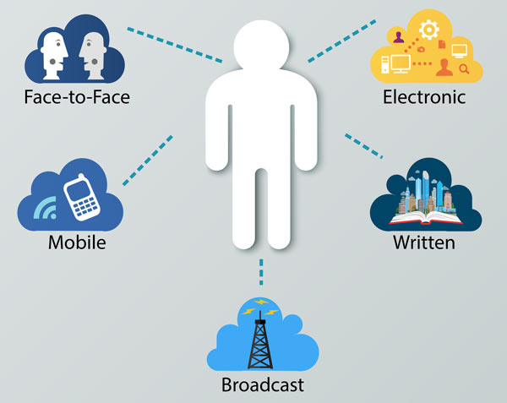
+Positive+ Expression of Emotions
Consider when and where to express your feelings
Time to discover the depth of emotions before expressing
Accept responsibility for your feelings
“I” versus “you”
“I’m getting angry” vs. “You’re making me angry.”
“I feel hurt when you do that” vs. “You hurt my feelings”
Be mindful of the communication channel!
In-person vs. Mediated

Slide 19
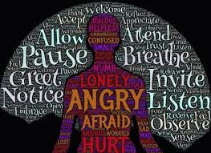
Skills to cultivate
Self monitoring/ self reflection
Active listening/ Paraphrasing
Suspending judgment
Slowing down communication
Comfortable with discomfort
Recognize and identify personal feelings
Expand your emotional vocabulary
Share multiple and nuanced feelings
What else…?

Slide 20
Scenario #1
Your Student Learning Outcomes (SLO) committee is a sub- committee of your Curriculum Committee, which in turn reports to the academic senate. The faculty chair of the SLO Committee is resisting requests from the curriculum chair to make more complete reports to the Curriculum Committee and to bring decisions to the Curriculum Committee for ratification. The SLO chair claims that her committee has developed expertise in the area of SLOs beyond that held by the average Curriculum Committee member, and this expertise should be respected by allowing the SLO committee to work without having its decisions questioned. Everyone is frustrated with the situation.
Using your emotional intelligence,
how would you handle this situation?

Slide 21
Scenario #2
Within a semester, your new college president is making decisions that your academic senate feels have historically been under academic and professional matters under the 10+1; therefore warrant involvement of the academic senate. In an attempt to talk with her about this, she asserts that as president she has the right to make these decisions without discussing it with you as senate president.
Using emotional intelligence,
how would you handle this situation?
What can you do now to help develop a healthy relationship built on mutual respect and trust?

Slide 22
Questions? Comments?

