Slide 1
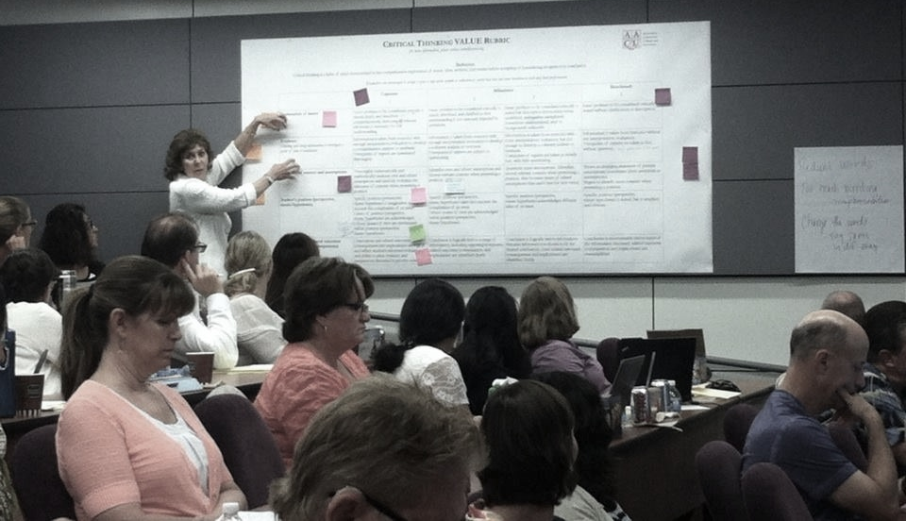
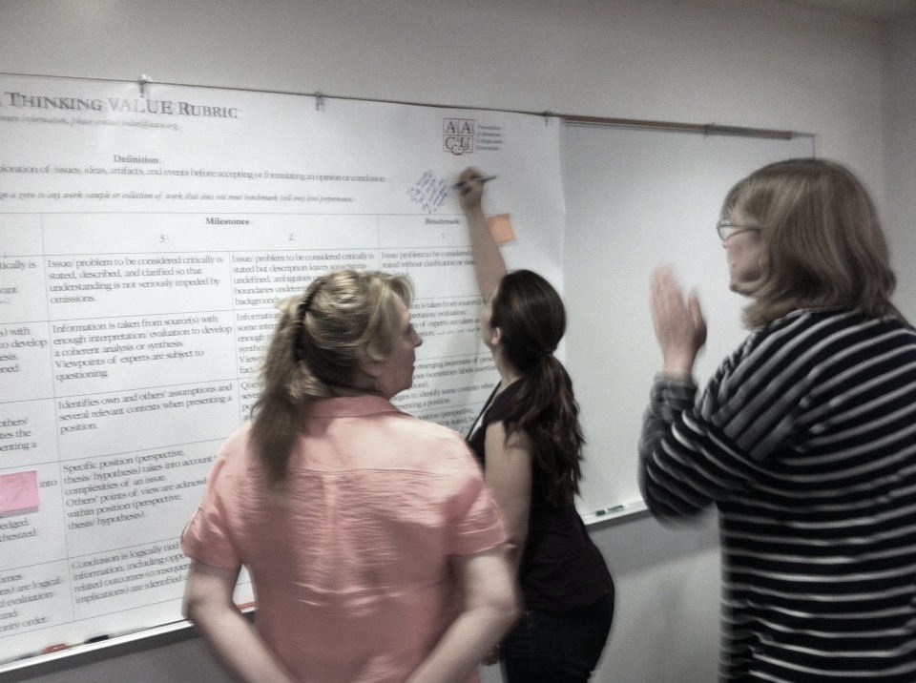
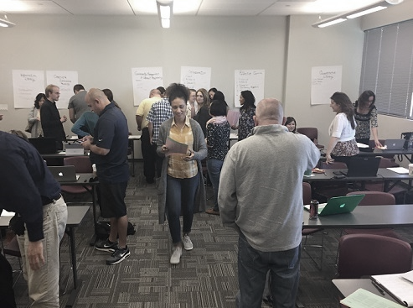
Engaging Faculty in Institutional Assessment - A Panel Discussion
SLO SYMPOSIUM February 3, 2017
Kelly Burke Rebecca Eikey Andy McCutcheon Cindy Stephens Paul Wickline

Slide 2
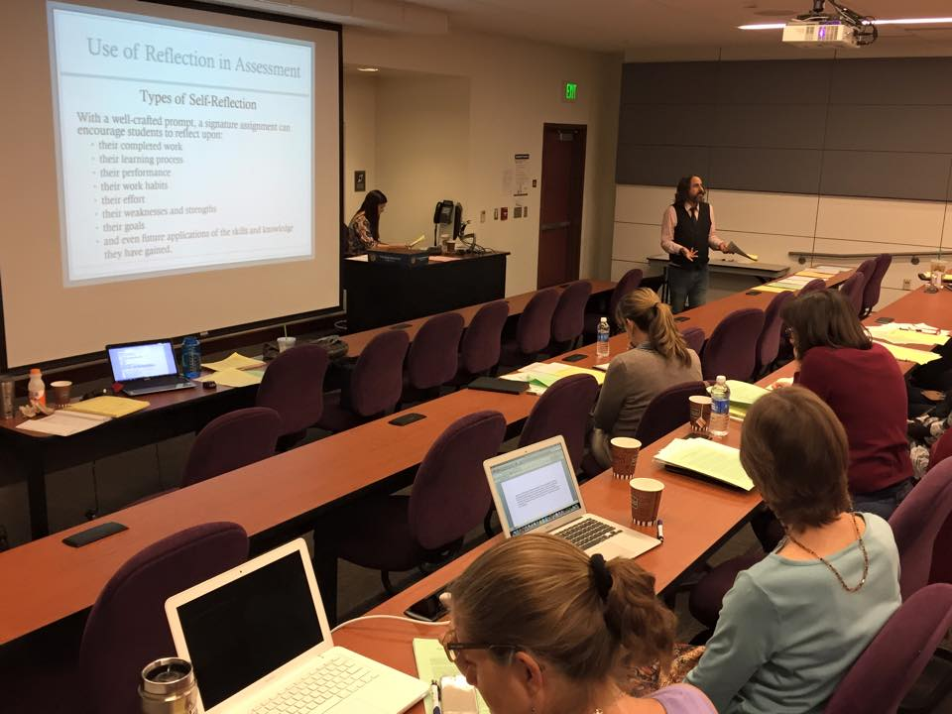
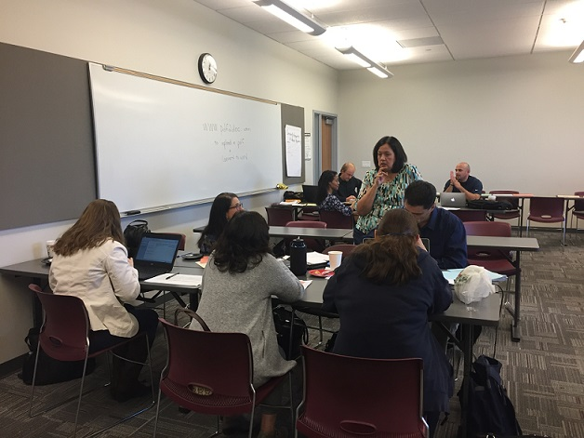
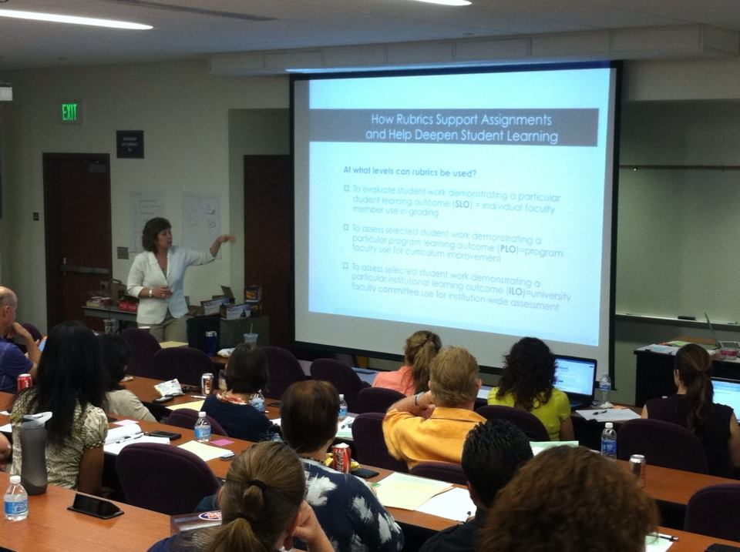
Guiding Question
Authentic & effective institutional assessment – how can this work be done?

Slide 3
Overview of ILO Development
Development of
ILOs Based on IGETC/CSU-GE
ILO Assessment Implemented & Documented
Research on ILO assessment at other colleges, conferences, networking
CSUs Adopt AAC&U LEAP Outcomes
Fall 2010
Fall 2012
2008
ILOs Opening Day 14 ILOs Based on AA/AS + CTE + Basic Skills
Sept. 2011
FLEX Workshops -Interest in adopting AAC&U LEAP Outcomes
Spring & Fall 2013
Signature Assignments
ePortfolios
VALUE Rubrics
FLEX Workshops
Notes:
Add graphic here – paperwork/frustration
Add 2013 and attendance at conferences and eportfolio, signature assignments!

Slide 4
Overview of ILO Development
Overview of ILO Development at COC
1st Day of Assessment
“Improving Student Learning and Capturing Evidence”
Alignment
Signature Assignments
2015
Two More “Days of Assessment” “Authentic & Effective Institutional Assessment “
2nd Survey on ILOs
Opening Day
Fall 2014
Mar-April
May & June
2nd Day of Assessment “Authentic Teaching, Learning & Assessment”
Division Roadshows
March & May
Spring 2014
1st Survey of ILOs “Thinking Critically about Critical Thinking”
Workshop with Guest Julie Stein, CSU-East Bay
August, September 2015
LEAP Outcomes
Signature Assignments
ePortfolio

Slide 5
Overview of ILO Development
Overview of ILO Development at COC
2016
Day of Assessment “Taking Program Level Assessment to the Next Level”
Day of Assessment “ILOs Development - Critical Thinking and Effective Communication”
March
May
November
Day of Assessment “Taking Program Level Assessment to the Next Level – CTE focus ”
May
Academic Senate Approval of ILOs
Day of Assessment “ILO Rubric Development”
June

Slide 6
Outcomes Build Upon Each Other
Institutional
Program, Degree, Certificate
Course Outcomes
Proposed ILOs
Critical Thinking
Effective Communication
Collaboration
Creative & Innovative Thinking
Information Literacy
Quantitative Literacy
Community Engagement & Global Responsibility
Lifelong Learning
Notes:
Students cannot develop college-level achievement of these outcomes in only one course or one experience. Must be developed over time—at progressively more challenging levels. Imperative that we coordinate across courses and programs—including, potentially, at the assignment level.

Slide 7
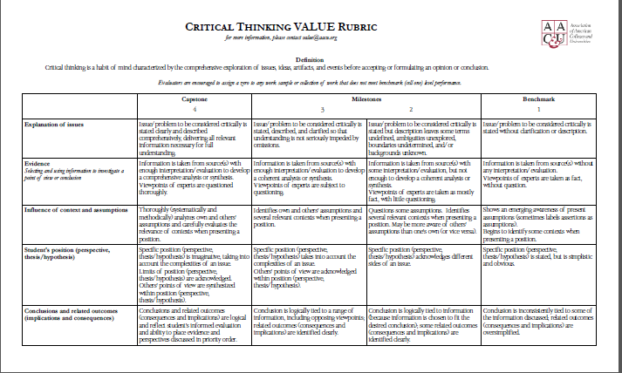
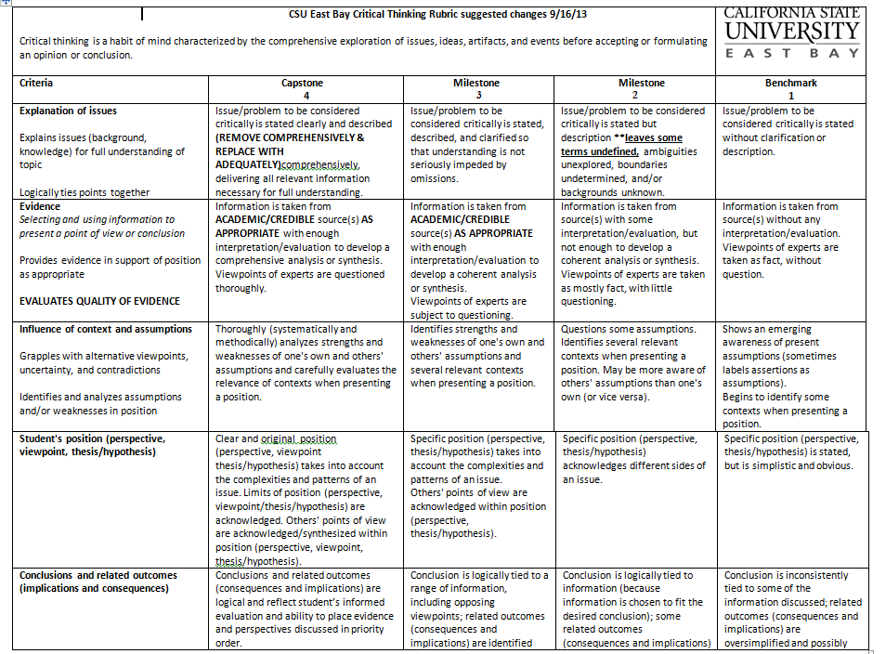
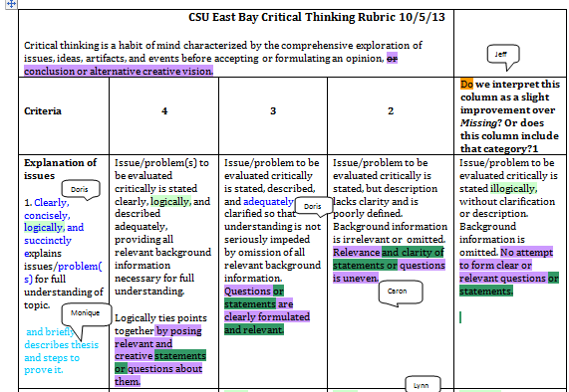
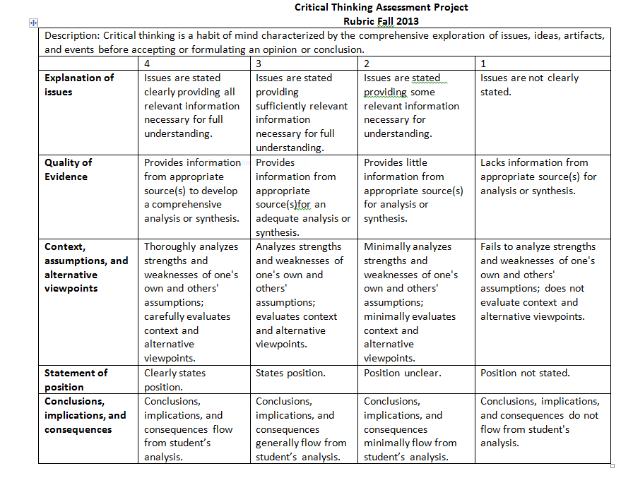
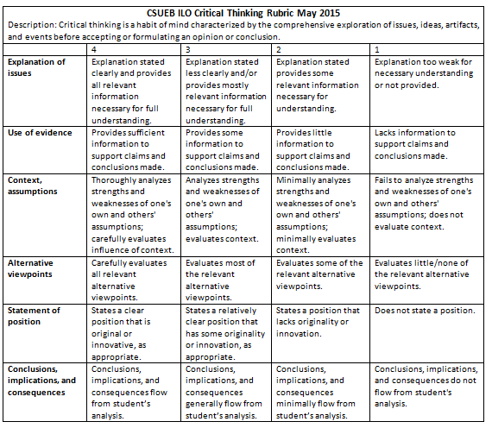
The Development of the Critical Thinking Rubric at CSU East Bay

Slide 8
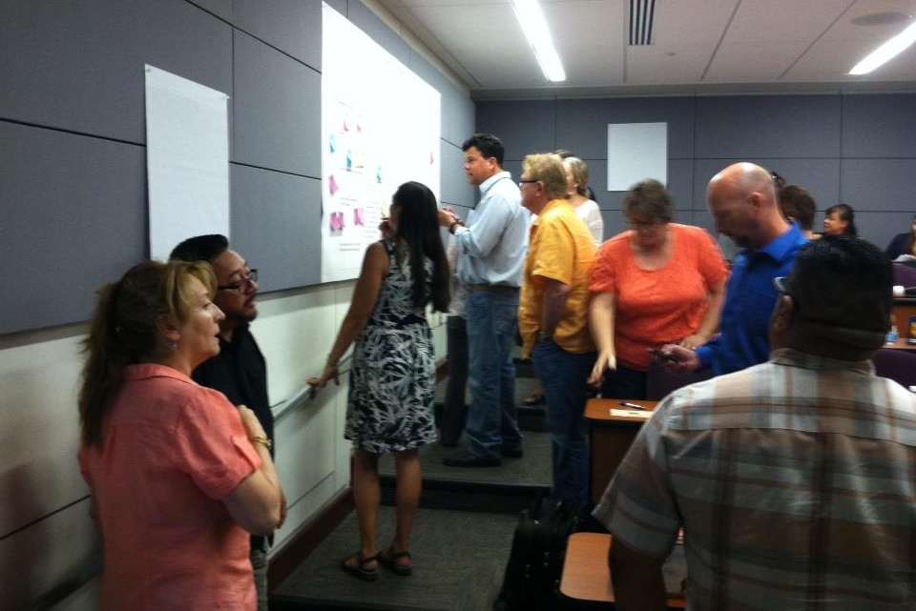
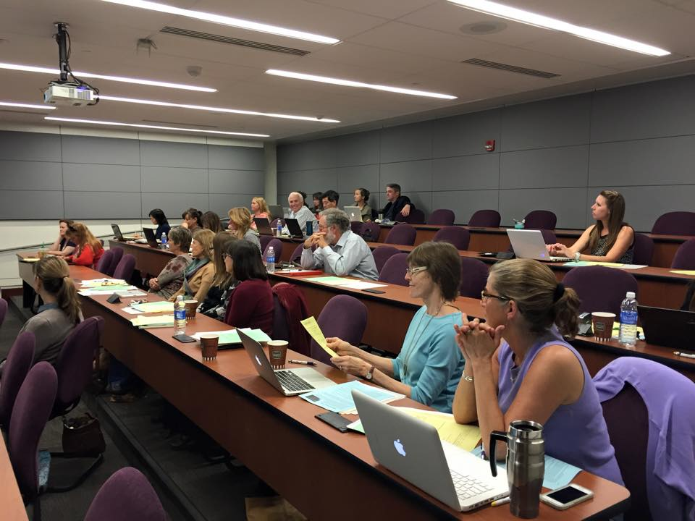
Sample of Faculty Activity
Develop a Critical Thinking Rubric using AAC&U’s as a staring point.
Write changes on CT Rubric Posters.

Slide 9
Feedback from faculty
“…ILO, PLO, SLO are prepared by all faculty…therefore I am getting and being involved in the preparation of ILO at COC. Awesome!”
“I came away with clearer idea of rubrics and student reflection specific to my signature assignment.

