Slide 1
Ensuring Quality and Equitable Online Courses Using the CVC Course Design Rubric and Local POCR

Slide 2
Presenters
Dylan Altman, ASCCC Online Education Committee - Los Angeles Valley College & Oxnard College
Wendy Bass, Ph.D., Distance Education Coordinator – Los Angeles Pierce College
Geoffrey Dyer, CVC Advisory Committee Co-Chair; - Taft College Faculty
Jodie Steeley, Ph.D., Director of Distance Education and Educational Technology – Fresno City College
Robert L Stewart Jr., ASCCC Area C Representative/Online Education Committee 1stChair

Slide 3
Session Description
The current Covid-19 pandemic has resulted in faculty having to pivot to distance education. At this time more than ever, faculty need to have access to tools that will ensure that students in the California Community Colleges system have access to equitable and high-quality online courses designed to support student learning and success. Local peer online course review (POCR) provides opportunities for faculty to support each other non-evaluatively in increasing the quality of the student experience for all learners.
Join this breakout session to learn about successful local POCR implementation and explore resources for establishing or scaling-up local POCR at your college.

Slide 4
Objectives
Learn about CVC & Benefits of Using @ ONE
Understand the benefits of using CVC-Course Design Rubric and Local POCR
Recognize how Rubrics and Local POCR promote quality
Acknowledge how Rubrics and Local POCR promote equity
Gauge Rubric and POCR usage at CCCs
Present Poll Results (DE Coordinators)
Discuss ASCCC Resolution to encourage CVC-Course Design Rubric and Local POCR adoption at local CCCs

Slide 5
California Virtual Campus (CVC)
Formerly OEI >>>then CVC-OEI >>> now CVC
Started out of a grant from the CCC Chancellor’s Office 7 years ago.
Led the adoption of CANVAS by all 115 CCC’s, creating a consistent framework for teaching and learning.
Invaluable resource before and after COVID.

Slide 6
Online Network of Educators (@ONE)
Pedagogy first, tools second.
Low-cost Workshops & Courses.
Free Courses for CCC's to adopt locally. Free "Byte-Size Canvas"
And so much more...

Slide 7
CVC & @One
More than CANVAS
Ecosystem
Student preparedness for success
Virtual student support services equivalent to face to face.
Equity
Accessbility (Access for all students)
OER
Humanizing instruction.
Online Teaching, Design, and Principles.
And...Local POCR

Slide 8
POCR Survey Results Out of 115 schools, 27 responded
Local POCR
Implementing local POCR – 20 yes; 7 no
1 school offering only release time
13 schools are giving a stipend
11 schools not offering anything
If have not yet started POCR, when will do this?
9 schools report being within the process of starting in the next year
Schools offering stipends are using...
CARES funding
The CTE Online Pathways Grant, so faculty submitting courses must be from the programs in the grant to receive stipends.
This is funded by the college's general fund. Course reviewers get paid for reviewing courses; this language is part of our contract.
Equity Funds
Professional Development Funds

Slide 9
Local Peer Online Course Review (POCR)
An engaging, sustainable process for ensuring student success in quality reviewed courses does not emerge overnight. It takes planning, time, and on-going communication! Below is a quick list of the six major elements that go into a successful Local POCR process:
Buy In: Identify stakeholders on your campus and in your district and start the conversation.
Teamwork: Build a cross-functional, cross-discipline POCR team that can build and guide your program over the long term.
Resources: Identify resources - those you have and those you need.
Planning: Outline the process your college will use, including timelines.
Promotion: Spread the word about your process and how it will benefit instructors, students and the college as a whole.
Recognition: Consider ways to motivate, incentivize, and honor the efforts of your POCR participants.

Slide 10
Benefits of Local POCR
POCR supports and trains faculty to create rigorous online courses that are
Well-Organized
Fully Accessible
Create Clear Expectations
Regular and Meaningful student-student and student-instructor interaction
Benefits for Supporting Instructors
Promoting student success
Meeting accreditation requirements
Meeting existing regulatory requirements
Making effective use of Canvas and it's tools

Slide 11
How Can Rubrics and Local POCR Promote Equity
There are two rubrics that are used in conjunction with one another that together not only guide instructors to meet any online course regulatory and accreditation requirements, but also to promote student success and access to high quality online courses. Among the issues addressed by these rubrics is Equity.
The first rubric is the CVC-OEI Course Design Rubric, and the 2nd rubric is the Peralta Online Equity Rubric
In any online class environment, there are bound to be students who are at different starting points, differing levels of understanding the content and/or the technology, different comfort levels with interaction, different ways of handling stress, and different levels of engagement, motivation and well-being.
Let's acknowledge some areas of these rubrics that can be leveraged to address equity issues so that all students in the course are provided with opportunities and a varied means to learn and thrive.

Slide 12
Equity and the Rubrics
CVC-Course Design Rubric
Content Presentation: Unit Objectives; CMS/LMS; Learner Support; Institutional Support
Interaction: Instructor Contact; Student-to-Student Contact
Assessment: Effective Assessment; Guidance & Feedback
Accessibility

Slide 13
Equity and the Rubrics
Peralta Online Equity Rubric
Technology
Student Resources and Support
Universal Design for Learning (UDL)
Diversity and Inclusion
Images and Representation
Human Bias
Content Meaning
Connection and Belonging

Slide 14
Survey Results from Participants . . .
Are you participating in local POCR on your campus? Yes/No
If you are participating in local POCR, are you giving a stipend or release time?
How are you funding release time and/or stipend?
If you have not yet created a local POCR, do you plan to?

Slide 15
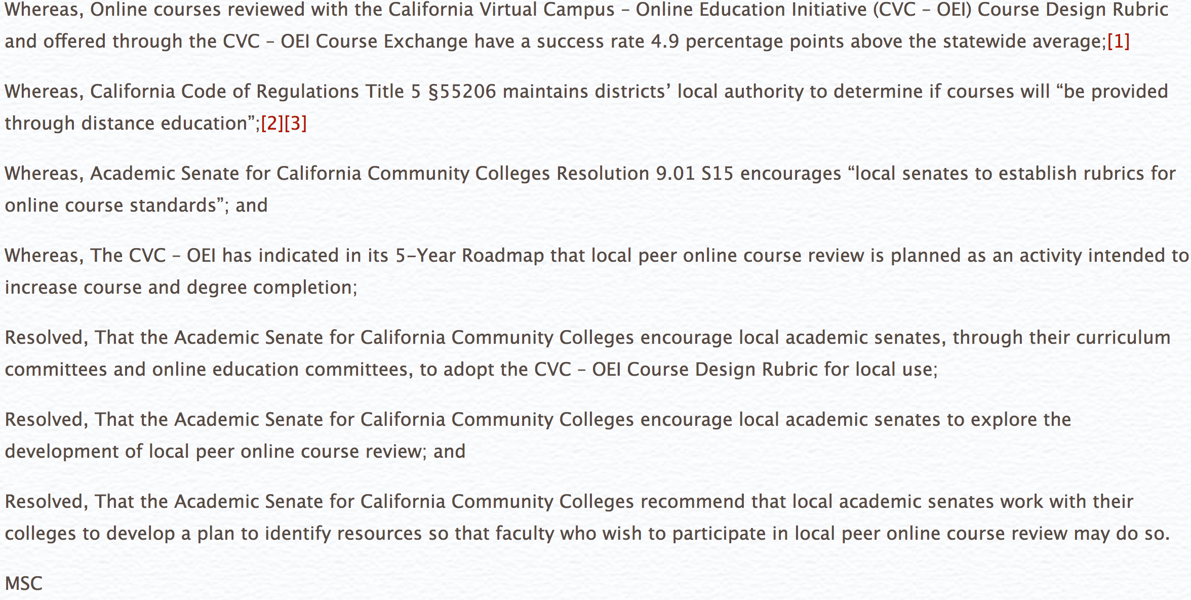
9.03 F18: Local Adoption of the California Virtual Campus – Online Education Initiative Rubric

Slide 16
Resources
https://asccc.org/content/cvc-oei-course-design-rubric-and-your-curriculum
https://onlinenetworkofeducators.org/course-design-academy/pocr-resources/
https://asccc.org/content/cvc-oei-what%E2%80%99s-been-accomplished-what%E2%80%99s-new-and-where-it%E2%80%99s-headed
https://asccc.org/content/adopting-oei-course-rubric-local-use
https://asccc.org/resolutions/local-adoption-california-virtual-campus-%E2%80%93-online-education-initiative-course-design
https://web.peralta.edu/de/files/2019/08/Describing-the-Peralta-Equity-Rubric-Aug-2019.pdf
https://web.peralta.edu/de/equity-initiative/equity/
https://web.peralta.edu/de/files/2020/10/Peralta-Online-Equity-Rubric-3.0-Oct-2020.pdf
https://onlinenetworkofeducators.org/wp-content/uploads/2020/06/CVC_OEI_Course_Design_Rubric_rev_April_2020.pdf
https://www.thoughtco.com/promoting-student-equity-and-engagement-4074141

Slide 17
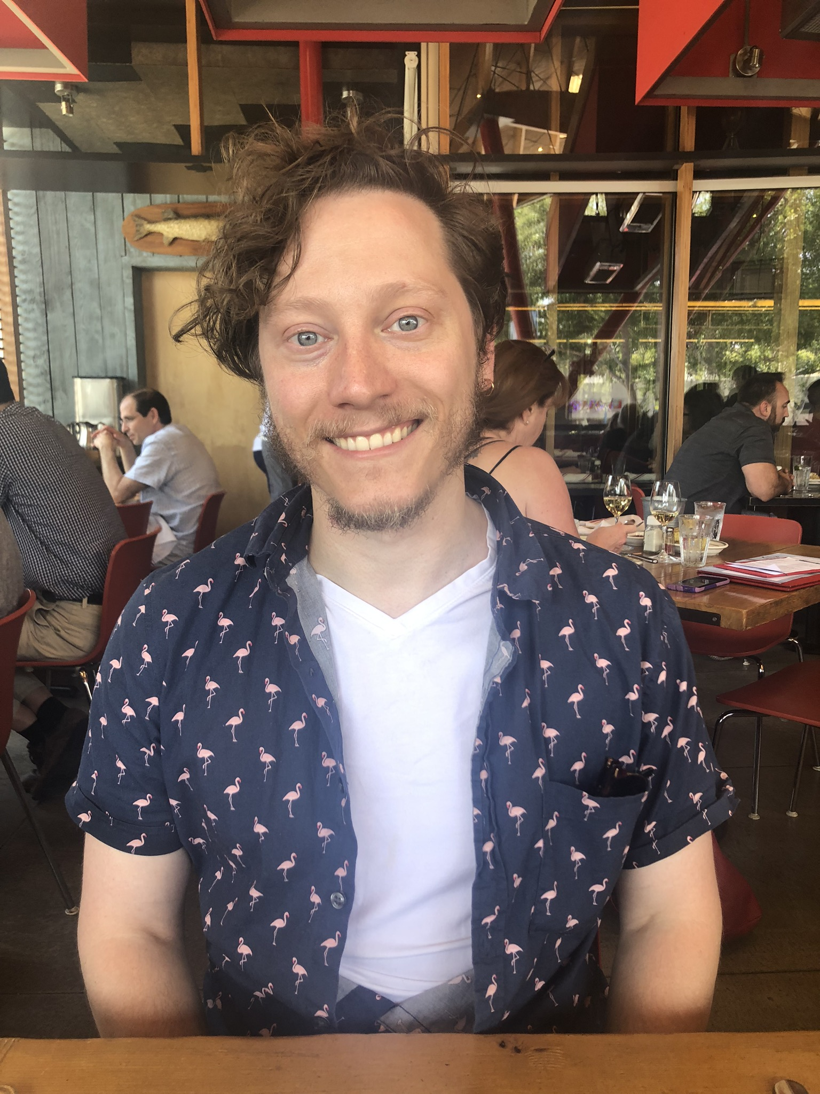
Thank you for Joining Us!
Questions?

