Slide 1
Are Grades Failing Our Students?
2020 Academic Academy: Redefining Distance Education
Licensed CC BY-SA 4.0 by Suzanne Wakim

Slide 2
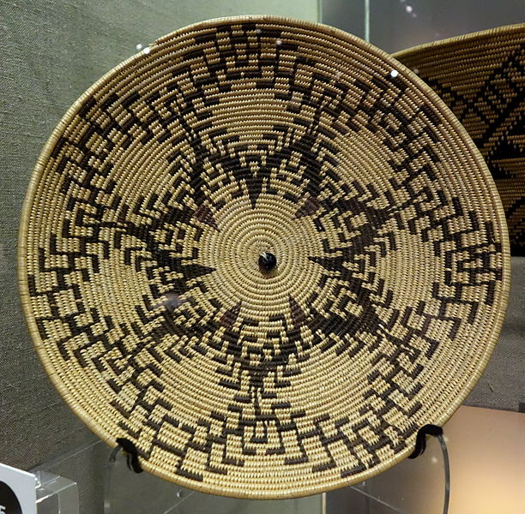
Acknowledgement
I acknowledge the traditional custodians of the land I am on today, the Maidu Tribes, and pay respect to their elders past and present.
Maidu Basket Plate; CC0

Slide 3
Discussion
What is the purpose of grades?
How are grades different from assessments?

Slide 4
Our Goal
Better Data
Better Equity
Brain by Geralt; pixabay license
Grading for Equity by Joe Feldman

Slide 5
Our Path
The points marketplace
Extra Credit
Due dates
Assigning Zeros
Homework
Authentic Assessment
The 0 – 100 grading scale
Park by kirillslov ; pixabay license

Slide 6
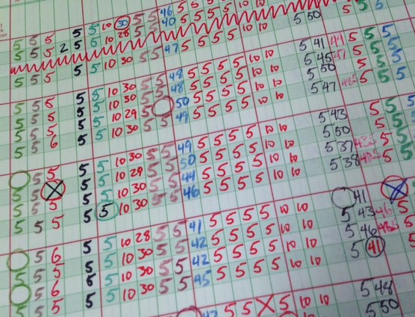
The Points Marketplace
Bank of Professor X
The Game of Points
Using points to manage behavior
Using points to measure learning
Photo; CC0
Gradebook by David Mulder; CC BY-SA 2.0; via Flickr

Slide 7
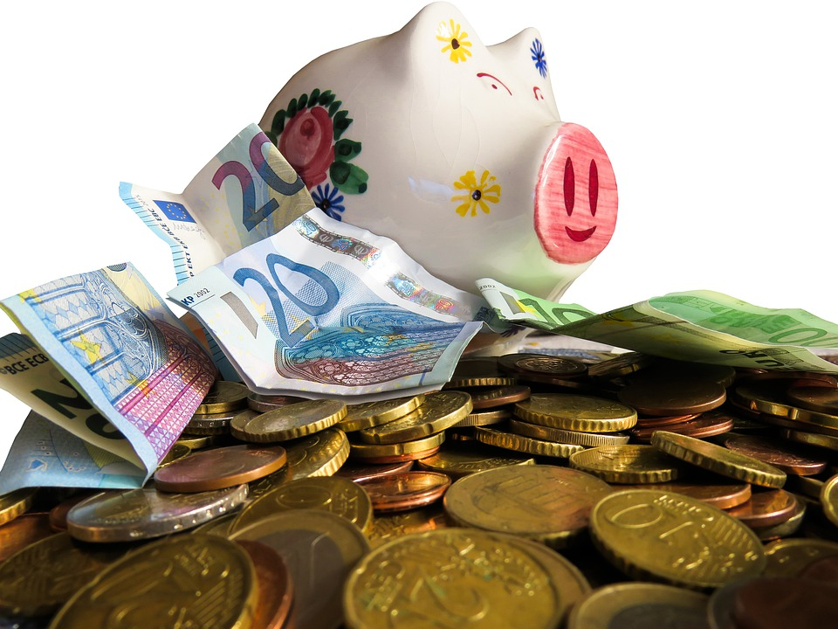
The Slush Fund (Extra Credit)
Weak learning in one area can be compensated for by more work in another.
Reflects a students’ environment more than their learning.
If it’s important, require it.
If not, don’t include it in the grade.
Piggy Bank by blend12; pixabay license

Slide 8
Due Dates
What does this measure?
Who is most likely to have late work? Why?
Are extensions granted for some students?
Which students are most likely to ask?
Those that know the game
Will they take advantage of us?
Due Date; CC0

Slide 9
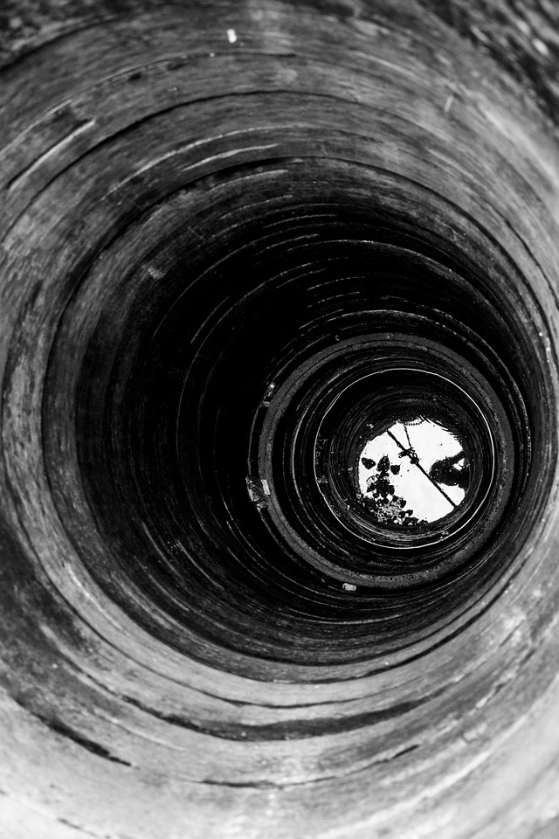
Assigning Zeros for Missing Work
That’s a loooong way down
Zero doesn’t accurately measure knowledge
Which students are most likely to miss assignments?
How can students “make up” these points?
Deep Well by royonly; pixabay license

Slide 10
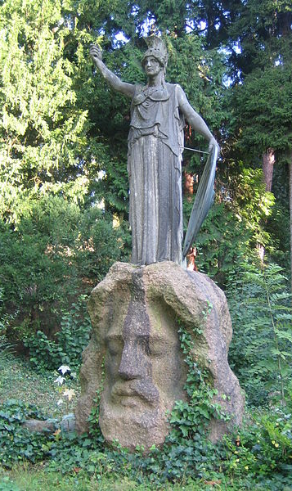
Homework
Formative Assessment
Allow revisions
Mistakes are part of learning
Summative Assessment
Perfect on the first try
Not an Assessment
Full points for “effort”
Athena by tschogibussi; CC BY-SA 3.0

Slide 11
Authentic Assessment
Define & Group
the following
Peptide Bond
Lactose
Cholesterol
Wax
Polysaccharide
Nucleotide
Cellulose
Nitrogenous base
Enzyme
Triglyceride
Glucose
Amino acid
Disaccharide
Fatty Acid
Deoxyribose
Chitin
Phospholipid
Ribose
DNA
protein

Slide 12
Standard Test Questions
What are we really measuring?
Which relationship is different?
Monosaccharide / Polysaccharide
Monosaccharide / Disaccharide
Phospholipid / Lipid
Amino Acid / Protein

Slide 13
What do we want to measure?
Notes:
TED talk by Roger Antonsen titled: Math is the hidden secret to understanding the world

Slide 14
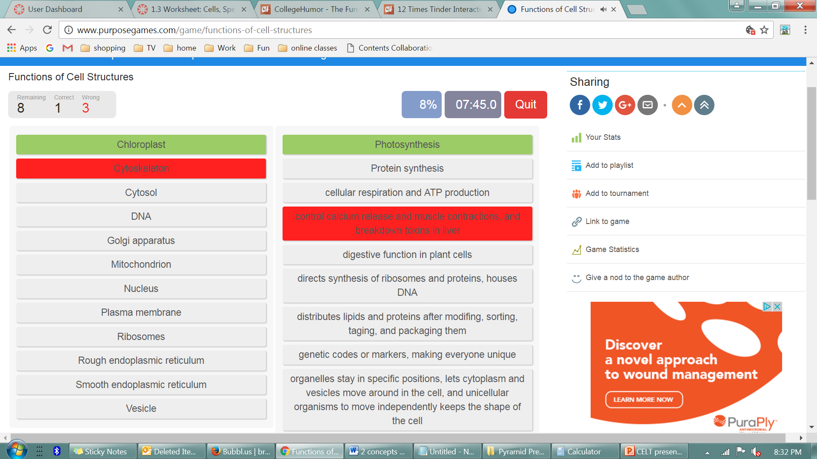
What do we want to measure?
Notes:
TED talk by Roger Antonsen titled: Math is the hidden secret to understanding the world

Slide 15
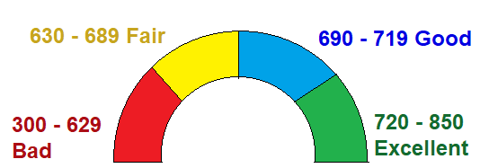
100 pt scale
Grading is not that precise
too many sig figs
So many ways to fail

Slide 16
GPA Scale
4 pts (A) Exemplary | 3 pts (B) Accomplished | 2 pts (C) Proficient | 1 pt (D) Developing | 0 pts (F) Beginning
 |  | traditional grading | minimum grading | 4 pt scale
Assignment 1 | 85% | 85 | 85 | 3 (B)
Assignment 2 | 85% | 85 | 85 | 3 (B)
Assignment 3 | 7% | 7 | 50 | 0 (F)
Final Grade |  | 59% (F) | 73% (C) | 2 (C)

Slide 17
Outcomes Based Grading
Exams are organized by topic rather than question type
Students get grades based on learning outcomes
 | Cardiovascular System (Test 1 Part A) | Digestive System (Test 1 Part B) | Nervous System (Test 1 Part C) | Total
Student A | 3 | 3 | 3 | 3 (B)
Student B | 4 | 4 | 2 | 3 (B)
Student C | 2 | 4 | 4 | 3 (B)

Slide 18
Grading schema
Weighing more recent grades higher
Mean v. Median
Grades | Mean | Median
40% 84% 86% 88% 94% | Average = 78% | Middle number of ordered set = 86%

Slide 19
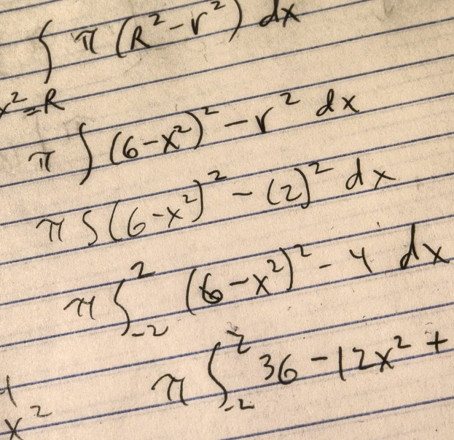
Complex Grading Schemes
Lifting the veil
Excel made me do it
Students don’t know how to improve
Rubrics can help
Numbers by Robert Couse-Baker CC BY 2.0

