Slide 1
An Equity Framework for Competency Based Education (CBE)
Notes:
Randy

Slide 2
Today’s Presenters
Randy Beach, ASCCC Curriculum Committee, Southwestern College (facilitator)
Amparo Diaz, Success Center for California Community Colleges
Chantée Guiney, CCCCO Specialist - Educational Services and Support
Nadia Leal-Carrillo, Success Center for California Community Colleges
Aisha Lowe, CCCCO Vice Chancellor- Educational Services & Support
Notes:
Randy

Slide 3
An Equity Framework for Competency Based Education (CBE)
The Why
Notes:
Aisha

Slide 4
Strengths
Unique Size and Scope
Largest system of higher education in the U.S., serving 2.2 million students in 73 districts and 116 colleges
Reflective of the State’s diversity
Serving students from varying ethnicities, ages, and levels of educational attainment
Accessible Education
Higher percentage of young people (18 – 24) attending college than other states (43% to 48%)
Source: California Community College Vision for Success
Notes:
Aisha
Vs. (https://foundationccc.org/Portals/0/Documents/Vision/VisionForSuccess_web_2019.pdf)
"In the next most populous state, Texas, the public community college system served a little over 700,000 students during the same time period. By any comparative measure, the CCC system is massive." (Vs., p. 7)
* COMPLETION
- 48 percent of students who entered a CCC left with a degree, certificate, or transferred after six years (p. 10)
*TIME TO DEGREE
- "Students who complete an associate’s degree on average take 5.2 years to do so (the median time is 3.8 years)..." (Vs., p. 10)
*ACHIEVEMENT GAPS
- "High-need regions of the state are not served equitably....significant disparities in basic CCC service coverage and penetration in different regions of the state. Areas with the lowest college attainment of adults and the lowest median household income also have the lowest CCC enrollment per capita.35 In other words, the CCC’s valuable education and job-training services are not always reaching those parts of the state where they are most needed. This is particularly an issue in the Central Valley and the Sierras, the Inland Empire, and the Far North regions of the state." (Vs., p. 13)

Slide 5
Challenges
Completion
Only 48% of students who enter a CCC leave with a degree, certificate, or transfer after six years
Time to Degree
Students who complete an AA degree on average take 5.2 years (median time is 3.8 years) and often accumulate excess units along the way
Achievement Gaps
Persist across the CCCs and regions of the state are not served equitably
Source: California Community College Vision for Success
Notes:
Aisha - CCC Vision for Success (https://foundationccc.org/Portals/0/Documents/Vision/VisionForSuccess_web_2019.pdf_
"In the next most populous state, Texas, the public community college system served a little over 700,000 students during the same time period. By any comparative measure, the CCC system is massive." (Vs., p. 7)
* COMPLETION
- 48 percent of students who entered a CCC left with a degree, certificate, or transferred after six years (p. 10)
*TIME TO DEGREE
- "Students who complete an associate’s degree on average take 5.2 years to do so (the median time is 3.8 years)..." (Vs., p. 10)
*ACHIEVEMENT GAPS
- "High-need regions of the state are not served equitably....significant disparities in basic CCC service coverage and penetration in different regions of the state. Areas with the lowest college attainment of adults and the lowest median household income also have the lowest CCC enrollment per capita.35 In other words, the CCC’s valuable education and job-training services are not always reaching those parts of the state where they are most needed. This is particularly an issue in the Central Valley and the Sierras, the Inland Empire, and the Far North regions of the state." (Vs., p. 13)

Slide 6
Our Students
Source: California Community College MIS Datamart
Notes:
Aisha
Talking points:
Our system reflects the ethnic and racial diversity of our state
46% of our students are Latinx
We serve a higher proportion of adults between the ages of 25 and 49
42% of our students receive financial aid, what we also see here is that there are system barriers in accessing state and federal aid despite the level of need

Slide 7
Pre-Covid: Adult Learners
Source: Back to College: Part One: California’s Imperative to Re-Engage Adults by California Competes (Oct 2018)
Notes:
Aisha
Talking points:
About 4 million adults in CA have some college but no degree and are not currently enrolled in an institution of postsecondary education
College attainment vs completion highlights inequities is our systems of higher education
28% of Black Californians attended college but did not complete
White and Asian student more likely to start and complete
Latinx students less likely to attend

Slide 8
COVID – 19 Impact on Students
“COVID-19 has changed my plans for college financially and emotionally. I am currently debating whether I should drop my Fall Semester classes because I need to find a full-time job to help my family.”
“It’s made it increasingly difficult to take on the full schedule of online classes topped with work from home and childcare from home all at the same time. My stress is through the roof.”
Source: California Student Aid Commission, California College Students’ Experiences during the Global Pandemic (June 2021) https://www.csac.ca.gov/sites/main/files/file-attachments/fall_2020_covid19_student_survey_results_presentation.pdf?1623427361
Notes:
Aisha

Slide 9
Opportunities
Re-engage adult learners
CBE is a great way to re-engage adult learners who need greater autonomy and flexibility
Reimagine Student Support Services
Under CBE student support services are more accessible to students
Provide high-Quality Pathways
We need to be adaptive to meet the needs of learners while providing high-quality programs by trusted institutions
Be adaptive to societal shifts
CBE can flex with changing technologies, employer demands, and unexpected societal shifts
Meet the goals outlined in the Vision for Success
CBE for-credit opportunities will enhance student outcomes and will help us meet our goals
Increase educational attainment in CA
Career preparation is essential to the future of our state and our system
Notes:
Aisha

Slide 10
Locally CBE is a tool for campus-wide transformation
Faculty Role, Load and Contracts
District/College Policies
Student Support Services
Dismantling silos to provide a tailored student experience leading to clearly defined competencies students can leverage in industry.
Student
Centered
DA CBE
Self
Directed
Variably
Paced
Institutional Data & Research
Outcomes
Focused
Financial Aid
SIS & LMS
Notes:
Aisha
To highlight those high level barriers

Slide 11
An Equity Framework for Competency Based Education (CBE)
The What
Notes:
Chantee

Slide 12
Title 5 CBE Definition
Direct assessment competency-based education is an intentional outcomes-based equity-minded approach to earning a college degree with the expectations of learning held constant, but time is variable through a flexible, self-paced, high-touch and innovative learning practice.
The goal of competency-based education is to empower students in their learning journey by providing a personalized, flexible, adaptive, and culturally responsive curriculum with which students can engage; it allows students to demonstrate mastery of learning and the achievement of competencies at their own pace aided by customized instructional and student service support.
2021 ASCCC Curriculum Institute 12
Notes:
Chantee
Slide content January 2020 5C CBE presentation

Slide 13
CBE Focuses on Mastery of Competencies
Credit Hour Model…
based on seat time originally designed to determine faculty pensions and not as a measure of learning.
Credit Hour is current basis for awarding financial aid, faculty workload & degree completion.
Competency Based Education… moves beyond seat-time focusing on mastery of competencies, through learning activities and experiences that align with clearly defined programmatic outcomes.
Hours will vary, but the learning is fixed.
Often fully online modules.
Flexible academic calendar term options.
“Cracking the Credit Hour” by Amy Laitinen
2021 ASCCC Curriculum Institute 13
Notes:
Chantee
Slide from January 2020 5C CBE presentation
Fully online modules
Different term options for the academic calendar

Slide 14
Competency-based education is and is not….
CBE is… | CBE is not…
Time is variable with program offered in a flexible, self-paced approach | Learner works at course-set pace with pre- determined schedule of assignments, activities, etc. with true beginning and end dates
Learning is fixed requiring demonstration of mastery of each competency | Learning varies with passing course grade (i.e., A, B, C, D)
Determined by rigorous summative authentic assessment focused on meeting core outcomes and competencies | Student evaluation varies based on accumulation of activities, exams, projects, discussion, attendance, etc.
Student learning supported by faculty and staff throughout learning journey | Independent study (i.e., students learn on their own and then take final exam)
Completion of program is based on mastery of intentionally designed scaffold of all competencies | Achievement of credential is based on passing grades and credit-hours (i.e., 60 credit hours=AA/AS)
2021 ASCCC Curriculum Institute 14
Notes:
Chantee Slide from January 2020 5C CBE presentation

Slide 15
Course/Credit-Based vs. Direct Assessment
 | Course/Credit-Based CBE | Direct Assessment CBE
Is the traditional academic term followed? | Yes Traditional academic terms are followed | No Credit-hour equivalences are established
Do students have autonomy over their progress? | Yes, but bound within the term Students can accelerate through summative assessment | Yes, within and across the program Students can proceed at their own pace toward mastery
How is learning evaluated? | Competency-based mastery Tied to courses | Competency-based mastery Tied to the program
Is transfer credit or CPL allowed? | Yes | No
Is an ACCJC substantive change approval required? | No | Yes U.S. Secretary of Ed approval of 1st program also required
2021 ASCCC Curriculum Institute 15
Notes:
Chantee
CCCCO CBE Report to BOG (2020)
ACCJC Policy on CBE (January, 2020)
Course/Credit-based:
The demonstration of competencies is embedded into a conventional curriculum comprising courses to be completed to earn credits toward a degree or credential.
Course/credit-based programs generally enroll students in traditional academic terms (typically, semesters or quarters) and award credits for courses successfully completed.
Students may accelerate their learning and receive credit for the course when they have demonstrated mastery of the competencies by passing a summative assessment.
Institutions may elect to create two academic transcripts, one that displays the credits earned (and grade point average or GPA) and one that specifies the competencies attained. (C-RAC, Common Framework for Defining & Approving CBE Programs, 2015).
Within the course/credit-based model, institutions primarily adhere to traditional credit-hour based policies and structures including course and program approval, schedule configurations, and funding apportionment structures.”
Direct Assessment:
CBE approach that is not based on academic terms, such as semesters and quarters, or credit hours.
Disregards conventional courses and bases both the evaluation of student achievement and the award of a degree or credential solely on the demonstration of competencies.
Allows students to proceed at their own pace rather than to progress through courses offered in a traditional academic term. Because conventional grades are not necessarily assigned and no term length is imposed, the transcript reflects competencies attained rather than grades or credit hours earned.
As with all CBE, students are expected to demonstrate the competency at a high level of achievement. Students demonstrate the competencies while they are enrolled in the program;
Transfer credit or prior learning assessment is not permitted in direct assessment programs or in the direct assessment portion of a “partial direct assessment” program. Direct assessment programs establish “credit-hour equivalencies” for the student learning outcomes they evaluate and may choose to provide a transcript indicating course/credit equivalencies in addition to the competency transcript.
Direct assessment programs must be in compliance with

Slide 16
Student Experience
Freedom and flexibility ​
Personalization​
Program is designed to minimize challenges​
Affordability​
Quality instructors and program​
Support from faculty and staff​
Trusted local institution​
Content applicable to current work
2021 ASCCC Curriculum Institute 16
Notes:
Chantee
From summary memo: The theme around freedom and flexibility was addressed the most by all three students. Specific examples pointed to how valuable this type of program was in accommodating the many demands of life, including full-time work, having a baby, and buying a house. As one student mentioned, this program “lets me handle the things that come up in my life, and then finish my work on weekends, early in the morning, or at night.” Another student shared similar sentiments: “I didn’t have to put my program on hold when things came up, which I might have had to do otherwise.” Students indicated that this was one of the biggest and most beneficial differences between competency-based education compared and previous experience with post-secondary education. Students also indicated that flexibility to pursue coursework online was very valuable as it allowed students to avoid commute time, parking fees, gas money, etc.

Slide 17
An Equity Framework for Competency Based Education (CBE)
The How
2021 ASCCC Curriculum Institute 17
Notes:
Amparo

Slide 18
Roadmap to Success
2021 ASCCC Curriculum Institute 18
Notes:
Amparo Hello Everyone. In this roadmap to success section, we’re going to walk through the key components of our plans for the collaborative.
Some of you here will have seen this information in the application materials, while for others this will be a lot of new information. So as we go along, please feel free to drop any questions you might have in the chat and we’ll try to get to them today. In the near future, this information will be available on the Vision Resource Center.

Slide 19
Roadmap for Success
Partner with Curriculum Committee (5C)
Draft Title 5 Regulation
Establish CBE Learning Collaborative
Support System-Wide Implementation
2021 ASCCC Curriculum Institute 19
Notes:
Amparo

Slide 20
CCCCO Efforts to Date
Jan 2020 Presentation to Board of Governors
Jan 2020 – June 2020 Partnered with 5C to Establish Title 5 Regulations
Sept 2020 Presented Regulation at Sept BOG meeting (1st Reading)
Nov 2020 Regulations approved by the BOG
Dec 2020 Collaborative Applications made available
Mar 2020 Applications Due
June 2020 Launched the Direct Assessment CBE Collaborative
2021 ASCCC Curriculum Institute 20
Notes:
Amparo

Slide 21
Regulatory Framework
Regulations are needed to enable colleges to maximize state and federal funding for CBE programs.
The student learning journey, with emphasis on equity, is the focus of the design and elements of the program.
Focus on direct assessment competency-based education as a starting point.
Program and module quality standards align with those of degree programs and degree-applicable credit courses.
The regulations will reside under the Alternative Instructional Methodologies in Subchapter 3 of Title 5 Division 6 Chapter 6.
The implementation of a CBE program will include related professional development.
Chancellor’s Office approval will be required before a college can offer a CBE program for apportionment purposes.
CBE programs will have a separate program approval process; modules are to be adopted as part of a program.
In providing students with the flexibility to learn at their own pace, grading and transcripts systems will align with a national model.
Regulations will allow for greater flexibility and will clearly differentiate between direct assessment CBE and other programs.
2021 ASCCC Curriculum Institute 21
Notes:
Amparo Highlight key policy assumptions

Slide 22
Title 5 Regulations Policy Areas
Program Design:
Modality
Program Selection
Flexibility
Program Standards:
Focus on eliminating opportunity gaps
Student support services
Faculty Roles:
Program design
Unbundled roles
Teaching and mentorship
Academic Grading:
Focus on mastery
Non-punitive
Repetition and Withdrawal:
No failing grades
Redirect to credit programs
Credit Hour Equivalency:
Level of learning
Educational activities
Assessments
Alignment to existing credit courses
2021 ASCCC Curriculum Institute 22
Notes:
Amparo
This is intended to highlight the buckets of policy areas.
Decisions points centered around equity : ​
Program Design
Highlights flexibility
-Online modality
Data informed program selection
Program standards:
-Eliminating opportunity gaps, starting with degree programs
- Student support services
Faculty Role
CBE faculty roles can be unbundled to meet the needs of the program
Faculty work collaboratively to develop comprehensive CBE programs
Faculty have a role in providing mentorship and connecting students to student support services
Grading
Range of Mastery
M + adopted to ensure students can transfer with GPAs above 3.0
No grades that negatively impact GPA
Repetition and withdrawal​
A student cannot fail a CBE program rather they are given a PW
Students are redirected from CBE program to credit programs
Credit hour equivalencies
(1) The level of learning;
(2) The types of educational activities;
(3) The formative assessments;
(4) The complexity and rigor of the summative assessment; and
(5) Alignment to existing credit courses.

Slide 23
An Equity Framework for Competency Based Education (CBE)
The Collaborative
2021 ASCCC Curriculum Institute 23
Notes:
Nadia

Slide 24
The Pilot
A collaborative of campuses implementing direct assessment CBE programs
Close coordination with the CCCCO
Seed money to launch programs
Program development support
Research implementation process and program outcomes
Recommendations for improvement
Inform broader system implementation
2021 ASCCC Curriculum Institute 24
Notes:
Nadia

Slide 25
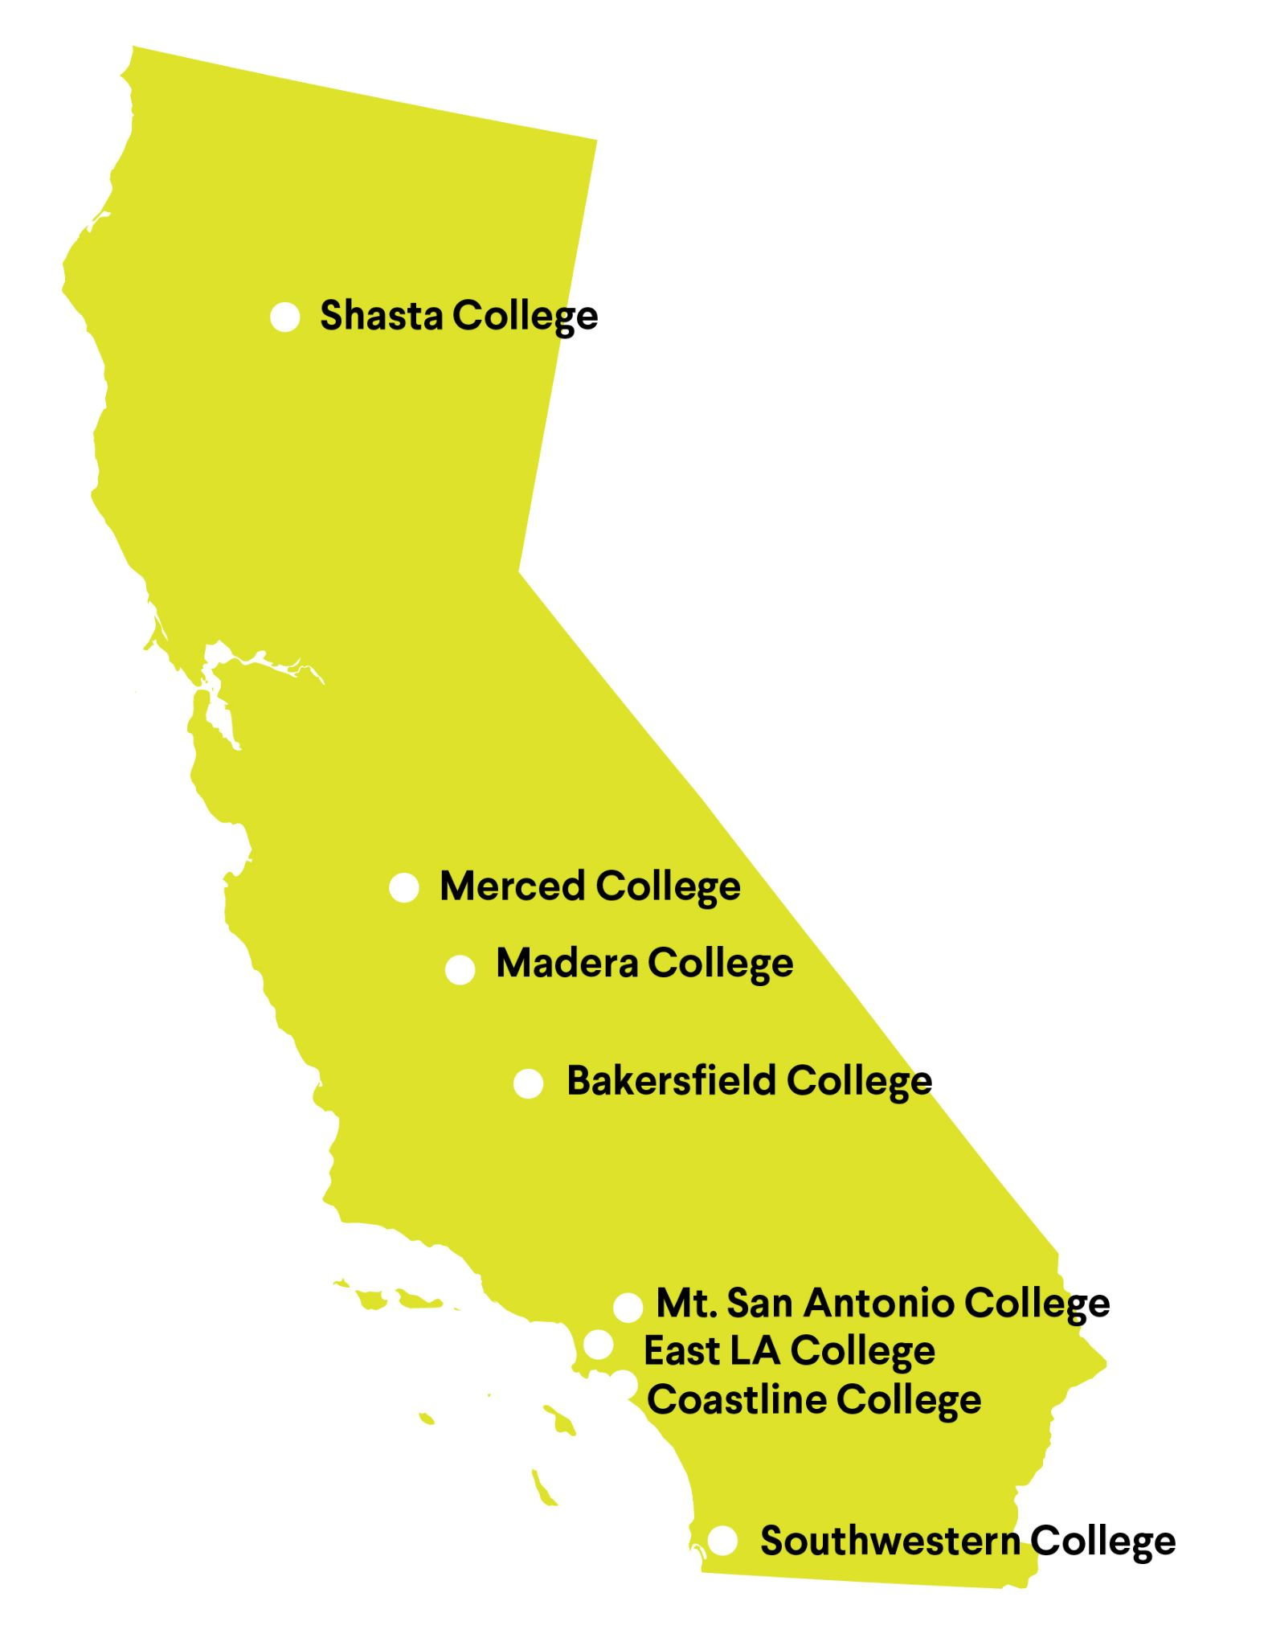
Pilot Colleges
Bakersfield
Coastline
East LA
Madera
Merced
Mt. San Antonio
Shasta
Southwestern
2021 ASCCC Curriculum Institute 25
Notes:
Nadia Prompt for college leads: NLC will ask leads to note name, title, program being considered and why they applied to be part of the collaborative.

Slide 26
CBE Program Plans
Programs Identified
Business Administration (2)
Early Childhood Education/Child Development (2)
Kinesiology & Wellness (1)
Technology & Logistics (1)
Programs Being Considered
Automotive Tech
Communications
Culinary Arts
Cyber Forensics
Elementary Teacher Education
Environmentally Hazardous Materials Technology
Geospatial Technology
Health Information Technology
Heavy Equipment
Landscape Nursery Tech
Sign Language
2021 ASCCC Curriculum Institute 26
Notes:
Nadia

Slide 27
Target Population of Students
First Generation
Parents
Displaced Workers
Recent High School Grads
Military & Veterans
Working Adults
Incarcerated & Formerly Incarcerated
2021 ASCCC Curriculum Institute 27
Notes:
Nadia
Working adults
Parents
Recent high school graduates
First generation
Displaced workers
Active military & veterans
Incarcerated or formerly incarcerated
Some college, no degree

Slide 28
Collaborative Timeline
M1
M2
M3
M4
M5
M6
Establish Local Infrastructure
Select the Program
Design the Program
Regional Accreditation & Approval
Build Operational Model
CCCCO
Approval
July 2021 -
December 2021
July 2021 -
December 2021
December 2021 -
August 2022
September 2022 -
December 2023
September 2022 -
August 2023
September 2023 -
November 2023
M7
M8
Launch the Program
Action Research & Scalability
Spring 2024
July 2025 -
Ongoing
2021 ASCCC Curriculum Institute 28
Notes:
Nadia
Lets take a look at the broad timeline that the syllabus lays out. The collaborative is a four-year effort, which is both a long time, and a very short time.
This academic year, we’ll be starting on Modules 1 and 2 - Establishing Local Infrastructure and Selecting the Program. We’ll finish the academic year working on Module 3 - Design the Program.
The 22-23 academic year will center on accreditation and building an operational model.
The next academic year 23-24, we plan to finalize programs in the fall and launch programs in the spring. Research will then continue in the following years.
That’s the very big picture, so let’s look now at how we get there.

Slide 29
Overview of Resources & Supports
College Program Development
Artifacts
Group Resources & Support
Research to Inform the Process
Developmental Evaluation
Collaborative Syllabus
Peer Learning Sessions
Vision Resource Center
Individualized Support
Coaching
Ongoing Feedback
2021 ASCCC Curriculum Institute 29
Notes:
Nadia Let’s starts with a high-level overview. Here, we’ve broken down resources and supports into four major components.
The first component is group resources and support. A common syllabus will keep us all on track, Peer Learning Sessions will give us a chance to learn together and from outside experts, and the Vision Resource Center will serve as a hub for key information.
The second component is college program development. Within the collaborative, program development will center around the creation of key artifacts. Artifacts include items such as implementation team charters, competency statements, revised policies, onboarding plans, etc.
The third component is individualized support for the college program development process. This will take the form of both coaching and written feedback around artifacts.
The final component of the collaborative is research. Developmental evaluation, conducted by RAND, will help inform the collaborative as we work and inform other colleges in the future. RAND will speak more on their plans soon.
Now that we’ve seen what the whole thing looks like, let’s take a closer look at a few components.

Slide 30
Next Steps
Stay up-to-date on the Collaborative by joining the CBE Vision Resource Center Community
Identify “the willing”: faculty and others with an interest or experience with CBE
Begin discussions with your Academic Senate or Curriculum Committee; Expand conversations to include admin and operations
Establish a workgroup to investigate how CBE might benefit students
Begin collecting LMI data for interested programs to identify CBE opportunities; this includes gauging student need and interest and consulting with community/four-year partners and advisory groups( for CE programs)
2021 ASCCC Curriculum Institute 30
Notes:
Aisha

Slide 31
Q&A
info@asccc.org
2021 ASCCC Curriculum Institute 31
Notes:
Randy

