Slide 1
Part-Time Faculty Inequity
Income, Equity, and Bringing Change

Slide 2
Speakers
Anastasia Zavodny | Palomar College, MiraCosta College, Cuyamaca College
Ian Colmer | Santa Monica College
Elbina Rafizadeh | Mission College

Slide 3
Broad Inequity: Income disparities
–Income describes
–how we afford basic life necessities
–our mental and emotional security
–our ability to respond to our student needs’

Slide 4
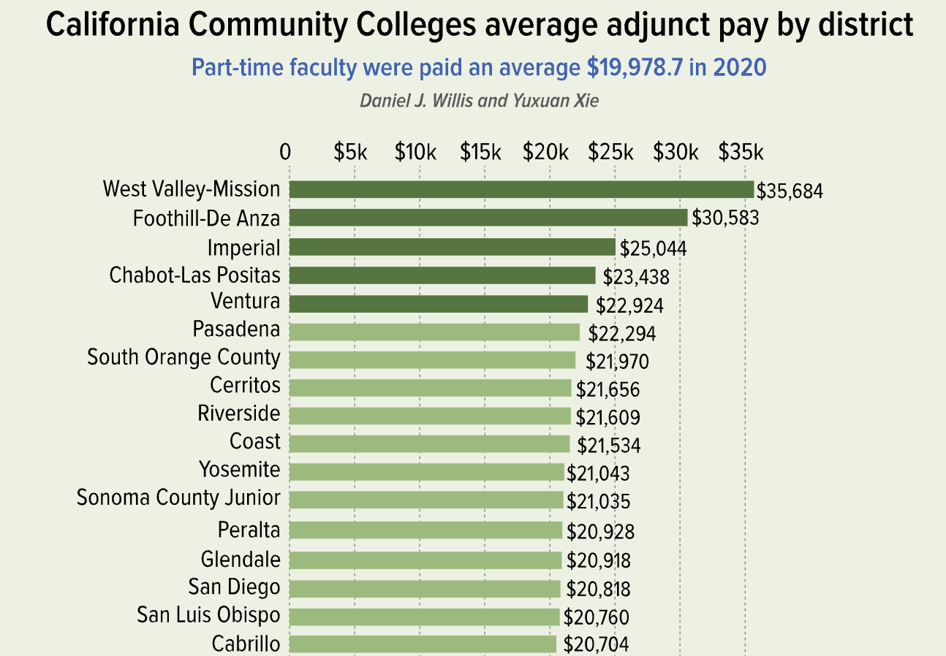
Current CCC Income Disparity

Slide 5
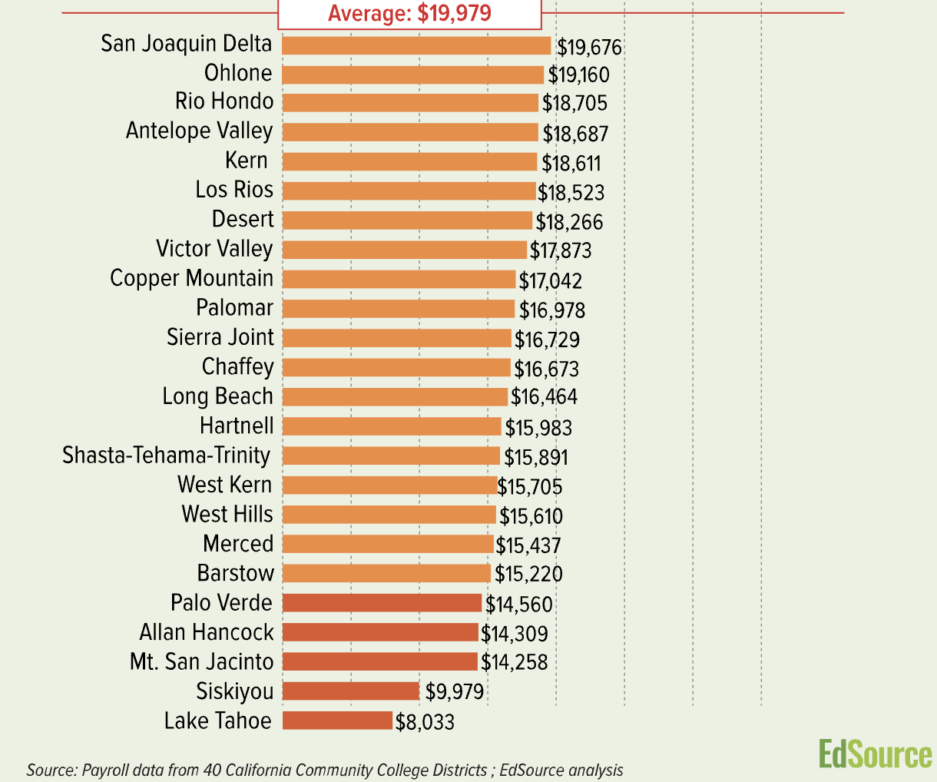
Current CCC Income Disparity

Slide 6
Current CCC Income Disparity

Slide 7
Question to ponder for breakout room.
Need for change:
How do we address this huge disparity?

Slide 8
Student & Adjunct Equity in CCC System
Student Equity Is a Clear Goal at the State Level
Vision for Success
Student Equity Plans
And Much More
Adjunct Equity . . . Not So Much
Let Districts Decide
“Long-standing precedent of neutrality”
“The best way to support part-time faculty is to advocate for additional budget investments in the context of local control”
Notes:
Vision for Success
CCCCO Student Equity
CCCCO on Adjunct Equity (EdSource Article)

Slide 9
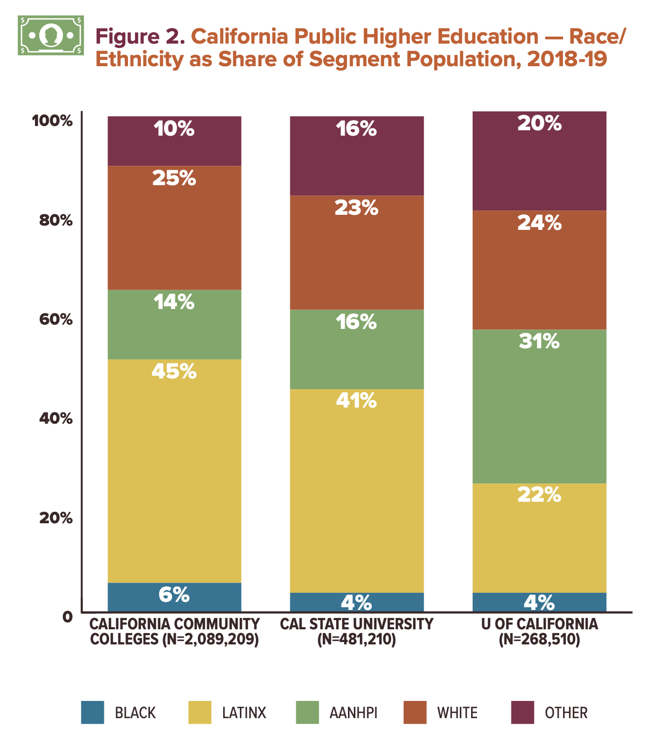
Notes:
Source

Slide 10
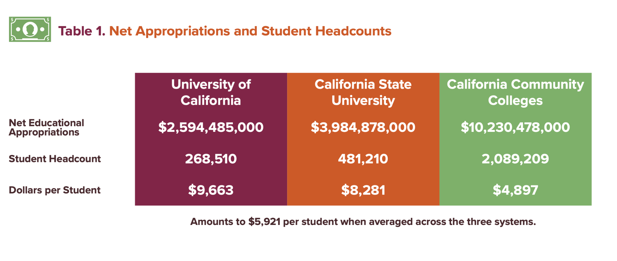
Notes:
Source

Slide 11
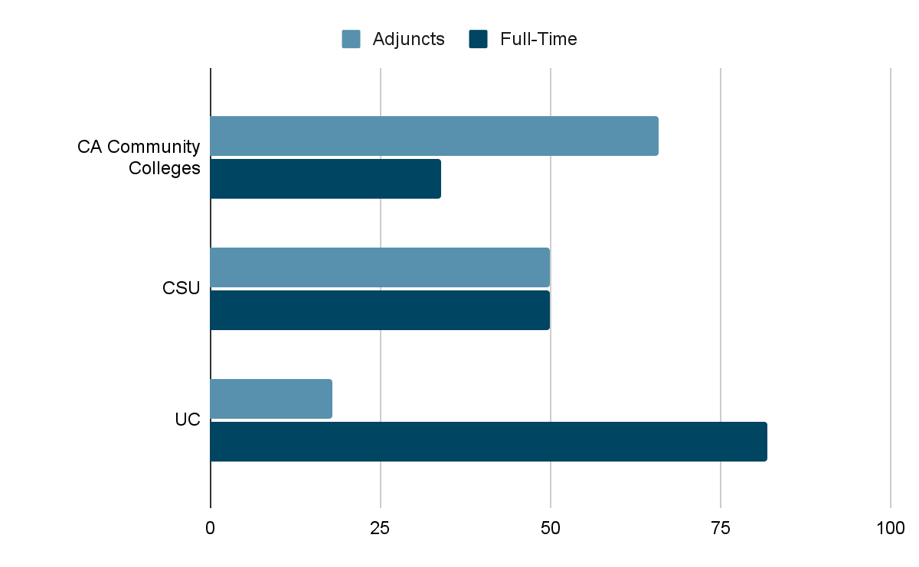
Reliance on Adjuncts in California Higher Ed
Notes:
“Nationally and in California, adjuncts make up the largest portion of the faculty at the community colleges: about two-thirds. Part-timers comprise 50% of the faculty at California State University and 18% at the University of California.”
Source (EdSource Article)

Slide 12
To Summarize…
CCCs teach students from relatively disadvantaged and marginalized groups
CCCs receive the least money per student
CCCs rely most on adjuncts
UCs teach students from relatively privileged groups
UCs receive most money per student
UCs rely least on adjuncts

Slide 13
Adjunctification Contributes to Racial Inequity
Less academic freedom
More institutional conservatism
Lack of professional development
Less faculty diversity
Worse student outcomes and experiences in many ways
Adjuncts more likely to teach gateway courses
Students less likely to enroll in subsequent classes
Adjuncts have less institutional knowledge
Notes:
https://www.insidehighered.com/advice/2022/04/01/colleges-must-support-adjuncts-order-support-students-opinion
https://ccrc.tc.columbia.edu/research-project/engaging-adjunct-faculty-in-the-student-success-movement.html
https://ccrc.tc.columbia.edu/publications/early-outcomes-students-part-time-faculty.html
https://ccrc.tc.columbia.edu/publications/how-and-why-do-adjunct-instructors-affect-students-academic-outcomes.html

Slide 14
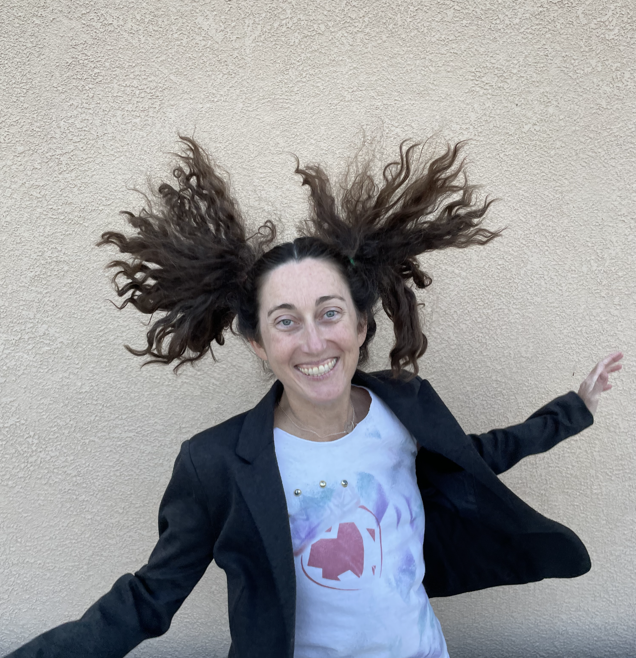
Bringing Change
Anastasia Zavodny
What’s worked
Best practices / How you can too!

Slide 15
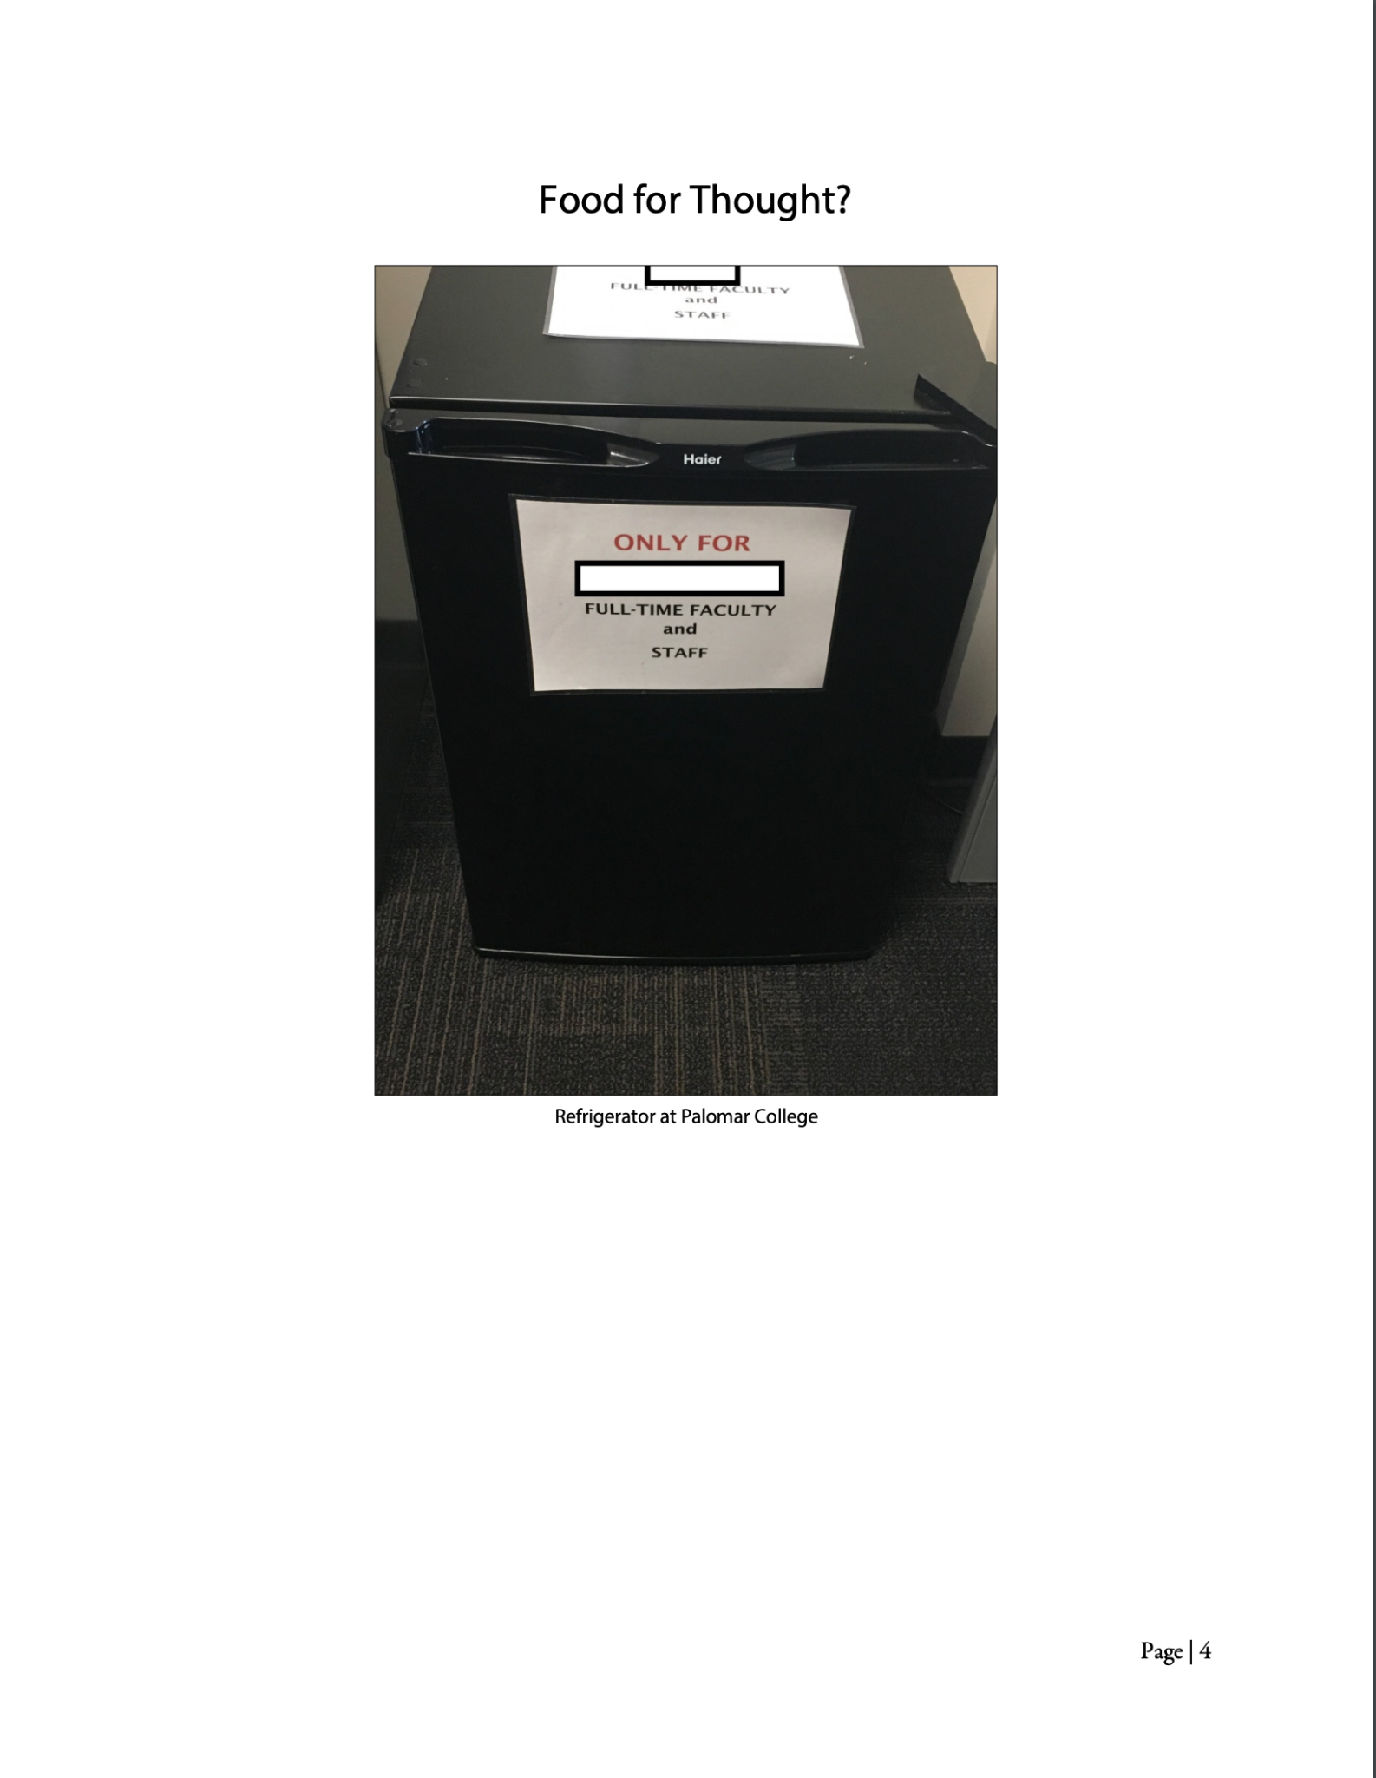
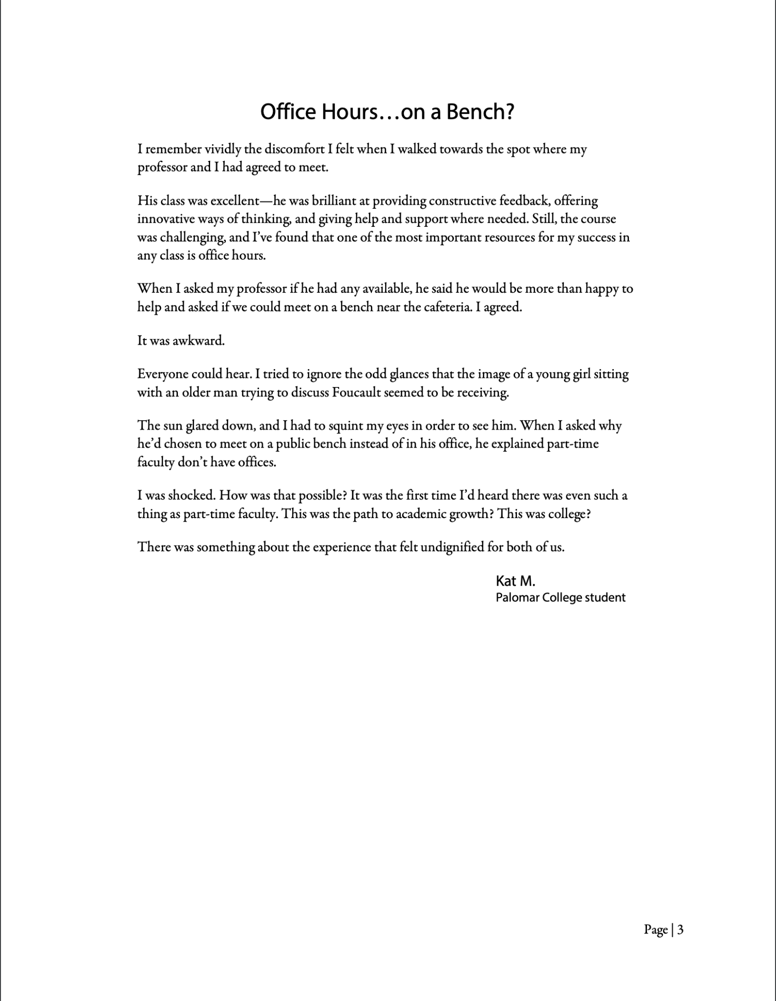
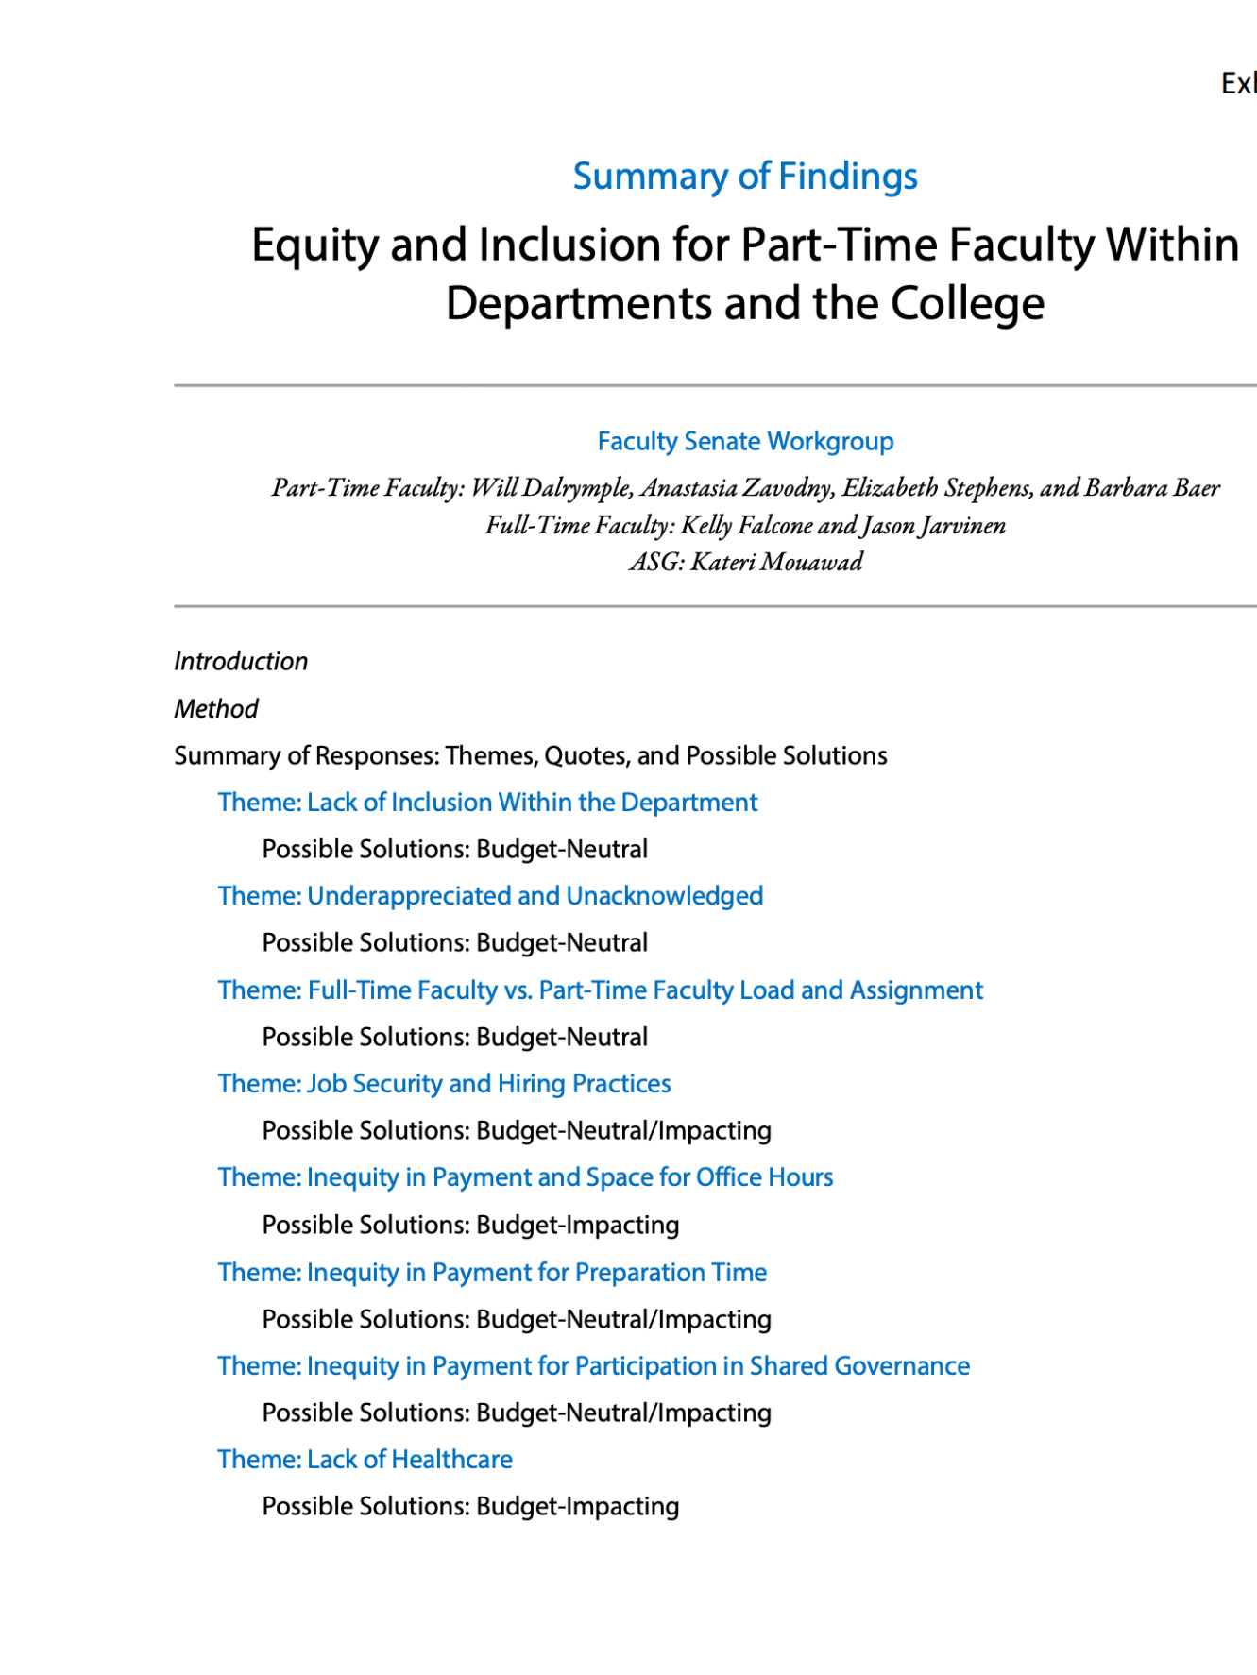
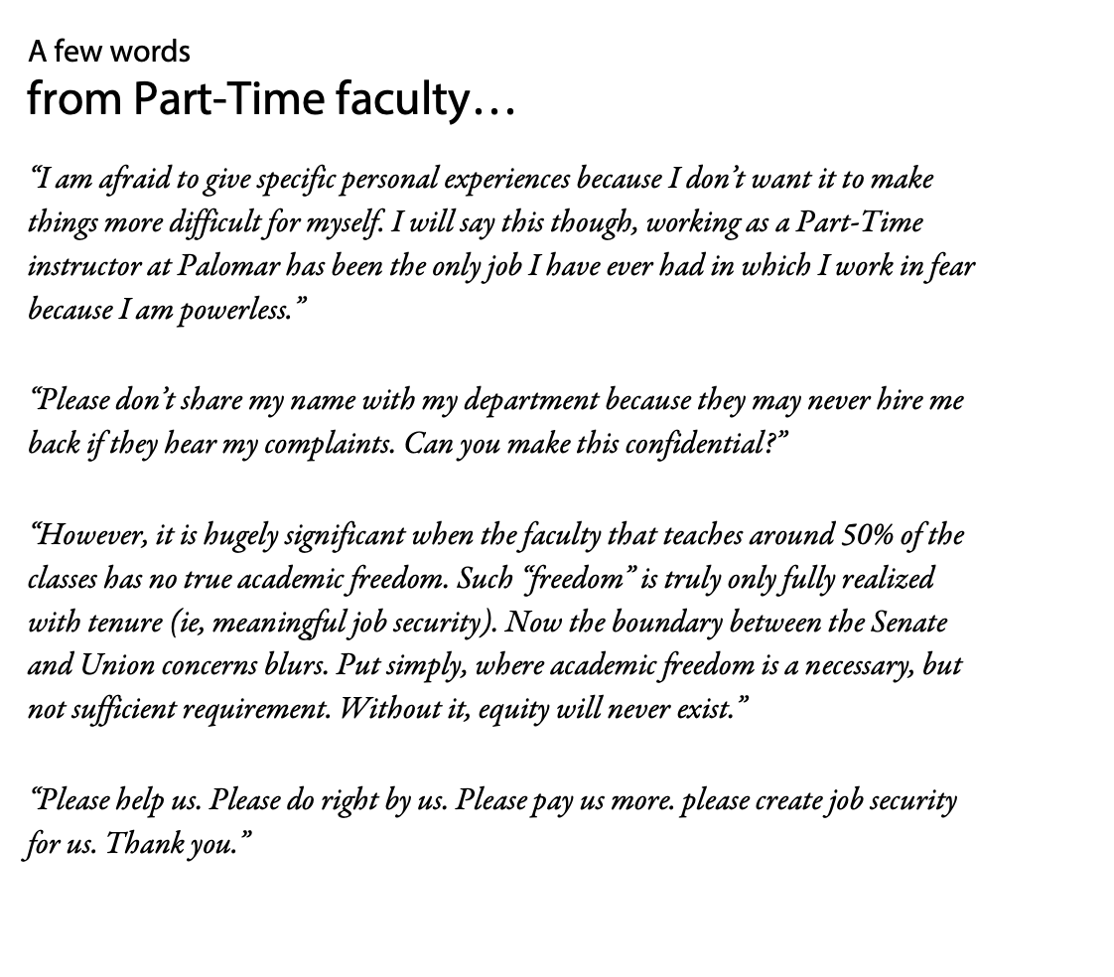
What’s Worked
Palomar College began an earnest focus on change Fall 2020
Survey sent to all Faculty
Summary of Findings report presented to local Faculty Senate
Faculty union additional survey sent to Faculty, with addendum report created
Groups created within both Senate and union to focus on Part-Time Faculty equity

Slide 16
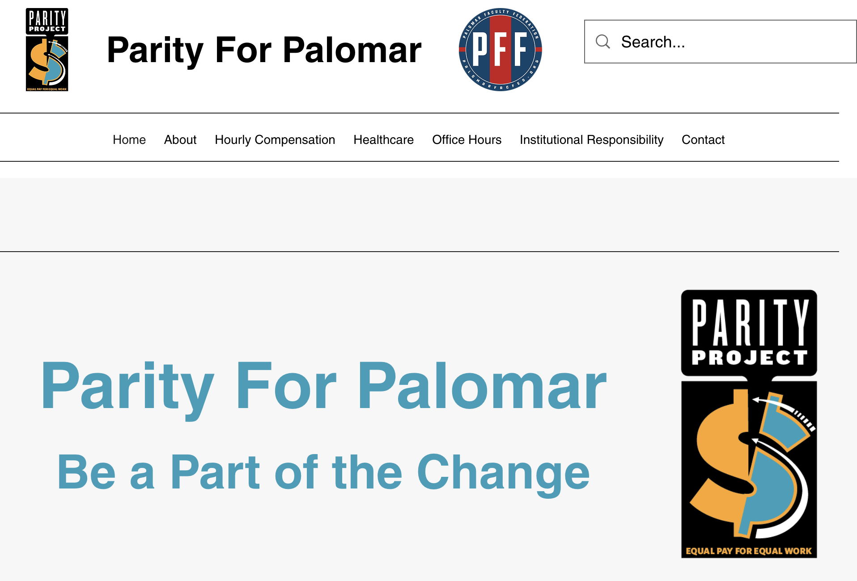
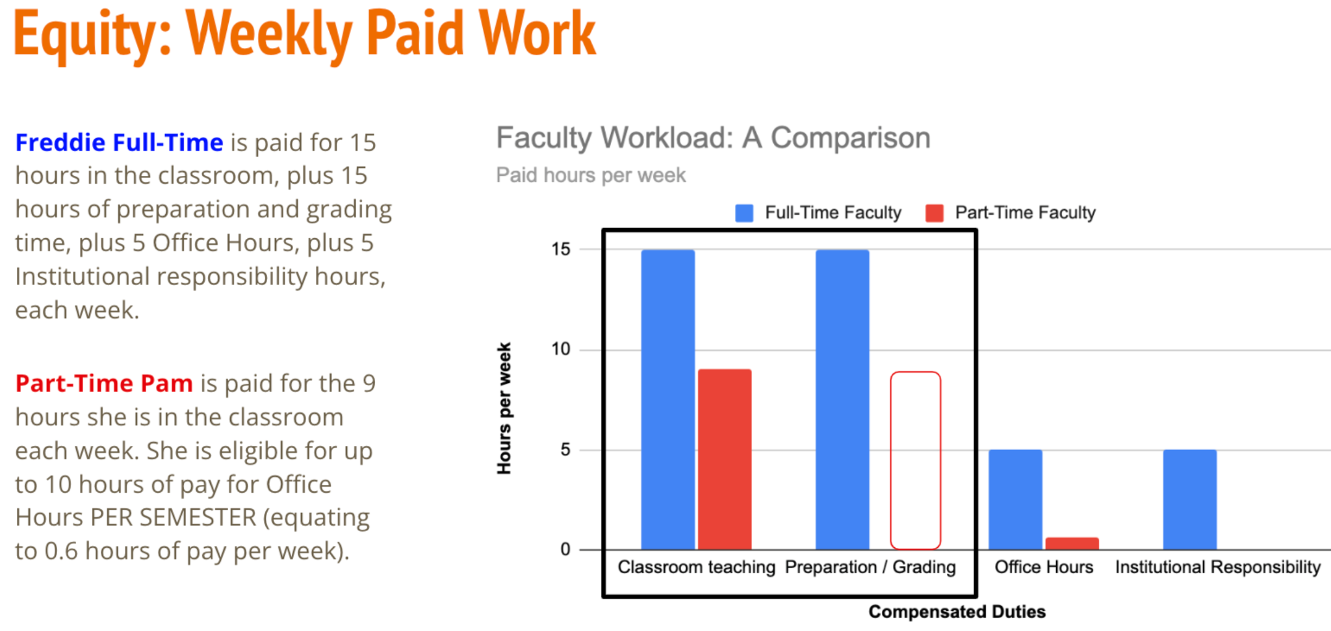
Palomar Accomplishments
Through both our Senate and union workgroups, we have so far accomplished:
Service pin recognition for Part-Time Faculty (same as Full-Time colleagues)
Removal of barriers to shared governance service
Increase in the number of compensated committees (from 10 to 13)
Increase in pay (from $15/hour to Faculty’s non-instructional rate)
ParityforPalomar website created
Presentations to Governing Board about equity
Videos created

Slide 17
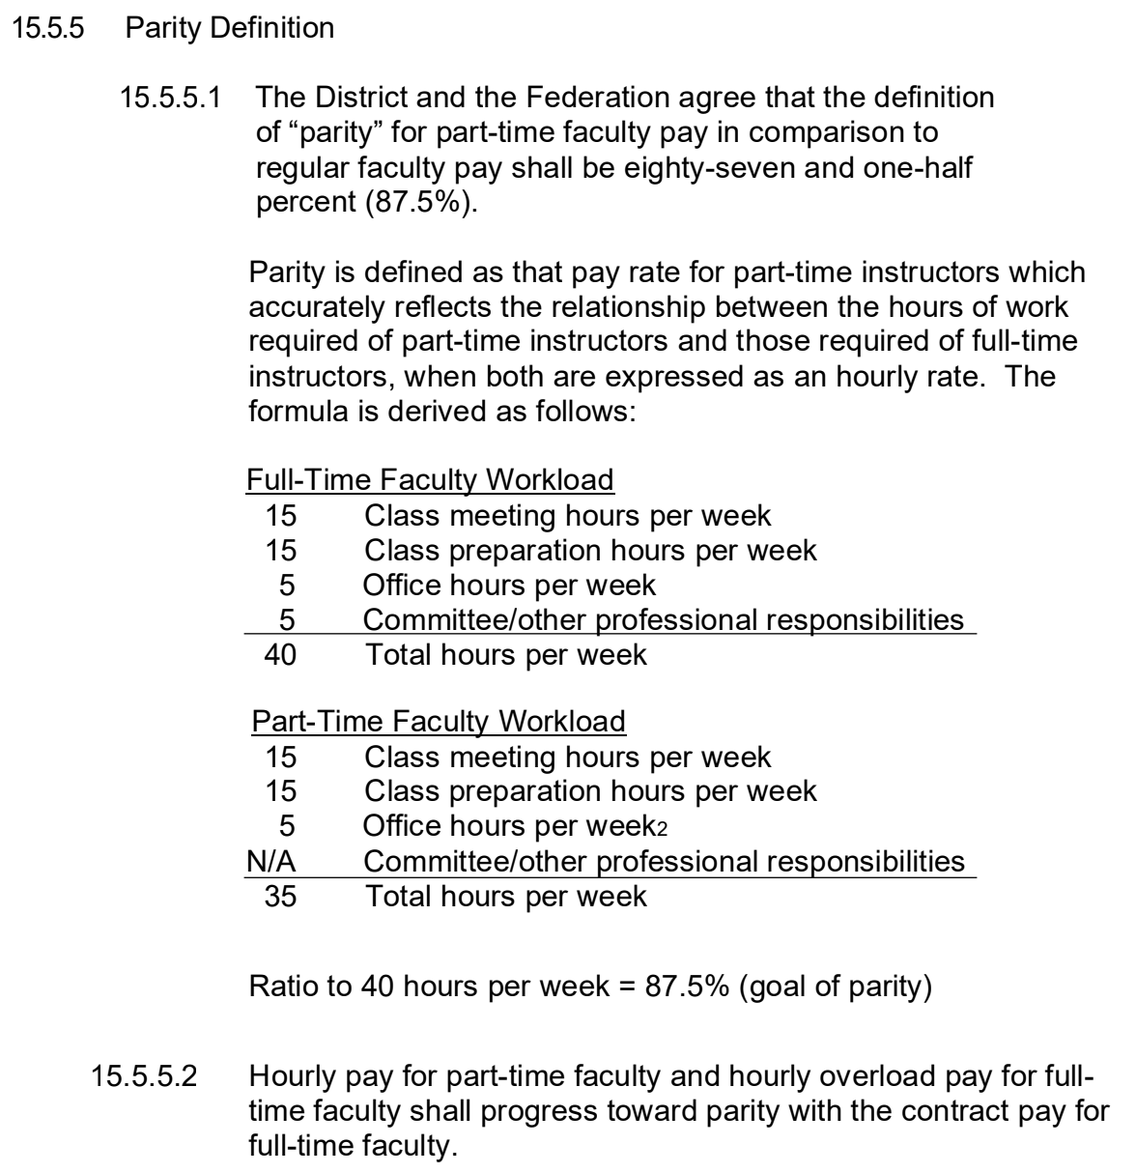
Palomar Accomplishments
Through both our Senate and union workgroups, we have so far accomplished:
Parity definition included in Contract
Increase in compensation “steps” (from 4 to 10)
Increase in Office Hours
Number of hours increased from set steps to flat 1.5 office hours per unit taught
Pay increased from flat fee of $55 to Faculty’s non-instructional rate
Healthcare!!!

Slide 18
Best Practices / How you can too!
How you can too:
Begin by understanding your local situation. Survey faculty, hold listening sessions.
Create workgroup(s) to guide discussions
Internally publish findings; select key areas of focus
Create deliberate plans of action and engage all stakeholders
Best practices:
Be transparent and accountable
Provide regular updates
Engage all stakeholders
Demonstrate harm of current situation and propose solutions
Know that change takes time!

Slide 19
Let’s Breakout and Chat!
While sharing with colleagues, please use our Padlet to keep track of your awesome ideas and questions!

Slide 20
Our Takeaways!
What are some of our key takeaways?
How can we use these to reach parity and equity for Part-Time Faculty?

