Slide 1
Equity and Anti-racism in Academic Freedom
April 25, 2020
Webinar
Notes:
R

Slide 2
Equity and Anti-Racism in Academic Freedom
Academic Freedom is essential to student-centered equity and anti-racism work in the California community colleges as identified in the California Community Colleges Chancellor’s Office Call to Action and the ASCCC Mission and Strategic Plan. The connection between academic freedom and equity is fundamental. Without the rights of faculty to speak, research, and pursue diverse ideas, equity is not possible. Academic freedom allows faculty to academically challenge racist ideology and structures in the context of their subject matter expertise.
Notes:
Robert

Slide 3
ACADEMIC FREEDOM:
What is it and why is it important to local academic senates?
Academic Freedom is required so that the faculty professionals who teach and research are protected from external forces that might try to influence the development of culture, science, and knowledge in order to serve any interest other than the intellectual, socioeconomic, and socioemotional advancement of students through the attainment of an education.
Notes:
R

Slide 4
AAUP and Academic Freedom
Academic freedom is related to the pursuit of knowledge without unnecessary restrictions.
The AAUP’s Statement on Professional Ethics contains the following that supports this idea:
Professors, guided by a deep conviction of the worth and dignity of the advancement of knowledge, recognize the special responsibilities placed upon them. Their primary responsibility to their subject is to seek and to state the truth as they see it.
As teachers, professors encourage the free pursuit of learning in their students. They hold before them the best scholarly and ethical standards of their discipline.
…professors seek above all to be effective teachers and scholars
http://www.aaup.org/AAUP/pubsres/policydocs/contents/statementonprofessionalethics.htm
Notes:
Robert

Slide 5
So What Does Academic Freedom
Really Mean?
Academic Freedom procedures related to academic freedom should address the following best practices from the AAUP:
Research and publication of the results
Classroom in discussing their subject
When they speak or write as citizens, they should be free from institutional censorship or discipline
Academic freedom is not absolute or equivalent to freedom of speech
Colleges have specific policies that define local academic freedom
Read your district Academic Freedom policy!
Notes:
W
Academic Freedom procedures related to academic freedom should address the following best practices from the American Association of University Professors:
Faculty are entitled to full freedom in research and in the publication of the results, subject to the adequate performance of their other academic duties; but research for pecuniary return should be based upon an understanding with the authorities of the institution.
Faculty are entitled to freedom in the classroom in discussing their subject, but they should be careful not to introduce into their teaching controversial matter which has no relation to the subject. Limitations of academic freedom because of religious or other aims of the institution should be clearly stated in writing at the time of appointment.
College and university faculty are citizens, members of a learned profession, and officers of an educational institution. When they speak or write as citizens, they should be free from institutional censorship or discipline, but their special position in the community imposes special obligations. As scholars and education officers, they should remember that the public may judge their profession and their institution by their utterances. Hence they should at all times be accurate, should exercise appropriate restraint, should show respect for the opinions of others, and should make every effort to indicate that they are not speaking for the institution.

Slide 6
The Relationship Between Academic Freedom, Theoretical Frameworks, and Disciplines
Academic Freedom allows faculty to introduce course content through theoretical frameworks that offer diverse or new perspectives on the content
Faculty within traditional disciplines have used Academic Freedom to both evolve and challenge the theoretical frameworks and bodies of knowledge related to their disciplines
For faculty of color and faculty committed to decolonization this meant challenging the eurocentric foundations of their academia in general and of their disciplines specifically
These challenges have led to a re-imagining of the role and structure of disciplines and to the establishment of disciplines such as Cultural Studies, the Ethnic Studies disciplines, Women and Gender Studies
Notes:
Manuel

Slide 7
Importance of Academic Freedom in the
advancement of Equity and Anti-Racism
The Connection between academic freedom and equity is fundamental.
Without the rights of faculty to speak, research and pursue diverse ideas, equity is not possible.
Academic Freedoms allow faculty to academically challenge racist ideologies and structures in the context of their expertise
Academic Freedom allows students to be introduced to a diverse range of ideas that often contrast and compete with each other within an academic framework and invites them to participate in a rigorous analysis, the development of a independent critical judgement
Allows faculty members the freedom to shape their courses in a way that allows for their subjects to be viewed, analyzed from different and specific lenses, particularly when the contrast with more traditional established theories
Notes:
M

Slide 8
Things Academic Freedom Allows
Academic freedom typically allows faculty to do the following:
Present the course content (per the Course Outline of Record) in the way they deem most appropriate
Determine the assignments, readings, assessments, and exams that will work best for their class.
To create a classroom environment where controversial topics can be discussed without being censored as long as the topic relates to the course and with recognition of students’ right to first amendment (freedom of speech)
Notes:
Stephanie

Slide 9
Limitations on Academic Freedom
Limitations on Academic Freedom
Right of professor to determine content of courses – as specified by Course Outline of Record, departmental and/or curriculum committee decision
Teachers are allowed to compel speech from students as long as doing so was “reasonably related to pedagogical concerns”
Not absolute to the point of compromising a student’s right to learn in a hostile-free environment
https://www.aaup.org/our-work/protecting-academic-freedom/academic-freedom-and-first-amendment-2007
Notes:
Stephanie

Slide 10
Academic Freedom is not Freedom of Speech
Freedom of Speech
1st amendment right for faculty AND students
Restricts the right of a public institution, including a public college or university, to regulate expression
Instructors are not to required to provide class time for students to voice views that contradict the material being taught however, instructors are required to allow students to express opposing views and values to some extent where the instructor invites expression of students’ personal opinions and ideas
In the classroom, speech must be germane to the subject matter and advances an academic message (stick to your subject)
Private institutions first amendment protections are often limited and do not have the same protections as public institutions
Email on district server, electronic communications, and faculty pages are not necessary protected under “free speech”
https://www.aaup.org/our-work/protecting-academic-freedom/academic-freedom-and-first-amendment-2007
Notes:
Stephanie

Slide 11
Equity, Curriculum and Academic Freedom
Role of the COR
Instructors must teach to the COR
Use of Academic Freedom to develop COR
Equity in the COR.
Resolution 9.01 Fall 2021
Resolved, That the Academic Senate for California Community Colleges work with the California Community Colleges Chancellor’s Office to revise California Code of Regulations Title 5 including section 55002 titled “Standards and Criteria for Courses” to include a component of culturally responsive curriculum, equity mindedness and anti-racism integrated into the COR that allows for local control on how that requirement is fulfilled;
Role of the Curriculum Committee
Review local Academic Freedom Policy
Provide/Support Academic Freedom Professional Devleopment
Support open conversations about equity and academic freedom.
Notes:
Stephanie

Slide 12
ACADEMIC FREEDOM:
Protecting Academic Freedom and Tenure
Tenure is the primary safeguard of academic freedom.
However, “approximately 70% of faculty within the system and do not have the protections of tenure status...This weakening of tenure adversely affects the protection and benefits of academic freedom, including participation in governance, for all faculty. “
(Protecting the Future of Academic Freedom, 19)
Notes:
Wendy

Slide 13
ACADEMIC FREEDOM:
Academic Freedom and Evaluations
Although colleges have academic freedom policies and some unions have negotiated language into the contract, it may not be enough as faculty face direct threats to academic freedom.
For part time faculty
Threats of job loss if violations of academic freedom are called out or grieved.
No or minimal compensation for shared governance.
Burden of governance falls to full time faculty
Notes:
Wendy

Slide 14
ACADEMIC FREEDOM:
Protecting Academic Freedom and Tenure
The demographic changes on our campuses have introduced diverse concepts and ideas into an academic environment that has and continues to be dominated by patriarchal euro-centric paradigms.
Does our evaluation process embrace these diverse ideas and concepts or does it perpetuate “traditional” academic paradigms?
Do we (perhaps unintentionally) constrain our colleagues through the evaluation process?
Notes:
Wendy

Slide 15
DEIA Competencies and Criteria
Why? Define the skills, knowledge, and behaviors that CCC employees must demonstrate to work, teach, and lead in a diverse environment that celebrates and is inclusive of diversity
Intended to be developmental in nature so that employees can demonstrate their growth in skills, knowledge, and behaviors
Measuring competencies is a more valid evaluation of performance than measurement of innate abilities
Competencies and criteria developed by statewide representatives on the DEIA Implementation Workgroup are available. Dialog to determine local DEIA competencies & criteria is encouraged
Notes:
Cheryl

Slide 16
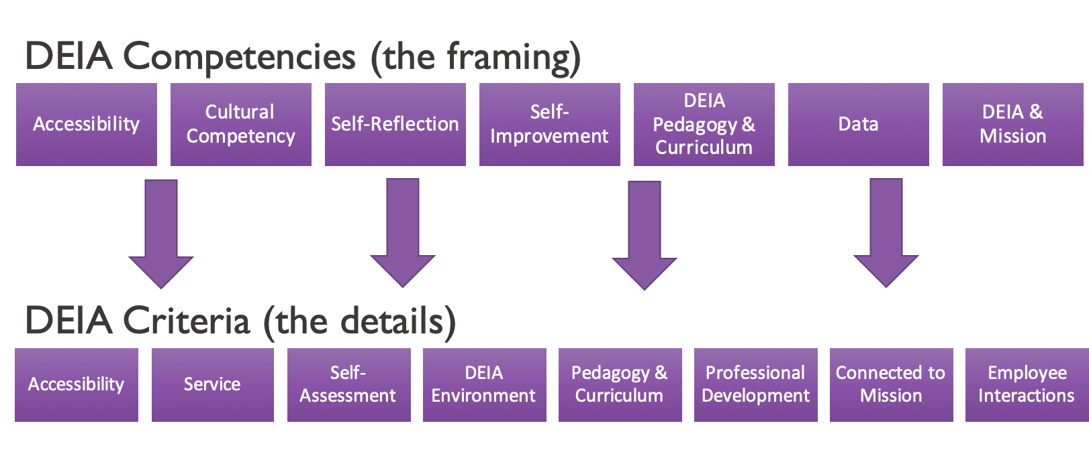
DEIA Competencies and Criteria
Notes:
Cheryl

Slide 17
DEIA, Evaluations, and Academic Freedom
Pending Regulatory Action Info
Proposed regulations
Include growth-oriented requirements for DEIA in evaluations and tenure review using DEIA competencies and criteria
Dependent on provision of ongoing professional development opportunities for all personnel
Dependent on local negotiation
Process
Introduced at March 21, 2022 Board of Governors Meeting
45-day comment period: March 11-April 25 @ 4:00PM
Likely to undergo revision before May Board of Governors Meeting
Academic Freedom
Knowing how equity & academic freedom intersect is important for members of evaluation committees
Notes:
Cheryl
CO Regulatory Action Info
https://www.cccco.edu/About-Us/Chancellors-Office/Divisions/General-Counsel/Pending-Regulatory-Action

Slide 18
Academic Freedom Paper
Protecting the Future of Academic Freedom During at Time of Significant Change (2020)
Introduction
Academic Freedom Defined
California Community College Changing Demographics
Academic Freedom and Free Speech
Academic Freedom and Marginalized Communities
Freedom of Research and Publication
Freedom in the Classroom
Freedom for Public Discussion
Academic freedom, tenure, and shared governance for full and part time faculty
Academic Freedom and Tenure
Notes:
Stephanie

Slide 19
Academic Freedom Paper
Protecting the Future of Academic Freedom During at Time of Significant Change (2020)
Recommendations
Recommendations for local senates:
Recommendations for local senates in collaboration with union colleagues:
Academic Freedom Resources
Appendices
Appendix 1: 1940 Statement of Principles on Academic Freedom and Tenure with 1970 Interpretive Comments
Appendix 2: Academic Freedom Contract Language
Appendix 3: Executive Summary of ASCCC Academic Freedom Survey Results
Appendix 4: College of the Canyons Joint Understanding Between Senate and Union
Notes:
Stephanie

Slide 20
ACADEMIC FREEDOM:
Comments and Questions
Notes:
Robert

Slide 21
ACADEMIC FREEDOM:
Resources
Protecting the Future of Academic Freedom During at Time of Significant Change (2020)-- ASCCC Paper
Academic Freedom and Equity- Rostrum Article, November 2020
AAUP 1940 Statement of Principles on Academic Freedom and Tenure
https://www.aaup.org/report/1940-statement-principles-academic-freedom-and-tenure
AAUP Academic Unionism Statement
https://www.aaup.org/academic-unionism-statement
Assembly Bill 1725 Vasconcellos (1988)
https://www.asccc.org/sites/default/files/1988%20AB%201725%20Community%20College%20Reform%20Act%20%28Vasconcellos%29.pdf
AAUP Red Book – Policy Documents and Reports, American Association of University Professors, 2015
https://www.aaup.org/reports-publications/publications/redbook
https://www.asccc.org/events/april-25-2022-200pm/equity-and-anti-racism-academic-freedom
Notes:
Robert

Slide 22
ACADEMIC FREEDOM:
Resources
Academic Freedom in the 21st-Century College and University: Academic Freedom for All Faculty and Instructional Staff
https://www.aft.org/sites/default/files/academicfreedomstatement0907.pdf
AAUP Statement on Academic Government for Institutions Engaged in Collective Bargaining https://www.aaup.org/report/statement-academic-government-institutions-engaged-collective-bargaining
Messier, John “Shared Governance and Academic Freedom: Yes, This Is Union Work” 2017, NEA
https://www.nea.org/assets/docs/TA2017S_Messier.pdf
Reichman, Henry “Professionalism and Unionism: Academic Freedom, Collective Bargaining, and the American Association of University Professors” AAUP Journal of Academic Freedom, 2015
https://www.aaup.org/sites/default/files/Reichman_0.pdf
Reichman, Henry, The Future of Academic Freedom, John Hopkins University Press, 2019
Notes:
Robert

Slide 23
ACADEMIC FREEDOM:
Presenter Contact Information
Cheryl Aschenbach, ASCCC Secretary caschenbach@lassencollege.edu
Wendy Brill-Wynkoop wendy.brill@canyons.edu
Stephanie Curry, ASCCC Area A Representative
stephanie.curry@reedleycollege.edu
Robert L. Stewart, Jr., ASCCC Area C Representative
stewarrl@lasc.edu
Manuel Vélez, ASCCC South Representative
mvelez@sdccd.edu
Notes:
Robert

