Slide 1
Evaluating Asccc mission and values
Anna Bruzzese, ASCCC South Representative
Rebecca Eikey, ASCCC Area C Representative
Kim Perigo, Standards & Practices Committee, San Diego Mesa College
FIRST BREAKOUT SESSION
2018 ASCCC Fall Plenary
Irvine Marriott Hotel in Irvine, CA
Notes:
All - introductions

Slide 2
Why we exist
What we want to create
What we believe
Notes:
Kim

Slide 3
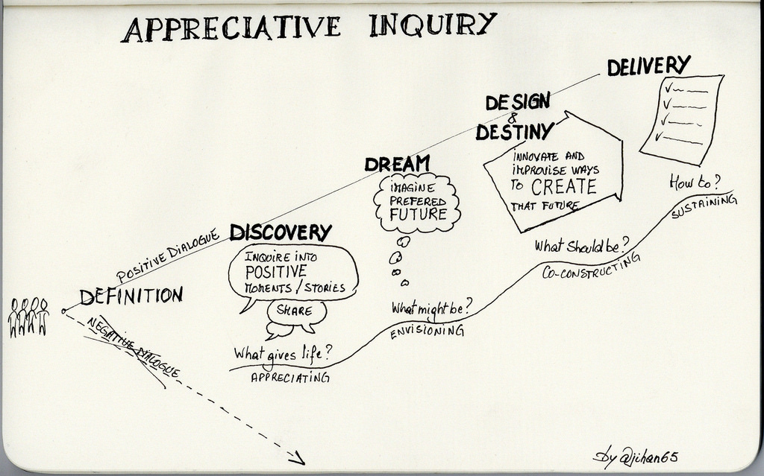
Notes:
Anna
Having an open mind
Identifying areas of success and building upon that

Slide 4
Design Thinking
“Abductive” thinking:
“Thinking in new and different perspectives and about future possibilities, which do not fit into existing models….in which feelings and emotions are just as important as rationality.”
Ask “How Might We?” Questions”
Have Empathy
There are No ‘Bad’ Ideas
Visual and 3D Representations
Collaboration
Notes:
Rebecca
Reference Paper: Design Thinking as an effective Toolkit for Innovation by Katja Tschimmel, Proceedings of the XXIII ISPIM Conference: Action for Innovation: Innovating from Experience. Barcelona. ISBN 978-952-265-243-0
Short explanation

Slide 5
Current Mission Statement is over 10-years old.
What changes have happened in our system since then?
What significant changes have happened in just the last academic year?
What has remained the same?
What opportunities should we be looking towards?
Notes:
Kim
Or rhetorical - One big group discussion

Slide 6
Partner Interviews
Gaining Empathy (Part 1)
First think about your own journey to senate leadership, then interview a partner:
What has brought you to senate leadership?
What resources did/do you need?
Who do you work with?
Digging Deeper (Part 2)
Try to dig for stories, feelings and emotion.
What do you value as a leader?
Ask ‘Why?’ often.
1 Interview | 2 Dig Deeper
8 min (2 sessions x 4 min each) | 8 min (2 sessions x 4 minutes each)
Notes from your first interview | Notes from your second interview
Switch roles & repeat interview | Switch roles and & repeat interview
Empathize
Notes:
Anna
Partner A will interview Partner B for 4 minutes and then switch
Series of activities using design thinking to get to Values.
Values are the beliefs of an individual or group, and in this case the organization, in which they are emotionally invested.
What do we value?

Slide 7
Reframe & Define
Capture Findings
Try to synthesize your learning into a few ‘needs’ you discovered, and few ‘insights’ you find interesting.
Needs should be verbs.
Insights are discoveries.
3 Capture Findings
3 min
Needs –what are they trying to accomplish* *use verbs Insights –new learnings about your partner’s feelings/view to leverage in your creation* *make inferences from what you heard
Define
Notes:
Rebecca
3. Capture Findings – do this individually and then as one big group – to determine the needs & insights
Have one of us write down Needs and Insights on large poster paper – we can see if there are repeated needs/insights and indicate that with checks or underlines on the poster paper.

Slide 8
What does the Future look like?
4 What’s does the future look like?
3 min
_______________________________________________________________ Name needs a way to _________________________________________________________________. his/her/their need Unexpectedly, in his/her/their world, _________________________________________________________________ Insight
Take a stand with a point-of-view
How do we leave the organization better than we received it?
How do we move the faculty voice forward?
Make actionable.
Define
Notes:
Kim
4. What’s the future look like? – do this as small groups of 4-5 people

Slide 9
Ideate – Generate Alternatives
Sketch to Ideate
Go for volume! This is idea generation. Not evaluation.
You don’t have to draw well. Stick figures and squiggly lines are okay! ☺
5 Sketch 3-5 radical ways to meet the future direction
5 min
______________________________________________ write what your future looks like above, then sketch it below
Ideate
Notes:
Kim
do this as small groups 4-5 people

Slide 10
Create
Take what you have done in your groups and create guiding principles that lead to a mission statement.
Build it or write it!
Share out.
Prototype
Notes:
Rebecca
The Starbucks mission statement describes six guiding principles that, as you can see, also communicate the organization’s values:
Provide a great work environment and treat each other with respect and dignity.
Embrace diversity as an essential component in the way we do business.
Apply the highest standards of excellence to the purchasing, roasting and fresh delivery of our coffee.
Develop enthusiastically satisfied customers all of the time.
Contribute positively to our communities and our environment.
Recognize that profitability is essential to our future success (Starbucks, 2008).
Similarly, Toyota declares its global corporate principles to be:
Honor the language and spirit of the law of every nation and undertake open and fair corporate activities to be a good corporate citizen of the world.
Respect the culture and customs of every nation and contribute to economic and social development through corporate activities in the communities.
Dedicate ourselves to providing clean and safe products and to enhancing the quality of life everywhere through all our activities.
Create and develop advanced technologies and provide outstanding products and services that fulfill the needs of customers worldwide.
Foster a corporate culture that enhances individual creativity and teamwork value, while honoring mutual trust and respect between labor and management.
Pursue growth in harmony with the global community through innovative management.
Work with business partners in research and creation to achieve stable, long-term growth and mutual benefits, while keeping ourselves open to new partnerships (Toyota, 2008).

Slide 11
ASCCC Mission Statement
The Academic Senate for California Community Colleges fosters the effective participation by community college faculty in all statewide and local academic and professional matters; develops, promotes, and acts upon policies responding to statewide concerns; and serves as the official voice of the faculty of California Community Colleges in academic and professional matters. The Academic Senate strengthens and supports the local senates of all California community colleges.
Adopted 1.03 S05
What are your impressions after reading the mission statement?
How does it compare to your creation?
Notes:
Anna

Slide 12
A mission statement is a concise explanation of the organization's reason for existence. It describes the organization's purpose and its overall intention. The mission statement supports the vision and serves to communicate purpose and direction to employees, customers, vendors and other stakeholders. It tends to be longer than vision statement.
Strategies should achieve the vision and satisfy the organization’s mission.
Goals & Objectives should be measureable and monitored.
Values
Mission Statement
Vision
Strategic Goals
Goals & Objectives
Values are the beliefs of an individual or group, and in this case the organization, in which they are emotionally invested. Can be in statement form to reaffirm mission/vision or make more clear.
The vision statement is a narrower, future-oriented declaration of the organization's purpose and aspirations. Based on “that purpose,” this is “what we want to become.” Strategy should flow from vision.
Notes:
Kim
https://open.lib.umn.edu/principlesmanagement/chapter/4-3-the-roles-of-mission-vision-and-values/

Slide 13
Strategic Planning
Notes:
Anna

Slide 14
Questions?
Anna Bruzzese – bruzzeaa@piercecollege.edu
Rebecca Eikey – Rebecca.Eikey@canyons.edu
Kim Perigo – kperigo@sdccd.edu
Thank you!
Notes:
All

Slide 15
ASCCC Values Statement
LEADERSHIP
The Academic Senate champions the leadership role of faculty at their colleges and at the state level and fosters effective faculty participation in governance to effect change. The Academic Senate facilitates and supports the development of faculty leaders. The Senate is respectful and reflective in its work and relationships and expects accountability from its leaders. In all its activities, the Academic Senate adheres to the highest professional ethics and standards. The Senate models effective leadership and promotes the inclusion of leaders from various backgrounds and experiences in order to represent all faculty.
EMPOWERMENT
The Academic Senate empowers faculty through its publications, resources, activities, policies, and presentations. The Senate collaborates with other statewide organizations, and with administrators, trustees, students, and others, to develop and maintain effective relationships. The Senate believes that collaboration with others and faculty engagement improve professional decisions made locally and at the state level. The Academic Senate works to empower faculty from diverse backgrounds and experiences in order to promote inclusiveness and equity in all of their forms.
VOICE
The Academic Senate promotes faculty primacy in academic and professional matters as established in statute and regulation. The Senate is the official voice of the California community college faculty in statewide consultation and decision making and, through leadership and empowerment, endeavors to make each local senate the voice of the faculty in college and district consultation and decision making. The Senate values thoughtful discourse and deliberation that incorporates diverse perspectives as a means of reaching reasoned and beneficial results.
Notes:
Do we want to show this?

Slide 16
ASCCC Inclusivity Statement
The Academic Senate for California Community Colleges recognizes the benefits to students, faculty, and the community college system gained from the variety of personal experiences, values, and views of a diverse group of individuals with different backgrounds. This diversity includes but is not limited to race, ethnicity, sex, gender identity, sexual orientation, disability status, age, cultural background, veteran status, discipline or field, and experience. We also understand that the California Community College System itself is diverse in terms of the size, location, and student population of its colleges and districts, and we seek participation from faculty across the system. The Academic Senate respects and is committed to promoting equal opportunity and inclusion of diverse voices and opinions. We endeavor to have a diversity of talented faculty participate in Academic Senate activities and support local senates in recruiting and encouraging faculty with different backgrounds to serve on Academic Senate standing committees and task forces. In particular, the Academic Senate acknowledges the need to remove barriers to the recruitment and participation of talented faculty from historically excluded populations in society.
Approved June 1 - 2, 2012
Notes:
Not sure we need this, but put the language down just in case; is this a Values Statement?

Slide 17
2018-23 Strategic Plan Goals
Assert the faculty voice and leadership in local, state, and national policy conversations.
Engage and empower *diverse groups of faculty at all levels of state and local leadership.
Assert ASCCC leadership in all faculty professional development for the California Community College system regarding academic and professional matters.
Enhance engagement, communication, and partnerships with local senates, system partners, and other constituent groups.
Secure resources to sustain and support the mission and the work of the ASCCC.
Sustain, support, and expand the ASCCC course identification numbering system (C-ID).
*See ASCCC Inclusivity Statement for definition of “diverse groups”

Slide 18
ASCCC Strategic Plan Goals & Objectives
Resolution 1.03 S15 – adoption of the 2015-2018 ASCCC Strategic Plan
Resolution 1.01 S18 – adoption of the 2018-2023 ASCCC Strategic Plan
Whereas, Strategic planning is an important activity for any successful organization, as this activity provides clear direction and stability and ensures that the organization’s leadership is responsive to its members;
Whereas, The initial draft of the strategic plan for the Academic Senate for California Community Colleges (ASCCC) was created by the elected representatives of the ASCCC, the Executive Committee, with careful thought regarding the organization’s mission and purpose as well as consideration of the ASCCC Executive Committee members’ perceptions of the wishes of faculty statewide and with attention to the future health and growth of the ASCCC; and
Whereas, The current Strategic Plan of the ASCCC expires in 2018; Resolved, That the Academic Senate for California Community Colleges adopt the 2018-2023 ASCCC Strategic Plan.

Slide 19
Goal: Assert the faculty voice and leadership in local, state, and national policy conversations
Objectives:
Develop and strengthen strategic relationships between the Executive Committee and legislators, system partners, and organizations involved in statewide and national education policy.
Expand advocacy and leadership opportunities for faculty, senates, and the Executive Committee.
How will these be met? Strategies such as:
Establish and maintain relationships between ASCCC Executive Committee members and legislators and aides.
Annually develop a legislative agenda aligned with the goals of the ASCCC and actively pursue/sponsor bills of interest.
Maintain a current public relations campaign to promote the priorities of the ASCCC….and more.
Notes:
Not sure this is needed? Can we explain this with the overview?

