Slide 1
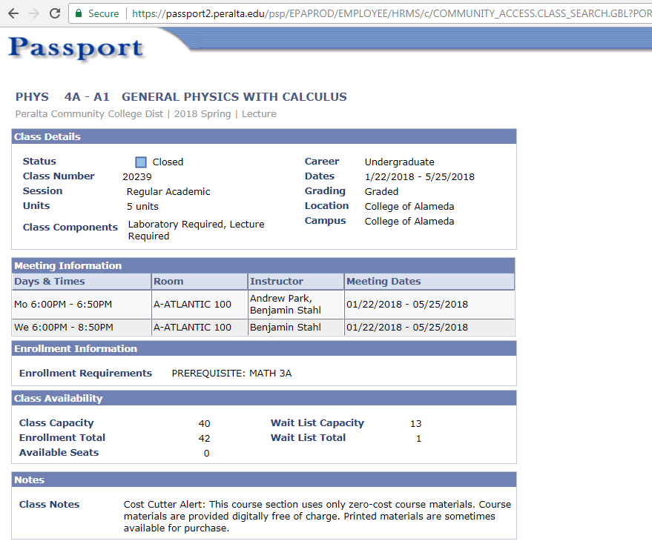
Course Schedule Work-Around
Insert a Class Note in Passport
Pros:
-explanatory language about OER
-faculty control
Cons:
-not searchable
-faculty must insert every semester

Slide 2
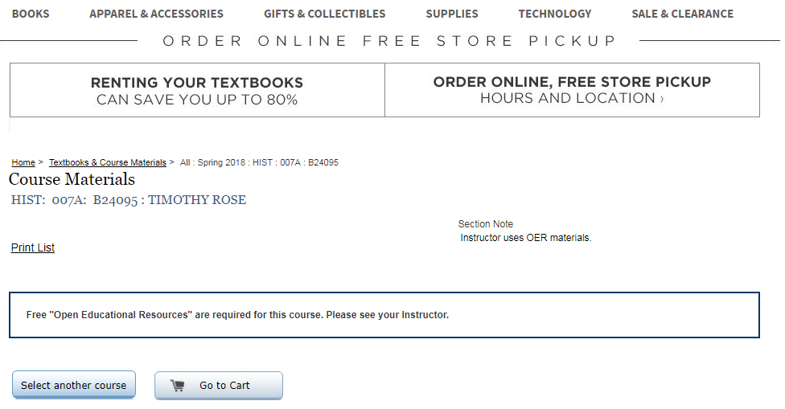
Bookstore Workaround
Instructors state they are using OER
Pros:
-bookstore collaboration
-faculty-driven
-possibility to link directly to materials/compare print prices
Cons:
-reliance on bookstore
-inconsistent and not searchable

Slide 3
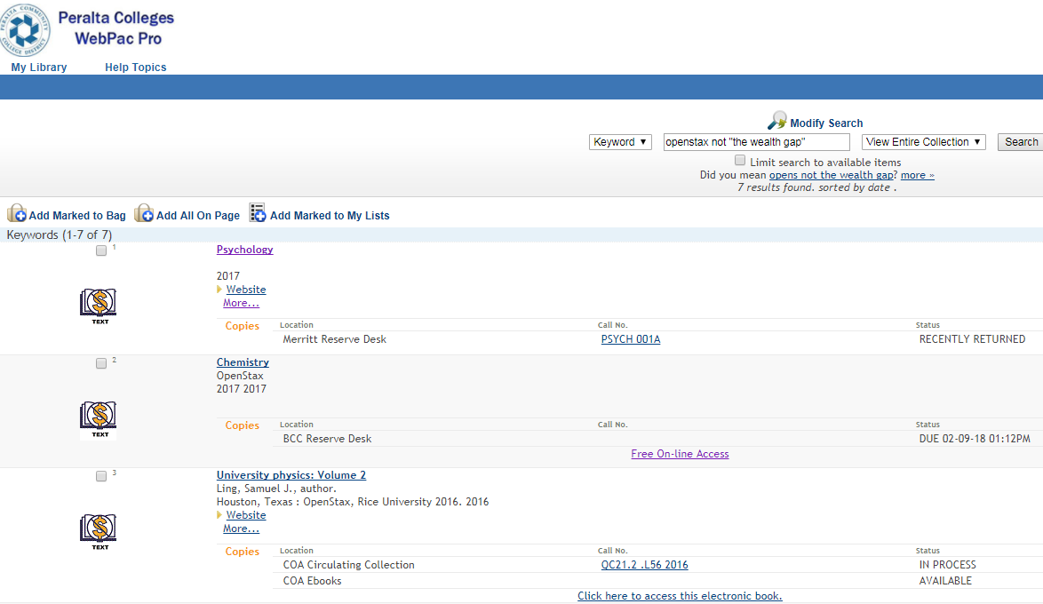
OPAC Workaround
Add catalog records to your OPAC
Pros:
-Librarians control
-use the logo
-links directly to the print and/or e-book
Cons:
-not compliant with SB 1359
-

