Slide 1
Friday, March 18 2:30 PM – 3:45 PM Breakout Session Block II Exemplary Program Winner 2015 – Bakersfield College MIH (Making it Happen) Program
Bakersfield College Addressing Equity by Making it Happen (MIH) and Guided Pathways Bakersfield College (BC) has been addressing Student Success, Equity and Student Support by transforming basic skills and carefully designing student pathways to address our 84% underprepared student population. BC began by addressing high school transition and placement through multiple measures, an intervention resulting in remarkable equity outcomes and course success. High School to College transition was recreated through onsite outreach to high school students and staff as well as extended summer orientation. BC equity and SSSP dollars scaled up supplemental instruction and the Writing Center with outstanding results addressing achievement gaps. But this transformation is complete only when the outcomes lead to clearly designed program pathways with completion coaches guiding the students along the way. This interactive breakout will provide an opportunity to examine your college’s ability to redesign placement, basic skills, program pathways and academic support services to help maximize student success.
OUTCOME: Attendees will be able to illustrate, using evidence from recent statewide studies and local Bakersfield College data, the importance and implications of multiple measures, designed pathways and student support for equitable student success.

Slide 2
Bakersfield College Addressing Equity by Making it Happen (MIH) and Guided Pathways
ASCCC Academic Academy 2016

Slide 3
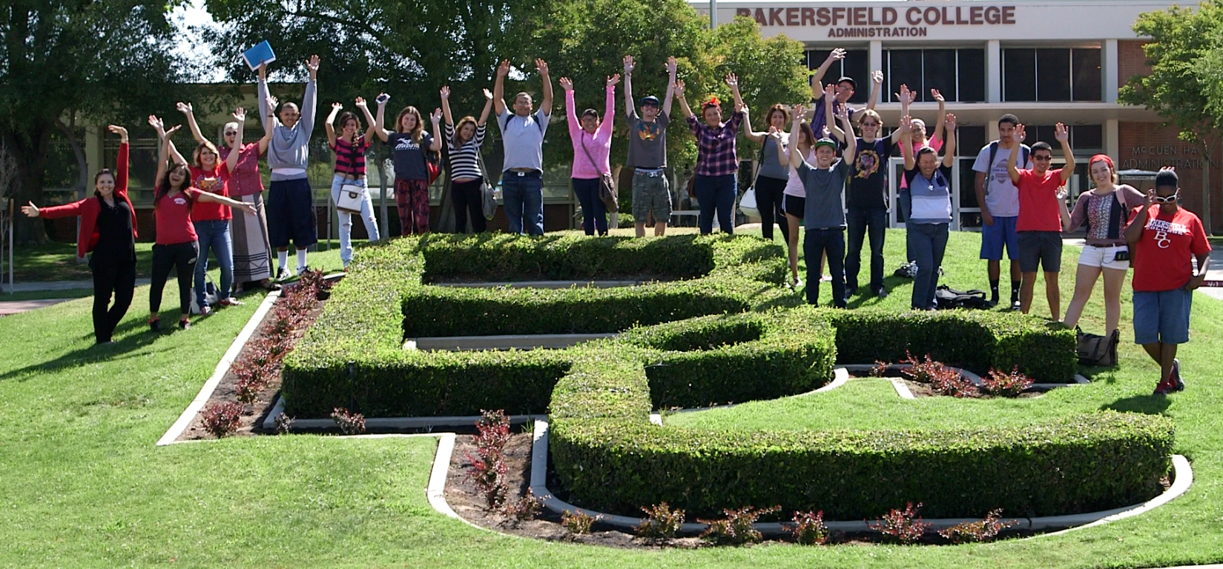
Goals
Improve access
Increase student engagement
Improve student progression
Decrease student time to completion
Notes:
Janet

Slide 4
Student Success at BC

Slide 5
Connection with High Schools
1. Assessment Testing at High schools (increased placement 9% in math and 3% in English college level)
2. Matriculation and Registration at high schools (42)
3. Retrieval of transcripts
4. Discussion of ERWC, AP and IB courses and placement
5. Development of better HS curriculum and college alignment

Slide 6
Match scores with variables
23%
28%
32%
43%
49%
55%
65%
70%
75%
Students Results | 30 Compass Score Very Low | 60 Compass Score | 90 Compass Score Very high
2.0 HS GPA
3.0 HS GPA
4.0 HS GPA

Slide 7
Multiple Measures: Why We Do It
 | Compass Score (30 extremely low to 90 extremely high)
High School GPA | 30 | 60 | 90
2.00 | 23% | 28% | 32%
3.00 | 43% | 49% | 55%
4.00 | 65% | 70% | 75%
Westrick & Allen, 2014: Conditional Success Rates (Table 6) http://bit.ly/ACTandGPA

Slide 8
BC Philosophy behind MMs and Assessment
Tests aren’t always the best measures
Tests alone are TERRIBLE measures
The goal is to predict success
More information provides better placement
We need to simplify the algorithm – junior year grades
Not perfect, iterative – don’t wait
Thousands of reasons to START NOW

Slide 9
Westrick & Allen, 2014: ACT COMPASS Validation Median Logistic R (Table 4) http://bit.ly/ACTandGPA
Multiple Measures: Improved Accuracy
Course | Compass Test | Compass | HSGPA | HSGPA + Compass
English 1 | Writing Skills | .31 | .57 | .62
Arithmetic | Pre-Algebra | .57 | .34 | .66
Algebra | Pre-Algebra | .36 | .65 | .80
Intermediate Algebra | Algebra | .47 | .66 | .84
College Algebra | Algebra | .41 | .76 | .88
College Algebra | College Algebra | .51 | .76 | .94
Notes:
HSGPA also more accurate at placing students and identifying students most in need of intervention (bottom 10% of distribution).
HSGPA better predictor of first year GPA, degree completion or transfer
Radunzel & Noble, 2012: http://www.act.org/research/researchers/reports/pdf/ACT_RR2012-5.pdf
ACCUPLACER scores did not add to the predictive power of the English models, though they did improve some math models, particularly sub-models predicting success in Pre-calculus and Calculus I at the community college.
Overall Predictive Strength, Median Logistic R
Course type Compass test
Predictor set
Compass HSGPA
Compass &
HSGPA
English Composition 1 Writing Skills 0.31 0.57 0.62
Speech/ Rhetoric Writing Skills 0.36 0.69 0.75
American History Reading 0.40 0.69 0.80
Other History Reading 0.47 0.67 0.81
Psychology Reading 0.47 0.63 0.77
Sociology Reading 0.54 0.60 0.77
Biology Reading 0.57 0.79 0.92
Arithmetic Skills Pre-Algebra 0.57 0.34 0.66
Elementary Algebra Pre-Algebra 0.36 0.65 0.80
Intermediate Algebra Algebra 0.47 0.66 0.84
College Algebra Algebra 0.41 0.76 0.88
College Algebra College Algebra 0.51 0.76 0.94

Slide 10
2012-2013 English Placement
Total Pathway Cost to Students
Combining
Multiple Measures
$1,677,552
$208,851
With Accelerated Classes creates a great cost savings and great opportunity for students
ACDV 201, ACDV 65,
ENGL 60, ENGL 50
HS GPA & ENGL Grades,
ENGL 53

Slide 16
Gateway English and Math

Slide 17
Lessons learned from High School partners and Multiple Measures
1. Good communication with High Schools – find a champion
2. Listen
3. Be honest but acknowledge your own data
4. Focus on the students – like us they have other targets required
5. High Schools want their students and community to be educated

Slide 18
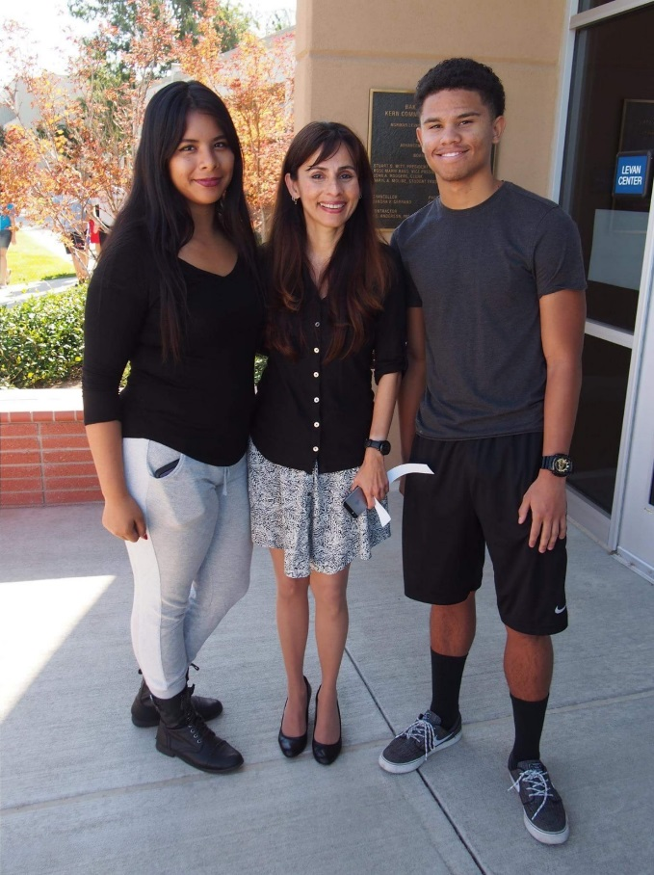
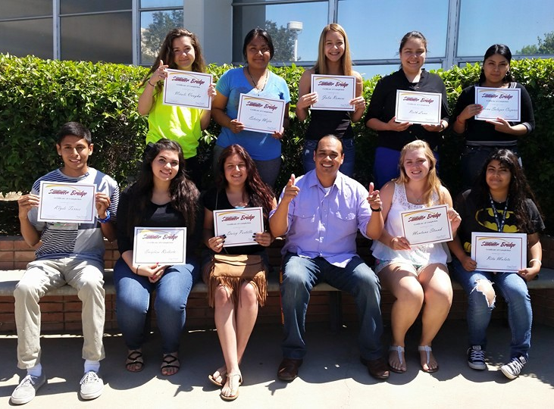
MIH Mentors
50 Mentors
5-10 Students/each
Faculty, Staff, and Administrators
Required Training: 20 Hours
Issues with communication
Issues with follow-thru
Moving to Peer Mentors
Moving to Pathways
Notes:
Kim, Carol, and Gloria Time here.

Slide 19
MIH Mentoring: Successes
Greater connection with students
Awareness of programs & activities (SI, tutoring Financial Aid)
Sense of BC Community
Reassurance (Being on the right track; Questions are addressed)
Insight to students’ “college knowledge”
Professional Development & fundamentals for Mentors
Recognition of SEP & other “college essentials”

Slide 21
Student Success at BC

Slide 22
Progression and Completion
1. Late Adopters - Accelerated and compressed curriculum in English, Math and Reading
2. Early Adopters - Multiple Measures (Developed using CAI MM workgroup suggestions, STEPs (LBCC), ASCCC Multiple Measures paper). These have morphed every year …..
3. Coordinated - Used the transcript review to place students into accelerated after bumping up
4. Early adopters - Pathways

Slide 24
Progress of First-time Students in Development
Mathematics at Bakersfield College
First Attempt Dev Math Skills
3,551 students attempted
65 % successful
Only 1,456 (41%) students attempted next level test
Lost 24%
First Attempt Arithmetic/Pre-Alg
8,566 students attempted
56 % successful
Only 3,784 (44%) students attempted next level test
Lost 12%
First Attempt Beginning Algebra
11,765 students attempted
43 % successful
Only 3,823 (32%) students attempted next level test
Lost 11%
First Attempt Intermediate Algebra
9,593 students attempted
48 % successful
Only 2,588(27%) students attempted next level test
Lost 21%

Slide 25
Course Acceleration & Compression Scaling up at BC

Slide 27
Saving Students Money and Time
In 2015, BC saved students
2111 semesters
through multiple measures and improved testing

Slide 28
Student Success at BC

Slide 29
Supplemental Instruction (SI) The Essential Elements
Targets Specific Courses, Not Students
Offers Peer-Facilitated Study Sessions
Combines Content & Study Skills
Peer Leader Attends Every Class
Peer Leader Receives Ongoing Training

Slide 30
Role of the SI Leader (Peer Leader)
Attends students’ class every lecture/lab meeting
participates in class & identifies student needs
acts as a model student
Facilitates voluntary study sessions for students outside of class time 2-3 hours/week
on a regular schedule
Promotes upcoming study sessions in class at start of each lecture
Establishes rapport and builds relationships with students
Shows students how to learn course content
Meets with instructor weekly (30 min.) to discuss how study sessions are progressing and exchange ideas on ways to assist students

Slide 31
Supplemental Instruction
Term | SI Leaders | Sections
Spring 2014 | 12 | 20
Summer 2014 | 5 | 9
Fall 2014 | 17 | 29
Spring 2015 | 26 | 43
Summer 2015 | 9 | 15
Fall 2015 | 60 | 102
Spring 2016 | 115 | 154
Fall 2015 SI Attendance | A | B | C | D | F | Total # Students | Avg GPA
0 | 22% | 25% | 25% | 11% | 16% | 847 | 2.28
1-2 times | 18 | 34 | 24 | 9 | 14 | 179 | 2.33
3-5 times | 24 | 35 | 24 | 9 | 8 | 101 | 2.55
6+ times | 35 | 29 | 26 | 7 | 2 | 215 | 2.87
SI Success Fall 2015 | Attendance: 0 | Attendance: 1-2 Times |  | Attendance: 3-5 times |  | Attendance: 6+
Successful | 72% | 77 |  | 83 |  | 91
Unsuccessful | 28% | 23 |  | 17 |  | 9

Slide 32
Goals
Improve access
Increase student engagement
Improve student progression
Decrease student time to completion
Notes:
Janet

