Slide 1
How Can Equity Be Considered in Course Outlines of Record (CORs)?

Slide 2
PRESENTERS:
Carrie Roberson, North Representative
John Stanskas, ASCCC Immediate Past President
Eric Wada, ASCCC C-ID Director
"The course outline of record (CoR) is a document with defined legal standing that plays a critical role in the curriculum of the California community colleges” and "has both internal and external influences that impact all aspects of its content.” So how do colleges reframe our lens around this critical aspect of course design as it relates to teaching strategies? This session is intended to provide and generate IDEAs around considerations for equity-driven Course Outlines of Record to meet the needs of diverse student populations.
Notes:
ALL

Slide 3
Core of the COR
2017 ASCCC's 2017 paper
The Course Outline of Record: A Curriculum Reference Guide Revisited:
"The course outline of record (COR) is a document with defined legal standing that plays a critical role in the curriculum of the California community colleges."
The COR "has both internal and external influences that impact all aspects of its content, from outcomes to teaching methodology, which, by extension, impact program development and program evaluation."
Notes:
Carrie It is by reviewing the course outline that the various instructors, both full- and part-time, may clearly identify the standards and content of the course they are to teach. In addition, the course outline plays a critical role in the on-going process of program review by which a college seeks to keep its curriculum relevant and to allocate its resources sufficiently to maintain its programs.
Although the outline is not intended to dictate instructional methods and materials, it should delineate an agreed upon set of learning objectives which are central to the course in that they (1) determine the desired student learning outcomes of the course and (2) establish a basis for evaluating and assessing student performance. The Course Outline of Record is used for all courses.

Slide 4
BASIC COR
Title 5 55002
Program and Course Approval Handbook (PCAH) 7th edition
ACCJC Standards
C-ID
Transfer institutions
CSU GE Articulation
UC Articulation
Notes:
Carrie

Slide 5
COR Connections
Vision for Success
Call to Action
Guided Pathways
Notes:
John-Equity gaps exist!

Slide 6
COR Considerations
Relation of what we teach is what students learn
Relevance to real life
Retention of students/faculty
Reasons for engagement students/faculty
Reality of impact
Notes:
John- If we want to improve faculty diversity, the curriculum we are required to teach needs to be relevant to “them”
discuss the impact the elements of the COR have on providing diversity and equity in the classroom, as we seek to provide rich, robust, and culturally-responsive curricula to meet the needs of our diverse student populations

Slide 7
Who is the COR for?
Discipline Faculty
Articulation Officers
Curriculum Committee
Local Board of Trustees
CCCCO
Accreditation/ACCJC
Industry Partners, employers, regional consortia, advisory boards
Transfer Institutions
STUDENTS!
…other?
Notes:
Eric- Student needs/ success

Slide 8
COR IDEAs & Strategies
C-ID and Equity
C-ID Overview
Faculty Discipline Review Groups (FDRGs) involve faculty from CCCs, CSUs, and where possible UCs.
5-year review surveys now ask for anti-racist and culturally-relevant curriculum in C-ID course descriptors and the Transfer Model Curriculum.
FDRGs will use surveys responses to see how descriptors can be rewritten to focus on anti-racist and culturally-relevant curriculum.
C-ID processes are being examined to improve inclusion in C-ID work.
Similar practices can occur locally in curriculum committees.
How are CORs reviewed locally?
Who reviews CORs?
Notes:
Eric

Slide 9
YOUR TURN…COR IDEAs
OBSTACLES and OPPORTUNITIES!
Notes:
Carrie

Slide 10
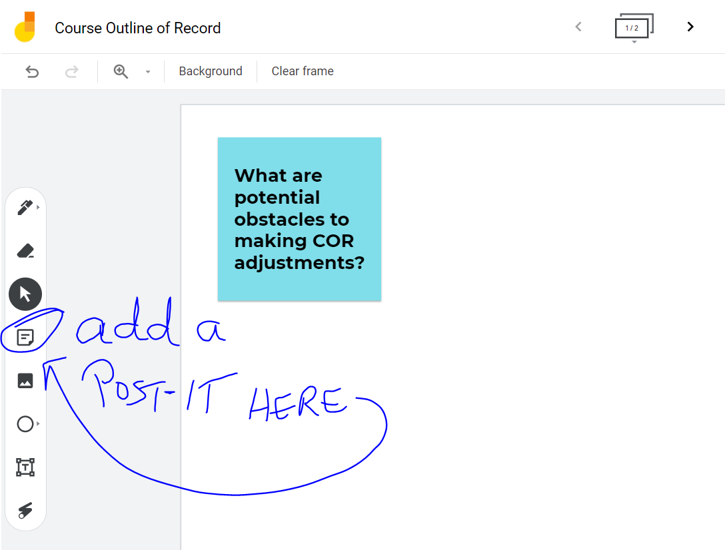
ACTIVITY
Google Jam Board
https://jamboard.google.com/d/1f6QO78tMLUnI6WdM1sWiXt-aY9UY9qBEQN7ZRRaQ_pE/edit?usp=sharing
Notes:
Carrie

Slide 11
QUESTIONS… and ANSWERS?
Notes:
ALL

Slide 12
RESOURCES
ASCCC
ASCCC Strategic Plan
The Course Outline of Record: A Curriculum Reference Guide Revisited
Culturally Responsive & Inclusive Curriculum Resources: Creating Culturally Responsive Curriculum
Program and Course Approval Handbook (PCAH)
Need more info?
CONTACT: info@asccc.org
Notes:
Add links

