Slide 1
Transforming from Eurocentric to Inclusive Curriculum-
A Theoretical Approach

Slide 2
PRESENTERS:
Adrienne Brown, Los Angeles Harbor College
Sam Foster, ASCCC South Representative
Carrie Roberson, North Representative
What we teach is what students learn. Although education begins at a very young age, it is evident that higher education impedes the success of our students through the exclusion of inclusion, diversity, equity, and anti-racist pedagogy driven by curriculum. To support the diverse students within the California Community College system, join this session to consider opportunities and obligations to examine and transform how we can facilitate learning from Eurocentric to inclusive curriculum and from a theoretical approach to practical application.
Notes:
Teaching and learning moment…

Slide 3
Education is indoctrination if you're white - subjugation if you're black.
James Baldwin
Notes:
Sam- Profound! What does this mean? What can we assume?

Slide 4
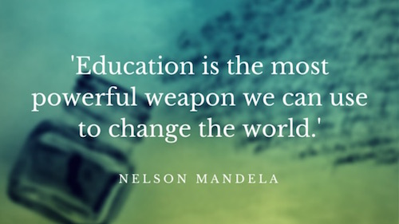
Curriculum= Teaching/Learning
“Eurocentric”
Representation* colors
Well developed contributions to society and beyond- notable absence of people of color
Notes:
Sam:
European history is important but is not the only
Art Literature
Black History Month

Slide 5
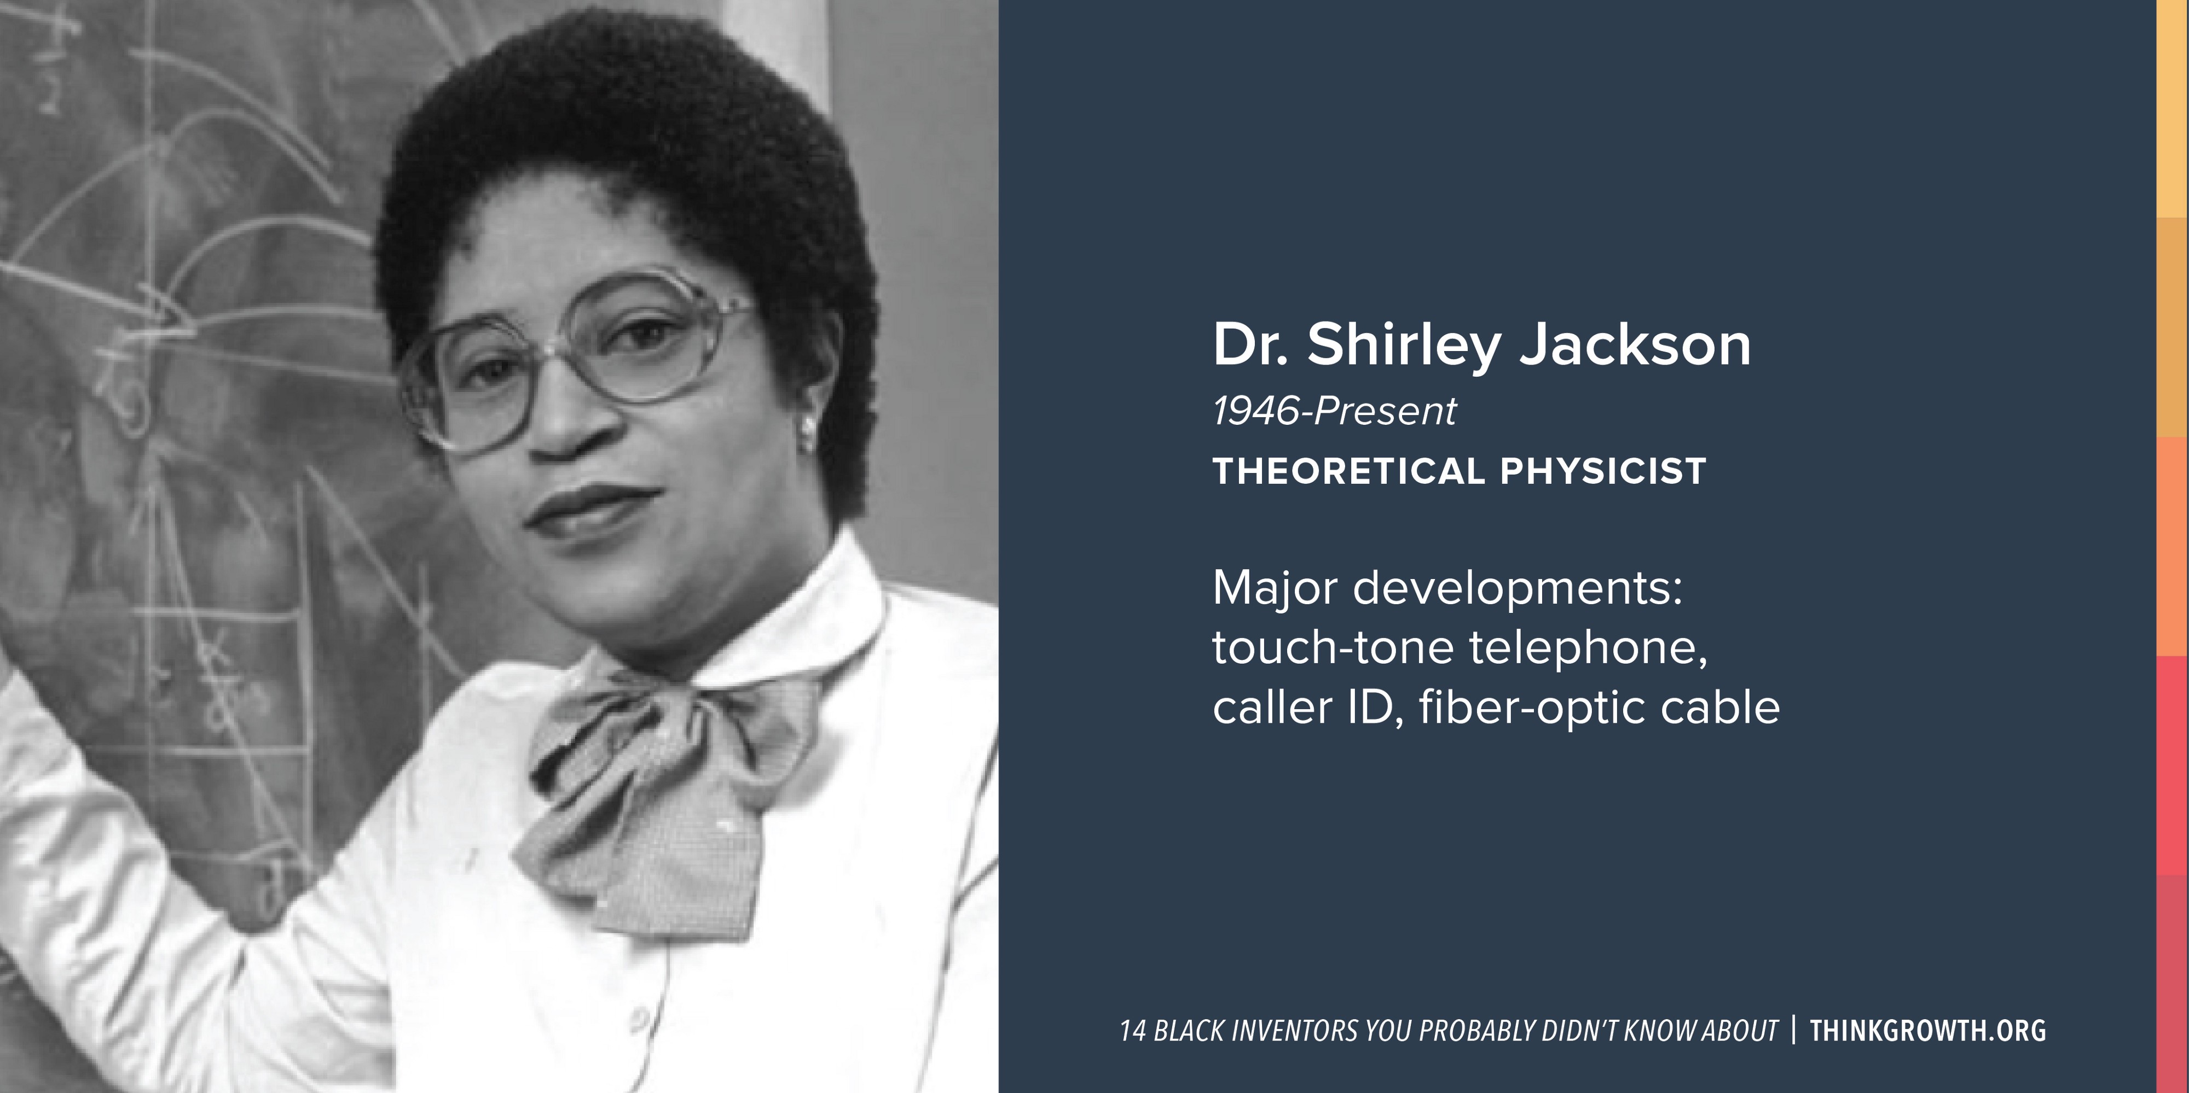
Who do you think of…?
Notes:
Carrie:
This person is an American physicist who received her Ph.D. from the Massachusetts Institute of Technology in 1973. She were the first African-American woman to earn a doctorate in nuclear physics at MIT. In addition to her lengthy list of academic achievements, she also has an impressive number of inventions under her belt.
Her experiments with theoretical physics paved the way for numerous developments in the telecommunication space including the touch-tone telephone, the portable fax, caller ID, call waiting, and the fiber-optic cable.
Today, this person is the 18th president of Rensselaer Polytechnic Institute in Troy, New York.

Slide 6
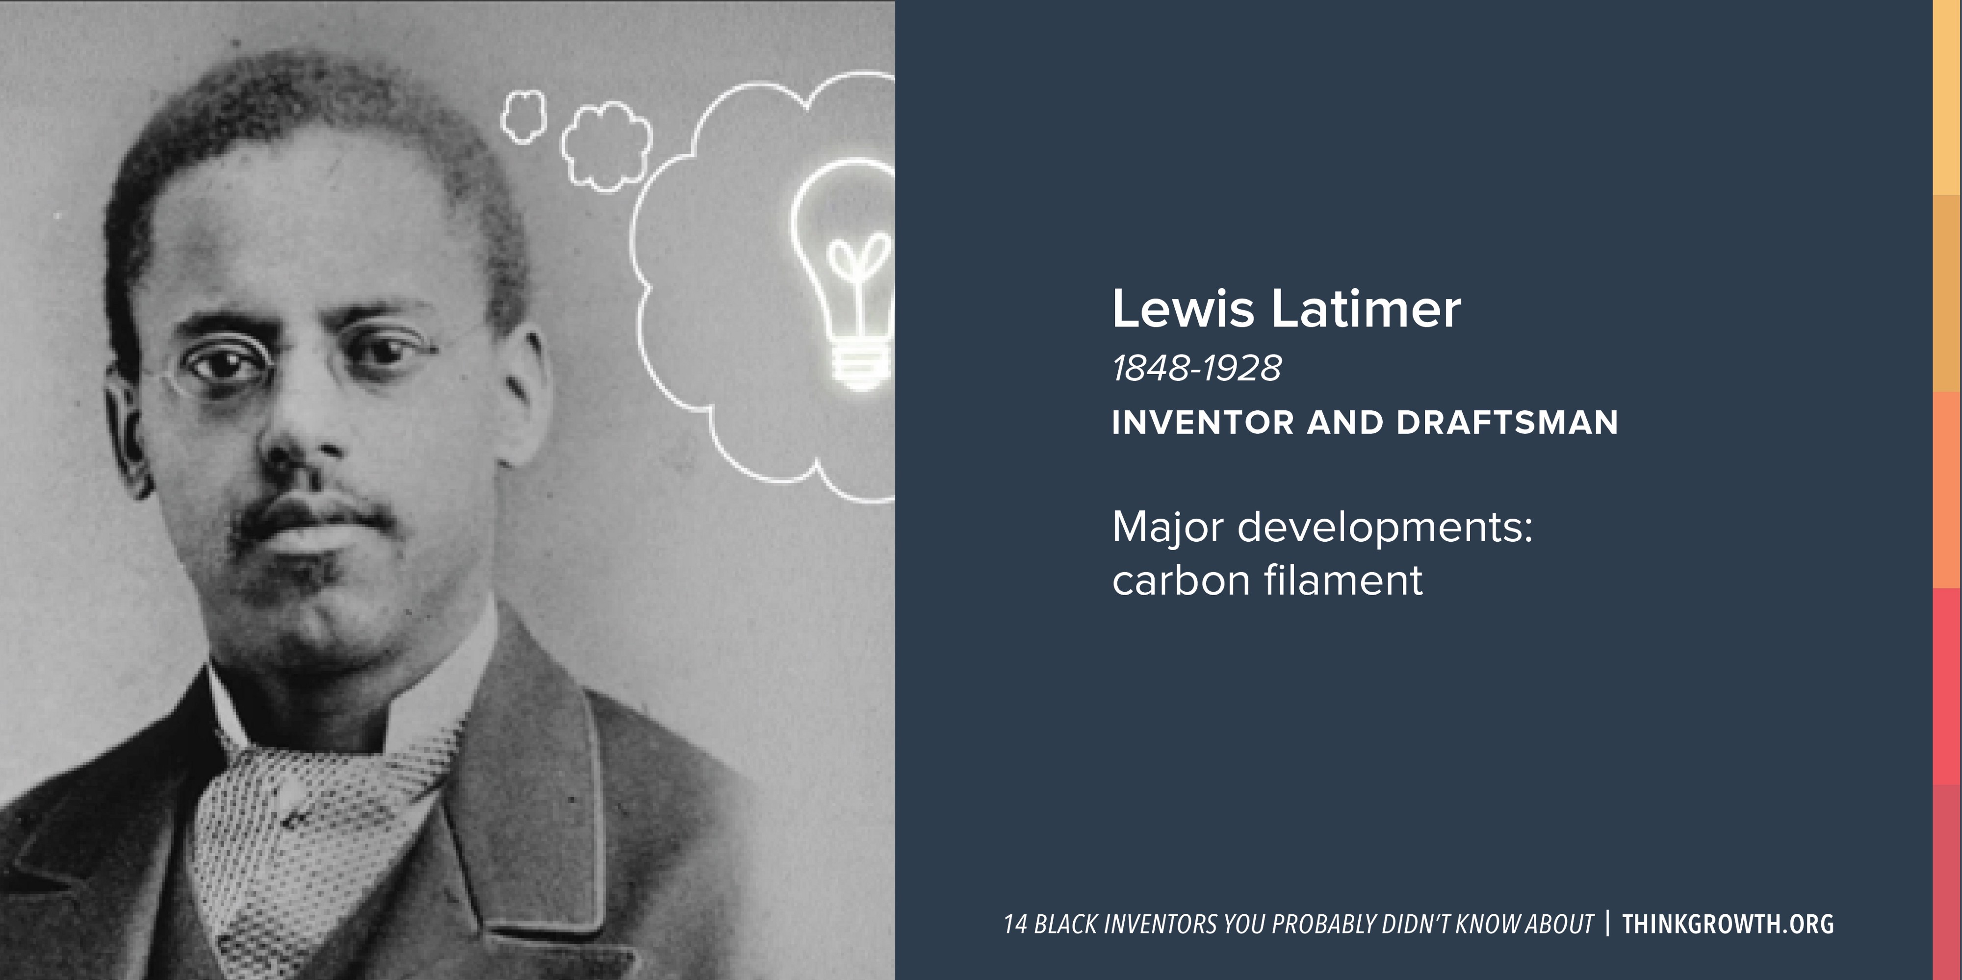
Who do you think of…?
Notes:
He This person is an inventor and engineer who collaborated with science greats Hiram Maxim and Thomas Edison.
One of their greatest inventions was the carbon filament, a vital component of the light bulb. The inventions didn’t stop there, working with Alexander Graham Bell, this individual helped draft the patent for Bell’s design of the telephone. This genius also designed an improved railroad car bathroom and an early air conditioning unit. So the next time you’re escaping a hot day inside your cool house, don’t forget to thank them.

Slide 7
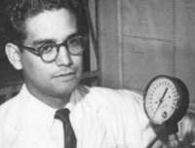
Who do you think of…?
Luis Miramontes
March 16, 1925 – September 13, 2004
Chemist
Major developments:
Co-inventor of the progestin norethisterone used in one of the first three oral contraceptives.
Notes:
This chemist, co-invented the contraceptive pill. As a college student under the direction of Syntex Corp Ceo George Rosenkranz and researcher Carl Djerassi, this person wrote a new procedure for the synthesis of the progestin norethindrone, the active ingredient for what would become the oral birth control pill. Carl Djerassi, George Rosenkranz, and this person were granted US patent 2,744,122 for "oral contraceptives" on May 1, 1956.

Slide 8
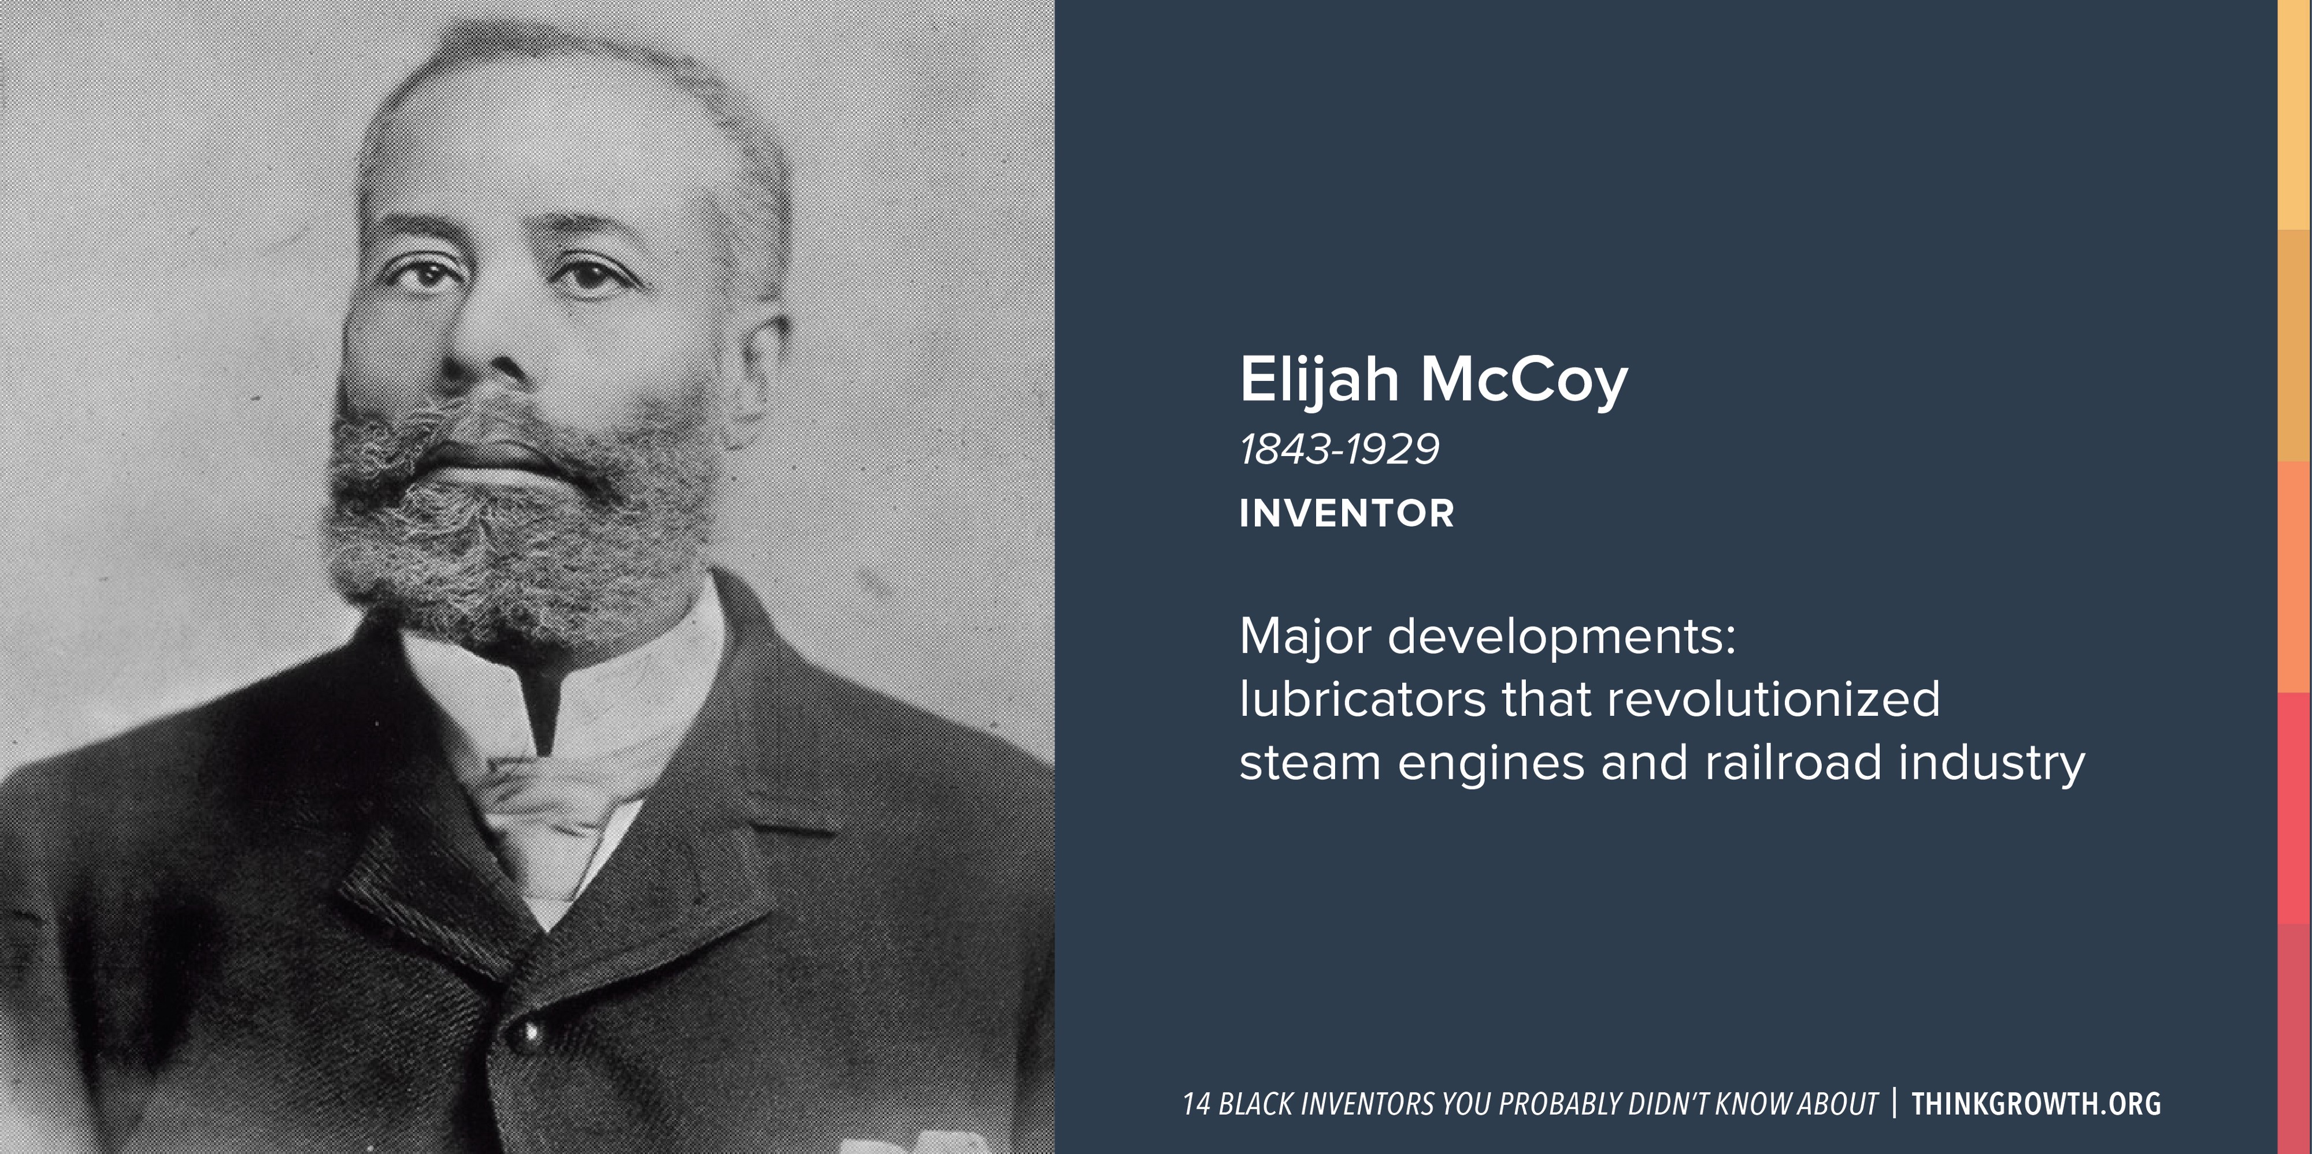
Who do you think of…?
Notes:
In an effort to improve efficiency and eliminate the frequent stopping necessary for lubrication of trains, McCoy devised a method of automating the task. In 1872 he developed a “lubricating cup” that could automatically drip oil when and where needed — vital in avoiding sticking to the track. The lubricating cup met with enormous success and orders for it came in from railroad companies all over the country. It was so popular that when other inventors attempted to steal his idea and sell their own versions of the device, companies were not fooled. They insisted on the authentic device, calling it “the Real McCoy.”

Slide 9
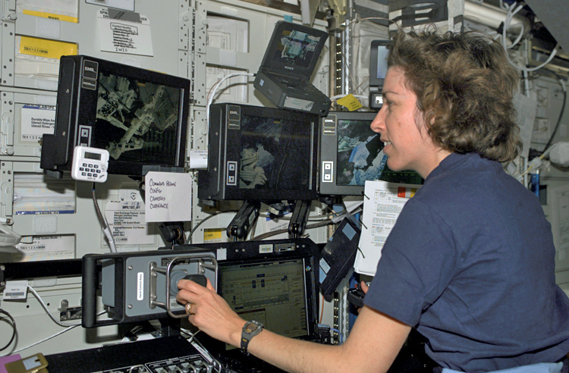
Who do you think of…?
Ellen Ochoa
May 10, 1958 – present
Major Developments:
1st Hispanic woman in space
2nd woman and 1st Hispanic woman to be named Director of NASA’s Johnson Space Center
Notes:
With an undergraduate degree in physics and a master’s and doctorate in electrical engineering, this person served as a researcher at Sandia National Laboratories and NASA’s Ames Research Center and is the co-inventor of three optics-related US Patents (4,674,824, 4,838,644, and 4,949,389). However, more famously, she was the first woman of her race astronaut, participating in four space shuttle flights for a total of 978 hours in space. In 2012, she became the first of her race and second woman to be named Director of NASA’s Johnson Space Flight Center in Houston, Texas. Not only has she won numerous awards for her pioneering career and been inducted into both the California Hall of Fame and the US Astronaut Hall of Fame, but also she has six schools named after her in four US states.

Slide 10
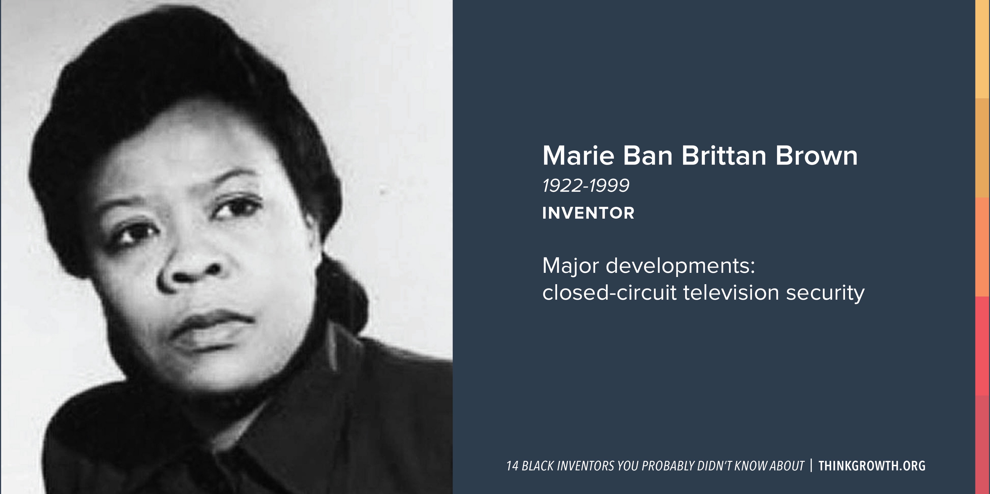
Who do you think of…?
Notes:
Although this person was a full-time nurse, they recognized the security threats to a home and devised a system that would alert people of strangers at the door and contact relevant authorities as quickly as possible- inventing the 1st home security system.
Her original invention consisted of peepholes, a camera, monitors, and a two-way microphone. The finishing touch was an alarm button that, when pressed, would immediately contact the police. Her patent laid the groundwork for the modern closed-circuit television system that is widely used for surveillance, home security systems, push-button alarm triggers, crime prevention, and traffic monitoring.

Slide 11
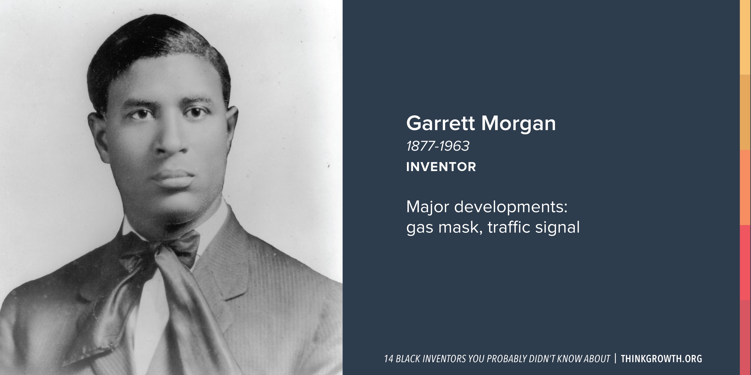
Who do you think of…?
Notes:
Those who survived either of the World Wars thanks to a gas mask have Garrett Morgan to thank. Morgan first created the “safety hood” to help firefighters navigate smokey buildings, later modifying it to carry its own air supply— making it the world’s first effective gas masks.
He also had the good sense to add a third position to the traffic signal — yes, there was a time when traffic signals just said indicated “stop” or “go” — an addition that further reduced automobile accidents.

Slide 12
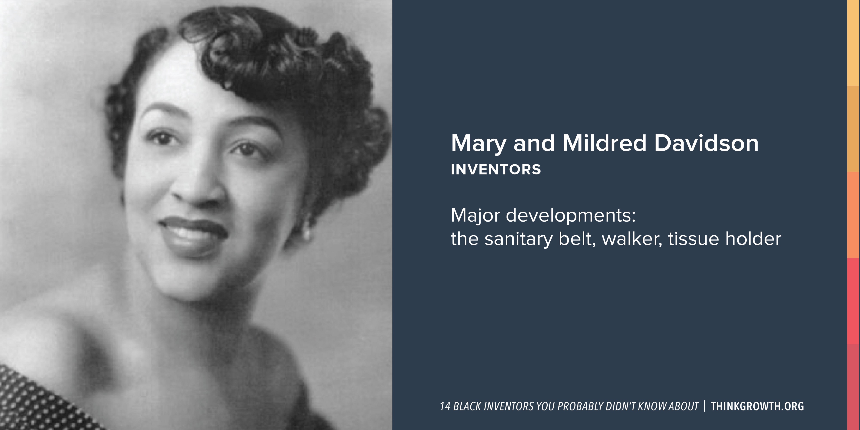
Who do you think of…?
Notes:
This person and their sister Mildred patented many practical inventions. They didn’t have technical education, but they were both exceptional at spotting ways to make peoples’ lives better. Together, they invented the sanitary belt. Later, this individual invented the moisture-resistant pocket for the belt. While disabled from multiple sclerosis, they went on to invent the walker and the toilet-tissue holder.

Slide 13

Realities exist!
Danger of a single story…
Notes:
Carrie- Show clip
Sam- Integral part of this wealthy nation
Not defined by a single story…

Slide 14

Considerations?
Programs
Discipline consideration
Course considerations
  COR
  Syllabus
  Textbooks/ readings
  Examples
  Images
…and more
Notes:
Can’t ignore, so what do we need to consider?
Student Services?

Slide 15

Help us, help you!
ACTIVITY
https://jamboard.google.com/d/13JOfhF6RX0neAX-prnlWrPser3Bx1dBhPvq8C_bor90/edit?usp=sharing

Slide 16

QUESTIONS… and ANSWERS?

Slide 17
RESOURCES
ASCCC
ASCCC Strategic Plan
Equity-Driven Systems: Student Equity and Achievement in the California Community Colleges
Need more info?
CONTACT: info@asccc.org

