Slide 1
Hot Topics for Part-Time Faculty Friday November 5th 2:30 – 3:45
Notes:
Carrie: traffic background (costume-ish)- being “late”
Welcome/Intros
Pathable info

Slide 2
WE virtually WELCOME YOU!
Ian Colmer, ASCCC Part-Time Committee
Carrie Roberson, ASCCC At-Large Representative
Anastasia Zavodny, ASCCC Part-Time Committee
We begin today by acknowledging that we are holding this ASCCC event gathering on the land of the Tongva/Gabrieleño and the Acjachemen/Juaneño Nations who have lived and continue to live here. We recognize the Tongva/ Gabrieleño and the Acjachemen/Juaneño Nations and their spiritual connection to the ocean and the land as the first stewards and the traditional caretakers of this area we now call Long Beach. As we begin, we thank them for their strength, perseverance, and resistance. We also wish to acknowledge the other Indigenous Peoples who now call Long Beach their home, for their shared struggle to maintain their cultures, languages, worldview and identities in our diverse city.
Notes:
POLL: When you think of your PT faculty colleagues, what word comes to mind?

Slide 3
TODAY!
The ever-changing nature of higher education in California impacts part-time faculty both directly and indirectly. While our part-time faculty play a significant role in supporting our students in their educational endeavors, many statewide policies and local decisions turn into HOT TOPICS that impact the roles and responsibilities of part-timers, who are often left to deal with the fallout on their own. As the largest employed group at our colleges, it is imperative to learn how ​these colleagues play a significant and unique role in student success and contribute to college morale. Join this session for an engaging conversation about current and ongoing HOT TOPICS and discuss with us how colleges can better support their professional development and bolster their voices on campus… and beyond.

Slide 4
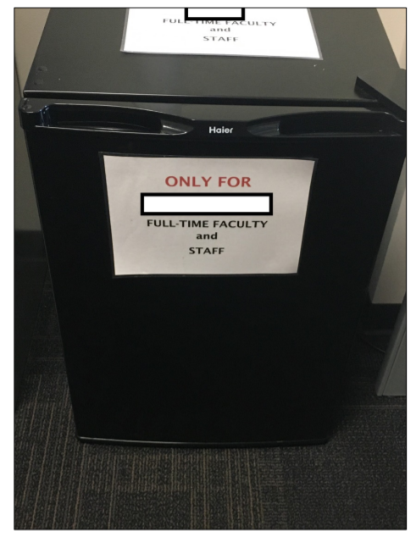
FOOD for THOUGHT...
“I recall one semester having only two classes, and not having enough money to pay rent or food. I am never going to forget the feeling of failure and hunger. It still brings me to tears when I remember how it felt to have to divide a Jack in box $ 1 taco between me and my child for lunch for weeks. Unfortunately, I know that my story is not unique. Many of our part-time faculty live in poverty, or are on the brink of living in poverty from one semester to the next. But despite this, they still give so much. So it is imperative that we try our best to support our part-time faculty, and increase equity among our colleagues that do so much for so little.”
Notes:
Why did we start with this?
HOT TOPICS to reality of basic needs

Slide 5
HOT TOPICS 10+1 and then some...
Lack of inclusion within department
Underappreciated/ under-acknowledged
Load/Assignments
Job security/ hiring practices
“Office hours”- time and space
Min quals are =
Local policies/procedures @ various campuses
Participation/voice in participatory governance
What you call em’- adjunct, associate, part-time, other?
What else...?
Notes:
Anastasia
From Anastasia’s “report”: https://go.boarddocs.com/ca/pccd/Board.nsf/files/BXTVP480683D/$file/121420FinalExhibitPacket.pdf (Exhibit 5)

Slide 6
Additional thoughts and considerations
Academic freedom
Voting for department chairs
Administrators say part-time faculty are temporary (yet many have been working for decades)
Anxiety about money
Lost health insurance
Going on unemployment
Encouraged to take on unpaid work in order to increase chances of getting hired FT
Encouraged to plan classes ahead of time, submit syllabi before semester starts, and initiate pre-course contact, which is all unpaid labor for classes that might be cancelled or taken away
Vision for Success -- how can we support our students when we aren’t supported ourselves?
Fewer opportunities for paid professional development
Evaluations (one full-timer can tank your career)
Not invited to department meetings
Scheduled to teach during department meetings
Part-timers with more wealth and privilege are more likely to weather the storm and be hired full-time
Segregating part-time offices
Ageism in being hired full-time
Lack of mentoring/coaching
Notes:
IAN:
Could go on and on

Slide 7
YOUR TURN!
What ideas do you have for how we might be able to increase equity of our Part-Time faculty colleagues?
What excuses do you have in relation to increasing equity of our Part-Time faculty colleagues?
ACTIVITY!
Notes:
ADD MUSIC

Slide 8
RE:SOLUTIONSNS
BASICS
BEYOND BASICS
Notes:
BASICS:
Anastasia:
Invites to Department meetings
Space- office hours on bench, refrigerator
IAN:
BEYOND BASICS:
Budget-neutral/impacting
Collaborate with unions
Campus-culture “shift”- keys to building

Slide 9
Take a look...
Notes:
Carrie:
Yourself
Your college
Your students

Slide 10
ASCCC Resources
ASCCC Part-Time Committee
ASCCC Part-Time Newsletter
ASCCC Part-Time Listserv

