Slide 1
Addressing Part-Time Faculty Inequities in Academic and Professional Matters Thursday November 16, 2023 1:45pm - 2:45pm

Slide 2
Facilitators
María-José Zeledón-Pérez, ASCCC Area D Representative
José Enriquez, San Diego City College Part-time Counselor
Stephanie Curry, ASCCC Area A Representative

Slide 3
Session Description
Institutional and systemic marginalization of part-time faculty in the California Community College is deep and ingrained in our process and policies. Even though, part-time faculty play an essential role in supporting the educational goals of over 1.8 million students and fulfilling the promise and mission of California Community Colleges, they experience inequitable treatment in the workplace across the full range of academic and professional matters.
In this session, we will address part-time faculty inequities in Academic and Professional Matters.

Slide 4
Session Agenda
Welcome and group introductions
10+1 Academic and Professional Matters
Part-time Faculty Inequitable Treatment
Inequities that Prevent Part-time Faculty Participation in 10+1 Matters
Barriers to Participation in Academic and Professional Matters
Recommendations
Open questions and discussion
Notes:
Jose

Slide 5
Welcome and Introductions
Name
College, discipline, and roles your serve on your campus
ASCCC Area

Slide 6
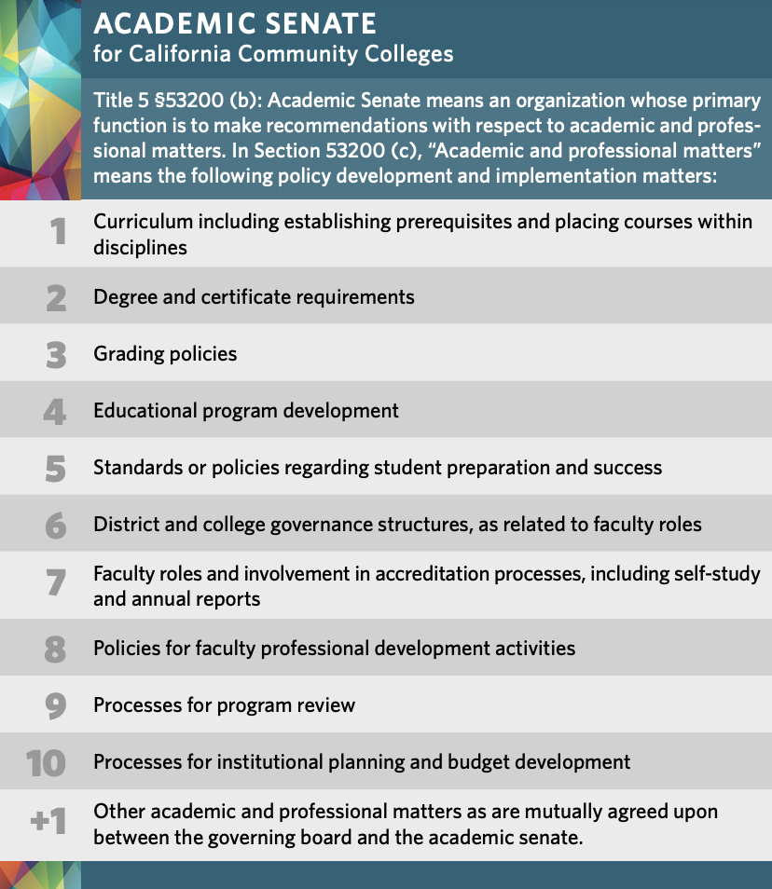
10+1 Academic and Professional Matters

Slide 7
Part-time Faculty Inequitable Treatment
Myth-Busting of Part-Time Faculty
Terminology matters
Work is not part-time neither is their dedication
Not a monolith group, many different situations and needs
Want to participate but face many barriers

Slide 8
Inequities that Prevent Part-time Faculty Participation in 10+1 Matters
Less likely to have an office space
Limited time at each college
Last minute assignments
Less access to professional development
Less access to information at the local and state level
Lack of progress in legislature
Lack of compensation for participation

Slide 9
Barriers to Participation in Academic and Professional Matters
Systemic restrictions in policies, practices, constitutions, bylaws
Lack of intentional invitation to participate
Scheduling conflicts of meeting and activities
Need to travel to multiple locations
Lack of a sense of belonging, validation and inclusion

Slide 10
What are barriers to participate in Academic and Professional Matters at your college?

Slide 11
Recommendations to Include Part-time Faculty in Academic and Professional Matters
Join any ASCCC committee (ASCCC Exec Committee, ASCCC Part-Time Faculty Committee, Part-time Faculty and Statewide Service, and the ASCCC Part Time Faculty Liaisons).
Advocate for local senates to review their local constitutions and bylaws to intentionally include part-time faculty as senators
Read your collective bargaining agreement to learn your rights and whether there is compensation
Onboard part-time faculty and provide ongoing support
Provide leadership opportunities to part-time faculty
Intentionally invite part-time faculty to participate in meetings and shared governance opportunities
Ensure that part-time faculty are included when developing professional development
Create a welcoming and validating environment to increase a sense of belonging for part-time faculty
Survey local part-time faculty about how they feel about inclusion and equity, preferred communication, and professional development needs

Slide 12
What are meaningful efforts at your local college/district to include Part-time Faculty in Academic and Professional Matters?

Slide 13
Questions and Discussion

Slide 14
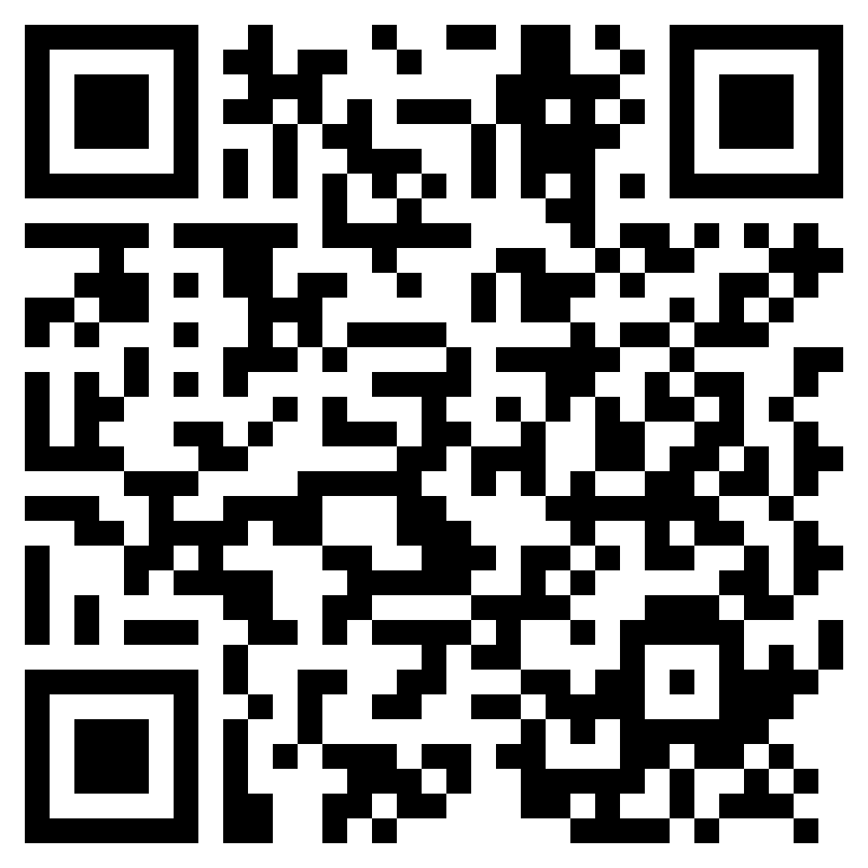
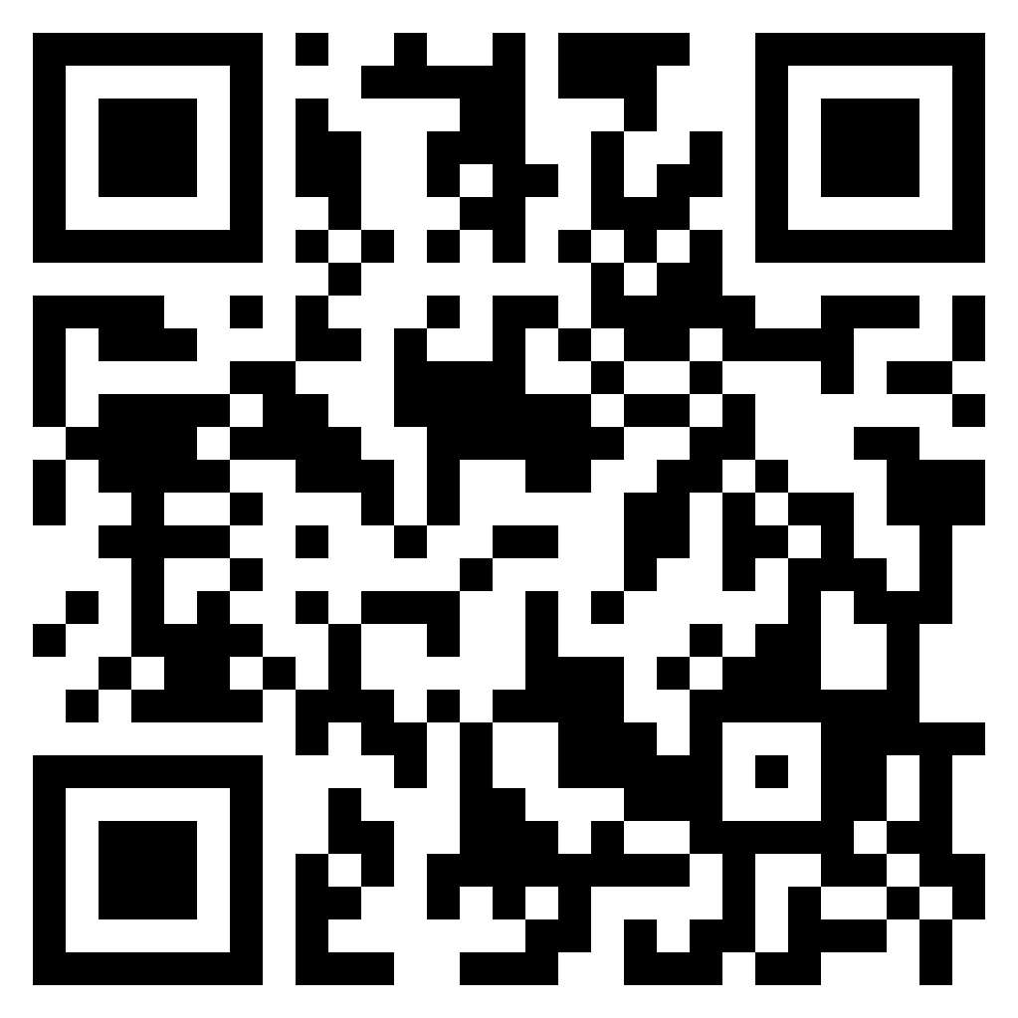
Resources
ASCCC Part-Time Faculty Resources Website: Part-Time Faculty Nexus
ASCCC Member Senate Area Map and List
2023 Fall Plenary Session Program

