Slide 1
Effective Communication Strategies for Inclusive Academic Senate Leaders Thursday November 16, 2023 3:00 pm - 4:00pm (Room: Viejo/Laguna)

Slide 2
Facilitators
Robert J. Chambers - San Diego City College
Christopher J. Howerton, ASCCC At-Large Representative
María-José Zeledón-Pérez, ASCCC Area D Representative

Slide 3
Session Description
Communication competency is often defined in relation to the effectiveness and appropriateness of our communication. To engage in transformational and transactional leadership, communication is our primary tool. In addition, our best decisions occur when we authentically welcome and include diverse perspectives. However, we sometimes find ourselves in situations of misunderstanding and tension. In this session, join us as we share suggestions on how to build a collaborative climate within your senate work, discuss the reality of working with conflict, and share strategies to develop your awareness and sensitivity to be an effective leader of diverse voices. Being intentional in this work will help us all meet the goal of higher levels of faculty engagement and create structures where our diverse faculty can emerge as faculty leaders.

Slide 4
Topics
Cultural Communication Considerations
Creating a Sense of Belonging Using Communication
Listening, Responding, and Building Confirming Climates
Conflict
Open Discussion

Slide 5
Cultural Communication Considerations

Slide 6
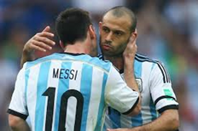
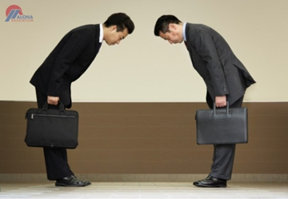
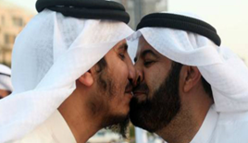
Cultures: High & Low Contact
High Contact Cultures
Maintain small distances among themselves
May be viewed as pushy and possibly intrusive from those outside their culture
Middle East, men touch, hug, kiss on the cheek, nose to nose
Low Contact Cultures
Maintain large distances among themselves
May be viewed as unapproachable, distant, and hostile
U.S touch between men limited to high 5/handshakes

Slide 7
Cultures: Low Context & High Context
Low context:
explicit
spelled out clearly
reveals intent through direct verbal codes
less reliance on nonverbal
ex: business deal with an American business owner
communicators are straightforward, concise, and efficient in telling what action is expected
US, Australia, and Switzerland
High context:
implicit
revealed through context
rely on implicit (unsaid) nonverbal messages
relationship building
ex: foreign exchange student from Japan
communicators use “flowery” language, humility, and elaborate apologies
Brazil, Spain, China, and France

Slide 8
Communication & Multiculturalism understanding the various ways that different cultures communicate
Gestures & Body Language
The nuances of facial expression, body language, gestures
Eye Contact
Eye contact can be a form of respect
Lack of eye contact can be a form of disrespect
Recognize that some people struggle with eye contct for other reasons
Voice
Those who speak different languages have various tones and inflexion
Ex. Accents, gender, Ebonics/Black Vernacular

Slide 9
Creating a Sense of Belonging Using Communication

Slide 10
Sense of Belonging: Centering Voice of Marginalized Faculty

Slide 11
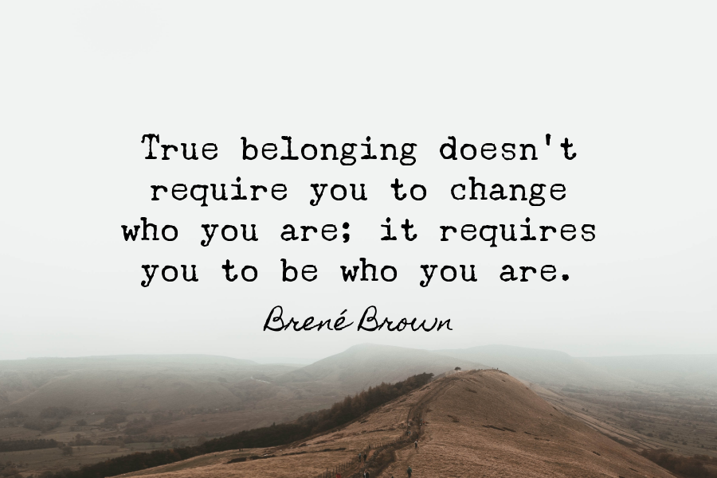
Inviting More Voices and Authentic Stories
The conversation around inclusion and diversity needs to take a human-centric approach. It’s not just about the numbers -it’s about the people.
When we bring our authentic stories with empathy to better relate and assist our colleagues and students, we provide an opportunity for others to look through new lenses for perspective taking.
Sharing our stories and owning them are a powerful tool to help us foster a sense of belonging and build community.
Underrepresented faculty voices are crucial for transformational change in our institutions.

Slide 12
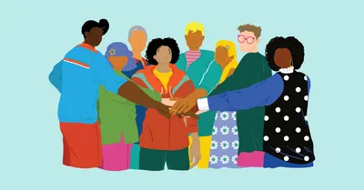
Belonging Moments
Perhaps most important, belonging in the real world occurs not only in “big moments” but mainly in “little moments” (i.e. as part of our daily interactions with others.)
Belonging is both formal and informal arrangements;
Belonging happens within a community;
Belonging occurs within a network of professional relationships;
Belonging is reciprocal and involves the “giving and receiving of wisdom”;
Builds a “community” to help faculty to be part of the campus life and leadership, part of a whole.

Slide 13
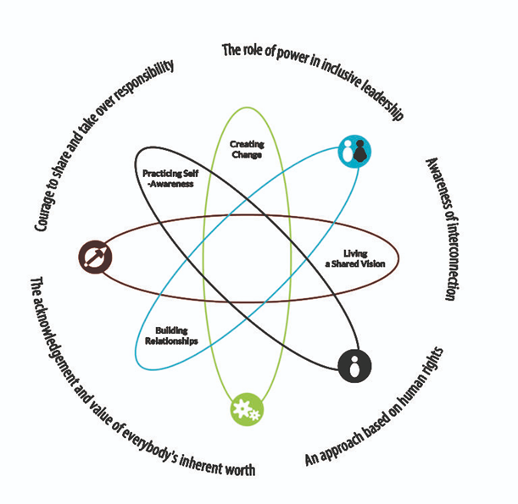
The Inclusive Leadership Framework
According to the Inclusive Leadership Handbook, an inclusive leadership approach “appreciates diversity, invites and welcomes everyone’s individual contribution, and encourages full engagement with the processes of decision-making and shaping reality. The following traits are important for creating an inclusive environment
Visible commitment
Humility
Awareness of bias
Curiosity about others
Cultural intelligence
Effective collaboration
What are some of the benefits of truly inclusive work group environments?

Slide 14
Listening, Responding, & Building Confirming Climates

Slide 15
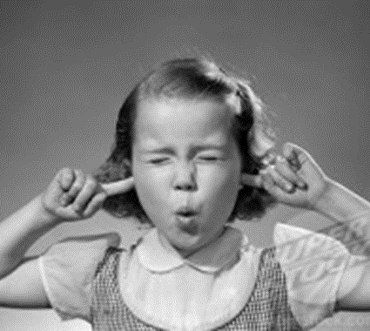
Mindful Listening
Listening and Hearing are not the same thing
Active Mindful Listening requires you to be present and avoid internal & external distractions/obstacles
Avoid engaging in “non-listening” techniques such as:
Pseudolistening
Monopolizing (such as Rerouting, Competitive Interrupting)
Selective Listening
Defensive Listening
Ambushing
Literal Listening
Tips: Be mindful, adapt listening appropriately, and listen actively! Use support responses and encouragers.
“Effective” depends on our purpose for listening, the context, and the needs of the circumstances.

Slide 16
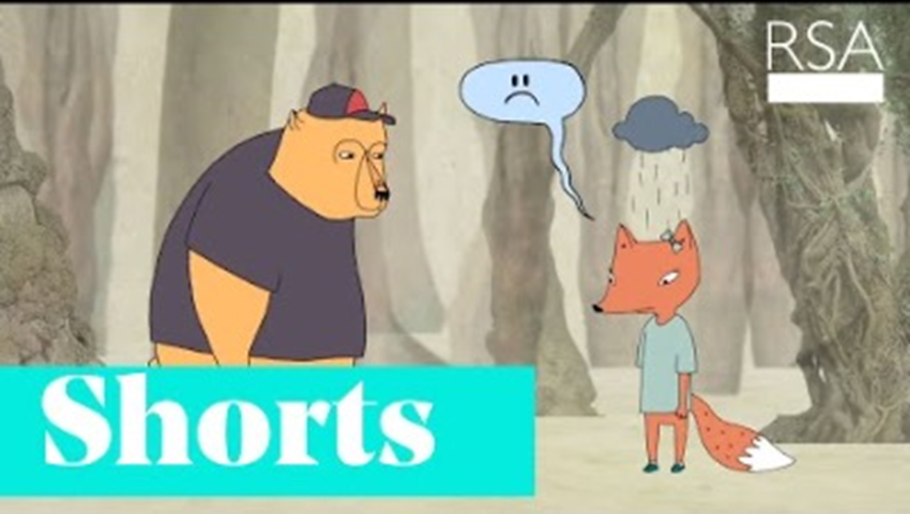
Empathic Listening
Listeners are not empathizing when…
Denying others the right to their feelings.
Minimizing the significance of the situation.
Reroute focus back on yourself.
Raining on the speaker’s parade. (a.k.a. “Yucking someone Yummy”)
VIDEO: Brené Brown on Empathy (2:50 min)

Slide 17
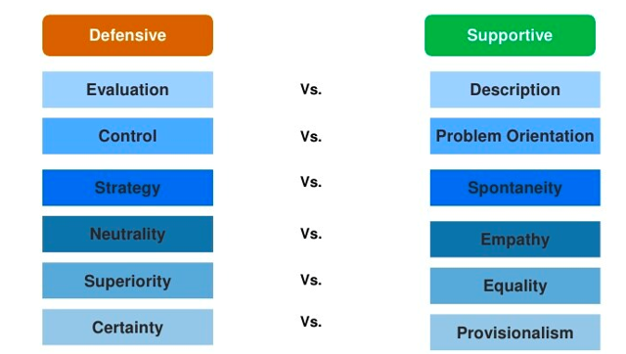
Interpersonal and Group Climate
On a continuum from confirming to disconfirming, supportive to defensive
Climate = overall feeling or emotional mood between people or among group members
Communication is the primary tool to build and influence the climate in personal, social, and professional relationships.

Slide 18
Confirming Behavior
There are three kinds of confirming behavior:
Recognition- confirms that "You exist for me."
Acknowledgement -is a statement about awareness of or interest in the other person’s perceptions, comments, or questions
Endorsement - is confirming behavior that sends the message "the way you are feeling is OK, or the way you are perceiving this is OK."

Slide 19
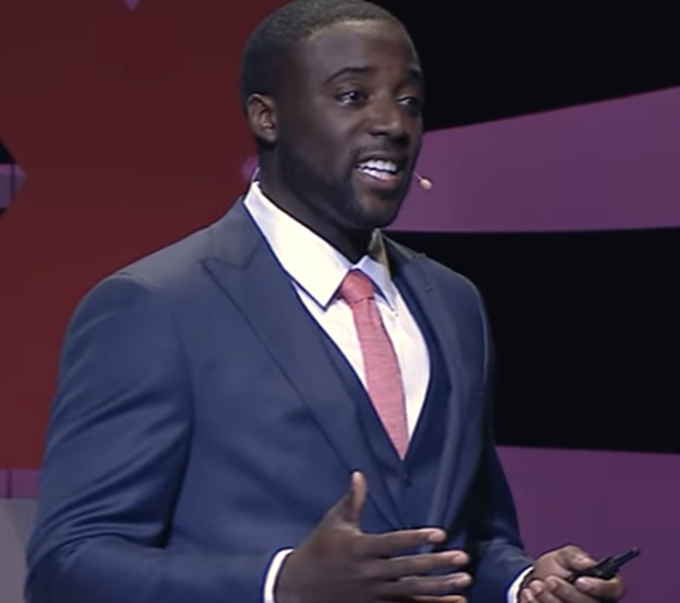
Practice Compassionate Curiosity
Use perception checking and “I” language
Listen to the other person’s needs
Validate their perception (truth)
Generate possible solutions
Other ways?
Video: Finding Confidence in Conflict
Kwame Christian - TEDxDayton (11:30 mins)

Slide 20
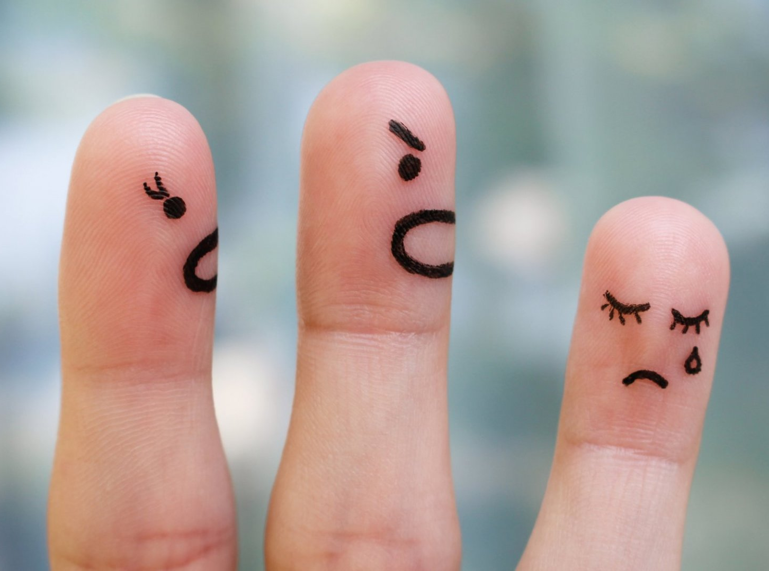
Respond Constructively to Criticism
Not everyone will communicate criticism in descriptive ways
May seem like evaluation = might make us feel defensive
Sometimes we must look past the way it’s said to see the message…ask for clarification
We need to evaluate if it is valid (dual perspective)
If it is valid, we need to consider whether or not we wish to change
Thank the person who offered the criticism – it gives us insight into us

Slide 21
Conflict

Slide 22
Conflict Defined
One useful definition of conflict (Wilmot & Hocker (1978) is: Conflict is an expressed struggle between at least two interdependent parties who perceive incompatible goals, scarce resources, and interference from others in achieving their goals.
What is “real” and what is just “perceived”?
Could be expressed directly or indirectly.
How does your past conflict experiences and perception about conflict influence the way you engage in new conflict moments?
“Conflict Resolution” vs “Conflict Management”
Destructive Conflict - dominance, escalation, retaliation, competition, and inflexibility
Constructive Conflict - “we-orientation”, cooperation, and flexibility

Slide 23
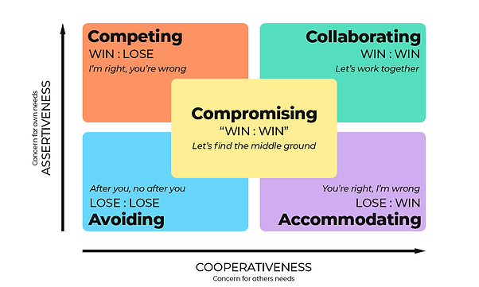
Conflict Styles
(Thomas Kilmann Model)
Collaborating (Problem Solving)
High task, High social “win/win”
Accommodating (Yielding)
Low task, High social
Compromising
Moderate task, Moderate social “Lose/Lose”
Avoiding (Withdrawing)
Low task, Low social
Competing (Power/Forcing)
High task, Low social “Win/Lose”
Personal Conflict Style Self-Assessment

Slide 24
Constructive and Unproductive Communication During Conflict
Constructive
Validation of each other
Sensitive listening
Dual perspective
Recognition of other’s concerns
Asking for clarification
Infrequent interruption
Focus on specific issues
Compromises and contracts
Useful metacommunication
Summarizing the concerns
Positive affect
Unproductive
Disconfirmation of each other
Poor listening
Preoccupation with self
Cross-complaining
Hostile mind reading
Frequent interruptions
Kitchen-sinking
Counterproposals
Excessive metacommunication
Self-summarizing by both partners
Negative affect

Slide 25
Tips on Conflict Management Skills
Attend to the Relationship Level of Meaning
Communicate Supportively
Listen Mindfully
Take Responsibility for your Thoughts, Feelings, and Issues
Check Perceptions
Look for Points of Agreement
Look for Ways to Preserve the Other’s Face
Imagine How you’ll Feel in the Future
Focus on the overall communication system
Time conflict purposefully (time, environment, etc.)
Aim for a “win-win”
Honor yourself, your partner, and the relationship
SHOW GRACE when appropriate

Slide 26
Reminders about Conflict
Conflict is natural in relationships
Conflict may be overt or covert
Social Groups shape the meaning of conflict behaviors
Cultural differences regarding conflict
Differences among social communities
Conflict can be managed well or poorly
Conflict can be good for individuals and relationships

Slide 27
Open Discussion
We want this to be a safe space. This session is not being recorded, and these plenary events are where we have community to support each other as we recognize what might work in one situation in the context of one college/district may not be the reality or opportunity in another.

Slide 28
Final Thoughts
Thank you for sharing space with us and engaging in this dialogue. We appreciate your dedication to your colleagues, local governance, and most importantly to your students.
Questions:
info@asccc.org

